Slide 1
Lecture 8 Particle in a box

Slide 2
The particle in a box
This is the simplest analytically solvable example of the Schrödinger equation and holds great importance in chemistry and physics.
Each of us must be able to set up the equation and boundary conditions, solve the equation, and characterize and explain the solutions.

Slide 3
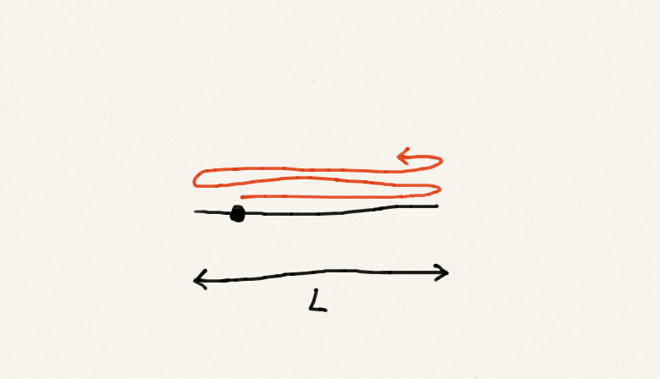
The particle in a box
A particle of mass m is confined on a line segment of length L.
The Schrödinger equation is generally:
V = 0 (0 ≤ x ≤ L) V = ∞ (elsewhwere)

Slide 4
The particle in a box
The Schrödinger equation of this problem is:

Slide 5
The particle in a box
Which functions stay the same form after a second-derivative operation?
And any linear combinations of these with the same k.

Slide 6
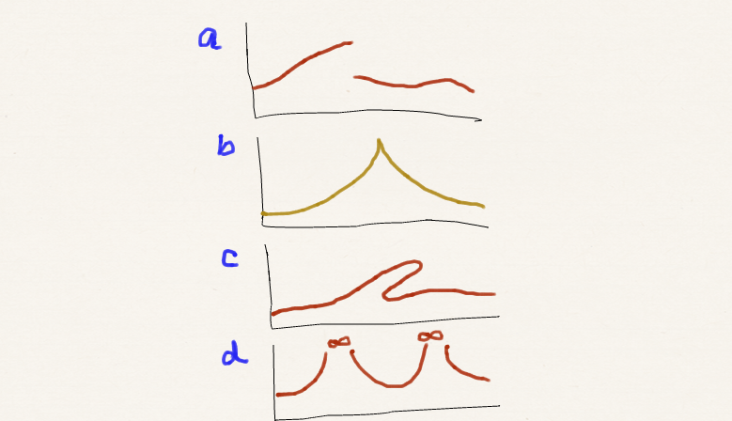
Boundary conditions
There are certain conditions that a wave function must fulfill:
continuous
(smooth)
single valued
square integrable

Slide 7
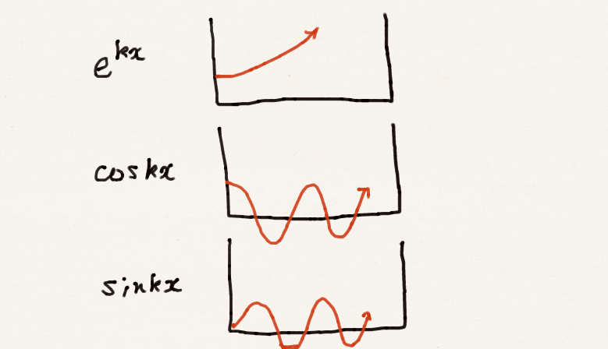
Boundary conditions
Outside and at the boundary of the box (x = 0 and x = L), Ψ = 0.
Owing to the continuousness condition, we must demand that Ψ(x=0) = 0 and Ψ(x=L) = 0.
e^{kx} cannot satisfy these simultaneously (e^{k0} = 1).
cos x is not promising (cos 0 = 1), either.
(Other than this, all four functions are single-valued and finite).

Slide 8
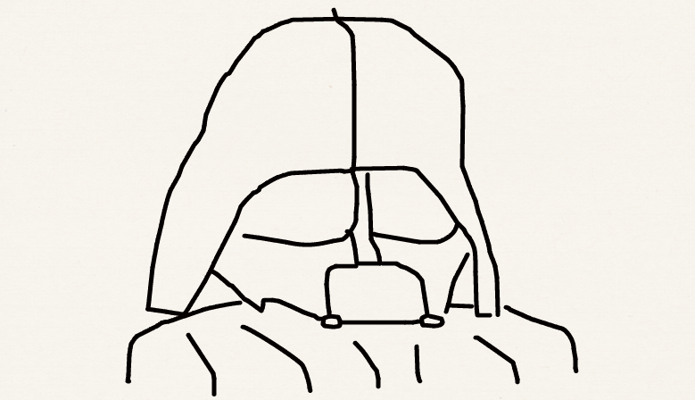
Boundary conditions
Boundary conditions are the restrictions imposed on the solutions of differential equations.
They are typically but not necessarily the numerical values that solutions must have at the boundaries of their domain.
For example, in classical mechanics, they may be the initial positions and velocities of the constituent masses; in fluid dynamics, they may be the shape of the container of the fluid.
Differential equation < Boundary conditions
Darth Vader < Chancellor

Slide 9
The acceptable solutions
Let us use the most promising “sin kx”:
These are two representations of the identical functions

Slide 10
The acceptable solutions
The boundary condition requires sin kL = 0.
n is called a quantum number.
We did not include n = 0 because this makes the wave function zero everywhere (sin 0x = 0, not normalizable or no particle!).
We did not include negative integers for n because they lead to the same wave functions (sin(–kx) = – sin kx).

Slide 11
The particle in a box
We have the solution:
+
Quantized! Note that boundary condition is responsible for quantization of energy.

Slide 12
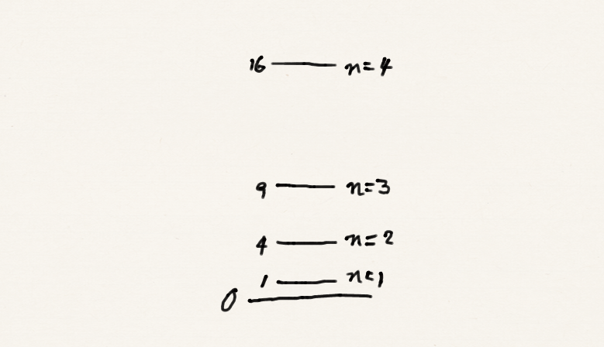
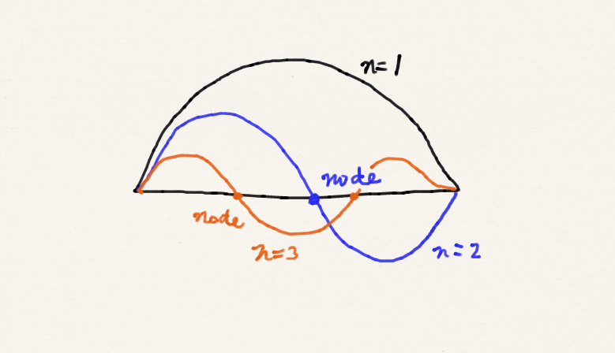
The particle in a box
Now the energy is quantized because of the boundary conditions.
The wave functions are the standing waves. The more rapidly oscillating the wave function is and the more the nodes, the higher the energy.

Slide 13
The zero-point energy
The lowest allowed energy is nonzero because n = 0 is not a solution.
This lowest, nonzero energy is called the zero-point energy. This is a quantum-mechanical effect.
The particle in a box can never be completely still (zero momentum = zero energy)! This is also expected from the uncertainty principle (consider the limit L→0).

Slide 14
The ground and excited states
The lowest state corresponds to the ground state and the n = 2 and higher-lying states are the excited states.
The excitation energy from n to n+1 state is which is quantized.
However, the effect of quantization will become smaller as L → ∞. In a macroscopic scale (L very large) or for a free space (L = ∞), energy and energy differences become continuous (quantum classical correspondence).

Slide 15
Quantum in nature
The particle in a box
Why is carrot orange?
β-carotene

Slide 16
Quantum in nature
The particle in a box
Why do I have to eat carrot?
vitamin A
retinal

Slide 17
Normalization
There are two ways of doing this:
Using the original sin kx form.
Using the alternative e^{ikx} – e^{–ikx} form
Differentiate both sides to verify this. Use cos2x = cos²x – sin²x.

Slide 18
Exercise
What is the average value of the linear momentum of a particle in a box with quantum number n?
Hints:

Slide 19
Exercise
Using the sin kx form of the wave function.
Alternatively,

Slide 20
More on the momentum
The momentum operator and its eigenfunctions are:
The wave function has equal weight on e^{ikx} and e^{–ikx}. The measurement of momentum gives ħk or –ħk with an equal probability. This is consistent with the picture that a particle bouncing back and forth.

Slide 21
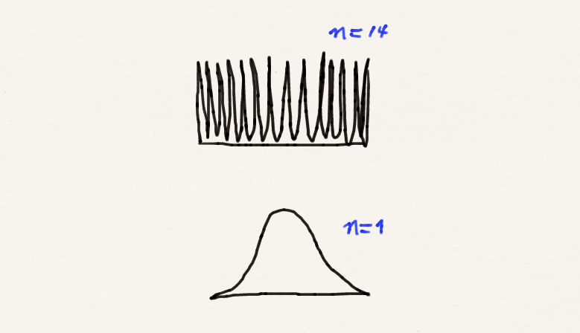
Probability density
The probability density is
Unlike the classical “bouncing particle” picture, there are places with less probability (even zero probability at nodes).
The higher n (quantum number), the more uniform the probability density becomes, approaching the uniform probability density of the classical limit (quantum classical correspondence).

Slide 22
Summary
The particle in a box: set up the equation and boundary condition, solve it, and characterize the solution.
Boundary conditions; quantum number; quantization of energies.
Wave functions as standing waves.
Zero-point energy and the uncertainty principle.
Quantum classical correspondence.

