Slide 1
Lecture 7
Information in wave function. II.
(c) So Hirata, Department of Chemistry, University of Illinois at Urbana-Champaign. This material has been developed and made available online by work supported jointly by University of Illinois, the National Science Foundation under Grant CHE-1118616 (CAREER), and the Camille & Henry Dreyfus Foundation, Inc. through the Camille Dreyfus Teacher-Scholar program. Any opinions, findings, and conclusions or recommendations expressed in this material are those of the author(s) and do not necessarily reflect the views of the sponsoring agencies.

Slide 2
Information in wave function
Properties other than energy are also contained in wave functions and can be extracted by solving eigenvalue equations.
We learn a number of important mathematical concepts: (a) Hermitian operator; (b) orthogonality of eigenfunctions; (c) completeness of eigenfunctions; (d) superposition of wave functions; (e) expectation value; (f) commutability of operators; (g) the uncertainty principle, etc.

Slide 3
What we have learned in the previous lecture
If a particle is in the state Ψ_{a}, it has a well-defined energy E; if it is in Ψ_{b}, then it has the position x; if it is in Ψ_{c}, it has the momentum p_{x}.
These three wave functions are eigenfunctions of three different operators and are generally different.

Slide 4
Next questions
What is the energy of a state that it not the solution of the Schrödinger equation (for energy)? What is the position and momentum of a state that is not the solutions of the Schrödinger-like eigenvalue equations for position and momentum?
Can a state be the simultaneous eigenfunction of two or more observable operators?

Slide 5
Superpositions and expectation values
To answer these, we use completeness and orthogonality of eigenfunctions of Hermitian operators.
We expand the normalized wave function Ψ as a linear combination of eigenfunctions.

Slide 6
Superpositions and expectation values
When we make a measurement of energy of the particle in this “mixed” state, we do NOT obtain a mixed energy that is a linear combination of energies E_{n}. Such a theory would contradict the quantization of energy.

Slide 7
Superpositions and expectation values
Instead, we obtain one of the allowed energy eigenvalues {E_{n}}. The probability of obtaining E_{n} is |c_{n}|².
This is consistent with the Born interpretation of a wave function – something to do with the probability.
This principle of superposition also applies to properties other than energy.

Slide 8
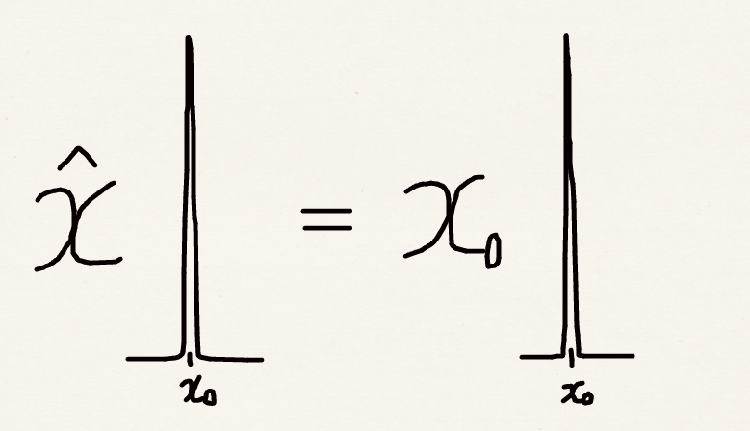
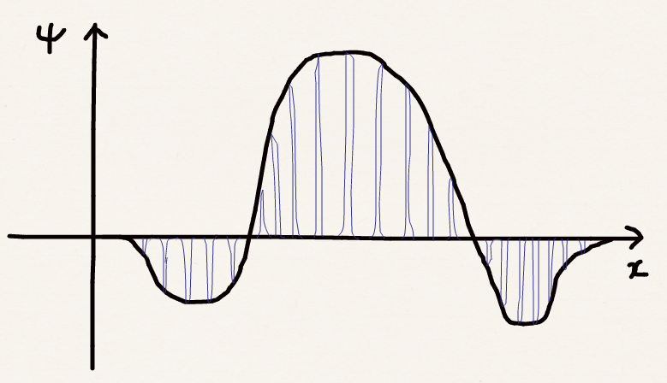
Superpositions and the Born interpretation
Dirac’s delta function

Slide 9
Superpositions and expectation values
What is the average energy (or any other property) value of a wave function Ψ ?
We obtain E_{n} at the probability of |c_{n}|². Therefore, the expectation value of energy would be:
In general,
Justification will be given next

Slide 10
Superpositions and expectation values
Quantum mechanics as a raffle draw.
Pure state (eigenstate)
Every time we draw (measure the property), we get the same result (2) because the bag contains only one ball.
2
1
Mixed state (superposition)
We get either 1, 2, 3, or 4 at equal probability. Expectation value is 2.5. This does NOT mean that we draw a ball labeled 2.5!
2
3
4

Slide 11
Justification
For a pure state, the wave function is an eigenfunction of the operator Ω:
For a mixed state, the wave function is a superposition of two or more eigenfunctions.
These are zero by orthogonality

Slide 12
The uncertainty principle
Can a state be the simultaneous eigenfunction of two or more observable operators?
The answer is yes and no.
Certain two observables cannot have a simultaneous eigenfunction and thus cannot be determined exactly simultaneously. The uncertainty principle is operative for the two observables or operators.

Slide 13
Non-commutable operators
For two operators to share the same eigenfunction,
Acting B from the left on the first equation and acting A from the left on the second equation, we have

Slide 14
Non-commutable operators
When two operators share the same eigenfunctions, then , namely, the two operators commute.
The composite operations of the two do not depend on the order of the two operations.
In other words, the order of measurements of the two observables does not alter the results of measurements.

Slide 15
Order of operations
2
1
1
2

Slide 16
Non-commutable operators
Many quantum-mechanical operators do not commute. For example, position and momentum operators do not commute.
Both p_{x} and x are operators acting on a function on the right. p_{x} can act on x or the function.

Slide 17
Non-commutable operators
x and p_{x} are non-commutable operators. Generally, we can express their commutability using the commutator [A,B] = AB – BA:

Slide 18
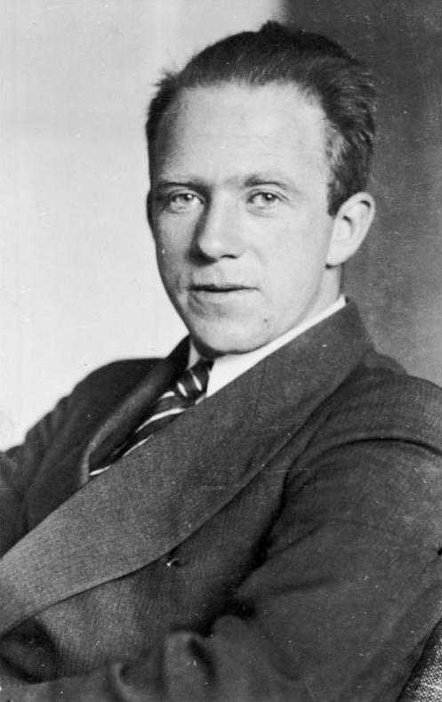
The uncertainty principle
When two operators do not commute:
A and B correspond to complementary observables, which cannot be determined simultaneously and exactly.
The errors in the observables ΔA and ΔB cannot be simultaneously zero.
Werner Heisenberg
Image source: Bundesarchiv, Bild183-R57262 / CC-BY-SA

Slide 19
The uncertainty principle
Position and momentum:
Note 1: x and p_{y} commute! The uncertainty is in determining x and p_{x} or y and p_{y}, etc.
Note 2: ħ has the unit of Js = Nms = kgm²/s. So does xp_{x}.
Note 3: when Δx = 0, Δp_{x} = ∞ and vice versa.
Time and energy:
Note 4: tE also has the unit of Js.

Slide 20
The uncertainty principle
The fact that the product of errors is on the order of ħ = 6.63 ×10^{–34} / 2π Js is why we do not notice this at the macroscopic scale.
The uncertainty principle is a consequence of the wave-like nature of a particle and a similar phenomena can be found in sound waves.
This is a fundamental physics law and has nothing to do with today’s instrumental precisions.

Slide 21
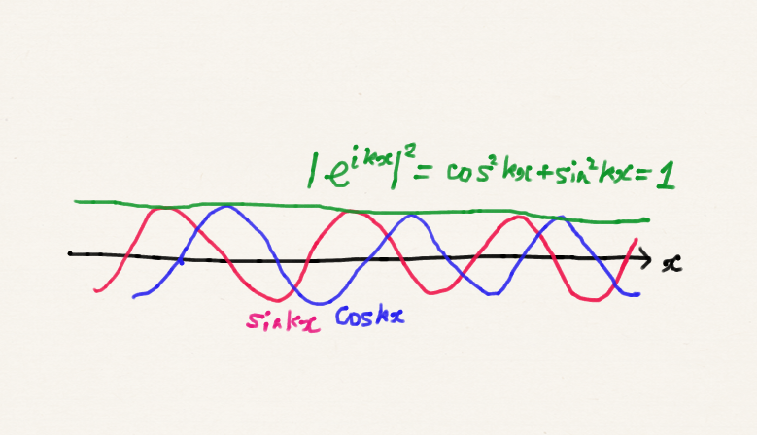
Δx = ∞, Δp_{x} = 0
Eigenfunction of momentum operator
probability density is . Position x is completely unknown.

Slide 22
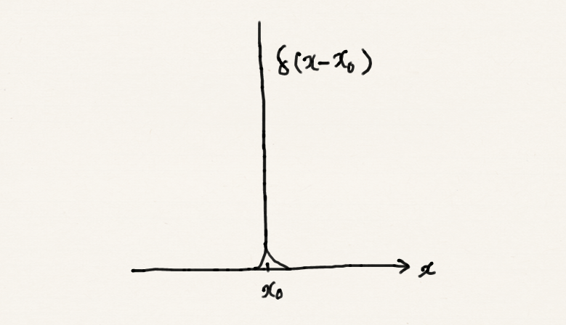
Δx = 0, Δp_{x} = ∞
Eigenfunctions of position operator
This identity (Fourier transform) indicates that the delta function contains contributions from all frequencies (momenta) evenly.

Slide 23
The uncertainty principle
An ultrashort pulse of light (for example, of a duration of femtoseconds) must be nearly white, containing all frequencies.
The sound that has a well-defined frequency (energy), such as a vowel, can be played indefinitely in time. The sound that occurs temporarily, such as a consonant, has no well-defined frequency.
A white noise, such as the sound caused by an explosion occurring in a very short time, contains all frequencies (energies).

Slide 24
Summary
Postulates of quantum mechanics:
(1) A physical state of a particle can be described by a wave function Ψ.
(2) We can normalize Ψ.
  (2-1) Two wave functions that differ merely by a factor of e^{ik} are considered the same.
(3) Its square |Ψ|² is the probability density of finding the particle at a location. Probability is probability density x volume element.

Slide 25
Summary
(4) The quantum-mechanical operator exists for each observable physical property:
Observable | Operator
Position | x
Momentum | –iħ∂/∂x
Energy | E, iħ∂/∂t
Energy (kinetic + potential) | – ħ²/2m + V

Slide 26
Summary
(5) Solve the eigenvalue equation and obtain the complete and orthogonal set of eigenfunctions and eigenvalues:
If Ω is the Hamiltonian, this is the time-independent Schrödinger equation. If we further replace ω by iħ∂/∂t we have the time-dependent Schrödinger equation.

Slide 27
Summary
(6) Is the wave function Ψ equal to one of the eigenfunctions (apart from the factor e^{ik})?
  (6-1) YES: every measurement of the property will give the definitive value, which is the corresponding eigenvalue.
  (6-2) NO: a measurement will give one of the eigenvalues in an unpredictable order but with a predictable probability. The probability is equal to |c_{n}|² where . The expectation value is .

Slide 28
Summary
(7) When we are to determine more than one observables A and B:
  Evaluate the commutator of the corresponding operators, [A, B] = AB – BA.
  If it is zero: we can determine the values of these two observables simultaneously and exactly.
  If nonzero: they are complementary observables. We cannot determine these values simultaneously and exactly.

