Slide 1
Lecture 6
Information in wave function. I.
(c) So Hirata, Department of Chemistry, University of Illinois at Urbana-Champaign. This material has been developed and made available online by work supported jointly by University of Illinois, the National Science Foundation under Grant CHE-1118616 (CAREER), and the Camille & Henry Dreyfus Foundation, Inc. through the Camille Dreyfus Teacher-Scholar program. Any opinions, findings, and conclusions or recommendations expressed in this material are those of the author(s) and do not necessarily reflect the views of the sponsoring agencies.

Slide 2
Information in wave function
Properties other than energy are also contained in wave functions and can be extracted by solving eigenvalue equations.
We learn a number of important mathematical concepts: (a) Hermitian operator; (b) orthogonality of eigenfunctions; (c) completeness of eigenfunctions; (d) superposition of wave functions; (e) expectation value; (f) commutability of operators; (g) the uncertainty principle, etc.

Slide 3
Eigenvalues and eigenfunctions
A wave function and energy can be obtained by solving the Schrödinger equation.
The wave function has the complete but probabilistic information about the location of a particle.
The Schrödinger equation is an eigenvalue equation:

Slide 4
Eigenvalues and eigenfunctions
What about other properties: momentum, kinetic energy, etc.? These can also be obtained by the Schrödinger-like eigenvalue equation:
For each property, there is a quantum-mechanical operator Ω.
There are infinitely many eigenfunctions and eigenvalues

Slide 5
The position operator
The operator for location along the x-axis is
If a wave function satisfies the eigenvalue equation:
e is the position of the particle.

Slide 6
The momentum operator
The operator for the x-component of the linear momentum is
If a wave function satisfies the eigenvalue equation:
e is the x-component of the momentum.

Slide 7
The potential energy operator
The operator for a potential energy, e.g., that of a parabolic form (this is analogous to a ball attached to a spring of constant k):

Slide 8
The kinetic energy operator
The kinetic energy is p²/2m. Using the definition of the momentum operator, we find

Slide 9
The energy operator. I.
The operator for energy = kinetic + potential energies is the Hamiltonian!
The eigenvalue equation for this operator is nothing but the time-independent Schrödinger equation:

Slide 10
The energy operator. II.
An alternative operator for energy is:
Replacing E by this in the time-independent SE, we have the time-dependent SE:

Slide 11
Hermitian operator
When a property can be extracted from a wave function by solving an eigenvalue equation , the property is called observable in the sense that it is an experimentally observable quantity.
Does any arbitrary operator correspond to some observable property?
The answer is NO.

Slide 12



Hermitian operator
Momentum operator
Nonphysical operator
iPod
Pod

Slide 13
Hermitian operator
A quantum-mechanical operator must be a Hermitian operator.
A Hermitian operator is the one that satisfies:

Slide 14
Hermitian operator
The observable quantities should be real, even when a wave function is complex and can have the phase factor of e^{ik}.
Go north for 40 + 25 i miles. It is only 20 i minute drive.
An example of nonphysical instructions

Slide 15
The position operator
The position operator is Hermitian, because x* = x and multiplication is commutative (the order of multiplication can be changed).

Slide 16
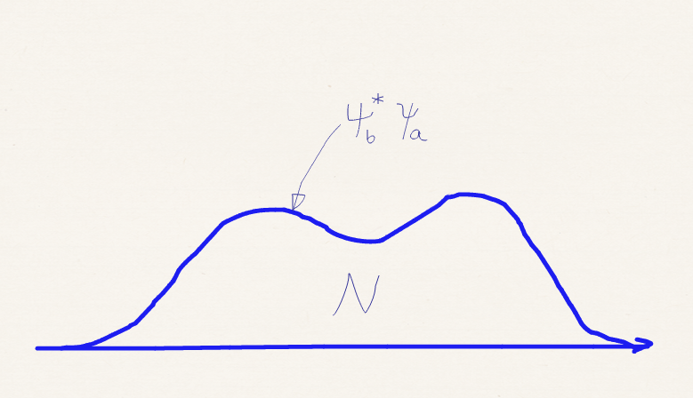
The momentum operator
A definite integral of a function ψ_{b}*ψ_{a} is some number, say, N.
Differentiating this by x, we get:

Slide 17
The momentum operator

Slide 18
The kinetic energy operator
A definite integral is some constant.
Differentiating by x,

Slide 19
The kinetic energy operator
Starting from an expression where ψ_{a} and ψ_{b}* are swapped

Slide 20
The kinetic energy operator

Slide 21
The Hamiltonian

Slide 22
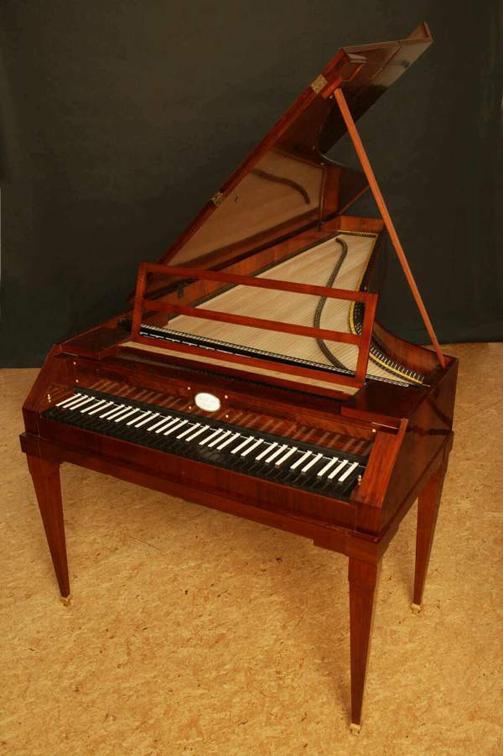
Properties of an Hermitian operator
Its eigenvalues are real.
Its eigenfunctions are orthogonal.
Its eigenfunctions are complete.
GNU free licensed image
from Wikipedia

Slide 23
Real eigenvalues
Consider an eigenfunction and eigenvalue of an Hermitian operator. At this point, we do not know if a is a real or a complex value. The eigenfunction is normalized.
Multiply ψ_{a}* from the left and integrate

Slide 24
Real eigenvalues
Take the complex conjugate of the previous eigenvalue equation.
Multiply ψ_{a} from the left and integrate

Slide 25
Real eigenvalues
Because Ω is Hermitian, we have
Equal
a is real

Slide 26
Orthogonality
What are “orthogonal” functions? Two functions ψ_{a} and ψ_{b} are orthogonal if
Eigenfunctions ψ_{a} and ψ_{b} corresponding to two different eigenvalues a and b are always orthogonal.

Slide 27
Orthogonality
Multiply ψ_{b}* from the left of the first equation and ψ_{a} from the left of the second equation and integrate
b = b*
Equal

Slide 28
Orthogonality

Slide 29
Completeness
In a two-dimensional space, any vector can be written as a linear combination of orthogonal vectors x and y.
In three-dimension, we need three orthogonal vectors x, y, and z that expands any vector.

Slide 30
Completeness
Any function (that conforms to the allowable forms of wave functions) is expressed as a linear combination of (orthogonal) eigenfunctions of an Hermitian operator.
In this sense, eigenfunctions of an Hermitian operator is complete.

Slide 31
Summary
In quantum mechanics, we translate energy and other observable quantities to operators, which must be Hermitian.

Slide 32
Summary
A Hermitian operator satisfies
It has the following three important properties: (1) its eigenvalues are real; (2) its eigenfunctions are orthogonal*; (3) its eigenfunctions form a complete set.
*Exception exists: Two eigenfunctions corresponding to an identical eigenvalue may not be orthogonal. However, they can be made orthogonal to each other.

Slide 33
Summary
Eigenvalue equations of these operators:
First of these is called the time-independent Schrödinger equation.
We know that the energy of the particle in state Ψ_{a} is E, the position of the particle in state Ψ_{b} is x, and the momentum of the particle in state Ψ_{c} is p_{x}.

