Slide 1
Lecture 5 The meaning of wave function
(c) So Hirata, Department of Chemistry, University of Illinois at Urbana-Champaign. This material has been developed and made available online by work supported jointly by University of Illinois, the National Science Foundation under Grant CHE-1118616 (CAREER), and the Camille & Henry Dreyfus Foundation, Inc. through the Camille Dreyfus Teacher-Scholar program. Any opinions, findings, and conclusions or recommendations expressed in this material are those of the author(s) and do not necessarily reflect the views of the sponsoring agencies.

Slide 2
The Born interpretation of wave function
A wave function gives the probability of finding the particle at a certain location.
This is the most commonly misunderstood concept in quantum chemistry.
It is a mistake to think of a particle spreading like a cloud according to the wave function. Only its probability density does.

Slide 3
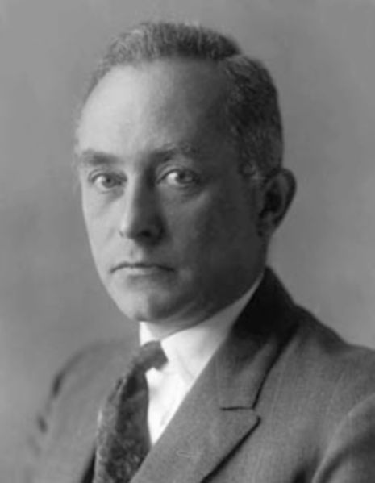
The Born interpretation
What is a wave function?
It has all the dynamical information about the particle.
More immediately, it has the information about the location of the particle.
Max Born

Slide 4
The Born interpretation
The square of the wave function |Ψ|² at a point is proportional to the probability of finding the particle at that point.
Always real, non-negative
Complex conjugate of Ψ

Slide 5
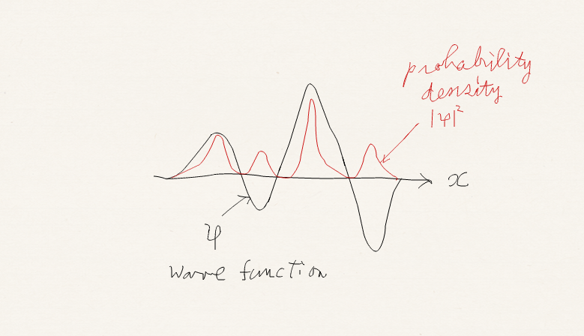
The Born interpretation
A wave function is in general complex.
But |Ψ|² is always real, non-negative.

Slide 6
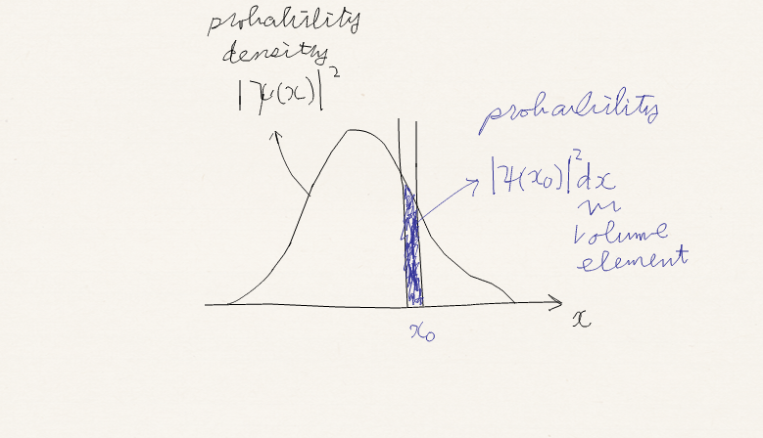
The Born interpretation
One-dimension: if the wave function of a particle has the value Ψ at point x, the probability of finding the particle between x and x+dx is proportional to |Ψ|² dx.

Slide 7
The Born interpretation
Three-dimension: the probability of finding the particle in an infinitesimal volume dτ = dx dy dz at point r is proportional to |Ψ(r)|² dτ.
|Ψ(r)|² is the probability density.

Slide 8
The Born interpretation
It is a mistake to think that a particle spreads like a cloud or a mist with density proportional to |Ψ|². (Such an interpretation was seriously considered in physics but was dismissed.)

Slide 9
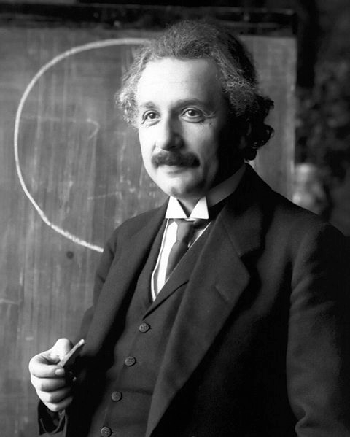
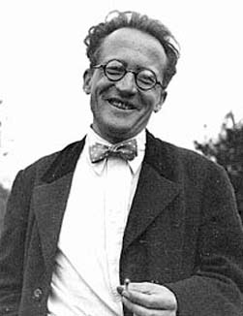
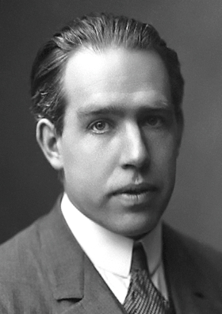
The Born interpretation
Many notable physicists resisted the Born interpretation such as Erwin Schrödinger and Albert Einstein, the very architects of quantum mechanics.
The strongest advocates were Max Born and Niels Bohr. Today, we know that this is the correct interpretation.

Slide 10
Nobel Prizes in Physics
1918 Planck – Quantization of energy
1920 Einstein – Photoelectric effect
1921 Bohr – Quantum mechanics
1927 Compton – Compton effect
1929 de Broglie – de Broglie relation
1932 Heisenberg – Quantum mechanics
1933 Schrödinger & Dirac – Atomic theory
1945 Pauli – Pauli principle
1954 Born – Born interpretation

Slide 11
Normalization
When Ψ satisfies the Schrödinger equation
so does NΨ, where N is a constant factor because this equation has Ψ in both right- and left-hand sides.

Slide 12
Normalization
We are free to multiply any constant factor (other than zero) to Ψ, without stopping it from the solution of the Schrödinger equation.
Remembering that |Ψ|²dxdydz is only proportional to the probability of finding the particle in dxdydz volume at (x,y,z), we consider it the most desirable and convenient if the wave function be normalized such that finding the particle somewhere in the space is equal to 1.

Slide 13
Normalization
We multiply a constant to Ψ. such that
These equations mean that probability of finding the particle somewhere is 1. After normalization, |Ψ|²dxdydz is not only proportional but is equal to the probability of finding the particle in the volume element dxdydz at (x,y,z).

Slide 14
Normalization
For these equations to be satisfied we simply adjust N to be
N is a normalization constant, and this process is called normalization.

Slide 15
Dimension of a wave function
Normalized wave functions in one and three dimensions satisfy where the right-hand side is dimensionless.
Ψ has the dimension of 1/m^{1/2} (one dimensional) and 1/m^{3/2} (three dimensional).

Slide 16
Example
Normalize the wave function e^{–r/a0}.
Hint 1:
Hint 2:

Slide 17
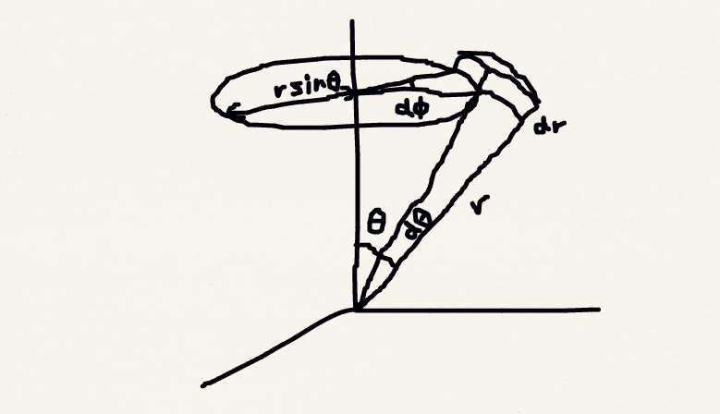
Hint 2

Slide 18
Example
The normalization constant is given by
Dimension 1/m^{3/2}

Slide 19
Normalization and time-dependent SE
If Ψ is a normalized solution of time-independent SE, Ψe^{ik} for any real value of k is also a normalized solution of SE because
The simplest example is when e^{iπ} = –1. Ψ and –Ψ are both normalized and with the same probability density |Ψ|².

Slide 20
Normalization and time-dependent SE
Therefore, both Ψ and Ψe^{ik} correspond to the same time-independent system. In other words, a time-independent wave function has inherent arbitrariness of e^{ik} where k is any real number. For example, Ψ and –Ψ represent the same time-independent state.
Let us revisit time-dependent and independent Schrödinger equations.

Slide 21
Time-dependent vs. time-independent

Slide 22
Time-dependent vs. time-independent
Time-dependent Schrödinger equation
Time-independent Schrödinger equation
If we substitute the wave function into time-dependent equation we arrive at time-independent one.

Slide 23
Normalization and time-dependent SE
This means even though this wave function has apparent time-dependence it should be representing time-independent physical state.
In fact (which we call “phase”) is viewed as the arbitrariness e^{ik}. Probability density is
Essentially
time-independent!

Slide 24
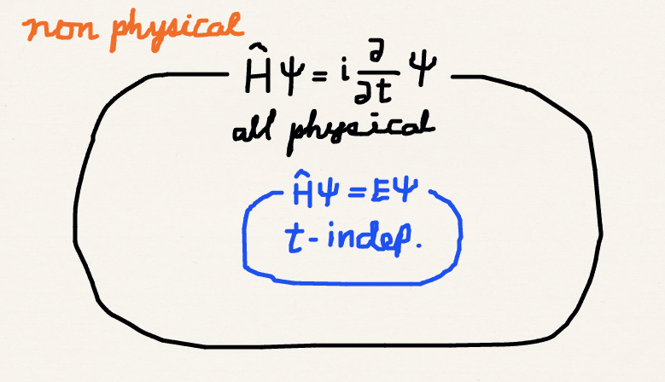
Time-dependent vs. time-independent

Slide 25
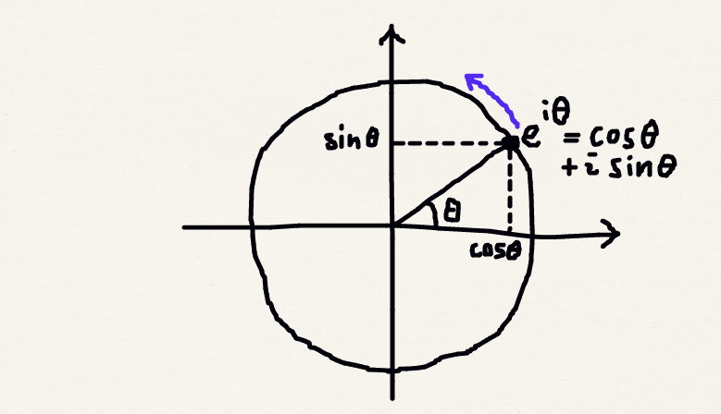
What is a “phase”?

Slide 26
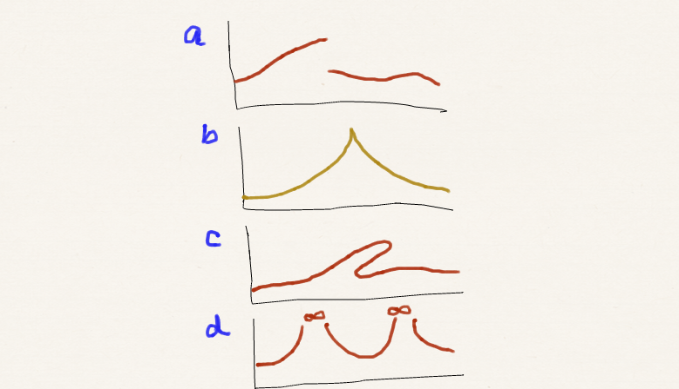
Allowable forms of wave functions
The Born interpretation: the square of a wave function is a probability density.
This immediately bars a wave function like figure (c), because a probability should be a unique value (single valued)

Slide 27
Allowable forms of wave functions
Probability should add up to unity, when all possibilities are included. Square of a wave function should integrate to unity.
This bars a function like (d) because it integrates to infinity regardless of any nonzero normalization constant (square integrable).

Slide 28
Allowable forms of wave functions
Apart from the Born interpretation, the form of the Schrödinger equation itself set some conditions for a wave function.
The second derivatives of a wave function must be well defined.

Slide 29
Allowable forms of wave functions
For the second derivative to exist, the wave function must be continuous, prohibiting a function like (a) which is discontinous.
It is also impossible to imagine a system where the probability density changes abruptly.

Slide 30
Allowable forms of wave functions
For the second derivatives to be nonsingular, the wave function should usually be smooth, discouraging a kinked function like (b).
There are exceptions. When the potential V also has a singularity, a kinked wave function is possible.

Slide 31
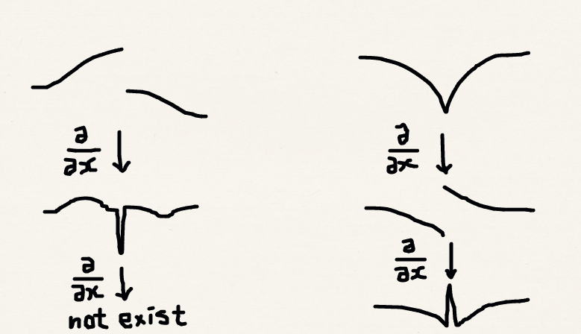
Existence of first and second derivatives

Slide 32
Summary
The Born interpretation relates the wave function to the probability density of a particle.
A wave function can be normalized such that square of it integrates to unity (100 % probability of finding a particle somewhere).
A wave function should be single-valued, square-integrable, continuous, and (smooth)*.
*Exceptions exist.

