Slide 1
Lecture 4
Complex numbers, matrix algebra, and partial derivatives

Slide 2
Basic mathematics for QM
Complex numbers
Matrix algebra
Partial derivatives
  Derivative operators in the Schrödinger equations
  Kinetic-energy operators in the Cartesian and spherical coordinates.

Slide 3
Complex numbers
We live in 3-dimensional universe or 4-dimensional spacetime.
Numbers exist in 2-dimensional complex plane.
Real part
Imaginary part
Complex number
Imaginary unit

Slide 4
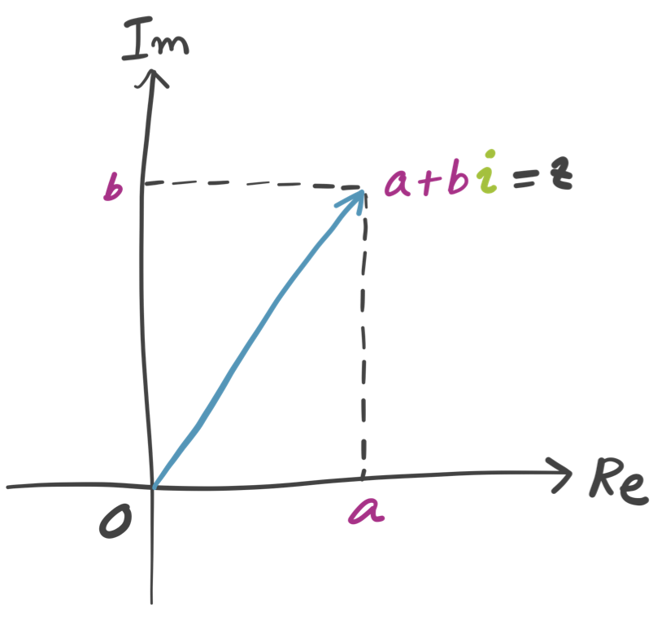
Complex numbers

Slide 5
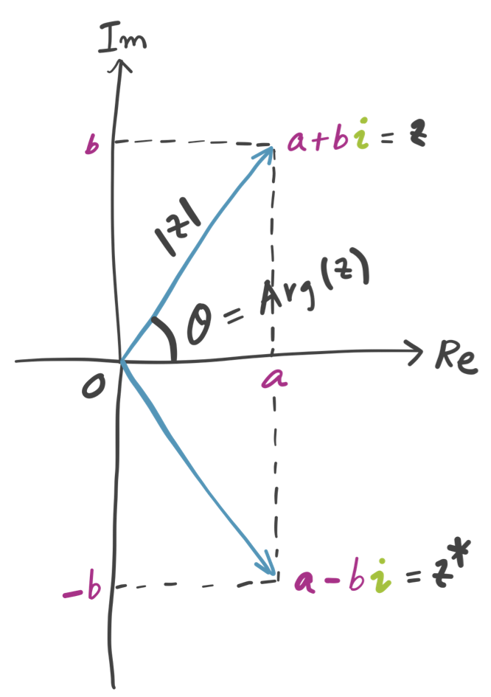
Complex numbers
Complex conjugate of z:
Absolute value of z:
Argument (phase) of z:

Slide 6
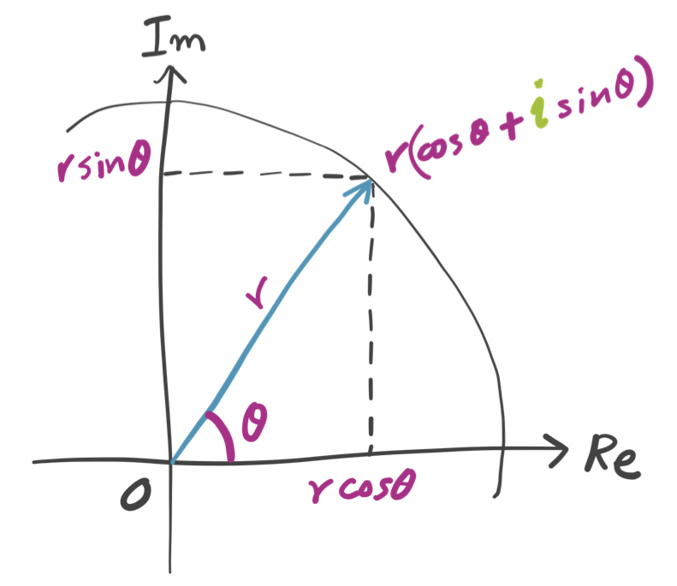
Complex numbers
Standard form:

Slide 7
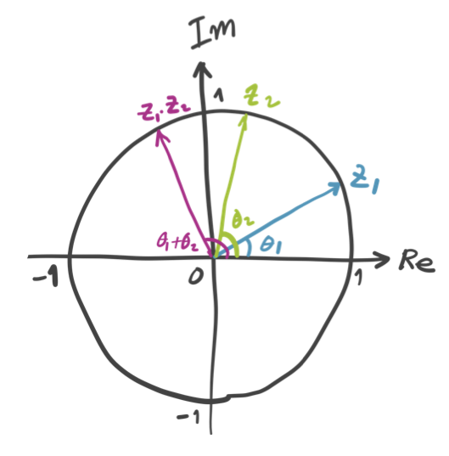
Complex numbers
Standard form:
When r₁ = r₂ = 1

Slide 8
Complex numbers
Euler’s formula:
When r₁ = r₂ = 1

Slide 9
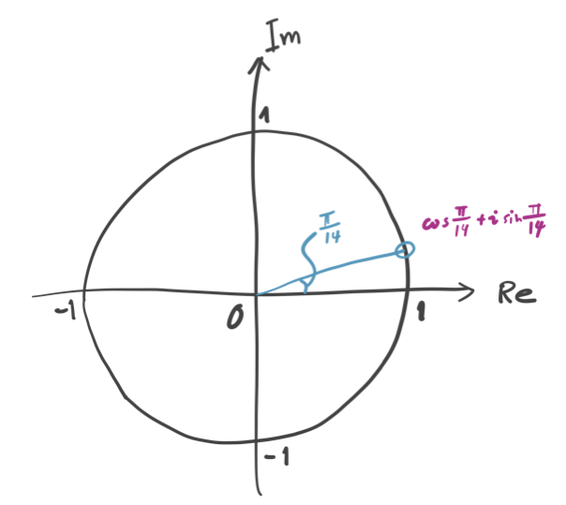
Complex numbers
28th order polynomial equation:

Slide 10
Matrix algebra
Matrices are everywhere in computational sciences and engineering.
This is because a computer is extremely good at performing simple arithmetic operations on a huge array of numbers, rather than performing symbolic or analytic operations on higher constructs.
QM has even stronger ties with matrix algebra.

Slide 11
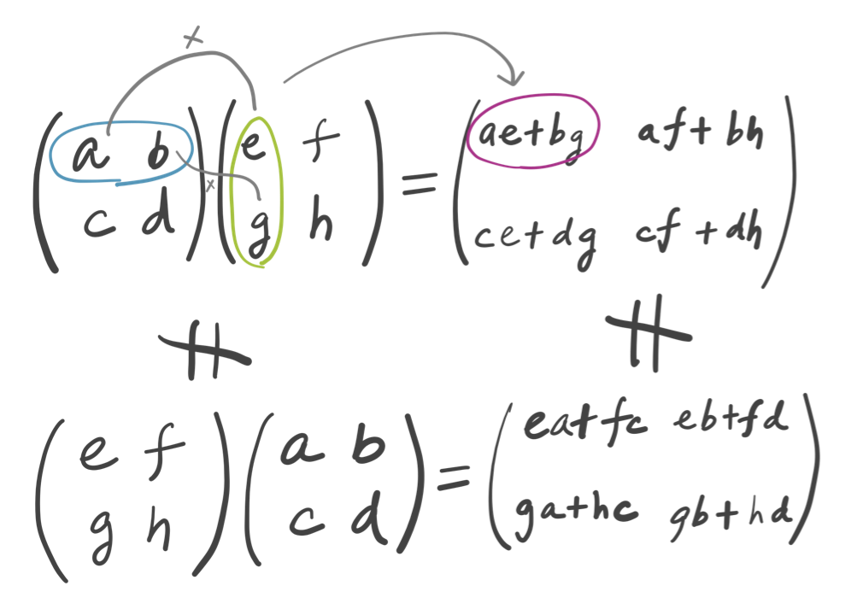
Matrix algebra
Matrix multiplication is not commutative …

Slide 12
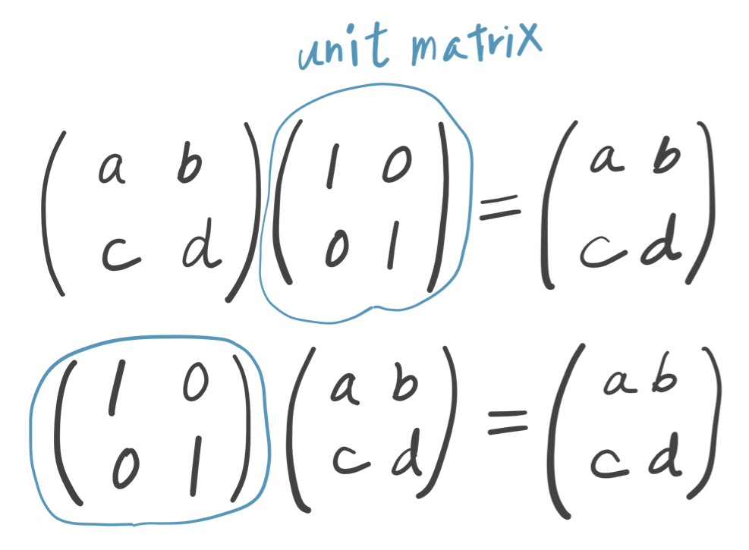
Matrix algebra
… except ones involving the identity or unit matrix.

Slide 13
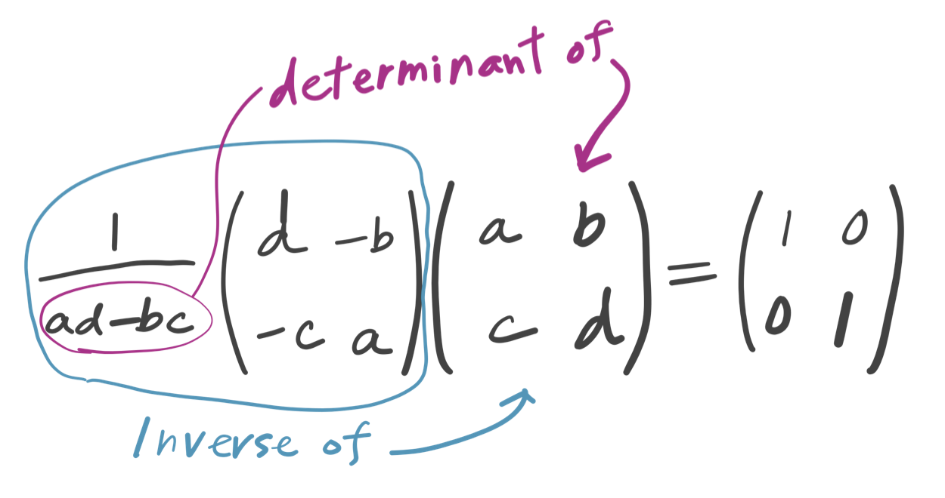
Matrix algebra
A matrix may or may not have an inverse ; It does not iff its determinant is zero.

Slide 14
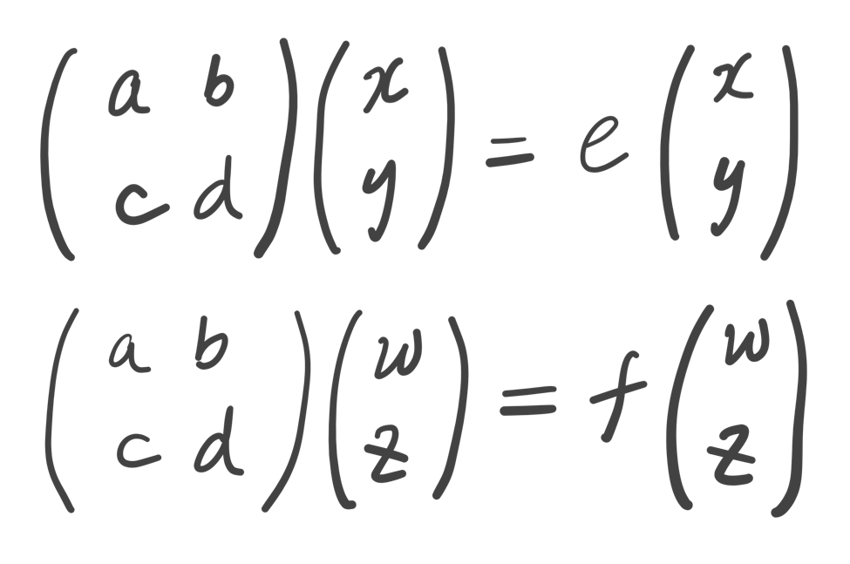
Matrix algebra
Matrix eigenvalue equation …
Eigenvectors
Eigenvalues

Slide 15
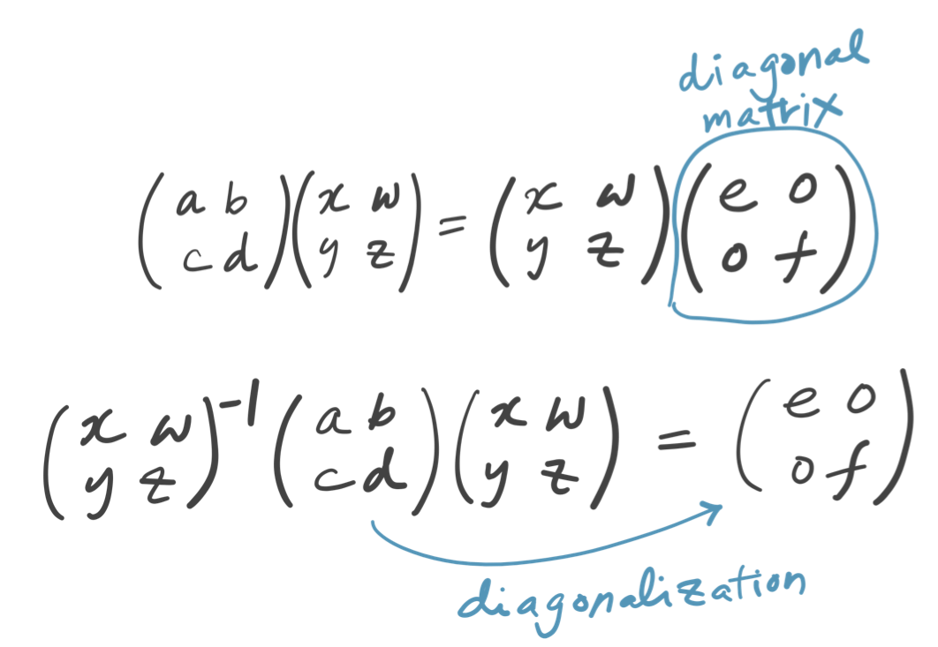
Matrix algebra
… can be solved by diagonalization, …

Slide 16
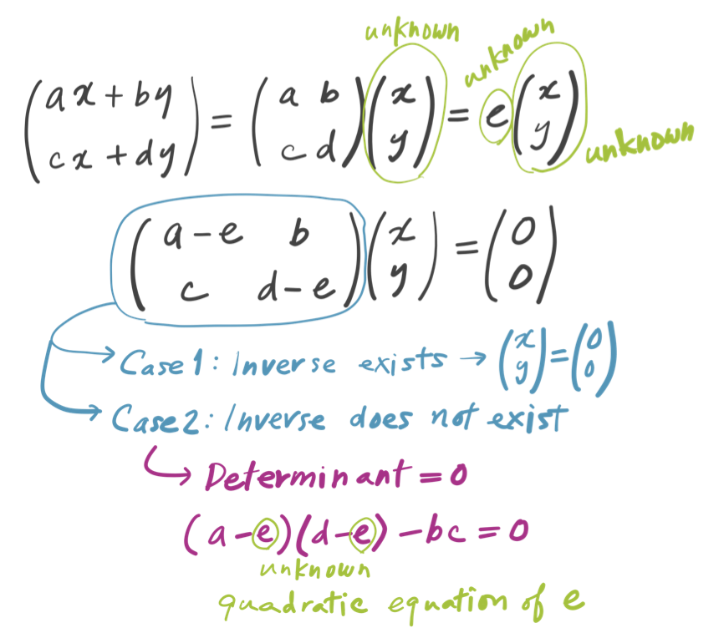
Matrix algebra
… or as a polynomial equation.

Slide 17
Partial derivatives
Quantitative theories of many science and engineering disciplines are expressed by differential equations.
In higher-than-one-dimensional problems, “differentiation” usually refers to a partial derivative rather than a full derivative.
means the derivative of f with
respect to z, while holding x and y
fixed during the differentiation.

Slide 18
Partial derivatives
Consider a function of space (x) and time (t) variables, f (x, t). Let the space variable also depend on time x = x(t). A partial derivative of f with respect to t is different from the full derivative because

Slide 19
Partial derivatives
Other than that, partial derivatives are essentially the same as usual derivatives.
is true. Is true?
YES and NO – yes (true) if the variables held fixed are identical in the left- and right- hand sides; no (false) if they are not.

Slide 20
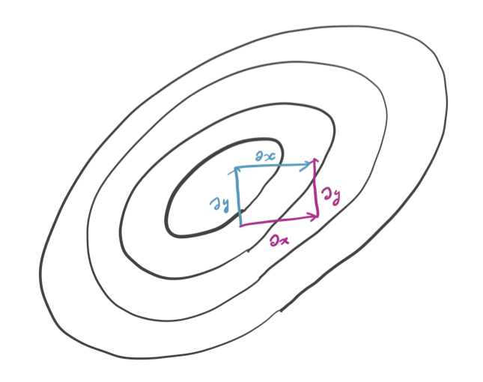
Partial derivatives
Consider the change in function f (x, y, z) caused by an increase in x (y and z held fixed) and then in y (x and z held fixed).
The result would be the same if we increase y first and then x. Hence,

Slide 21
Time-dependent
Schrödinger equation
The time-dependent Schrödinger equation is:
We do not differentiate x, y, z dependent part of the wave function by t (see the simple wave in the previous lecture).

Slide 22
The Schrödinger equation
For one-dimension, it is
The kinetic energy operator comes from the classical to quantum conversion of the momentum operator

Slide 23
The Schrödinger equation
In three-dimension, we have three Cartesian components of a momentum:
Accordingly, the momentum operator is a vector operator:
(“del” or “nabla”) is a vector

Slide 24
The Schrödinger equation
Kinetic energy in classical mechanics:
(The vector inner product is )
In quantum mechanics:

Slide 25
The Schrödinger equation
The Schrödinger equation in three dimensions is,

Slide 26
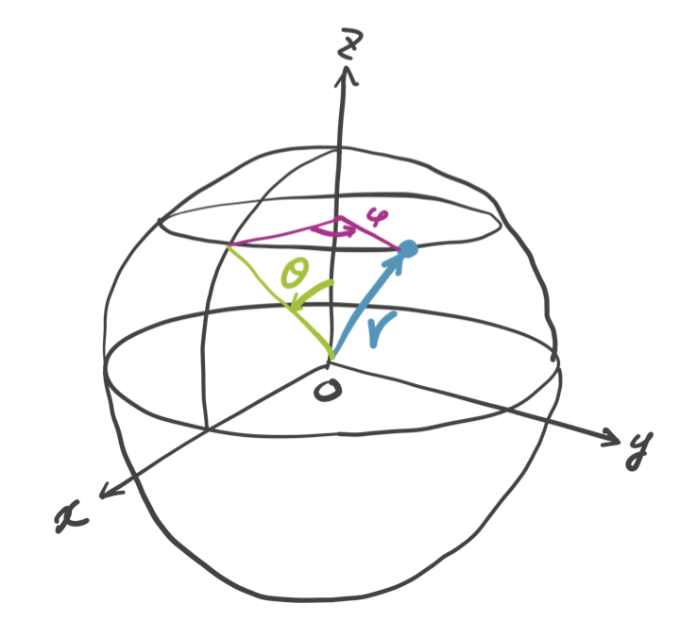
The Schrödinger equation in spherical coordinates
Instead of Cartesian coordinates (x, y, z), it is sometimes more convenient to use spherical coordinates
(r, θ, φ)

Slide 27
The Schrödinger equation
The kinetic energy operator can be written in two ways – Cartesian or spherical.

Slide 28
Challenge homework #2
Derive the spherical-coordinate expression of
(the green panel) using the equations in blue and orange panels.

Slide 29
Summary
We have reviewed some basic, but essential concepts of mathematics for quantum mechanics.
The derivative operators in the Schrödinger equations are partial derivatives.
The kinetic-energy operators in the Cartesian and spherical coordinates are presented.

