Slide 1
Lecture 37 Nuclear magnetic resonance

Slide 2
Nuclear magnetic resonance
The use of NMR in chemical research was pioneered by Herbert S. Gutowski of Department of Chemistry, University of Illinois, who established the relationship between chemical shifts and molecular structures. He also discovered spin-spin coupling.
Foundation of magnetic spectroscopy.
Proton NMR.

Slide 3
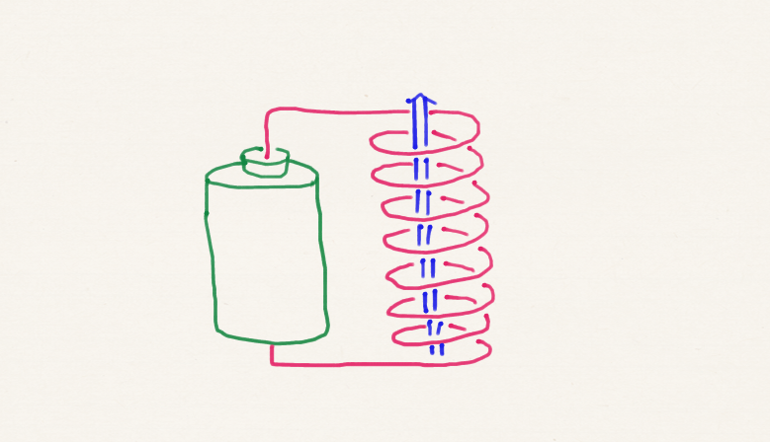
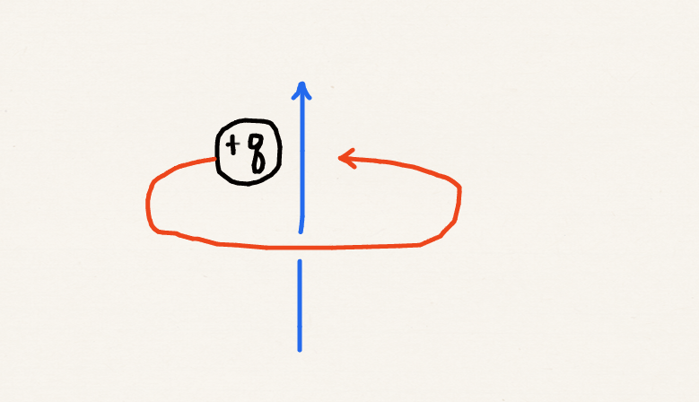
Circular electric current = magnet
Electrons in p, d, f orbitals
Electron spin
Nuclear spin
charge
magnetic
moment
angular
momentum
mass

Slide 4
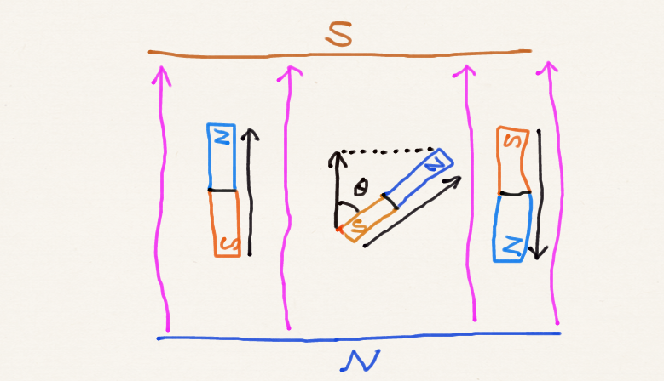
Magnet-magnetic-field interaction
Classical
high energy
Magnetic moment
Magnetic field
Quantum
low energy

Slide 5
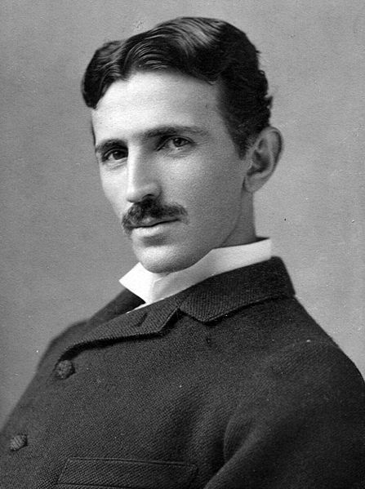
Tesla
C
T (Tesla)
J
kgm²/s
kg
1 T = 1 V s / m²
Nikola Tesla
Public domain image from Wikipedia
Field strength in 500 MHz NMR ($0.5M) = 11.7 T
Field strength in 1 GHz NMR ($20M) = 23.5 T
Strongest continuous magnetic field = 45 T
(National High Magnetic Field Lab at Tallahassee, FL)

Slide 6
Electrons in p, d, f orbitals
First-order perturbation theory
Bohr magneton
9.724×10⁻²⁴ J/T
(2 l + 1)-fold degeneracy
(field off)
Zeeman effect (field on)

Slide 7
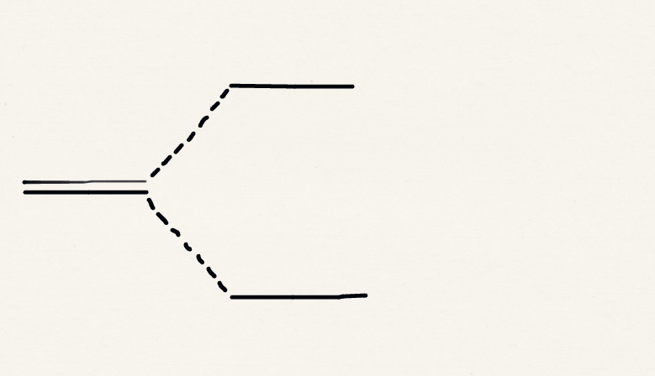
Electron spin
Quantum electrodynamics
g-value
2.002319…
α
2-fold degeneracy
(field off)
β
ESR or EPR (field on)

Slide 8
Nuclear spin
Nuclear magneton
1800 times smaller
than Bohr magneton
Proton
mass
Negative sign
positive nuclear charge
Nuclear g-factor
proton: 5.586
β
2-fold degeneracy
(field off)
α
NMR (field on)

Slide 9
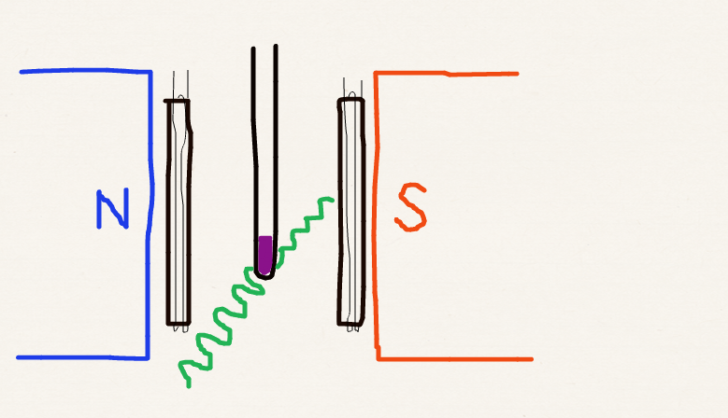
Proton NMR
Sweep coils
β
α
Radio freq
Sample

Slide 10
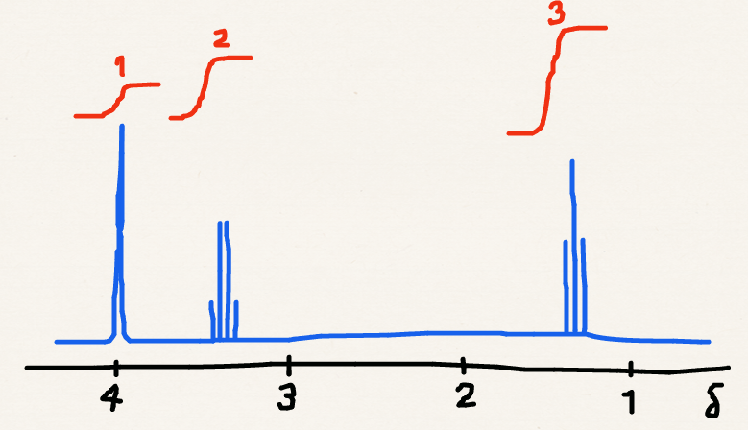
Proton NMR spectra
Overall intensity
Groups of peaks
Relative intensities of groups of peaks
Pattern in each group (hyperfine structure)

Slide 11
Overall intensity
β
excess
α spins
α
Intensity of a NMR signal ~ energy of RF radiation absorbed / time
~ ΔE × number of excess α spins
~ B² / T
Stronger magnet + lower temperature

Slide 12
Group of peaks: chemical shifts
Resonance freq.
Resonance freq. of TMS
Si(CH₃)₄
Chemical shift
“ppm”
β
α

Slide 13
Group of peaks: chemical shifts
Resonance freq.
Shielding constant
Chemical shift

Slide 14
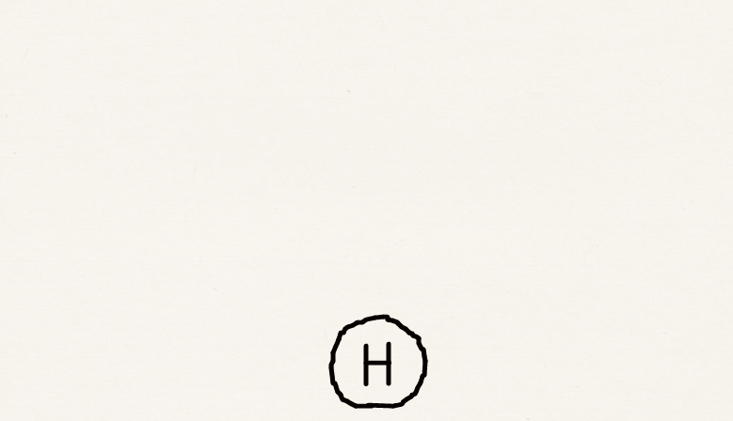
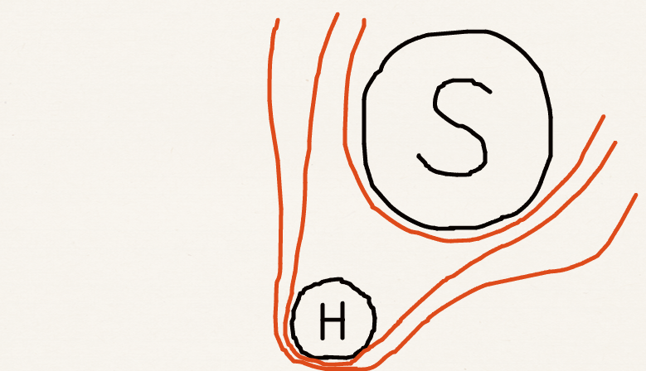
Group of peaks: chemical shifts
Shielding constant
+

Slide 15
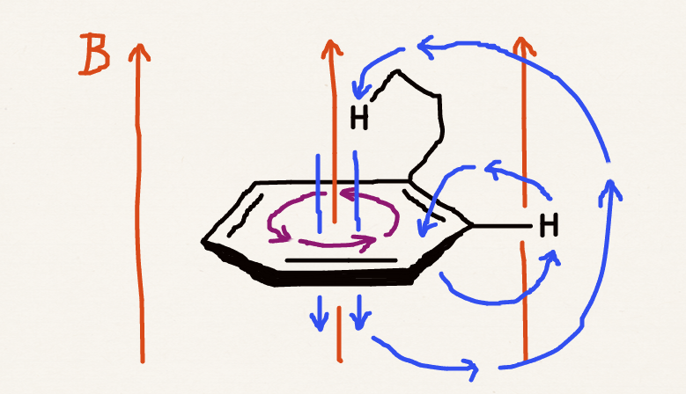
Group of peaks: chemical shifts
Shielding constant

Slide 16
Group of peaks: chemical shifts
RCH₃
-CH₂-
-CH-
ROH
ArOH
Ar-H
-CHO
-COOH
14 12 10 8 6 4 2 0 δ

Slide 17
Relative intensities
C₂H₆O
RCH₃
H
H₂
H₃
-CH₂-
OH
CH₂
ROH
CH₃
4 2 0
δ
CH₃CH₂OH

Slide 18
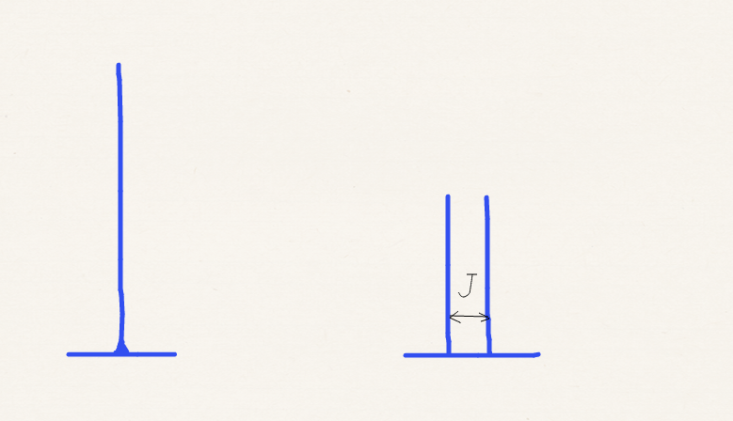
Hyperfine structure
Spin-spin coupling:
H
nearby H
β
CH₃CH₂OH
β
α
OH
CH₂
CH₃
α
α
β

Slide 19
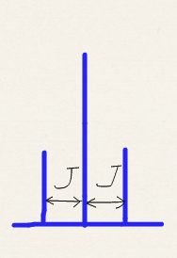
Hyperfine structure
Spin-spin coupling:
H
H
H₂
β
ββ
CH₃CH₂OH
β
βα, αβ
α
αα
OH
CH₂
CH₃
αα
α
αβ, βα
α
β
ββ

Slide 20
Hyperfine structure
Pascal’s triangle
CH₃CH₂OH
1
nearby H
1
1
OH
CH₂
CH₃
nearby H₂
1
2
1
nearby H₃
1
3
3
1
nearby H₄
1
4
6
4
1

Slide 21
Hyperfine structure
CH₃CH₂OH
Q: Why doesn’t the proton in the OH group cause splitting?
A: The proton undergoes a rapid exchange with protons in other ethanol or water molecules; its spin is indeterminate in the time scale of spectroscopic transitions; this causes lifetime broadening of spectral line rather than splitting.
OH
CH₂
CH₃
?

Slide 22
Hyperfine structure
CH₃CH₂OH
Q: Why is there no spin-spin coupling between the two protons in the CH₂ group?
A: There is spin-spin coupling between them; however, its effect on the peaks is null and undetectable; this is because these protons are chemically and magnetically equivalent.
OH
CH₂
CH₃
?
?

Slide 23
Hyperfine structure
Triplet
magnetic
CH₃CH₂OH
Singlet
non-magnetic
No change in spacing
no spin-spin coupling
with spin-spin coupling

Slide 24
Spin-spin coupling constant
H
H
H
C
H
H
C
C
H

Slide 25
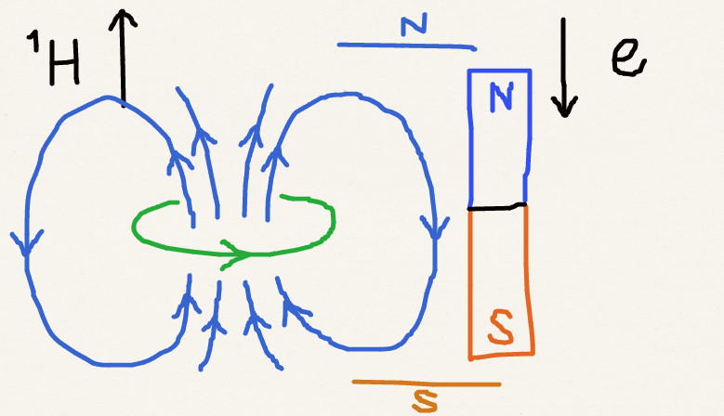
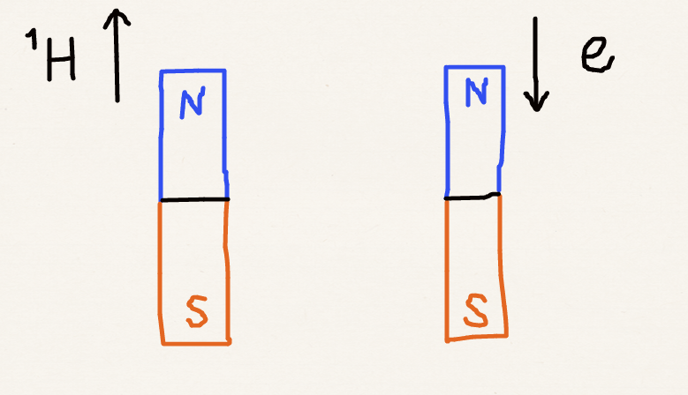
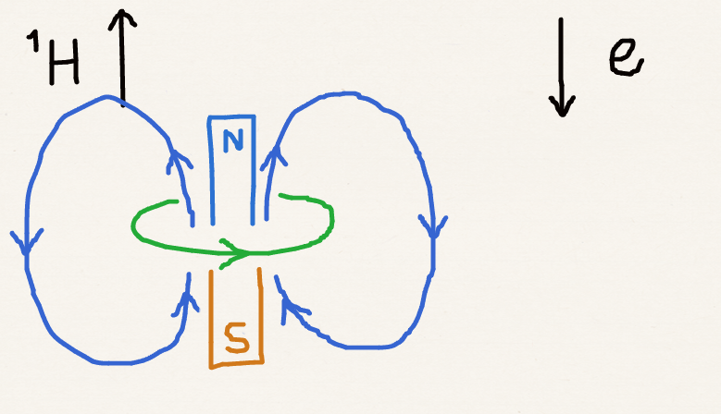
Spin-spin coupling constant
H
H
Fermi
contact
Fermi
contact
Covalent bond
singlet-coupling
higher energy??
higher energy??
Fermi contact
lower energy!

Slide 26
Spin-spin coupling constant
H
C
H
Fermi
contact
Hund
Fermi
contact
Covalent
bond
singlet
coupling
Covalent
bond
singlet
coupling

Slide 27
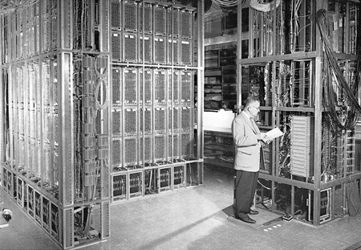
Spin-spin coupling constant
H
C
C
H
H
C
H
Karplus equation
Martin Karplus
Department of Chemistry
University of Illinois
Image (c) University of Illinois
ILLIAC

Slide 28
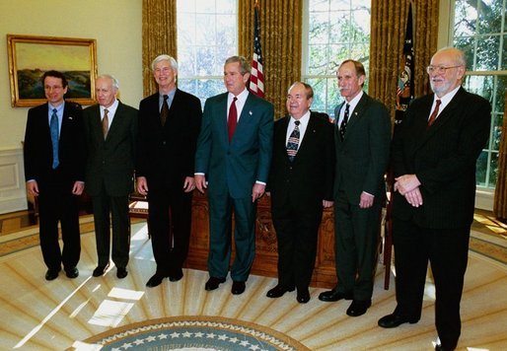
Magnetic resonance imaging: MRI
Magnetic field gradient
Resonance frequency
~ location (x)
x
Intensity
~ number of protons (in water) at x
Public domain image from Wikipedia
Paul Lauterbur (far right)
Department of Chemistry
University of Illinois

Slide 29
Summary
We have studied the foundation of magnetic interactions and magnetic spectroscopy.
We have learned the theory of proton NMR as an essential tool for chemical structural analysis.
The origins of chemical shifts, hyperfine structures, and spin-spin coupling constants are discussed as well as their relation to molecular structures.

