Slide 1
Lecture 36 Electronic spectroscopy

Slide 2
Electronic spectroscopy
Transition energies between electronic states fall in the range of UV/vis photons. UV/vis or optical or electronic absorption spectroscopy determines the electronic energy levels and, therefore, electronic excited state structure and dynamics.
Vibrational energy levels and structures of electronic excited states can be obtained from the Franck-Condon progression.
We will also consider cases where the Franck-Condon principle breaks down and vibronic coupling must be taken into account.

Slide 3
Electronic absorption
Transition dipole moment:
Born-Oppenheimer separation
Zero
Electronic
transition
moment
Vibrational
overlap
(not zero)

Slide 4
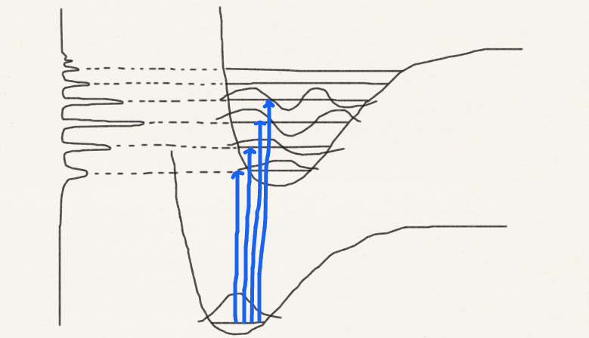
Franck-Condon factor
Intensity
Franck–Condon factor
Franck-Condon or
vibrational progression
Electronic (UV/vis) spectra give not only electronic excitation energies but also vibrational frequencies in excited states
0-0 transition

Slide 5
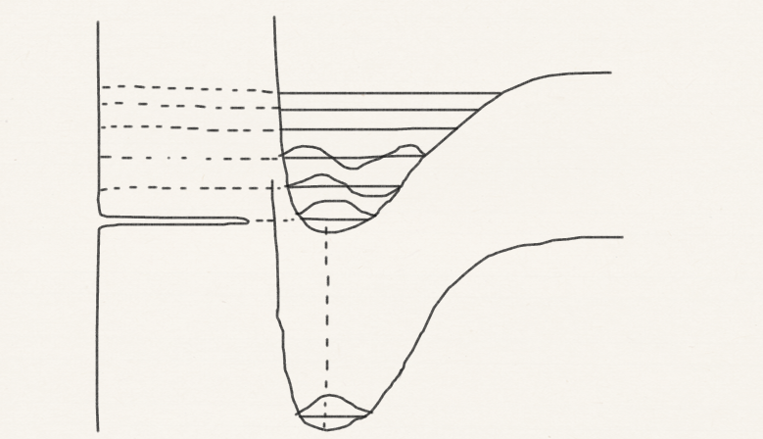
Progression pattern 1
Short progression dominated by 0-0 transition suggests that the two PES (electronic states) have similar equilibrium structures and similar vibrational frequencies (bond strengths)
This in turn implies that the excited electron has likely vacated a non-bonding or weaker π orbital.

Slide 6
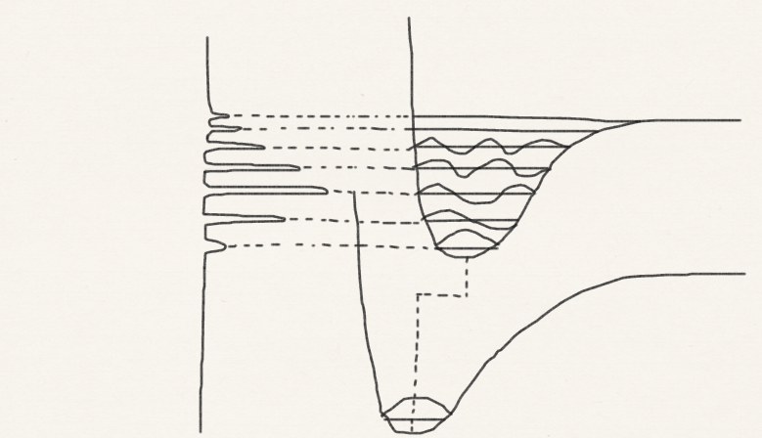
Progression pattern 2
This in turn implies that the excited electron has likely vacated a bonding σ orbital, significantly weakening the bonds and changing the molecular structure.
Long progression with a weak 0-0 transition suggests that the two PES (electronic states) have very different equilibrium structures.

Slide 7
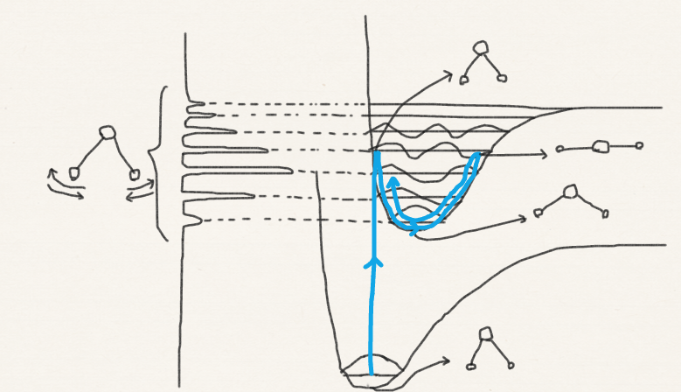
Progression pattern 2 (continued)
The molecule is vertically excited to a new, upper PES (cf. classical-quantum correspondence in harmonic oscillator). The molecule finds itself far from the new equilibrium structure and starts to vibrate back to it. The vibration is along the totally-symmetric structure change from the ground to excited state.

Slide 8
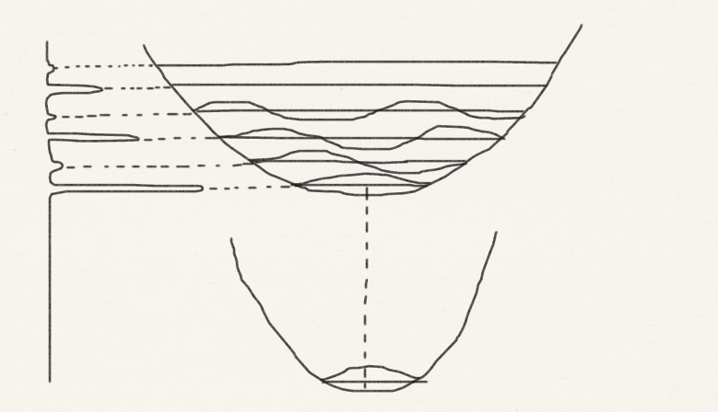
Progression pattern 3
This may occur for non-totally-symmetric vibrations which may change their frequencies upon electronic excitations, but no structure change can occur along the corresponding non-totally-symmetric coordinate.
Long progression with alternating intensities suggests that the two PES (electronic states) have similar equilibrium structures but very different vibrational frequencies.

Slide 9
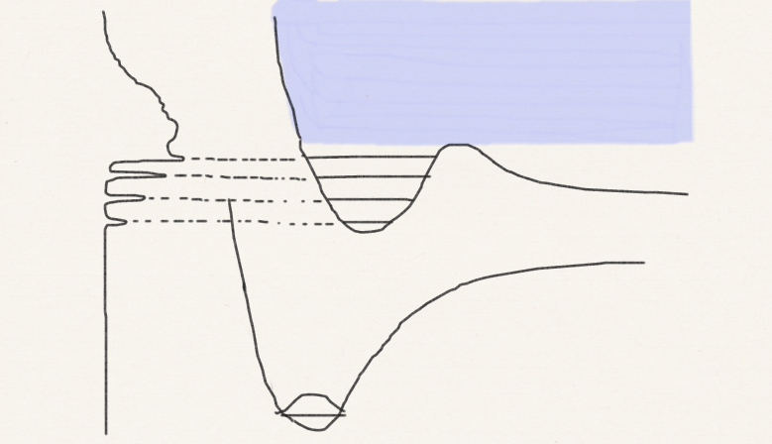
Progression pattern 4
Progression with a blurred structure suggests that the upper PES (electronic state) becomes dissociative where the blurring starts.

Slide 10
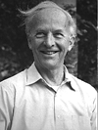
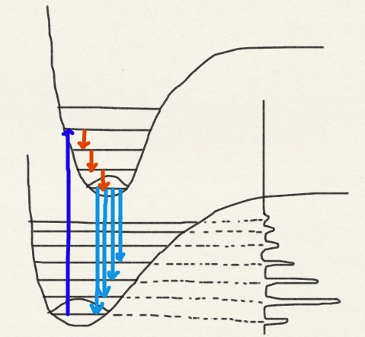
Fluorescence (emission) spectroscopy
The molecule loses energy to its surrounding non-radiatively and reaches the ground vibrational state of electronic excited state (Kasha’s rule).
Pump energy to the molecule so it gets electronically excited
Michael Kasha
The molecule makes a radiative transition (fluoresce) (cf. Einstein’s spontaneous emission or radiation). Franck-Condon progression is observed.

Slide 11
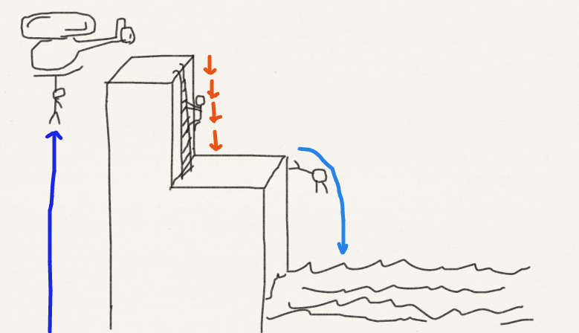
Fluorescence quenching
Molecules prefer lowering energies by making small non-radiative transitions (rather than a large radiative transition) by giving energies to its surrounding (the energy becomes heat). A quantum of vibrational energy can be dispensed with by collisions in the gas phase (Kasha’s rule).
A quantum of electronic energy can be dispensed with by more frequent collisions in liquid phases. Fluorescence can be quenched in solution.

Slide 12
Vibronic coupling
The d-d transitions in metal complexes and Franck-Condon-forbidden transitions in benzene become allowed because of vibronic coupling.
Vibronic coupling and vibronic transition occur because of the breakdown of Born-Oppenheimer separation and Franck-Condon principle.
Born-Oppenheimer

Slide 13
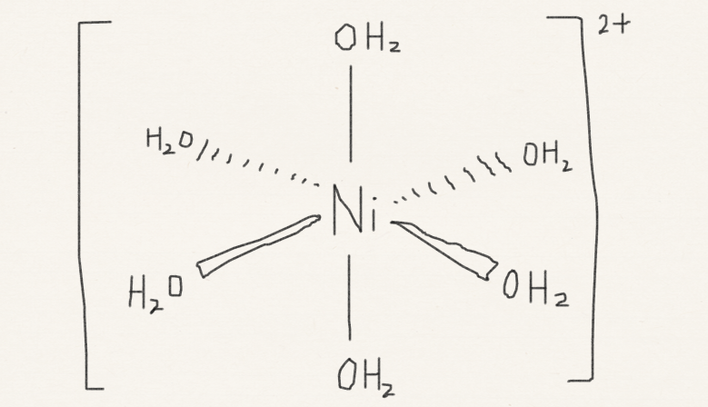
d-d transition forbidden (review)
O_{h} | E | 8C₂ | … | i | … | h = 48
A_{1g} | 1 | 1 |  | 1 |  | x²+y²+z²
…
E_{g} | 2 | −1 |  | 2 |  | (z², x²−y²)
…
T_{2g} | 3 | 0 |  | 3 |  | (xy, yz, zx)
…
spherical
O_{h}
E_{g}
d_{z2}, d_{x2−y2}
d orbitals
T_{2g}
d_{xy}, d_{yz}, d_{zx}

Slide 14
Laporte rule
An “ungerade” function changes its sign (typically character of −1) upon inversion
An ungerade function is not totally symmetric (because of character of −1). Its integral is zero. Transition from g to g or u to u is forbidden.
A “gerade” function does not change its sign (typically character of +1) upon inversion
Axis operators are ungerade (they flip directions upon inversion)

Slide 15
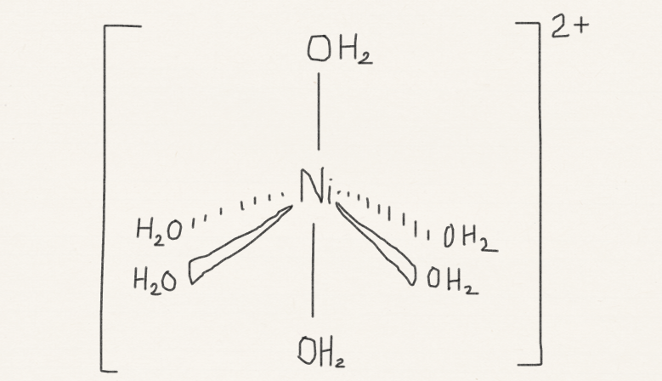
d-d transition forbidden (review)
Vibration
C_{4v}
O_{h}
d_{z2}
A₁
E_{g}
d_{z2}, d_{x2−y2}
d_{x2−y2}
B₁
Laporte
does not apply; allowed
Laporte
forbidden
Vibration
d_{yz}, d_{zx}
E
T_{2g}
d_{xy}, d_{yz}, d_{zx}
B₂
d_{xy}

Slide 16
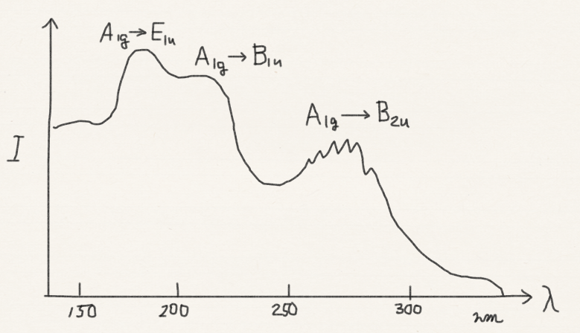
Benzene A_{1g} to B_{2u} forbidden
D_{6h}
Why are these observed?

Slide 17
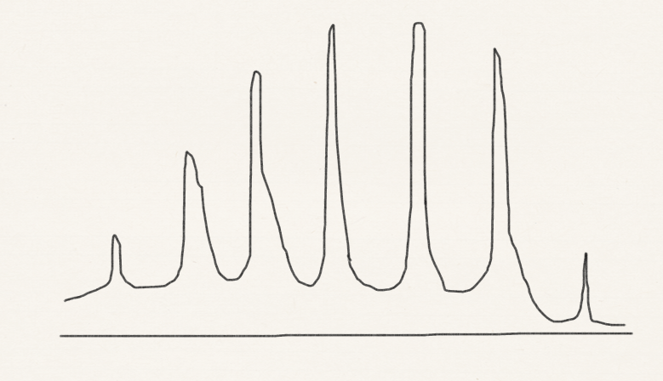
Benzene A_{1g} to B_{2u} FC forbidden
920 cm⁻¹
Hotband
1128 cm⁻¹

Slide 18
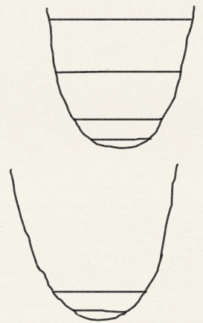
Benzene A_{1g} to B_{2u} vibronic allowed
B_{2u}
B_{2u}×E_{2g}×A_{1g}=E_{1u}
920 cm⁻¹
B_{2u}×E_{2g}×A_{1g}=E_{1u}
A_{1g} vibration of upper state 920 cm⁻¹
920 cm⁻¹
B_{2u}×E_{2g}=E_{1u}
520 cm⁻¹
B_{2u}
0-0
A_{1g}
Hotband
0-0
A_{1g}×E_{2g}=E_{2g}
E_{2g} vibration of upper state 520 cm⁻¹
608 cm⁻¹
A_{1g}
E_{2g} vibration of lower state 608 cm⁻¹

Slide 19
Benzene A_{1g} to B_{2u} vibronic allowed
B_{2u}
B_{2u}×E_{2g}×A_{1g}=E_{1u}
920 cm⁻¹
B_{2u}×E_{2g}×A_{1g}=E_{1u}
920 cm⁻¹
B_{2u}×E_{2g}=E_{1u}
520 cm⁻¹
B_{2u}
A_{1g}
0-0
A_{1g}×E_{2g}
608 cm⁻¹
A_{1g}

Slide 20
Summary
We have learned the Franck-Condon principle and how vibrational progressions in electronic spectra inform us with the structures and PES’s of molecules in the ground and excited states.
We have learned the fluorescence and its quenching as well as Kasha’s rule.
We have also considered the cases where the Franck-Condon principle (i.e., Born-Oppenheimer separation) breaks down and vibronic coupling must be invoked to explain the appearance of the spectra.

