Slide 1
Lecture 35 Vibrational spectroscopy

Slide 2
Vibrational spectroscopy
Transition energies between vibrational states fall in the range of IR photons. IR absorption spectroscopy can determine vibrational energy levels and thus molecular structures and dynamics.
Raman spectroscopy can also be used to study molecular vibrations.
We will learn the theories of diatomic and polyatomic molecular vibrations in the harmonic approximation.
We will discuss the effect of anharmonicity.

Slide 3
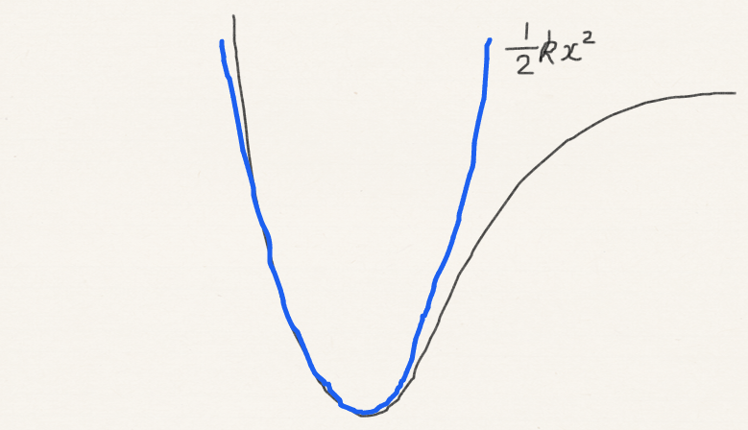
Diatomic molecules in harmonic approximation
Anharmonicity
= 0
= k

Slide 4
Selection rules: IR absorption
Energy separations between vibrational states are in infrared range.
Transition dipole
dipole moment
Zero
IR absorption does not occur in nature!?
(Global warming solved by orthogonality!?)

Slide 5
Selection rules: IR absorption
Fallacy is the constancy of the dipole moment during vibration.
Transition dipole
dipole moment
Zero
Gross selection rule: dipole varies with vibrations

Slide 6
Selection rules: IR absorption
Which molecules have infrared absorption?
N₂
No (zero dipole; zero dipole derivatives)
O₂
No (zero dipole; zero dipole derivatives)
CO₂
Yes (zero dipole; nonzero dipole derivatives)
H₂O
Yes (nonzero dipole; nonzero derivatives)

Slide 7
Selection rules: IR absorption
Specific selection rule

Slide 8
Selection rules: Raman scattering
Transition polarizability
polarizability
Gross selection rule: polarizability varies with vibration
Specific selection rule

Slide 9
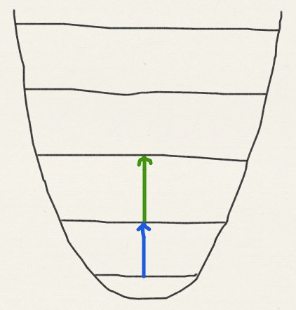
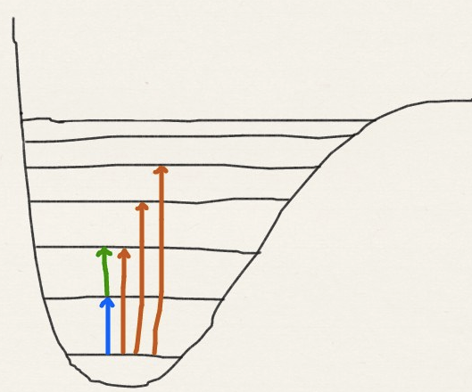
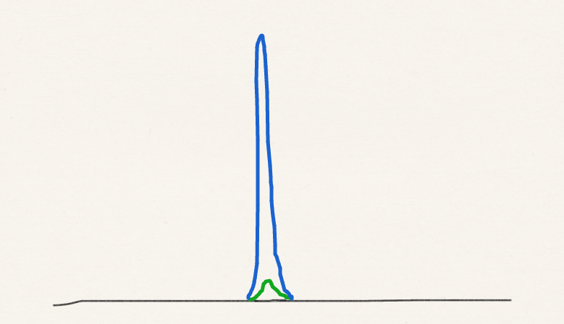
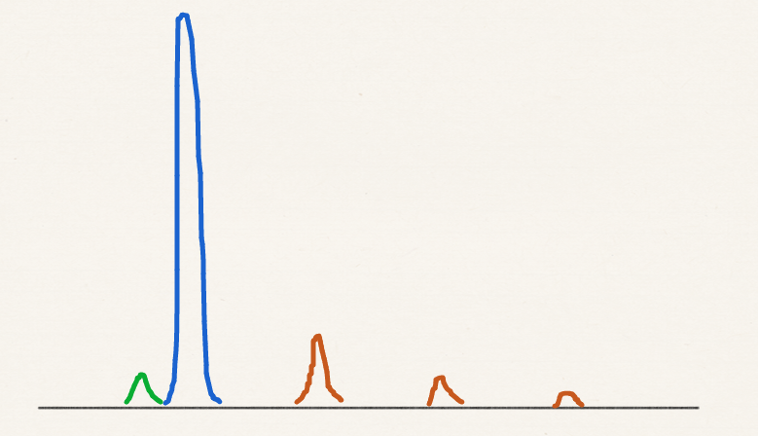
Anharmonicity
Fundamental: v = 1 ⬅ 0
Overtone:
v = 2 ⬅ 0; v = 3 ⬅ 0, etc.
Hot band: v = 2 ⬅ 1; v = 3 ⬅ 2, etc.

Slide 10
Polyatomic molecules in harmonic approximation
Linear molecules: 3N – 5 modes.
Nonlinear molecules: 3N – 6 modes.
The Schrödinger equation for polyatomic vibrations (i.e., once assumed to be separable from rotations) can be solved exactly in the harmonic approximation.
The wave function becomes the product of harmonic oscillator wave functions along normal modes. The energy is the sum of harmonic oscillators’ energies.

Slide 11
Normal modes
A normal mode is classical motion of nuclei with well-defined frequency, a set of nuclear coordinates representable by arrows in the case of CO₂:
The 3N – 6 dimensional classical vibration of masses connected by harmonic springs can be decomposed into 3N – 6 separate one-dimensional classical harmonic oscillators, each of which in a normal coordinate.

Slide 12
Classical versus quantum harmonic oscillators
Classical – Newton
Quantum – Schrödinger
Classical – Hamilton

Slide 13
Normal mode analysis
Consider just the in-line motion of CO₂:
We have
O₁
C
O₂
x
All three coordinates
are coupled

Slide 14
Normal mode analysis
In matrix form:

Slide 15
Normal mode analysis
The object of the normal mode analysis is to find linear combinations of the original coordinates that decouple the equations:
so that
These are the normal coordinates (see next pages how to obtain them)

Slide 16
Normal mode analysis
Mass-weighted
force constant matrix

Slide 17
Normal mode analysis

Slide 18
Normal modes
Symmetric stretch
Anti-symmetric stretch
Translation

Slide 19
Classical to quantum transition
Symmetric stretch
1285 cm⁻¹
Anti-symmetric stretch
2349 cm⁻¹

Slide 20
Normal modes
A normal mode transforms as an irreducible representation of the symmetry group of the molecule:
A_{1g}
A_{1u}

Slide 21
IR-Raman exclusion rule
Infrared active – nonzero dipole derivatives – x, y, z irreps.
Raman active – nonzero polarizability derivatives – xx, yy, zz, xy, yz, zx irreps.
Exclusion rule: if the molecule has the inversion symmetry, no modes can be both infrared and Raman active, because x, y, and z always have character of −1 (ungerade) for inversion while xx, yy, zz, xy, yz, and zx have +1 (gerade).

Slide 22
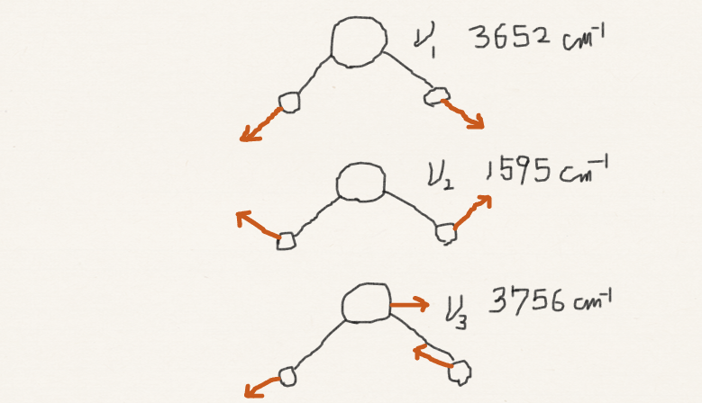
IR and Raman activity: H₂O
A₁
A₂
B₁
B₂
IR- & Raman-active
C_{2v}, 2mm | E | C₂ | σ_{v} | σ_{v}’ | h = 4
A₁ | 1 | 1 | 1 | 1 | z, x², y², z²
A₂ | 1 | 1 | −1 | −1 | xy
B₁ | 1 | −1 | 1 | −1 | x, zx
B₂ | 1 | −1 | −1 | 1 | y, yz

Slide 23
IR and Raman activity: CO₂
A_{1g}
A_{1u}
Raman active
IR active
D_{∞h}, | E | … | i | …
A_{1g} | 1 | … | 1 | … | x²+y², z²
… | … | … | … | … | …
A_{1u} | 1 | … | −1 | −1 | z
… | … | … | … | … | …

Slide 24
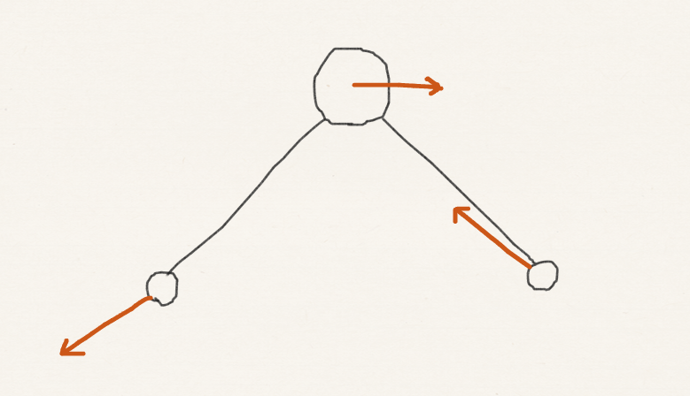
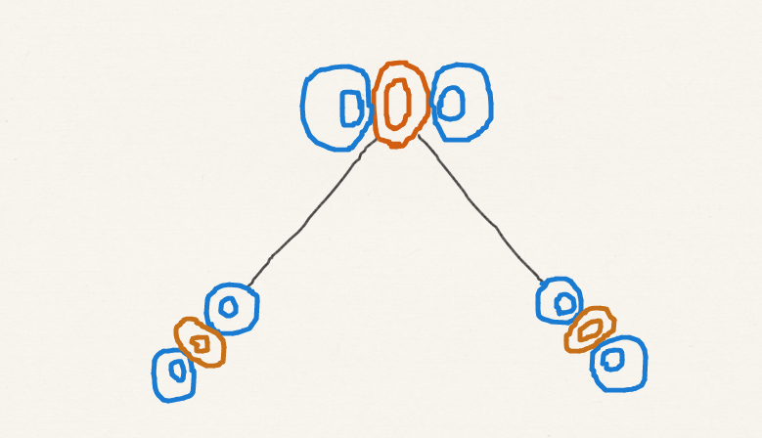
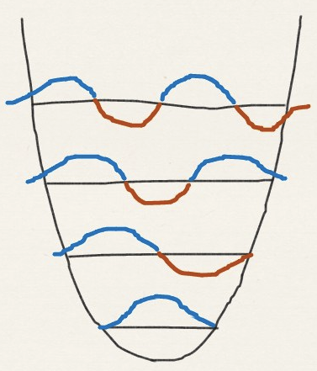
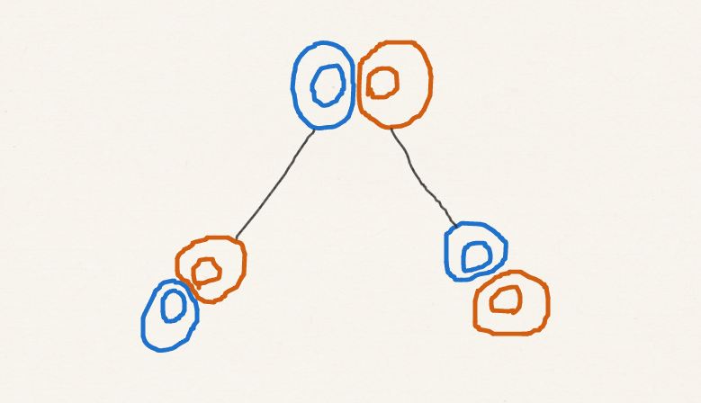
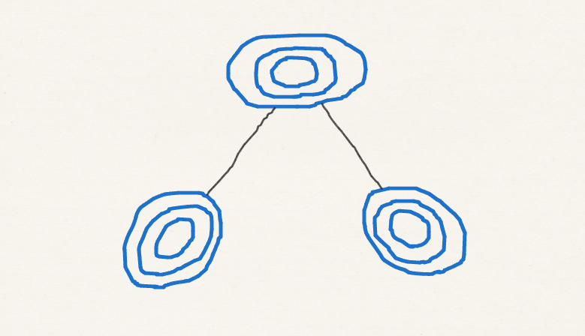
Irreducible representation of vibrational wave functions
v = 2
A₁
v = 1
v = 3
B₁
v = 2
v = 1
v = 0
A₁
v = 0

Slide 25
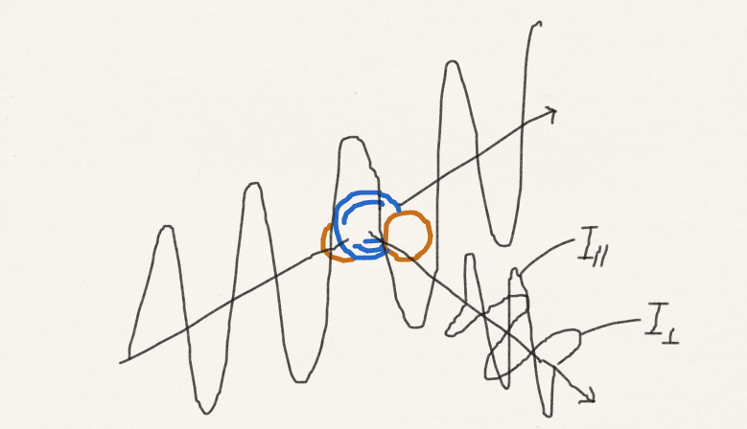
Raman depolarization ratio
ρ = I┴ / I_{II} = 0.75 ~ 1.0 (depolarized – non totally symmetric modes – xy, yz, zx)
+ + + + + + + + + +
– – – – – – – –

Slide 26
Summary
We have learned the gross and specific selection rules of IR and Raman spectroscopy for vibrations.
We have considered the harmonic approximation for diatomic and polyatomic molecules. In the latter, we have performed normal mode analysis.
We have studied the effect of anharmonicity on vibrational spectra.
We have analyzed the symmetry of normal modes and vibrational wave functions.
On this basis, we have rationalized IR-Raman exclusion rule and Raman depolarization ratio.

