Slide 1
Lecture 34
Rotational spectroscopy: intensities

Slide 2
Rotational spectroscopy
In the previous lecture, we have considered the rotational energy levels.
In this lecture, we will focus more on selection rules and intensities.

Slide 3
Selection rules and intensities (review)
Transition dipole moment
Intensity of transition

Slide 4
Rotational selection rules
Oscillating electric field (microwave)
Transition
moment
No electronic / vibrational transition
x-dipole
dipole

Slide 5
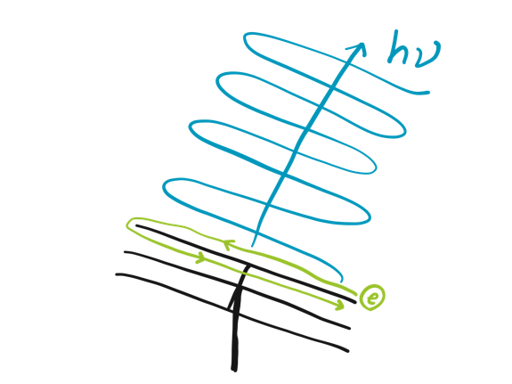
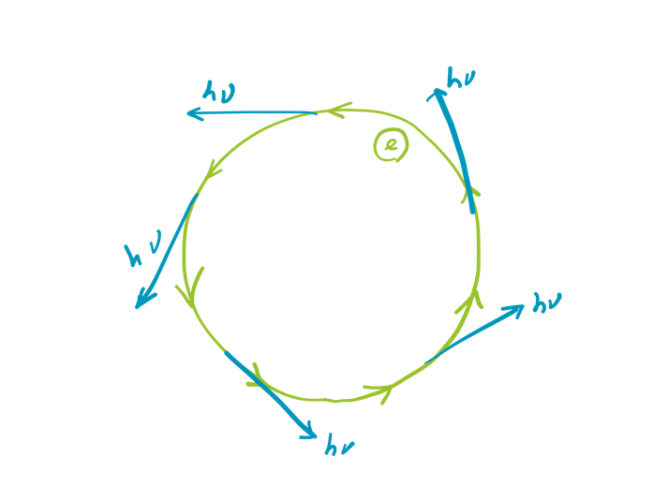
Rotational selection rules
Gross selection rule:
nonzero permanent dipole
Does H₂O have microwave spectra?
Yes
Does N₂ have microwave spectra?
No
Does O₂ have microwave spectra?
No

Slide 6

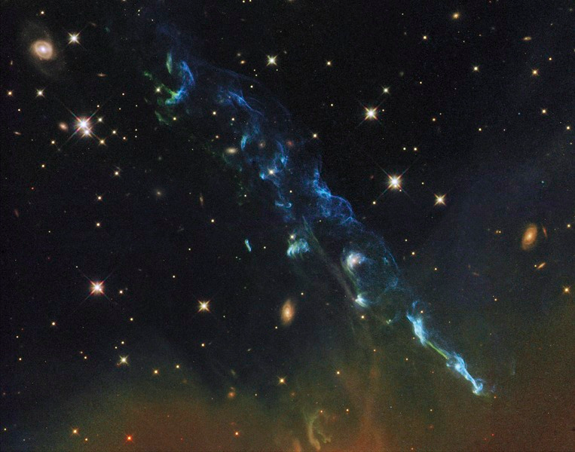
Quantum in nature
How could astrochemists know H₂O exist in interstellar medium?
Microwave spectroscopy
Public image
NASA

Slide 7
Selection rules of atomic spectra (review)
From the mathematical properties of spherical harmonics, this integral is zero unless

Slide 8
Rotational selection rules
Specific selection rule:

Slide 9
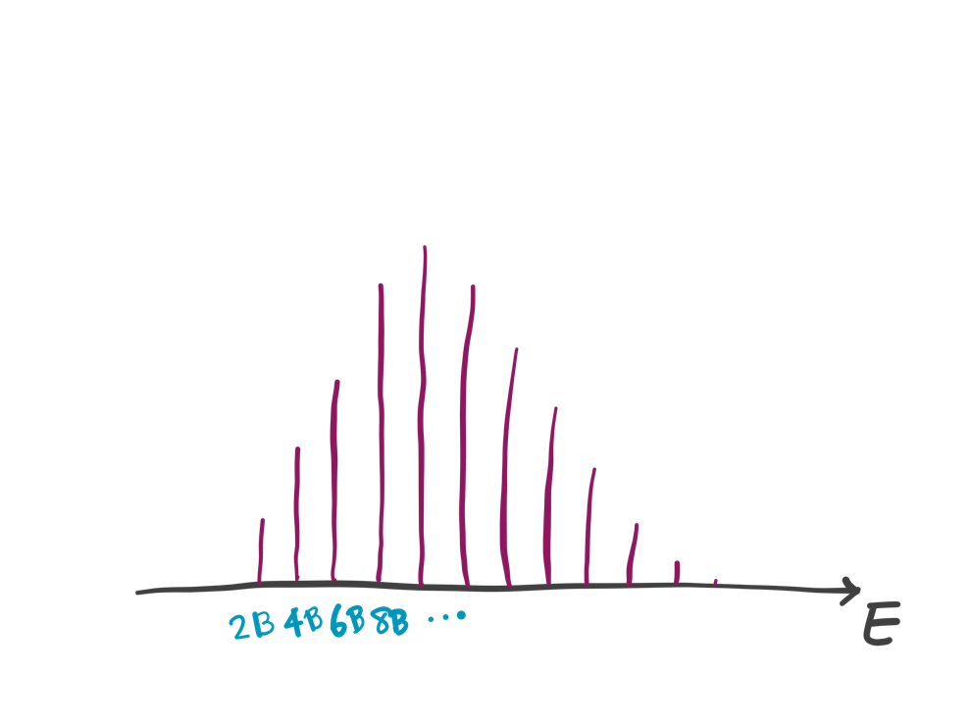
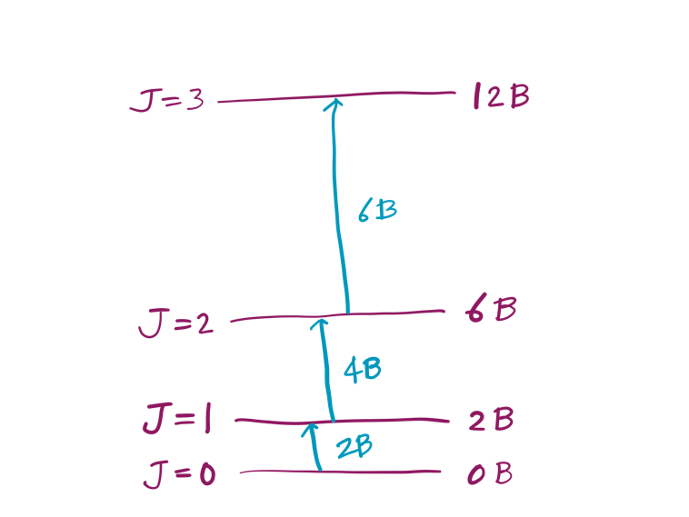
Spherical & linear rotors
In units of wave number (cm^{–1}):

Slide 10
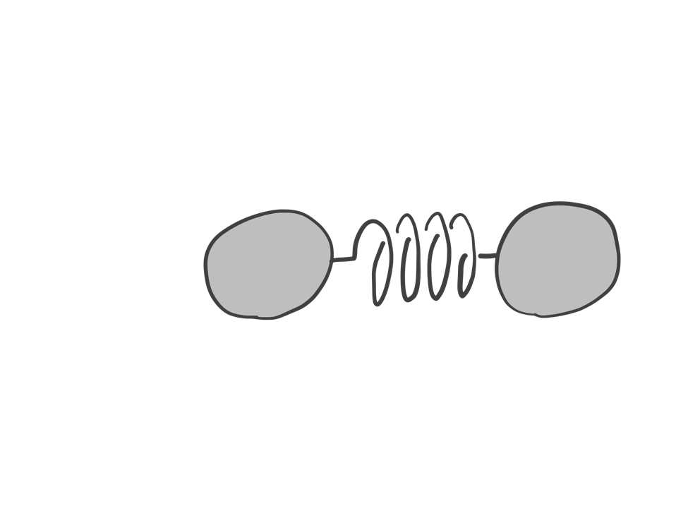
Nonrigid rotor:
Centrifugal distortion
Diatomic molecule

Slide 11
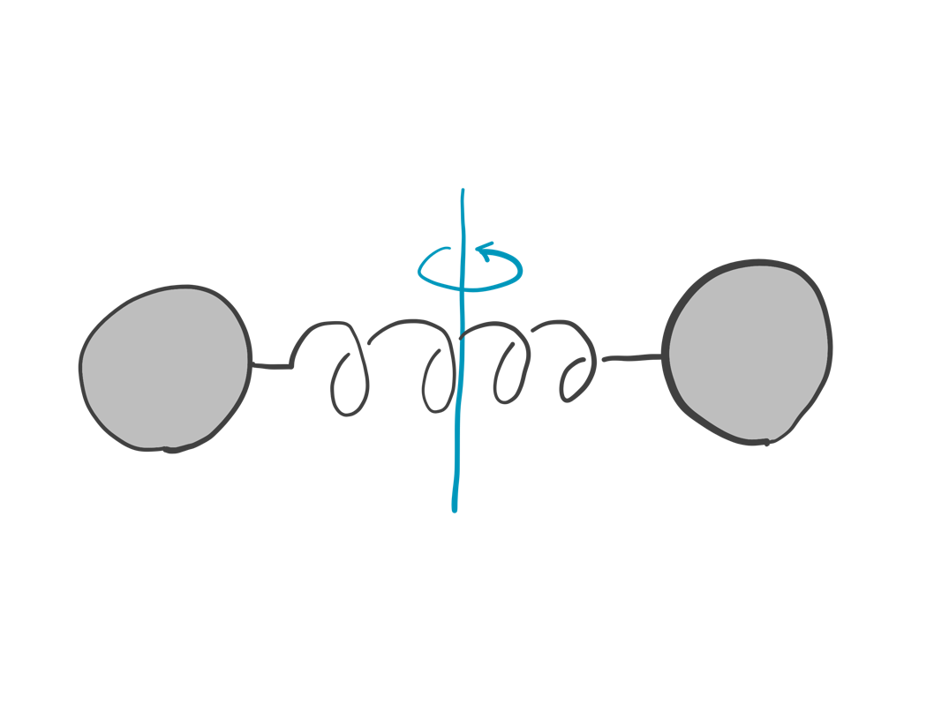
Nonrigid rotor:
Centrifugal distortion
Diatomic molecule
Vibrational
frequency

Slide 12
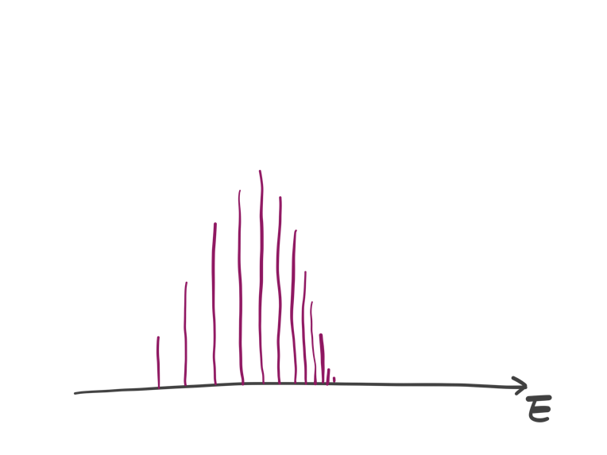
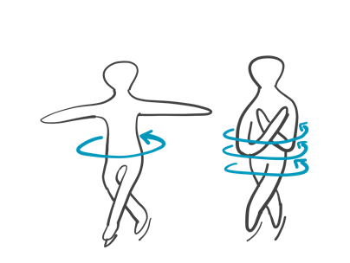
Nonrigid rotor:
Centrifugal distortion
Nonrigid
Rigid

Slide 13
Appearance of rotational spectra
Rapidly increasing and then decreasing intensities
Transition moment²
Degeneracy
Boltzmann distribution
(temperature effect)

Slide 14
Rotational Raman spectra
Gross selection rule:
polarizability changes by rotation
Specific selection rule:
x² + y² + z² ~ Y_{0,0}
xy, etc. are essentially Y_{0,0}, Y_{2,0}, Y_{2,±1}, Y_{2,±2}
Linear rotors: ΔJ = 0, ±2
Spherical rotors: inactive (rotation cannot change the polarizability)

Slide 15
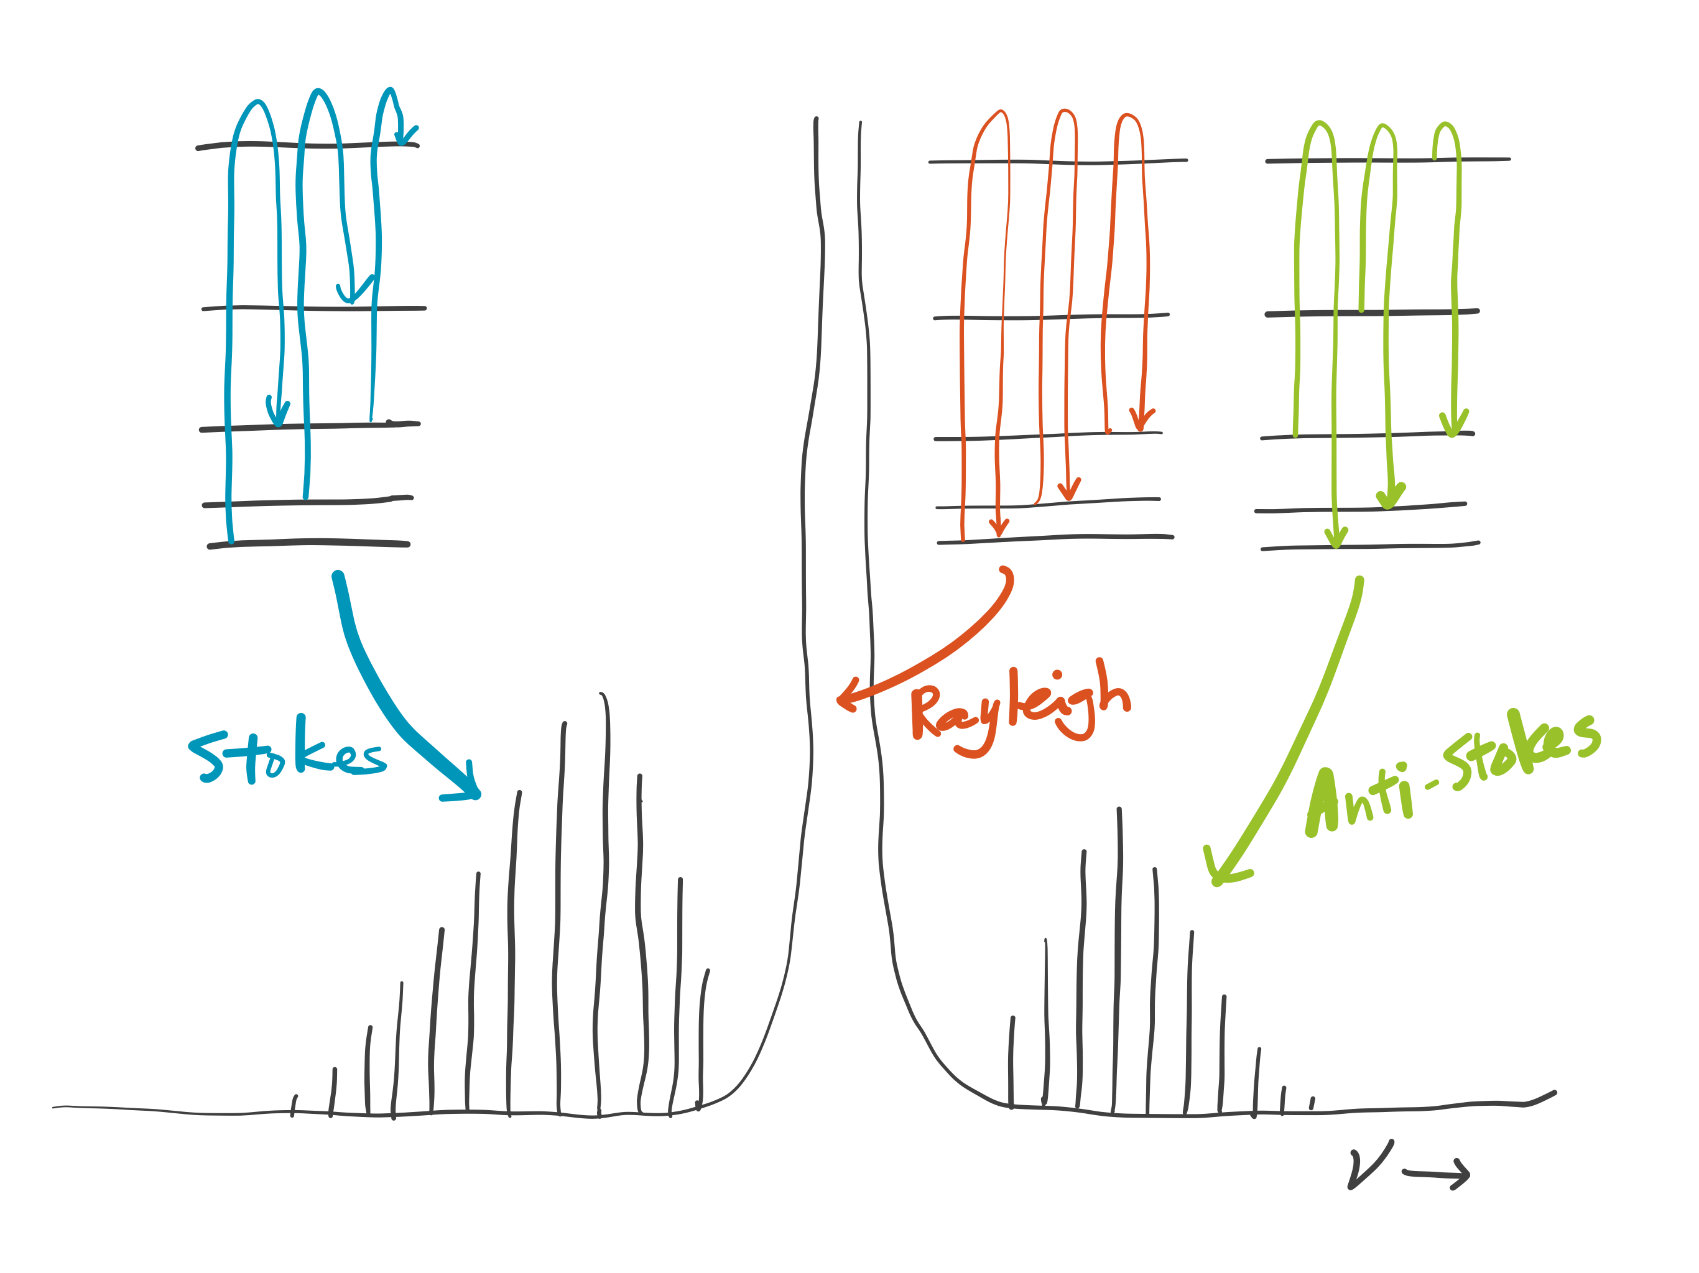
Rotational Raman spectra
Anti-Stokes wing slightly less intense than Stokes wing – why?
  Boltzmann distribution (temperature effect)

Slide 16
Rotational Raman spectra
Each wing’s envelope is explained by
  Degeneracy
  Boltzmann distribution (temperature effect)

Slide 17
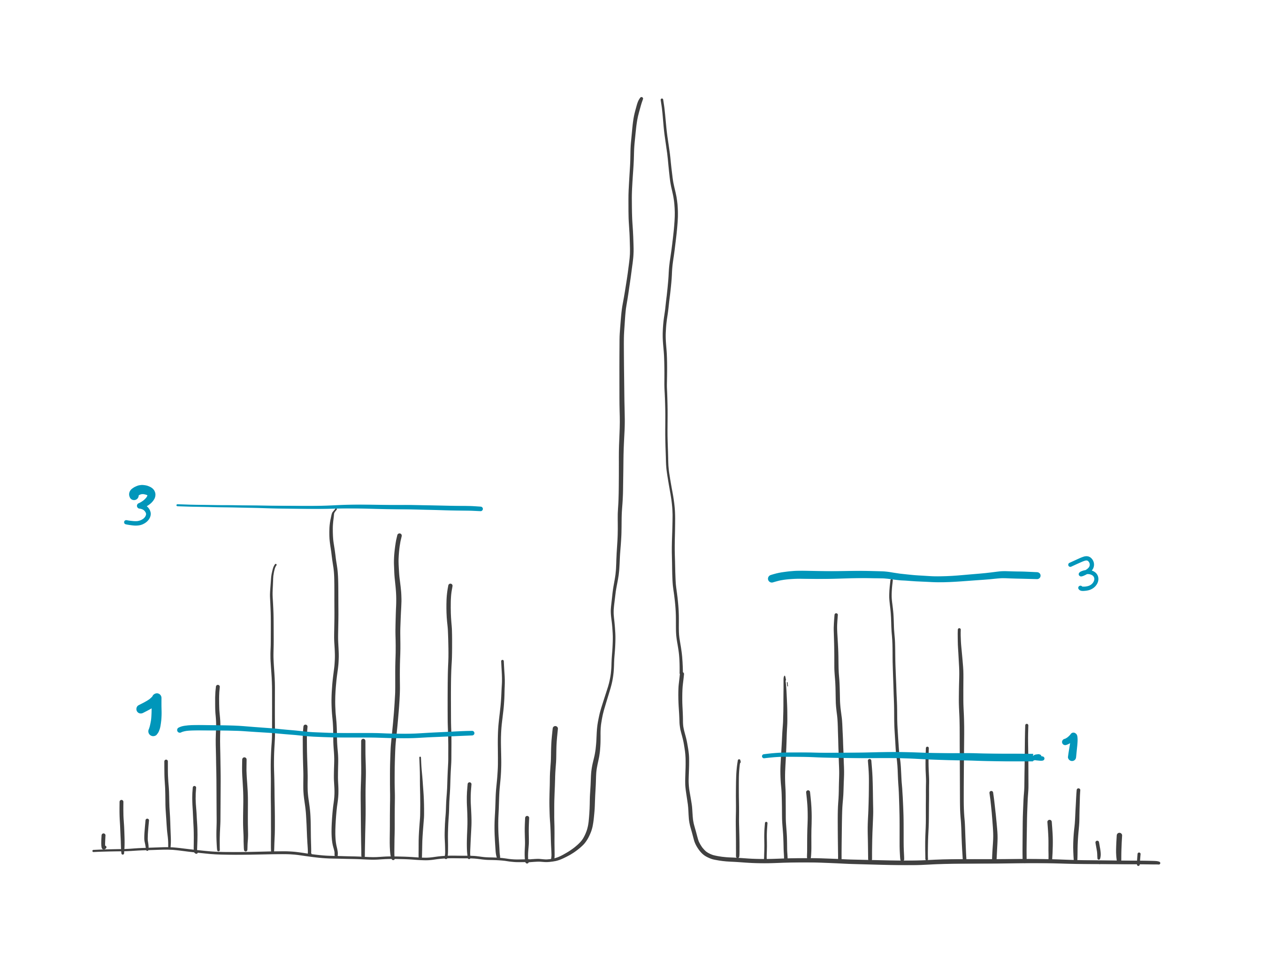
H₂ rotational Raman spectra
Why does the intensity alternate?

Slide 18
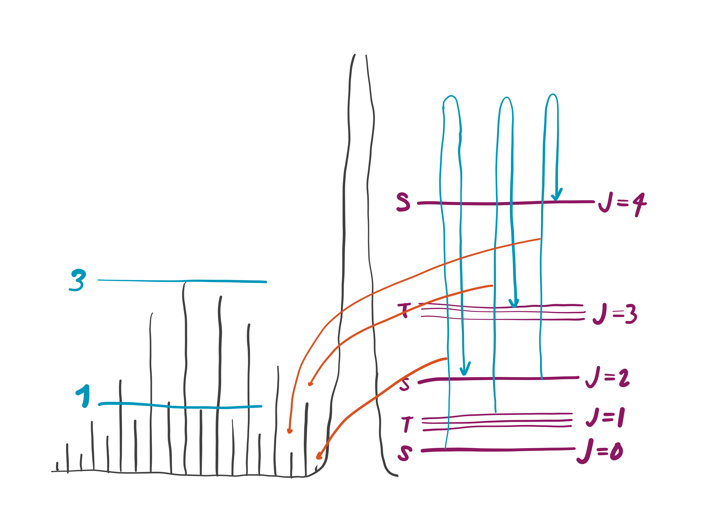
H₂ rotational Raman spectra
Why does the intensity alternate?
Answer: odd J levels are triply degenerate (triplets), whereas even J levels are singlets.

Slide 19
Nuclear spin statistics
Electrons play no role here; we are concerned with the rotational motion of nuclei.
The hydrogen’s nuclei (protons) are fermions and have α / β spins .
The rotational wave function (including nuclear spin part) must be antisymmetric with respect to interchange of the two nuclei.
The molecular rotation through 180° amounts to interchange.

Slide 20
Para and ortho H₂
Singlet (para-H₂)
Sym.
Antisym.
Nuclear (proton) spins
Triplet (ortho-H₂)
Sym.
Antisym.
With respect to interchange (180°molecular rotation)

Slide 21
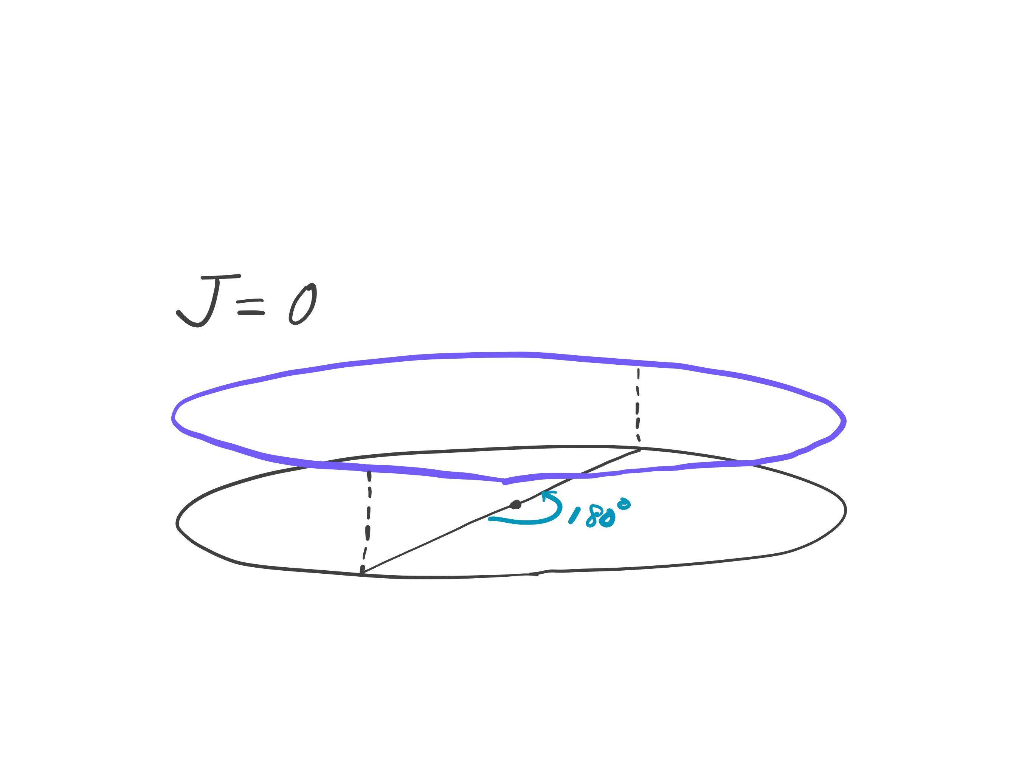
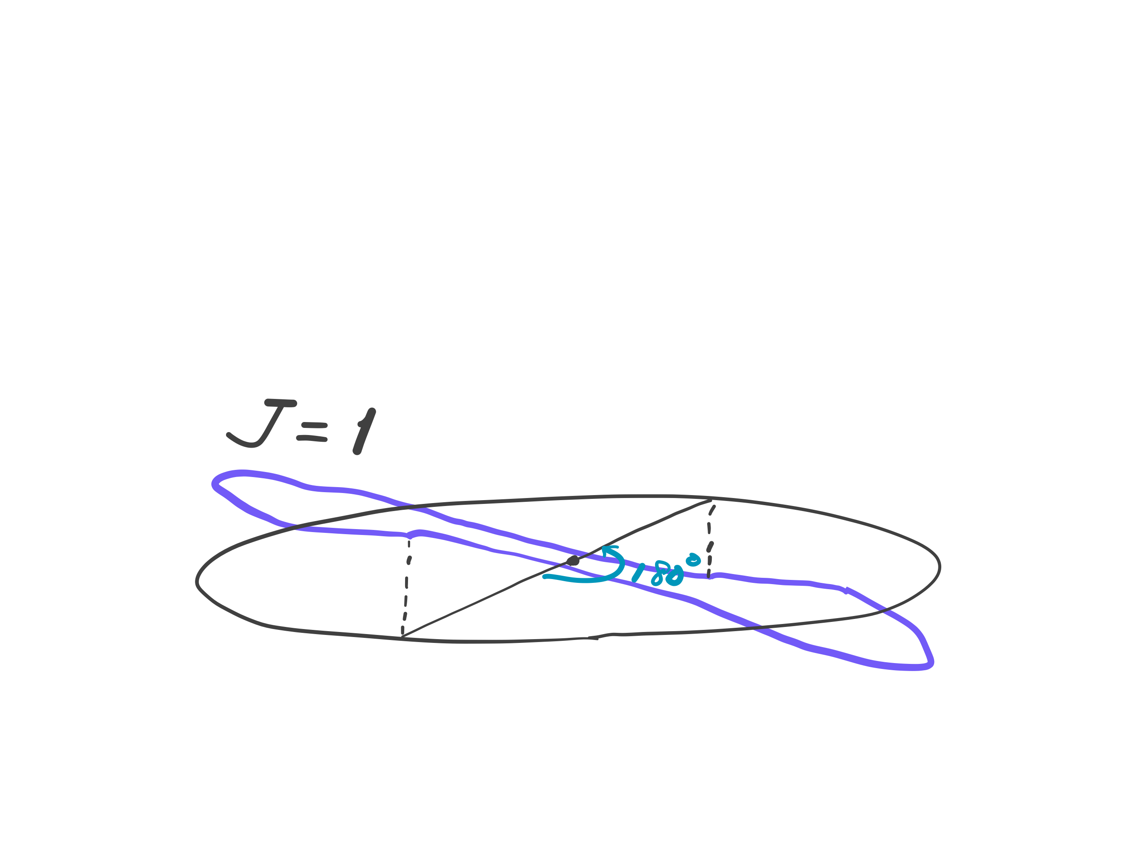
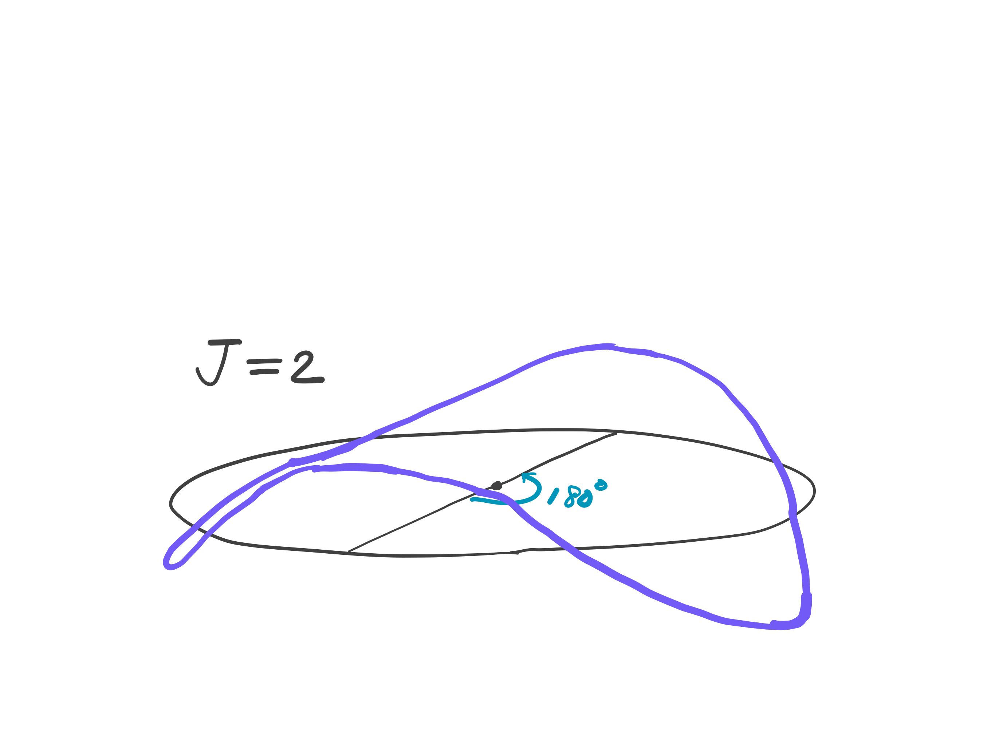
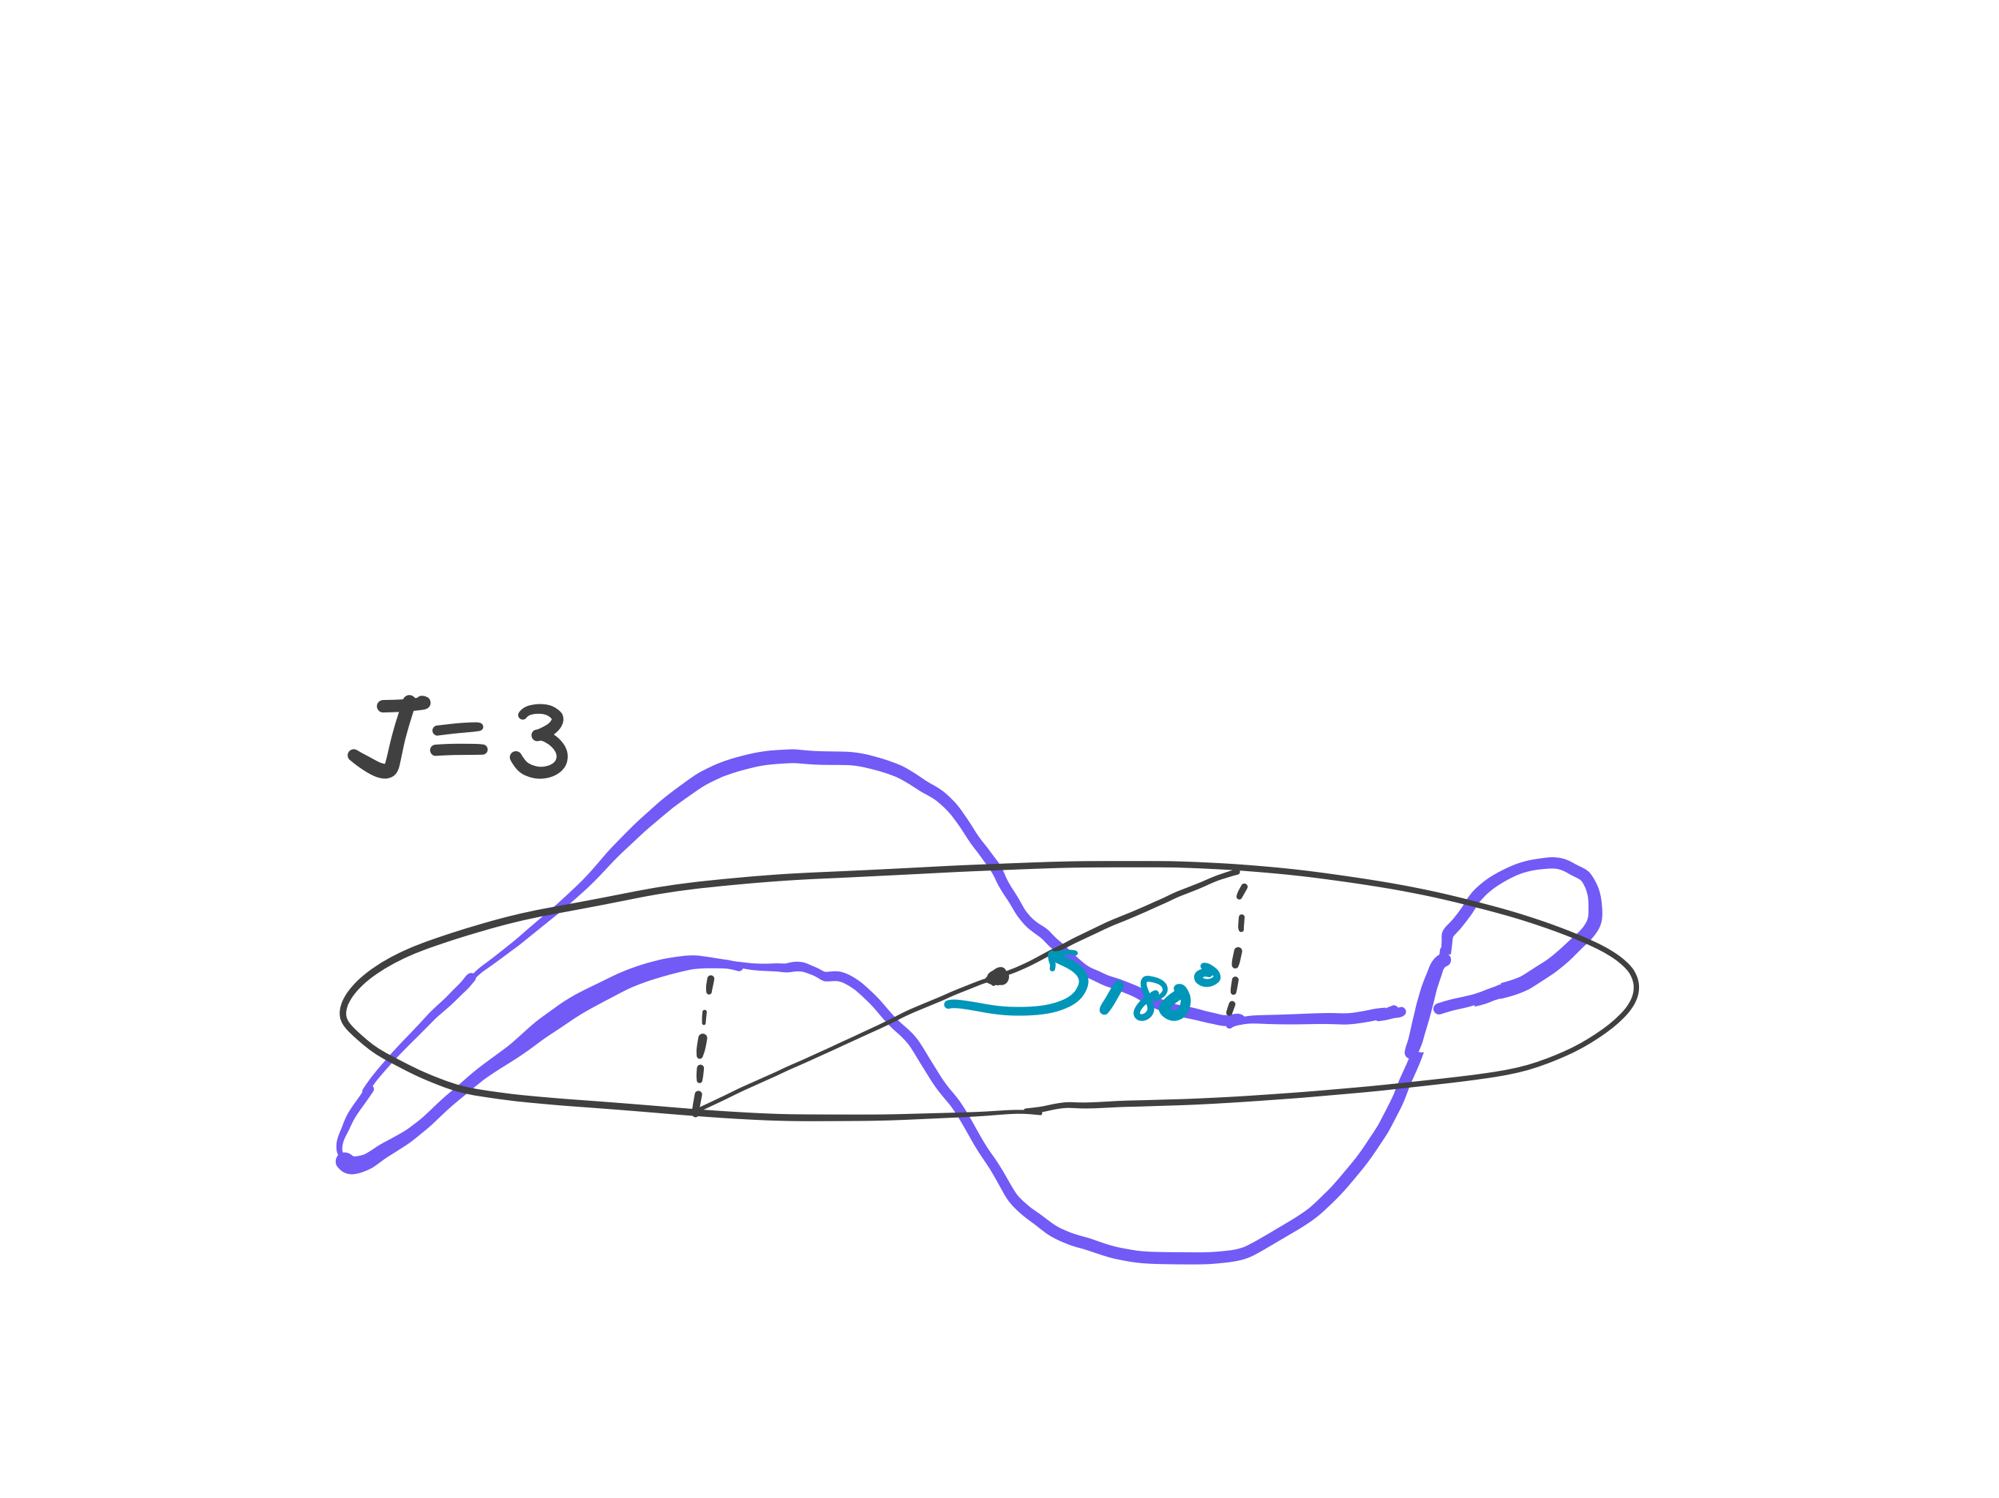
Spatial part of rotational wave function
By 180 degree rotation, the wave function changes sign as (–1)^{J} (cf. particle on a ring)

Slide 22
Para and ortho H₂
Sym.
Antisym.
Singlet (para-H₂)
Sym.
Antisym.
Triplet (ortho-H₂)

Slide 23
Summary
We have learned the gross and specific selection rules of rotational absorption and Raman spectroscopies.
We have explained the typical appearance of rotational spectra where the temperature effect and degeneracy of states are important.
We have learned that nonrigid rotors exhibit the centrifugal distortion effects.
We have seen the striking effect of the antisymmetry of proton wave functions in the appearance of H₂ rotational Raman spectra.

