Slide 1
Lecture 33 Rotational spectroscopy: energies

Slide 2
Rotational spectroscopy
In this lecture, we will consider the rotational energy levels.
In the next lecture, we will focus more on selection rules and intensities.

Slide 3
Diatomic molecule
4
A rigid linear rotor in 3D = the particle on a sphere
3
Energy
2
1
J = 0
Moment of inertia

Slide 4
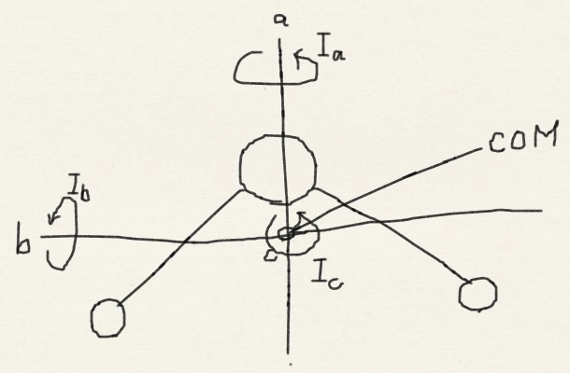
Moments of inertia
Principal axis of rotation
Principal moment of inertia

Slide 5
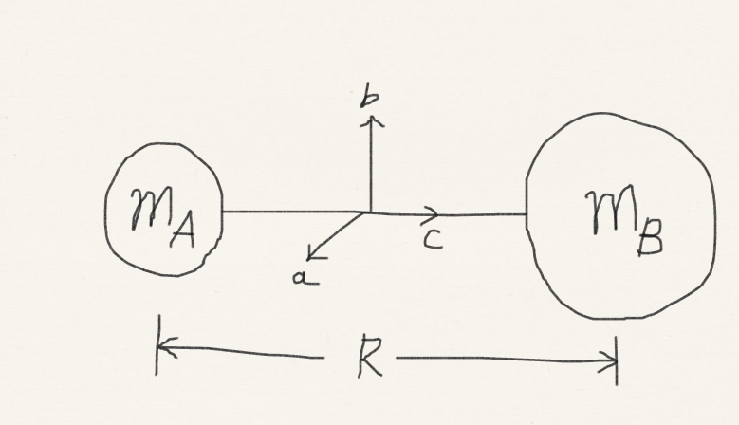
Linear rotors
Two equal nonzero moments of inertia (I_{a} and I_{b})
and the third (I_{c}) equal to zero

Slide 6
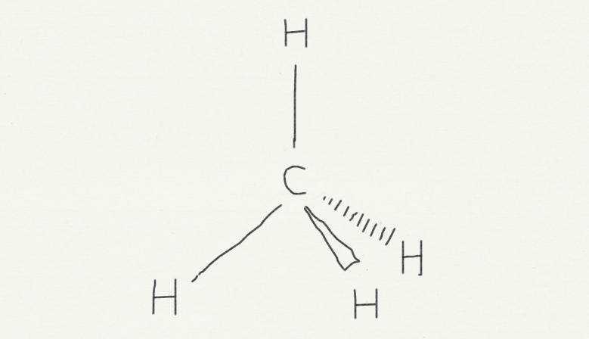
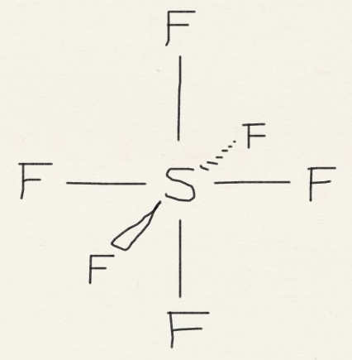
Spherical rotors
Three equal moments of inertia

Slide 7
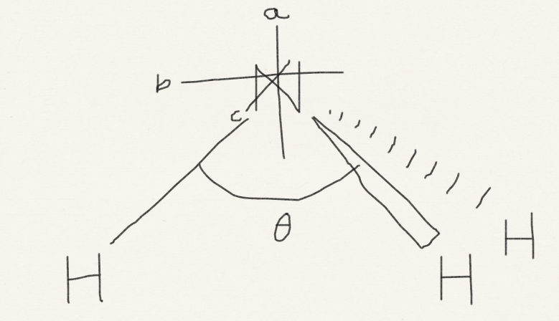
Symmetric rotors
Two equal moments of inertia

Slide 8
The rotational energy levels
(in cm^{–1}) = 1 / λ = v / c = hv / hc = E / hc
20B
8B
12B
Energy
6B
6B
4B
2B
2B
0B
The rotational constant B is given in cm^{–1}

Slide 9
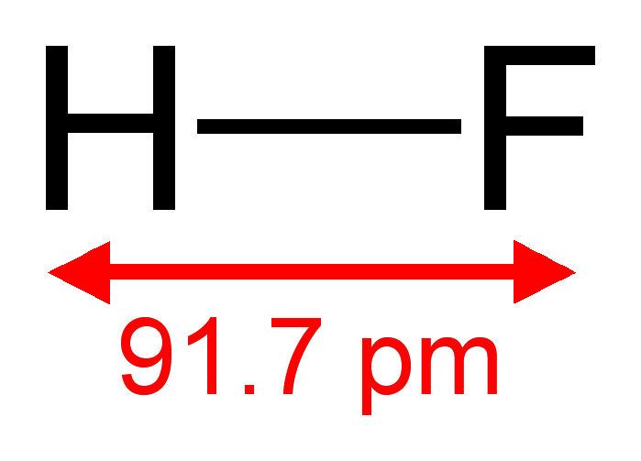
Quantum in nature
Microwave spectroscopy or computational quantum chemistry
How could chemists know HF bond length is 0.917Å?
Wikipedia

Slide 10
Spherical & linear rotors
In units of cm^{–1}:
20B
8B
12B
Energy
6B
6B
4B
2B
2B
0B

Slide 11
Symmetric rotors
Classically,
Quantum-mechanical rotational terms are

Slide 12
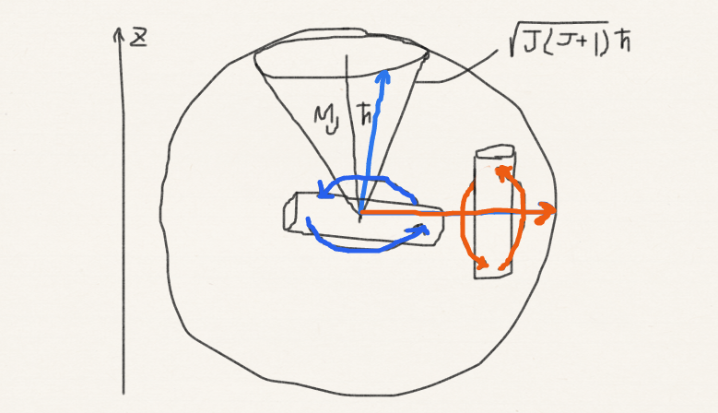
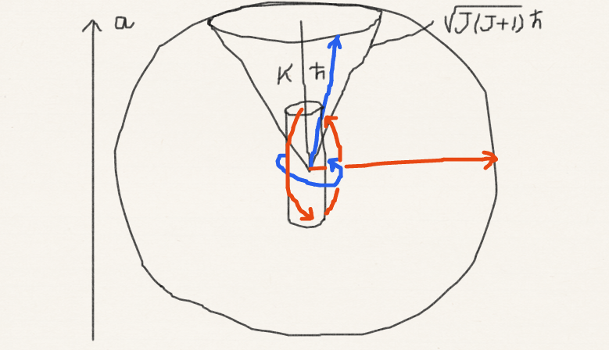
Symmetric rotors
K acts just like M_{J}. The only distinction is that K refers to rotation around the principal axis, whereas M_{J} to externally fixed axis

Slide 13
Degeneracy
Linear rotors
(2J+1)-fold degeneracy (M_{J} = 0,±1,…, ±J)
Symmetric rotors
(2J+1)-fold degeneracy (M_{J} = 0,±1,…, ±J)
another 2-fold degeneracy (K = ±1,…, ±J) [(A – B) ≠ 0 and K and –K give the same energy]
Spherical rotors
(2J+1)-fold degeneracy (M_{J} = 0,±1,…, ±J)
another (2J+1)-fold degeneracy (K = 0,±1,…, ±J) [(A – B) = 0 and energy does not depend on K]
K for shape, M_{J} for orientation.

Slide 14
Zeeman effect
M_{J} -degeneracy can be lifted by applying a static magnetic field.
field
on
M_{J}
−3
−2
field
off
−1
0
First-order
perturbation theory
+1
+2
+3

Slide 15
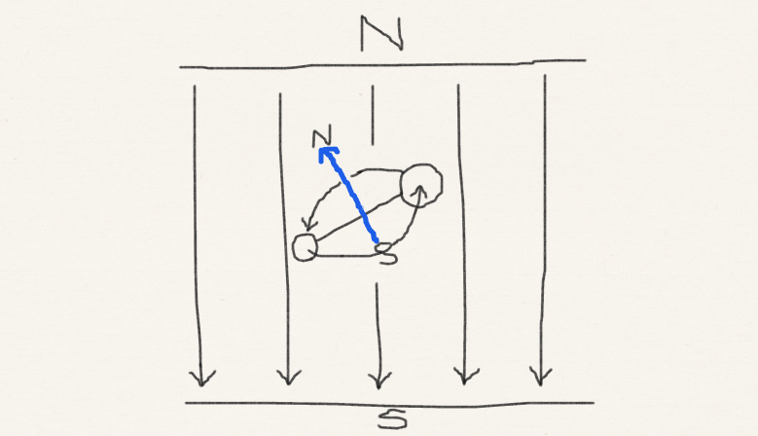
Zeeman effect
field
on
M_{J}
−3
−2
field
off
−1
0
+1
+2
+3

Slide 16
Stark effect
field
on
M_{J}
M_{J} -degeneracy can also be lifted by applying a static electric field.
0
±1
field
off
±2
Second-order
perturbation theory
±3
±4

Slide 17
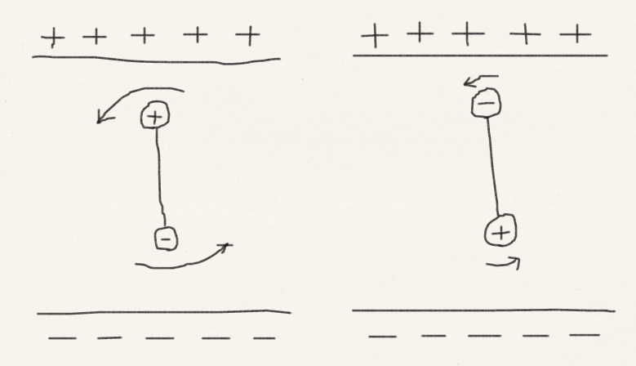
Stark effect
field
on
M_{J}
0
±1
field
off
±2
±3
±4

Slide 18
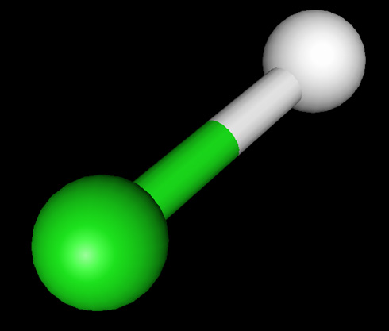
Linear rotors
Zeeman
effect
1ST order
PT
Stark effect
2J+1 degenerate
2ND order PT
No rotation
around the axis
No degeneracy

Slide 19
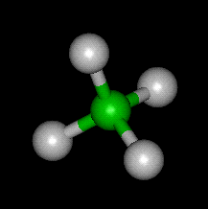
Spherical rotors
Zeeman
effect
1ST order
PT
Stark effect
2J+1 degenerate
2ND order PT
2J+1 degenerate

Slide 20
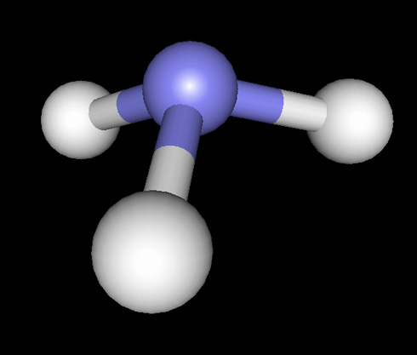
Symmetric rotors
Zeeman
effect
1ST order
PT
Stark effect
2J+1 degenerate
2ND order PT
Doubly degenerate

Slide 21
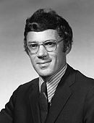
Willis Flygare From UIUC Department of Chemistry website
“Willis Flygare earned his bachelor's degree from St. Olaf College in 1958 and his doctorate from the University of California at Berkeley in 1961. He was a professor of chemistry at Illinois from 1961 until his death. During that period he developed a new experimental method involving the molecular Zeeman effect, and with it, he measured most of the known molecular quadrupole moments and magnetic susceptibility anisotropies. He developed a highly sensitive microwave spectrometer by combining molecular beams with Fourier transform techniques.”

Slide 22
Summary
We have learned about the rotational energy levels of molecules in the rigid-rotor approximation.
We have classified rigid rotors into linear rotors, spherical rotors, symmetric rotors, and the rest.
We have discussed the energy levels and their degeneracy of these rotors.
We have learned about the Zeeman and Stark effects.

