Slide 1
Lecture 32 General issues of spectroscopies. II

Slide 2
General issues of spectroscopies
We will learn two types of spectroscopies: absorption/emission spectroscopy and scattering spectroscopy.
We will learn their relationship to dipole moment and polarizability as well as perturbation theories.

Slide 3
Absorption/emission versus scattering spectroscopy
Absorption/emission spectroscopy: microwave, IR, and UV/vis absorption as well as fluorescence
Scattering spectroscopy: Raman
IR
Raman

Slide 4
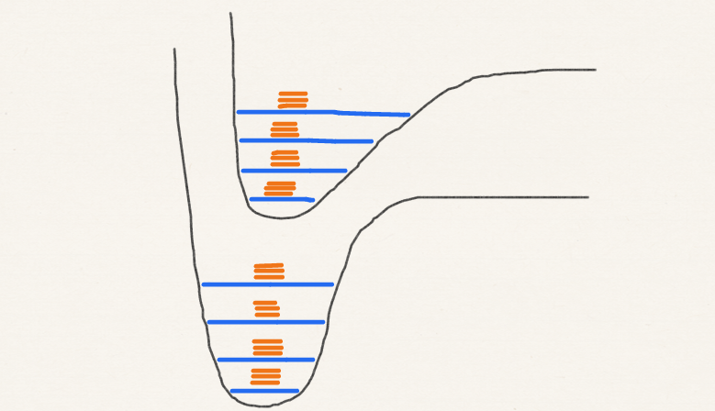
Absorption spectroscopy
One-photon process
1st order perturbation theory

Slide 5
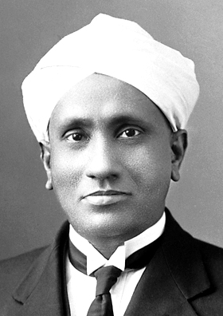
Scattering (Raman) spectroscopy
C. V. Raman
Two-photon process
2nd order perturbation theory
Public domain image from Wikipedia

Slide 6
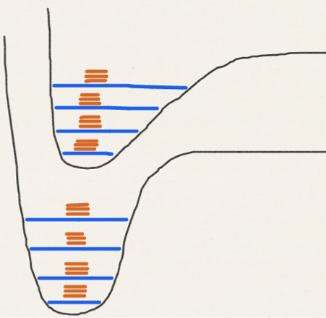
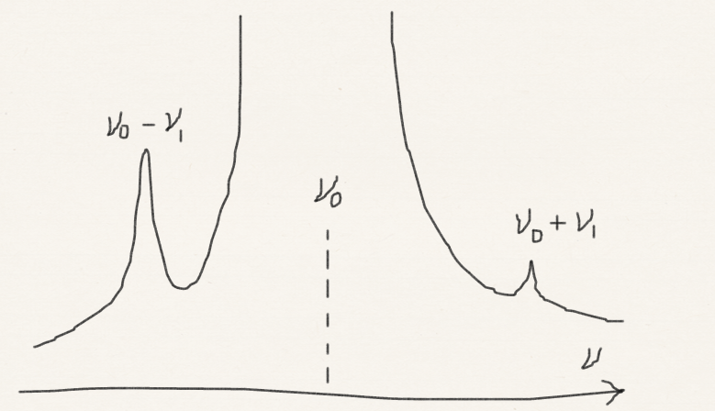
Scattering (Raman) spectroscopy
Stokes
Raman
Anti-Stokes
Raman
(a hot band)
Rayleigh

Slide 7
Quantum in nature
Rayleigh scattering
Why is sky blue?

Slide 8
Scattering (Raman) spectroscopy
Raman
Resonant
Rayleigh
Resonant
Raman

Slide 9
Dipole moment and polarizability
Absorption spectroscopies (such as IR spectroscopy) are related to the dipole moment and its changes.
Scattering spectroscopies (such as Raman spectroscopy) are related to the polarizability and its changes.
Polarizability – softness of wave function (cf. HSAB theory); the larger the polarizability, the more easily the wave function is distorted by external electric field to create a large induced dipole.

Slide 10
Dipole moment
+ + + + + + + + + + + +
Electric field
Perturbation
E₀
E₀ + µE
– – – – – – – – –
Think of molecular length!
First-order perturbation theory

Slide 11
Polarizability
+ + + + + + + + + + + +
E₀ + µE + αE²
=E₀ + (µ+ αE)E
E₀
– – – – – – – – –
Induced dipole
Think of molecular volume!
Second-order perturbation theory

Slide 12
Polarizability
+ + + + + + + + + + + +
– – – – – – – – –

Slide 13
Absorption/emission versus Raman spectroscopies
Absorption/emission occurs when molecular vibration, rotation, etc. alter dipole moment. Allowed transitions transform as x, y, z.
Raman occurs when molecular vibration, rotation, etc. alter polarizability. Allowed transitions transform as xx, yy, zz, xy, yz, zx.

Slide 14
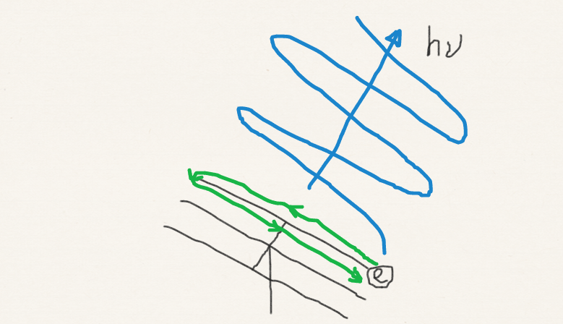
Classical (Smekal) theory of Rayleigh and Raman scattering
An oscillating electric field (incident photon) causes the molecule to have an induced dipole:
Polarizability varies with molecular vibration; so does induced dipole:

Slide 15
Summary
We have the general theories of absorption/emission spectroscopy and scattering (Raman) spectroscopy.
We have learned the relationship between absorption/emission spectroscopies to dipole moment and between scattering (Raman) spectroscopy and polarizability.
They are described by first- and second-order time-dependent perturbation theories.

