Slide 1
Lecture 31 General issues of spectroscopies. I

Slide 2
General issues of spectroscopies
In this lecture, we have an overview of spectroscopies:
Photon energies and dynamical degrees of freedom and spectroscopies
Three elements of spectroscopy
Three modes of optical transitions
Lasers
Spectral line widths

Slide 3
Important physical quantities
λ (wave length) (typically in nm)
v (frequency) (typically in Hz = s^{–1}) = c / λ
(wave number) (in cm^{–1}) = 1 / λ = v / c
Visible light : 400 – 700 nm
1 eV = 8065 cm^{–1}
298 K = 207 cm^{–1}
10000000 / 400 nm = 25000 cm^{–1} = 3.1 eV

Slide 4
Photon energies and spectroscopies
Radio-wave | Micro-wave | IR | Visible | UV | X-ray | γ-ray
>30 cm | 30 cm – 3 mm | 33–13000 cm^{–1} | 700–400 nm | 3.1–124 eV | 100 eV –100 keV | >100 keV
Nuclear spin | Rotation | Vibration | Electronic | Electronic | Core electronic | Nuclear

Slide 5
Electronic, vibration, and rotation
all
3n+3N
electronic
3n
nuclear
3N
translational
3
relative
3N−3
rotational
3 or 2
vibrational
3N−6 or 3N−5
Born-Oppenheimer approximation
Exact separation
Rigid rotor approximation

Slide 6
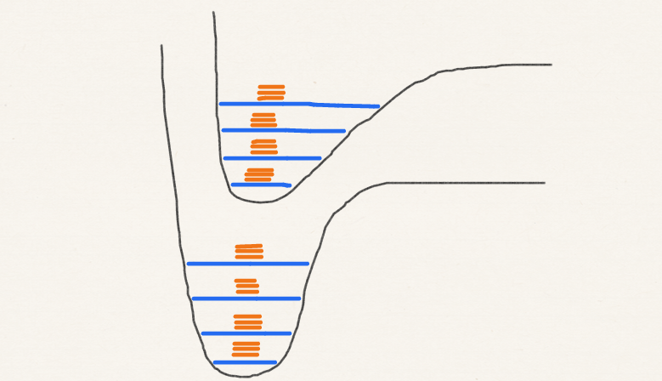
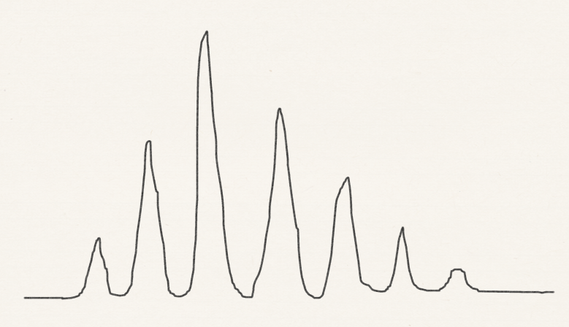
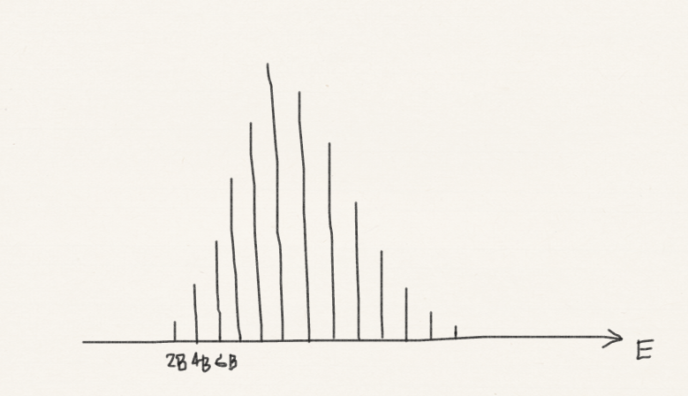
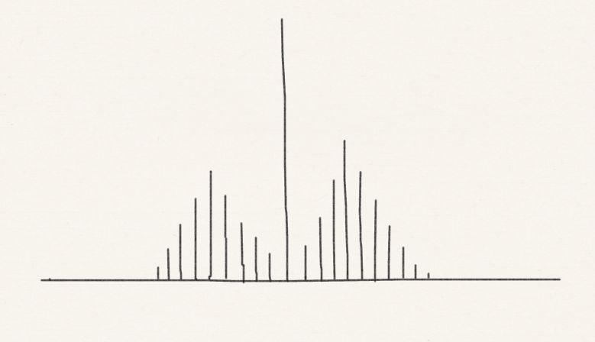
Electronic, vibration, and rotation
Vibrational spectroscopy
IR/Raman spectroscopies
Electronic spectroscopy
UV/vis spectroscopy
Rotational spectroscopy
Microwave spectroscopy
kT

Slide 7
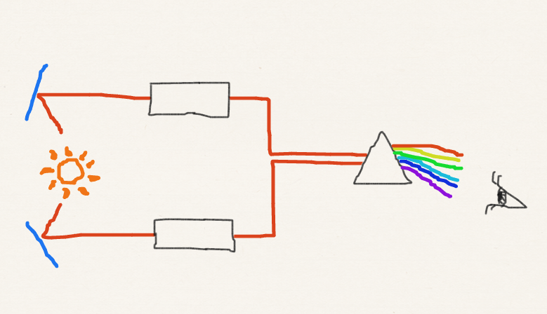
Three elements of spectroscopy
2. Dispersing element
Sample
1. Source
Reference
3. Detector

Slide 8
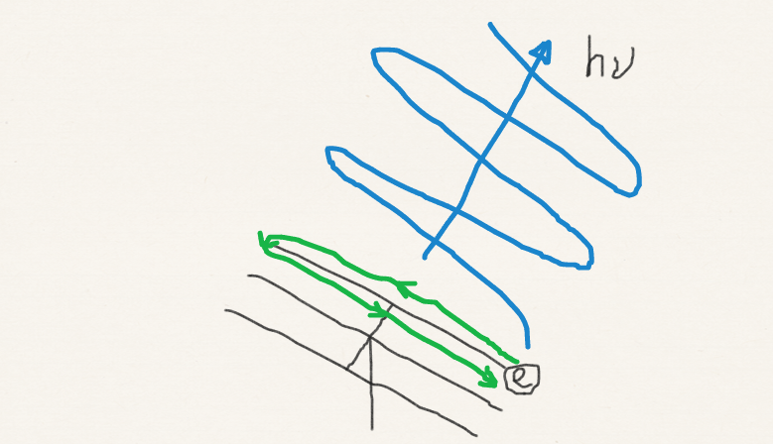
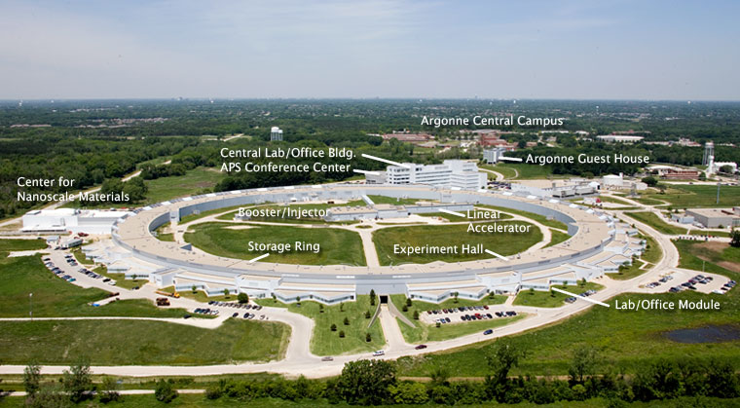
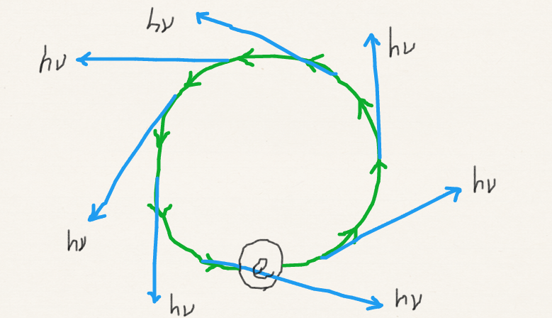
Sources of radiation
The sun and stars
Various conventional lamps
Newer radiation sources:
Lasers
Synchrotron radiation
Advanced Light Source at Argonne National Laboratory
Public domain image created by U.S. Department of Energy

Slide 9
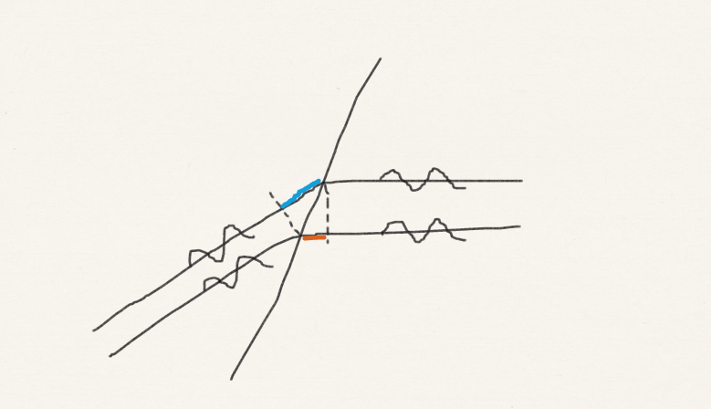
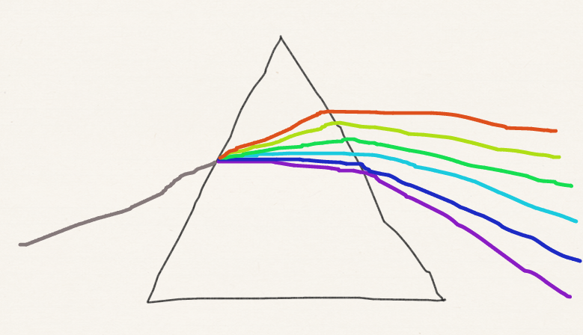
The dispersing elements: prism
air
glass

Slide 10
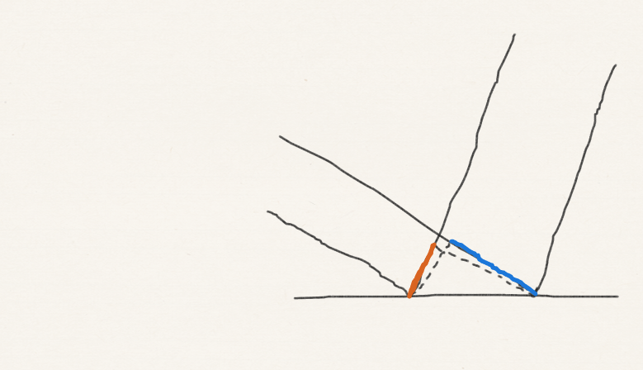
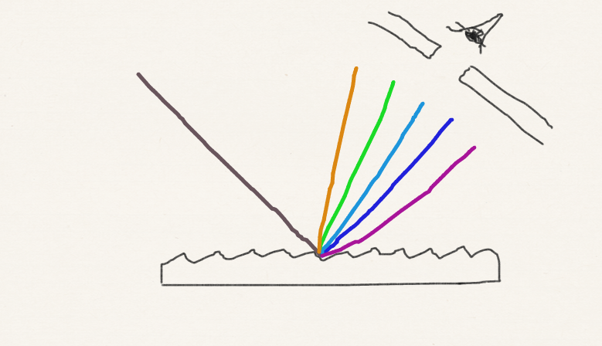
The dispersing elements: diffraction grating

Slide 11
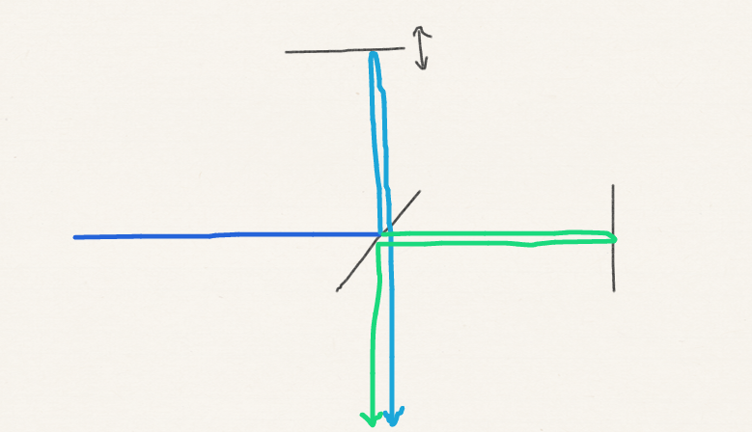
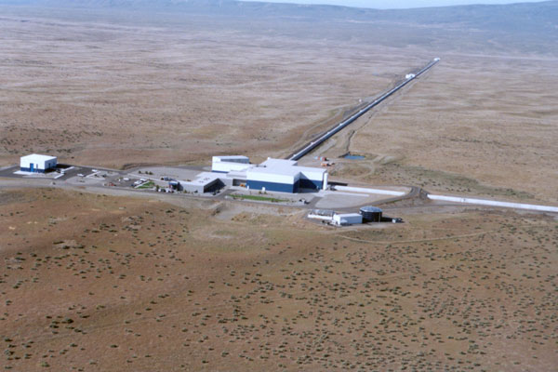
The dispersing elements: Fourier transform technique
Movable mirror
Half mirror
Mirror
Laser Interferometer Gravitational Observatory (LIGO) at Hanford, WA
Copyrighted image in courtesy of LIGO Laboratory

Slide 12
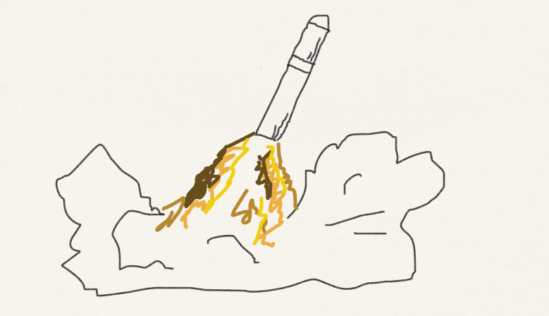
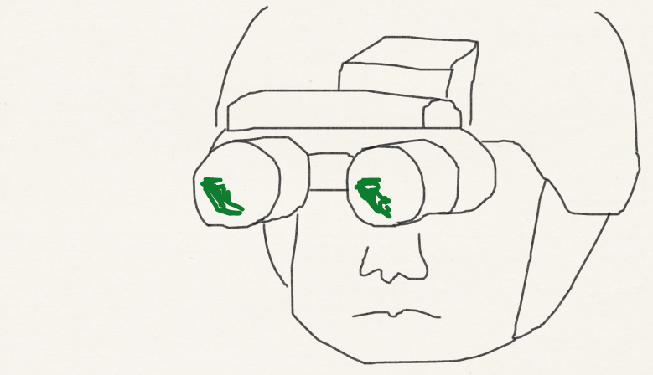
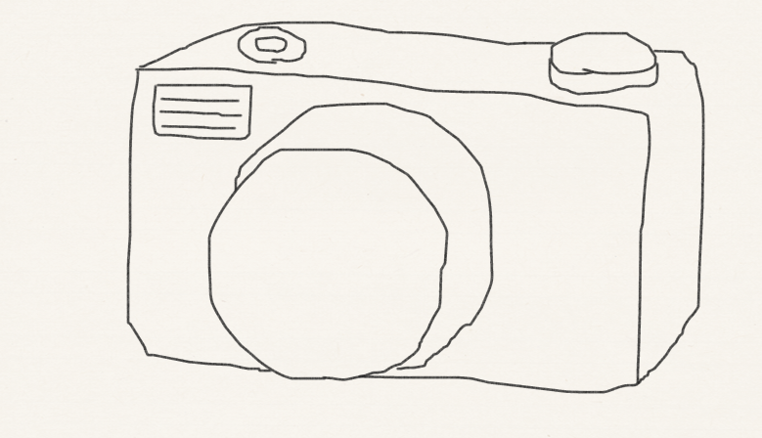
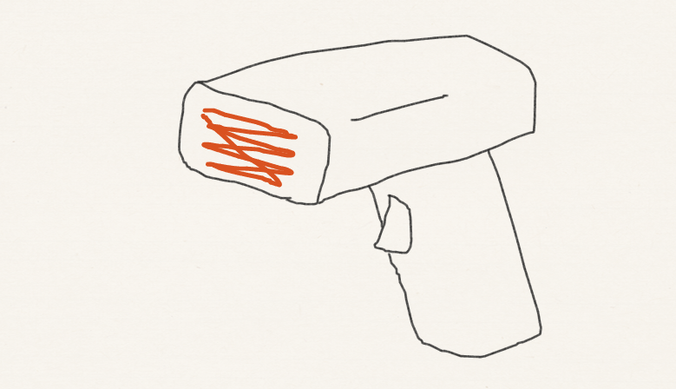
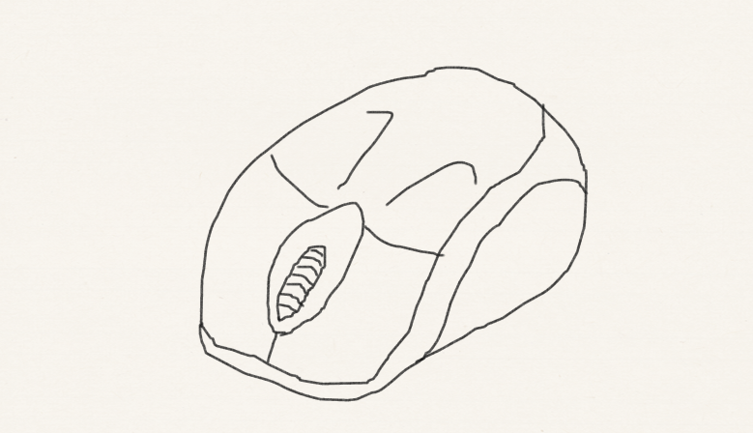
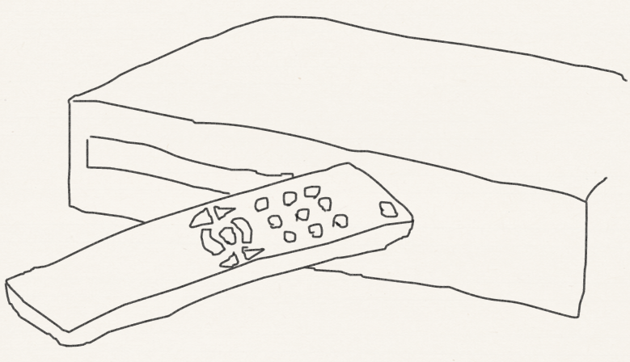
Detectors
Night vision goggle
Heat sensing missile
Digital camera
Pyroelectric
Pyroelectric
CCD
Barcode reader
Optical mouse
Remote control
CCD
Photodiode
Photodiode

Slide 13
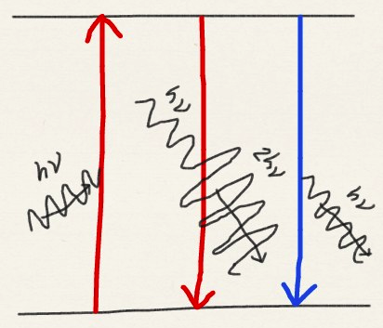
Einstein’s theory of three modes of optical transitions
Stimulated
emission
Spontaneous
emission
Absorption always needs the help of photon – stimulated absorption.
Emission occurs in two ways – stimulated or spontaneous emission.
Stimulated
absorption

Slide 14
Three modes of optical transitions
B'
Spontaneous
emission
Stimulated
emission
A
N'
ρ
ρ
N
B
Stimulated
absorption

Slide 15
Three modes of optical transitions
Equilibrium: no net excitation or deexcitation
Blackbody radiation

Slide 16
Three modes of optical transitions
B'
Spontaneous
emission
Stimulated
emission
A
N'
Einstein A coeff
ρ
Einstein B coeff
Same effects on both states. If it were not for A, N = N'
ρ
The greater the frequency, the the greater the rate of the spontaneous emission, causing Boltzmann distribution
N
B
Stimulated
absorption

Slide 17
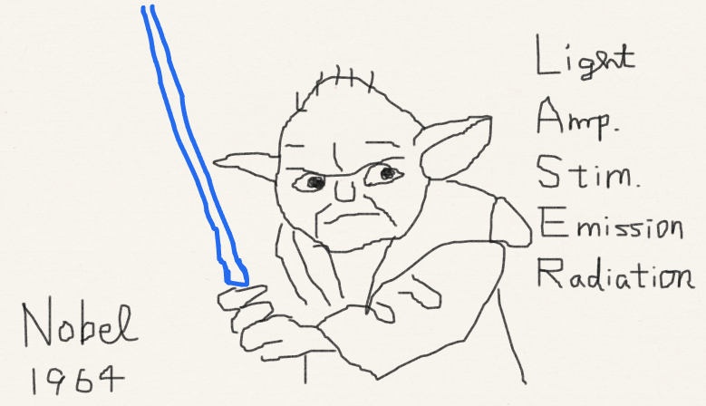
Lasers
High power
Monochromatic and polarized
Coherent
Low divergence and long path lengths

Slide 18
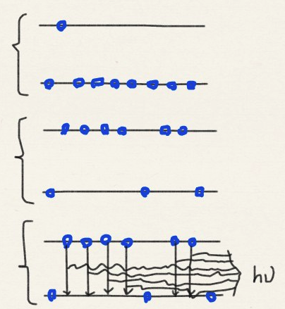
Population inversion
Thermal equilibrium
Pumping
Laser action

Slide 19
Applications of laser
High power
Nonlinear/multiphoton spectroscopy (including Raman)
High sensitivity
Monochromatic
State-to-state reaction dynamics; Laser isotope separation
High resolution

Slide 20
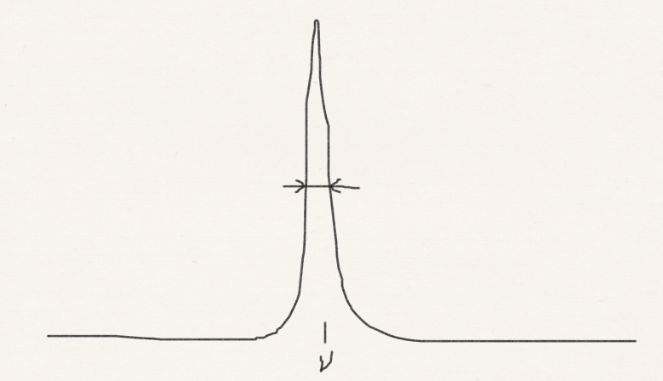
Line widths: lifetime broadening
Collisional deactivation
Natural line width

Slide 21
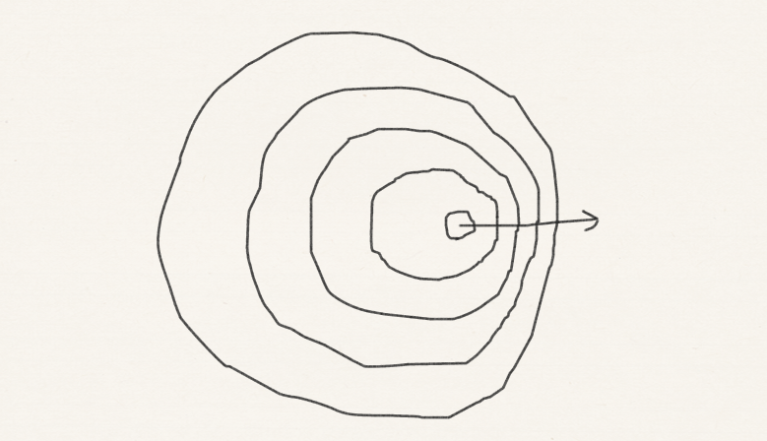
Line widths: Doppler broadening

Slide 22
Summary
We have discussed photon energies, molecular dynamical degrees of freedom, and spectroscopies.
We have surveyed three elements (light source, dispersing element, and detector) of spectroscopy.
We have characterized three modes of optical transitions (stimulated absorption and emission as well as spontaneous emission).
We have learned the origins of line widths.

