Slide 1
Lecture 30 Point-group symmetry III

Slide 2
Non-Abelian groups and chemical applications of symmetry
In this lecture, we learn non-Abelian point groups and the decomposition of a product of irreps.
We also apply the symmetry theory to chemistry problems.

Slide 3
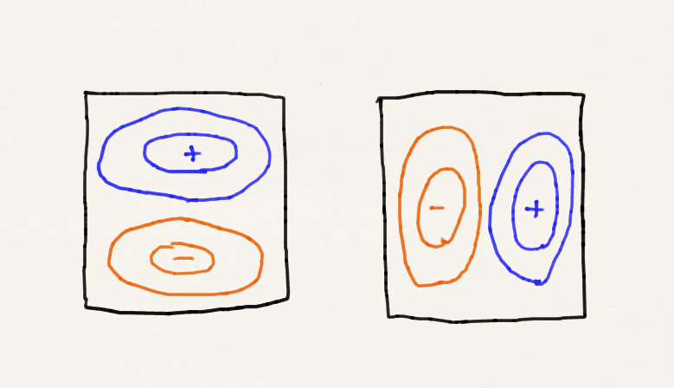
Degeneracy
The particle in a square well (D_{4h}) has doubly degenerate wave functions.

Slide 4
The D_{4h} character table (h = 16)
D_{4h} | E | 2C₄ | C₂ | 2C₂’ | 2C₂” | i | 2S₄ | σ_{h} | 2σ_{v} | 2σ_{d}
A_{1g} | 1 | 1 | 1 | 1 | 1 | 1 | 1 | 1 | 1 | 1
A_{2g} | 1 | 1 | 1 | −1 | −1 | 1 | 1 | 1 | −1 | −1
B_{1g} | 1 | −1 | 1 | 1 | −1 | 1 | −1 | 1 | 1 | −1
B_{2g} | 1 | −1 | 1 | −1 | 1 | 1 | −1 | 1 | −1 | 1
E_{g} | 2 | 0 | −2 | 0 | 0 | 2 | 0 | −2 | 0 | 0
A_{1u} | 1 | 1 | 1 | 1 | 1 | −1 | −1 | −1 | −1 | −1
A_{2u} | 1 | 1 | 1 | −1 | −1 | −1 | −1 | −1 | 1 | 1
B_{1u} | 1 | −1 | 1 | 1 | −1 | −1 | 1 | −1 | −1 | 1
B_{2u} | 1 | −1 | 1 | −1 | 1 | −1 | 1 | −1 | 1 | −1
E_{u} | 2 | 0 | −2 | 0 | 0 | −2 | 0 | 2 | 0 | 0

Slide 5
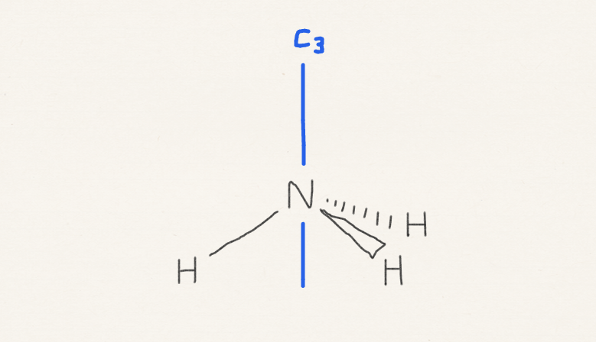
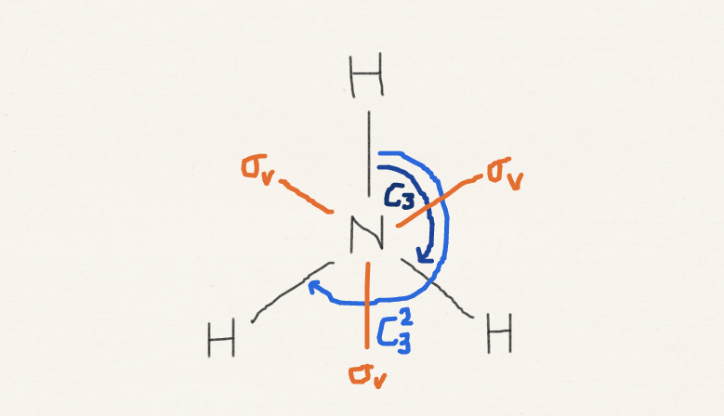
C_{3v}: another non-Abelian group
C_{3v}, 3m | E | 2C₃ | 3σ_{v} | h = 6
A₁ | 1 | 1 | 1 | z, z², x²+y²
A₂ | 1 | 1 | −1
E | 2 | −1 | 0 | (x, y), (xy, x²−y²), (zx, yz)

Slide 6
C_{3v}: expanded character table
C_{3v}, 3m | E | 2C₃ | 3σ_{v} | h = 6
A₁ | 1 | 1 | 1 | z, z², x²+y²
A₂ | 1 | 1 | −1
E | 2 | −1 | 0 | (x, y), (xy, x²−y²), (zx, yz)
C_{3v}, 3m | E | C₃ | C₃² | σ_{v} | σ_{v} | σ_{v} | h = 6
A₁ | 1 | 1 | 1 | 1 | 1 | 1 | z, z², x²+y²
A₂ | 1 | 1 | 1 | −1 | −1 | −1
E | 2 | −1 | −1 | 0 | 0 | 0 | (x, y), (xy, x²−y²), (zx, yz)

Slide 7
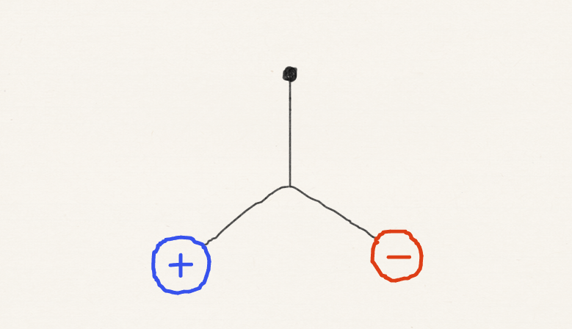
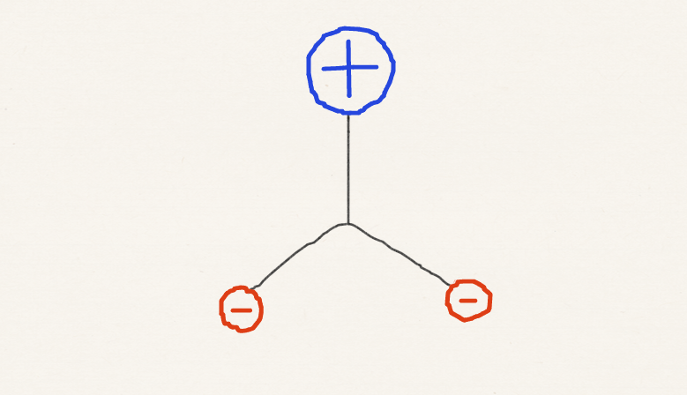
Integral of degenerate orbitals
C_{3v}, 3m | E | C₃ | C₃² | σ_{v} | σ_{v} | σ_{v} | h = 6
A₁ | 1 | 1 | 1 | 1 | 1 | 1 | z, z², x²+y²
A₂ | 1 | 1 | 1 | −1 | −1 | −1
E | 2 | −1 | −1 | 0 | 0 | 0 | (x, y), (xy, x²−y²), (zx, yz)

Slide 8
What is E ✕ E ?
C_{3v}, 3m | E | C₃ | C₃² | σ_{v} | σ_{v} | σ_{v} | h = 6
A₁ | 1 | 1 | 1 | 1 | 1 | 1 | z, z², x²+y²
A₂ | 1 | 1 | 1 | −1 | −1 | −1
E | 2 | −1 | −1 | 0 | 0 | 0 | (x, y), (xy, x²−y²), (zx, yz)
E ✕ E | 4 | 1 | 1 | 0 | 0 | 0
What is the irrep for this set of characters?
It is not a single irrep.
It is a linear combination of irreps

Slide 9
Superposition principle (review)
Eigenfunctions of a Hermitian operator are complete.
Eigenfunctions of a Hermitian operator are orthogonal.

Slide 10
Decomposition
An irrep is a simultaneous eigenfunction of all symmetry operations.

Slide 11
Orthonormal character vectors
The character vector of A₁ is normalized.
The character vector of E is normalized.
The character vectors of A₁ and E are orthogonal.
C_{3v}, 3m | E | C₃ | C₃² | σ_{v} | σ_{v} | σ_{v} | h = 6
A₁ | 1 | 1 | 1 | 1 | 1 | 1 | z, z², x²+y²
A₂ | 1 | 1 | 1 | −1 | −1 | −1
E | 2 | −1 | −1 | 0 | 0 | 0 | (x, y), (xy, x²−y²), (zx, yz)

Slide 12
Decomposition
The contribution (c_{A1}) of A₁:
The contribution (c_{A2}) of A₂:
The contribution (c_{E}) of E:
C_{3v}, 3m | E | C₃ | C₃² | σ_{v} | σ_{v} | σ_{v} | h = 6
A₁ | 1 | 1 | 1 | 1 | 1 | 1 | z, z², x²+y²
A₂ | 1 | 1 | 1 | −1 | −1 | −1
E | 2 | −1 | −1 | 0 | 0 | 0 | (x, y), (xy, x²−y²), (zx, yz)
E ✕ E | 4 | 1 | 1 | 0 | 0 | 0
Degeneracy = 2 × 2 = 1 + 1 + 2

Slide 13
Chemical applications
While the primary benefit of point-group symmetry lies in our ability to know whether some integrals are zero by symmetry, there are other chemical concepts derived from symmetry. We discuss the following three:
Woodward-Hoffmann rule
Crystal field theory
Jahn-Teller distortion

Slide 14
Woodward-Hoffmann rule
The photo and thermal pericyclic reactions yield different isomers of cyclobutene.
photochemical
thermal

Slide 15
Woodward-Hoffmann rule
What are the symmetry groups to which these reactions A and B belong?
σ
photochemical / disrotary / C_{s}
C₂
thermal / conrotary / C₂

Slide 16
Woodward-Hoffmann rule
Reactant
Product
a
b
c
d
e
f
g
h
occupied
occupied
higher energy
higher energy
Process | a | b | c | d | e | f | g | h
Photochemical / C_{s} | A” | A’ | A” | A’ | A” | A” | A’ | A’
Thermal / C₂ | A | B | A | B | B | A | B | A
Process | a | b | c | d | e | f | g | h
Photochemical / C_{s} | A” | A’ | A” | A’ | A” | A” | A’ | A’
Thermal / C₂ | A | B | A | B | B | A | B | A
“Conservation of orbital symmetry”

Slide 17
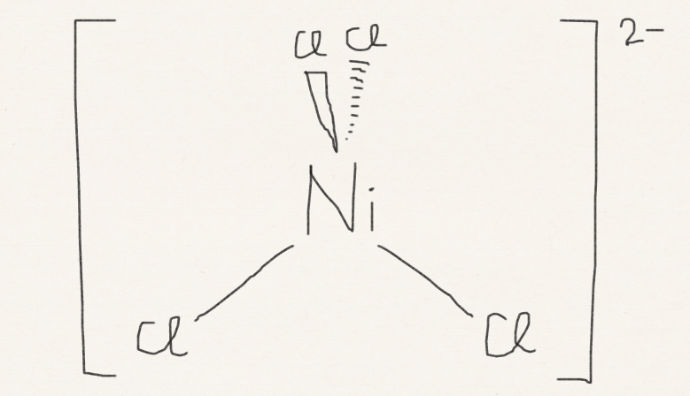
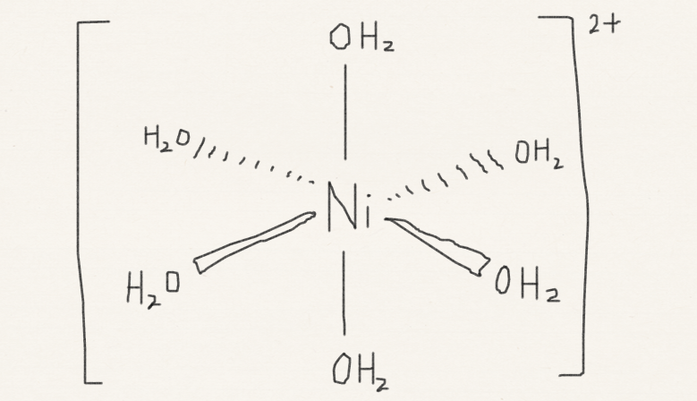
Crystal field theory
[Ni(NH₃)₆]²⁺, [Ni(en)₃]²⁺, [NiCl₄]²⁻, [Ni(H₂O)₆]²⁺
Permission is granted to copy, distribute and/or modify this document under the terms of the GNU Free Documentation License, Version 1.2 or any later version published by the Free Software Foundation; with no Invariant Sections, no Front-Cover Texts, and no Back-Cover Texts. A copy of the license is included in the section entitled GNU Free Documentation License.

Slide 18
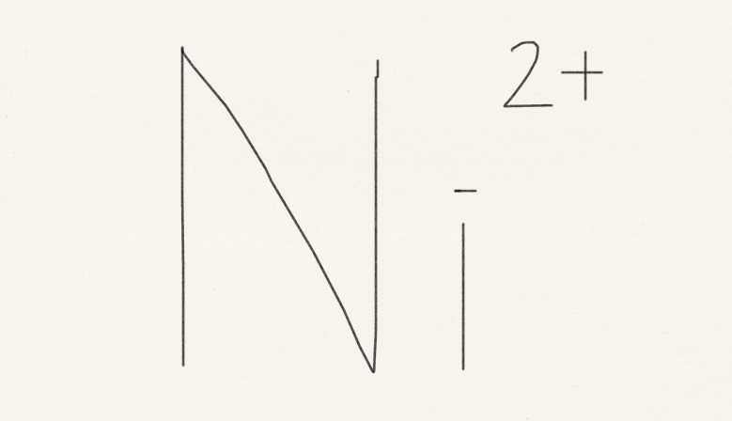
Crystal field theory
T_{d}
spherical
O_{h}
E_{g}
T₂
d_{z2}, d_{x2−y2}
d_{xy}, d_{yz}, d_{zx}
d orbitals
T_{2g}
E
d_{xy}, d_{yz}, d_{zx}
d_{z2}, d_{x2−y2}

Slide 19
NiCl₄²⁻ belongs to T_{d}
T_{d} | E | 8C₃ | 3C₂ | 6S₄ | 6σ_{d} | h = 24
A₁ | 1 | 1 | 1 | 1 | 1 | x²+y²+z²
A₂ | 1 | 1 | 1 | −1 | −1
E | 2 | −1 | 2 | 0 | 0 | (z², x²−y²)
T₁ | 3 | 0 | −1 | 1 | −1
T₂ | 3 | 0 | −1 | −1 | 1 | (xy, yz, zx)
T_{d}
spherical
T₂
d_{z2}
d_{xy}
d_{xy}, d_{yz}, d_{zx}
+
d orbitals
E
CT transition
allowed
d_{z2}, d_{x2−y2}

Slide 20
Ni(OH₂)₆²⁺ belongs to O_{h}
O_{h} | E | 8C₂ | 6C₂ | 6C₄ | … | h = 48
A_{1g} | 1 | 1 | 1 | 1 |  | x²+y²+z²
…
E_{g} | 2 | −1 | 0 | 0 |  | (z², x²−y²)
…
T_{2g} | 3 | 0 | 1 | −1 |  | (xy, yz, zx)
…
spherical
O_{h}
E_{g}
d_{z2}
d_{z2}, d_{x2−y2}
d_{xy}
+
d orbitals
T_{2g}
d_{xy}, d_{yz}, d_{zx}
d-d transition
forbidden

Slide 21
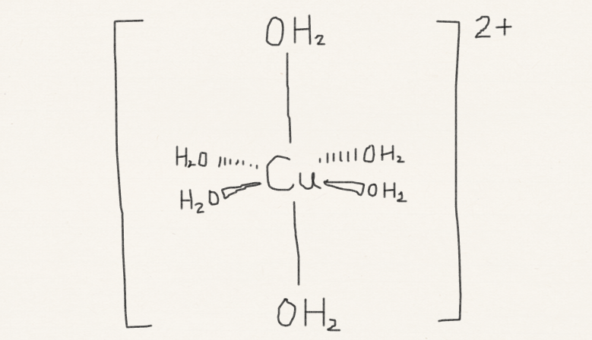
Jahn-Teller distortion
O_{h}
D_{4h}

Slide 22
Jahn-Teller distortion
(3d)⁸
(3d)⁹
Hunt’s rule
no Hunt’s rule
d_{z2}, d_{x2−y2}
d_{z2}, d_{x2−y2}
d_{xy}, d_{yz}, d_{zx}
d_{xy}, d_{yz}, d_{zx}

Slide 23
Cu(OH₂)₆²⁺ belongs to D_{4h}
D_{4h} | E | 2C₄ | C₂ | 2C₂’ | … | h = 48
A_{1g} | 1 | 1 | 1 | 1 |  | x²+y², z²
…
B_{1g} | 1 | −1 | 1 | 1 |  | x²−y²
B_{2g} | 1 | −1 | 1 | −1 |  | xy
E_{g} | 2 | 0 | −2 | 0 |  | xz, yz
…
D_{4h}
O_{h}
d_{x2−y2}
B_{1g}
d_{zx}
d_{xy}
E_{g}
A_{1g}
d_{z2}
d_{z2}, d_{x2−y2}
+
B_{2g}
d_{xy}
T_{2g}
E_{g}
d_{xy}, d_{yz}, d_{zx}
d_{yz}, d_{zx}

Slide 24
Jahn-Teller distortion
In Cu(OH₂)₆²⁺, the distortion lowers the energy of d electrons, but raises the energy of Cu-O bonds. The spontaneous distortion occurs.
In Ni(OH₂)₆²⁺, the distortion lowers the energy of d electrons, but loses the spin correlation as well as raises the energy of Ni-O bonds. The distortion does not occur.

Slide 25
Summary
We have learned how to apply the symmetry theory in the case of molecules with non-Abelian symmetry. We have learned the decomposition of characters into irreps.
We have discussed three chemical concepts derived from symmetry, which are Woodward-Hoffmann rule, crystal field theory, and Jahn-Teller distortion.

