Slide 1
Lecture 3 The Schrödinger equation

Slide 2
The Schrödinger equation
We introduce the Schrödinger equation as the equation of motion of quantum chemistry.
We cannot derive it; we postulate it. Its correctness is confirmed by its successful quantitative explanations of all known experimental observations.*
*Some restrictions apply: There are observable effects due to the special theory of relativity such as the spin-orbit coupling, intersystem crossing, and other scalar relativistic effects. These effects can be substantial in heavy elements. There are also observable quantum electrodynamics effects, which cannot be described by the Schrödinger equation, either. They are small.

Slide 3
The Schrödinger equation
Classical mechanics fails in describing motion at the atomic and molecular scales and is simply incorrect. A new, correct equation of motion is needed and it has to recognize:
Quantized nature of energy,
Wave-particle duality.

Slide 4
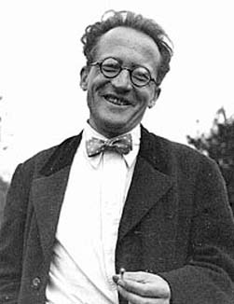
The Schrödinger equation
The correct equation of motion that works for microscopic particles was proposed by Erwin Schrödinger.
Hamiltonian
Wave function
Energy
The Schrödinger equation
Erwin Schrödinger

Slide 5
Hamilton’s representation of classical mechanics
Newton’s equation of motion = the conservation of energy (kinetic + potential energies = constant)
Hamiltonian
Energy
Classical
Potential energy
Kinetic energy

Slide 6
Hamilton’s representation of classical mechanics
v
v
ma
−F

Slide 7
The Schrödinger equation
In quantum mechanics, energy should be conserved, just as in classical mechanics.
Schrödinger used the Hamilton’s equation as the basis of quantum mechanics.
Quantum
Classical

Slide 8
Hamilton’s representation of classical mechanics
In classical mechanics, H is a function of p, m, and x ; p and x are functions of time.
Once we know the mass (m), position (x), and velocity (p = mv) of a particle, we can know the exact trajectory (positions as a function of time) of the particle from the classical mechanics.

Slide 9
The Schrödinger equation
However, the concept of trajectory is strictly for particles only. Schrödinger needed to modify the equation to account for the wave-particle duality.
Introduction of a wave function.
Wave function

Slide 10
The Schrödinger equation
The equation must also give energies that are quantized
The operator form of equation.
H is now an operator (it has a “^” hat sign)
Kinetic energy operator

Slide 11
What is an operator?
An operator carries out a mathematical operation (multiplication, differentiation, integrations, etc.) on a given function.
number a
function A(x)
Function
f(x)
Operator
number b
function B(x)
Darth Vader Chancellor

Slide 12
The Schrödinger equation
Generally, when function A is acted on by an operator, a different function (B) results.
The Schrödinger equation says that the input and output functions should be the same (Ψ), apart from a constant factor (E).
function Ψ(x)
Operator
function EΨ(x)

Slide 13
Eigenvalues and Eigenfunctions
In general, operator Ω (omega) and a function ψ (psi) satisfy the equation of the form: where ω is some constant factor, we call ω an eigenvalue of the operator Ω and ψ an eigenfunction of Ω. The equation of this form is called eigenvalue equation.
There are infinitely many eigenfunctions and eigenvalues

Slide 14
The Schrödinger equation
A wave function associated with a well-defined energy is an eigenfunction of the H operator with the eigenvalue being the energy.
Not any arbitrary value of energy can be an eigenvalue of the H operator.
This eigenvalue form of the Schrödinger equation makes the energies quantized.*
*Strictly speaking, it is the boundary condition together with the eigenvalue form of the equation that causes the energies to be quantized. We will learn about the importance of the boundary condition in a partial differential equation shortly.

Slide 15
The Hamiltonian operator
is called the Hamiltonian operator.
It is an operator for energy.
Kinetic
energy
operator
Potential
energy
operator

Slide 16
The Hamiltonian operator
The kinetic energy operator is the operator for kinetic energy:
How can this classical to quantum translation be justified?

Slide 17
The Hamiltonian operator
Again, this form is postulated, not derived. We can try to imagine the thought process of Schrödinger who came up with this translation.
First, we see that postulating is the same as postulating

Slide 18
The Hamiltonian operator

Slide 19
The momentum operator
Let us call the momentum operator and try to justify it.
We will apply this to a “simple wave” to see that it is indeed an operator for a momentum.

Slide 20
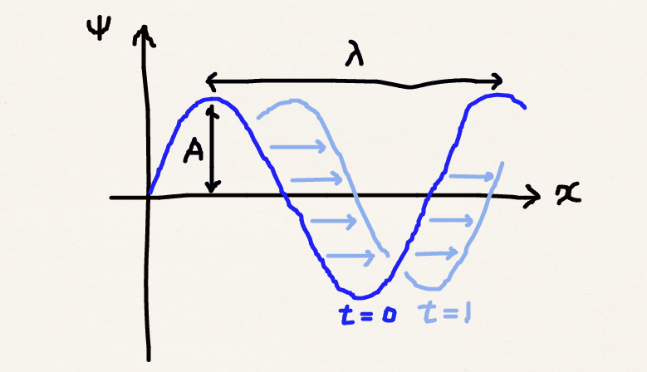
The simple wave
A function describing a simple sinusoidal wave with wave length λ (lambda) and frequency ν (nu):

Slide 21
The simple wave
Euler’s relation
Let us use this to represent the simple wave

Slide 22
The momentum operator
We act the momentum operator on the simple wave

Slide 23
The momentum operator
The simple wave is an eigenfunction of the momentum operator with the eigenvalue h / λ.
According to de Broglie relation:
The momentum operator makes sense.

Slide 24
Time-dependent Schrödinger equation
We have seen the effect of an operator that differentiates with respect to x (position).
What if we differentiate with respect to t (time)?

Slide 25
Time-dependent Schrödinger equation
To reiterate the result:
A sinusoidal wave is an eigenfunction of an operator with an eigenvalue of hv.
According to Planck, hv is the energy of an oscillator with frequency v.

Slide 26
Time-dependent Schrödinger equation
We have found an operator for energy:
Substituting this into the time-independent Schrödinger equation ( ), we obtain time-dependent Schrödinger equation

Slide 27
Summary
We have introduced the Schrödinger equation – the equation of motion of quantum mechanics and “the whole of chemistry.”*
The time-independent Schrödinger equation parallels Hamilton’s equation in classical mechanics and physically represents conservation of energy.
It incorporates the wave-particle duality and quantization of energy.
*In the words of Paul Dirac.

Slide 28
Summary
 | Classical | Quantum
Position | x
Momentum | p = mv
Potential energy | V
Energy | E | E or
Equation | H = E
Wave-particle duality | No. Particle only | Yes via the wave function
Quantization | Continuous and nearly arbitrary | Eigenvalues and quantized

