Slide 1
Lecture 29 Point-group symmetry II

Slide 2
Symmetry logic
Symmetry works in stages. (1) List all the symmetry elements of a molecule (e.g., water has mirror plane symmetry); (2) Identify the symmetry group of the molecule (water is C_{2v}); (3) Assign the molecule’s orbitals, vibrational modes, etc. to the symmetry species or irreducible representations (irreps) of the symmetry group.
In this lecture, we learn step (3).

Slide 3
Character tables
We will learn how to assign a molecule’s orbitals, vibrational modes, etc. to irreducible representations (irreps).
We do so with the aid of character tables.
We can then know whether integrals of our interest (such as transition dipole moments, overlap integrals, Hamiltonian matrix elements) are zero by symmetry.

Slide 4
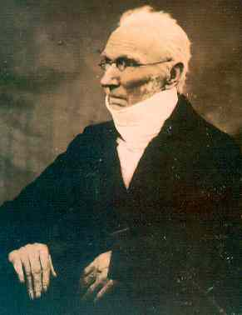
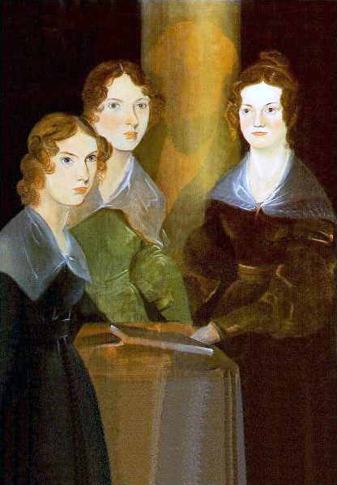
Symmetry group and irreps
Parent
Children

Slide 5
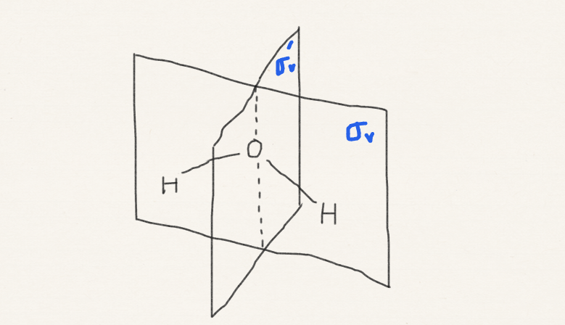
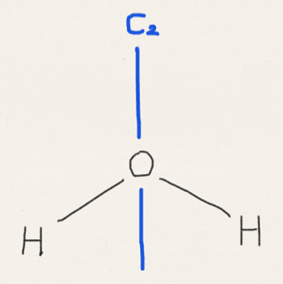
How to use symmetry (review)
Consider the water molecule.
Step 1: Identify its point group.
Step 1 answer: C_{2v}.

Slide 6
How to use symmetry
Step 2: find the character table of C_{2v} and read it (in your text book – no need to memorize any or all the tables)
C_{2v}, 2mm | E | C₂ | σ_{v} | σ_{v}’ | h = 4
A₁ | 1 | 1 | 1 | 1 | z, x², y², z²
A₂ | 1 | 1 | −1 | −1 | xy
B₁ | 1 | −1 | 1 | −1 | x, zx
B₂ | 1 | −1 | −1 | 1 | y, xy

Slide 7
How to use symmetry
Step 2 answer: keys given below.
Order of C_{2v}
Operations of C_{2v}
C_{2v}, 2mm | E | C₂ | σ_{v} | σ_{v}’ | h = 4
A₁ | 1 | 1 | 1 | 1 | z, x², y², z²
A₂ | 1 | 1 | −1 | −1 | xy
B₁ | 1 | −1 | 1 | −1 | x, zx
B₂ | 1 | −1 | −1 | 1 | y, xy
Irreducible representations (or irreps)
Tables of +1 and –1
(characters)
x, y, z axes

Slide 8
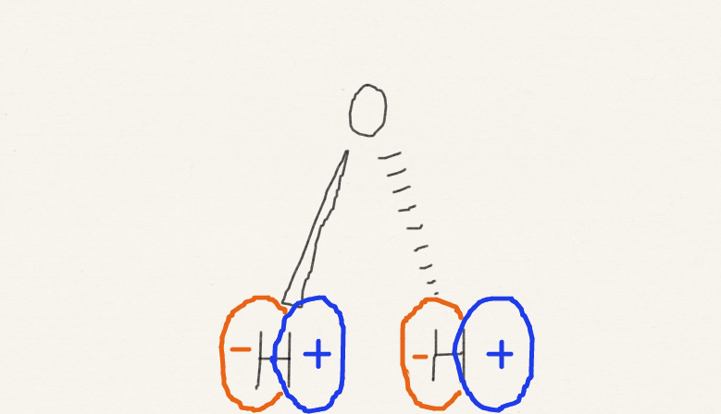
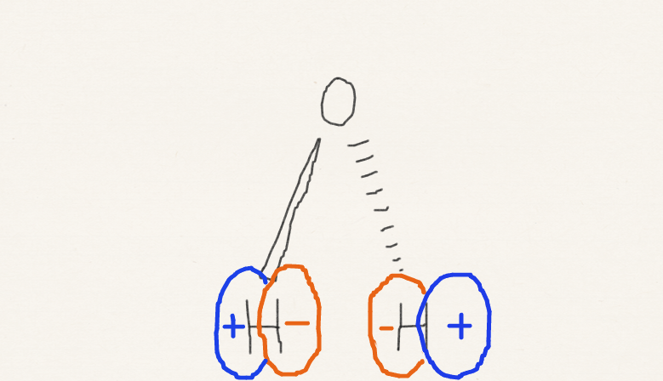
How to use symmetry
Rule 1: each real* orbital (real electronic wave function, real vibrational wave function, etc.) must transform as one of irreps.
Step 3: identify the irrep of each orbital.
*Complex orbitals are necessary in periodic solids and relativistic molecular quantum chemistry, where space group and double group are used, respectively. Here, we discuss real Abelian point-group symmetry.

Slide 9
How to use symmetry
Step 3 answer:
transforms as B₂
C_{2v}, 2mm | E | C₂ | σ_{v} | σ_{v}’ | h = 4
A₁ | 1 | 1 | 1 | 1 | z, x², y², z²
A₂ | 1 | 1 | −1 | −1 | xy
B₁ | 1 | −1 | 1 | −1 | x, zx
B₂ | 1 | −1 | −1 | 1 | y, xy

Slide 10
How to use symmetry
Step 3 answer:
transforms as A₂
C_{2v}, 2mm | E | C₂ | σ_{v} | σ_{v}’ | h = 4
A₁ | 1 | 1 | 1 | 1 | z, x², y², z²
A₂ | 1 | 1 | −1 | −1 | xy
B₁ | 1 | −1 | 1 | −1 | x, zx
B₂ | 1 | −1 | −1 | 1 | y, xy

Slide 11
Which is σ_{v} and which is σ'_{v}?
Which σ we call σ_{v} is arbitrary and is a matter of choice.
Depending on this choice, the same orbital may be labeled B₁ or B₂. Both are correct.
No physical conclusions (such as spectroscopic selection rules) will be altered by the choice.

Slide 12
How to use symmetry
Step 4: find whether the integral of the orbital is zero by symmetry (we cannot know the nonzero values from symmetry).
Rule 2: only the integral of an integrand with the totally symmetric irrep (A, A₁, A’, A_{g}, A₁’ A_{1g}, etc.) is nonzero.
Totally symmetric =
1st row (all characters are +1)
C_{2v}, 2mm | E | C₂ | σ_{v} | σ_{v}’ | h = 4
A₁ | 1 | 1 | 1 | 1 | z, x², y², z²
A₂ | 1 | 1 | −1 | −1 | xy
B₁ | 1 | −1 | 1 | −1 | x, zx
B₂ | 1 | −1 | −1 | 1 | y, xy

Slide 13
How to use symmetry
Step 4 answers:
transforms as B₂
transforms as A₂

Slide 14
How to use symmetry
In practice, we are interested in the integral of a product of functions (not a single function) such as
Step 5: find the irrep of the integrands and whether the integrals are zero by symmetry.
B₂
A₂

Slide 15
How to use symmetry
Rule 3: is totally symmetric. The irreps of axis operator etc. are given in the table.
C_{2v}, 2mm | E | C₂ | σ_{v} | σ_{v}’ | h = 4
A₁ | 1 | 1 | 1 | 1 | z, x², y², z²
A₂ | 1 | 1 | −1 | −1 | xy
B₁ | 1 | −1 | 1 | −1 | x, zx
B₂ | 1 | −1 | −1 | 1 | y, xy

Slide 16
How to use symmetry
Rule 4: the characters of the irrep of a product of irreps are the columnwise products of characters of irreps.
C_{2v}, 2mm | E | C₂ | σ_{v} | σ_{v}’ | h = 4
A₁ | 1 | 1 | 1 | 1 | z, x², y², z²
A₂ | 1 | 1 | −1 | −1 | xy
B₁ | 1 | −1 | 1 | −1 | x, zx
B₂ | 1 | −1 | −1 | 1 | y, xy
1
B₁
–1
1
–1

Slide 17
How to use symmetry
Step 5 answers:
C_{2v}, 2mm | E | C₂ | σ_{v} | σ_{v}’ | h = 4
A₁ | 1 | 1 | 1 | 1 | z, x², y², z²
A₂ | 1 | 1 | −1 | −1 | xy
B₁ | 1 | −1 | 1 | −1 | x, zx
B₂ | 1 | −1 | −1 | 1 | y, xy

Slide 18
Rule 1 justification
Rule 1: each real orbital (vibration, etc.) must transform as one of irreps.

Slide 19
Rule 1 justification
Symmetry operations (E, C₂, σ, etc.) are all operators (just like Hamiltonian operator).
Each irrep is a simultaneous eigenfunction of all of these symmetry operators with eigenvalues +1 or –1 (characters).
C_{2v}, 2mm | E | C₂ | σ_{v} | σ_{v}’ | h = 4
A₁ | 1 | 1 | 1 | 1 | z, x², y², z²
A₂ | 1 | 1 | −1 | −1 | xy
B₁ | 1 | −1 | 1 | −1 | x, zx
B₂ | 1 | −1 | −1 | 1 | y, xy

Slide 20
Rule 1 justification
Symmetry operators (E, C₂, σ, etc.) and the Hamiltonian operator H commute because the shape of the potential energy function is invariant to any of the symmetry operation.
H and all symmetry operations have simultaneous eigenfunctions – orbitals, vibrations, etc. which are eigenfunctions of H (or related operators) are also simultaneous eigenfunctions of symmetry operations, i.e., irreps.

Slide 21
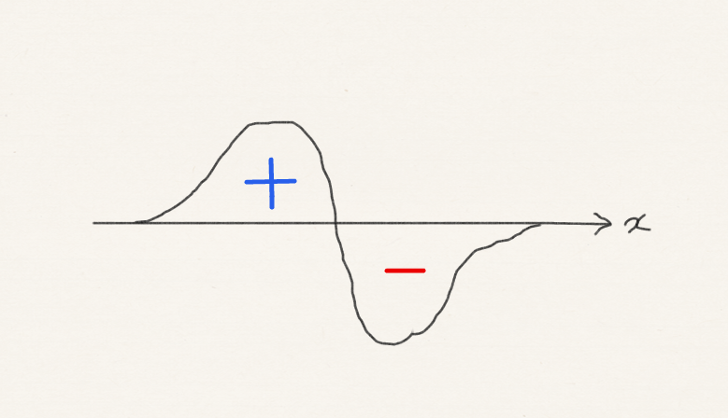
Rule 2 justification
Rule 2: only the integral of an integrand with the totally symmetric irrep is nonzero.
C_{2v}, 2mm | E | C₂ | σ_{v} | σ_{v}’ | h = 4
A₁ | 1 | 1 | 1 | 1 | z, x², y², z²
A₂ | 1 | 1 | −1 | −1 | xy
B₁ | 1 | −1 | 1 | −1 | x, zx
B₂ | 1 | −1 | −1 | 1 | y, xy
Character “–1” means the integrand has positive and negative lobes of identical shapes and sizes that are superimposed by the symmetry operation. The presence of just one “–1” means that the integral is zero.

Slide 22
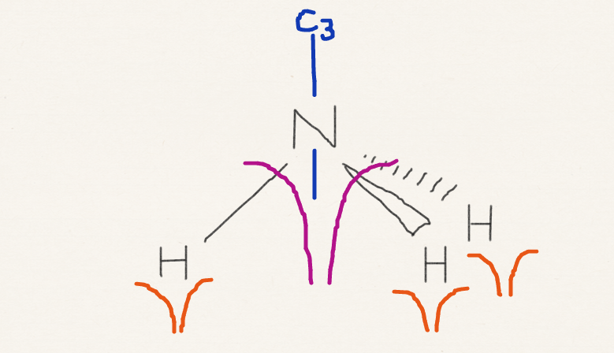
Rule 3 justification
Rule 3: is totally symmetric.

Slide 23
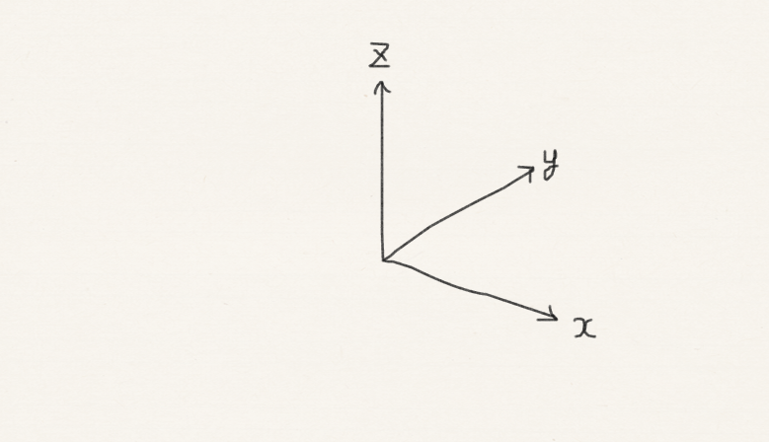
Rule 3 justification
Rule 3: the irreps of axis operator etc. are given in the table.
C_{2v}, 2mm | E | C₂ | σ_{v} | σ_{v}’ | h = 4
A₁ | 1 | 1 | 1 | 1 | z, x², y², z²
A₂ | 1 | 1 | −1 | −1 | xy
B₁ | 1 | −1 | 1 | −1 | x, zx
B₂ | 1 | −1 | −1 | 1 | y, xy

Slide 24
Rule 4 justification
Rule 4: the characters of the irrep of a product of irreps are the columnwise products of characters of irreps.
C_{2v}, 2mm | E | C₂ | σ_{v} | σ_{v}’ | h = 4
A₁ | 1 | 1 | 1 | 1 | z, x², y², z²
A₂ | 1 | 1 | −1 | −1 | xy
B₁ | 1 | −1 | 1 | −1 | x, zx
B₂ | 1 | −1 | −1 | 1 | y, xy
1
B₁
–1
1
–1

Slide 25
Summary
We have learned how to assign orbitals (and other attributes) of a molecule to the irreducible representations of the symmetry group.
We have learned how to obtain the irrep of a product of irreps.
From these, we can tell whether integrals of orbitals (and others) are zero by symmetry.

