Slide 1
Lecture 28
Point-group symmetry I

Slide 2
Molecular symmetry
A typical conversation between chemists …
Symmetry is the “language” all chemists use every day (besides English and mathematics).
Formaldehyde is C_{2v}. The A₁ to B₂ transition is optically allowed.
This vibrational mode is A_{g}. It is Raman active.

Slide 3
Molecular symmetry
We will learn how to
  classify a molecule to a symmetry group,
  characterize molecules’ orbitals, vibrations, etc. according to symmetry species (irreducible representations or “irreps”),
  use these to label states, understand selection rules of spectroscopies and chemical reactions.

Slide 4
Molecular symmetry
We do not need to
  memorize all symmetry groups or symmetry species (but we must know common symmetry groups, C₁, C_{s}, C_{i}, C₂, C_{2v}, C_{2h}, D_{2h}, C_{∞v}, D_{∞h}, and all five symmetry operations/elements),
  memorize all the character tables,
  memorize the symmetry flowchart or pattern matching table,
  know the underlying mathematics (but we must have the operational understanding and be able to apply the theory routinely).

Slide 5
Mathematics behind this
The symmetry theory we learn here is concerned with the point-group symmetry, symmetry of molecules (finite-sized objects).
There are other symmetry theories, space-group symmetry for crystals and line-group symmetry for crystalline polymers.
These are all based on a branch of mathematics called group theory.

Slide 6
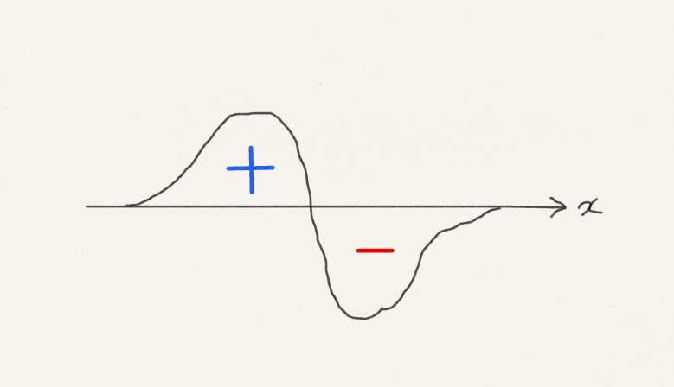
Primary benefit of symmetry to chemistry

Slide 7
Symmetry logic
Symmetry works in stages. (1) List all the symmetry elements of a molecule (e.g., water has mirror plane symmetry); (2) Identify the symmetry group of the molecule (water is C_{2v}); (3) Assign the molecule’s orbitals, vibrational modes, etc. to the symmetry species or irreducible representations (irreps) of the symmetry group.
In this lecture, we learn the symmetry elements and symmetry groups.

Slide 8
Five symmetry operations and elements
Identity (the operation); E (the element)
n-fold rotation (the operation); C_{n}, n-fold rotation axis (the element)
Reflection (the operation); σ, mirror plane (the element)
Inversion (the operation); i, center of inversion (the element)
n-fold improper rotation (the operation); S_{n}, n-fold improper rotation axis (the element)

Slide 9
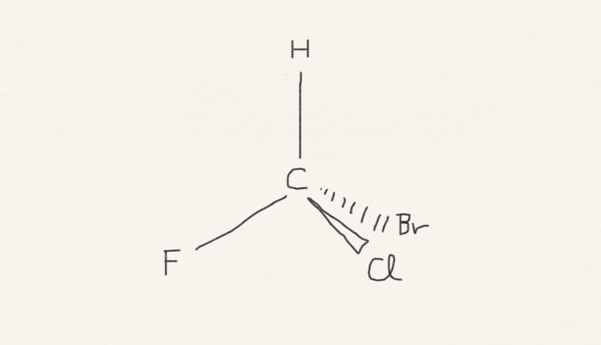
Identity, E
is no operation (doing nothing), which leaves the molecule unchanged.
Any and every molecule has this symmetry element.

Slide 10
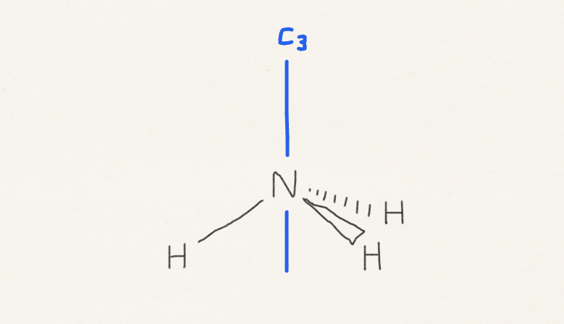
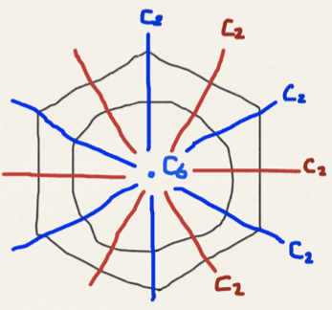
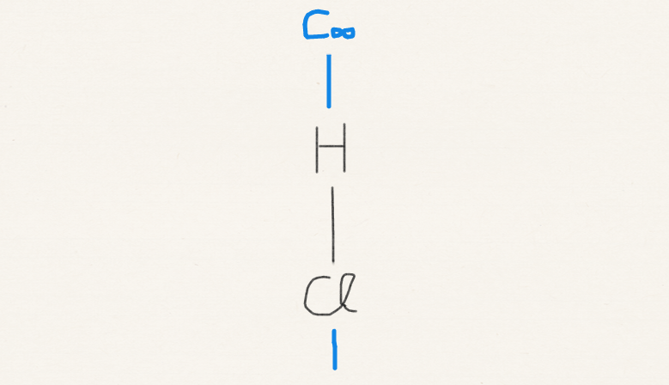
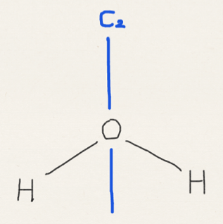
n-fold rotation, C_{n}
Rotation through 360º/n around the axis.
The axis with the greatest value of n is called the principal axis.

Slide 11
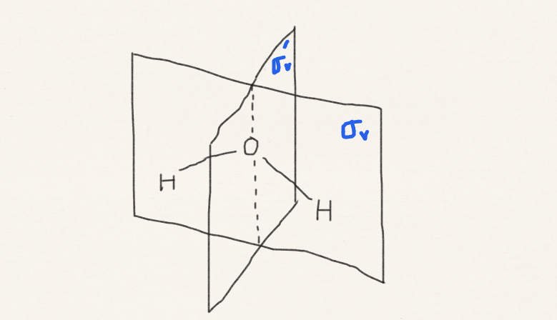
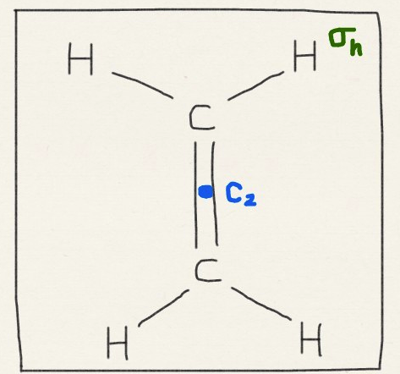
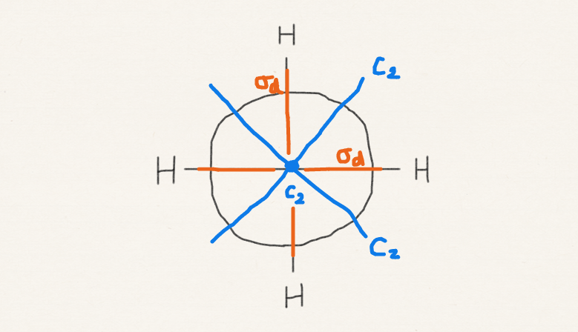
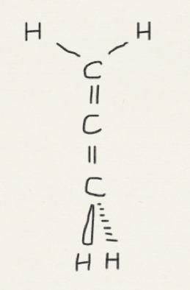
Reflection
σ_{v} parallel (vertical) to the principal axis
σ_{h} perpendicular (horizontal)
σ_{d} bisects the angle between two C₂ axes (diagonal or dihedral)

Slide 12
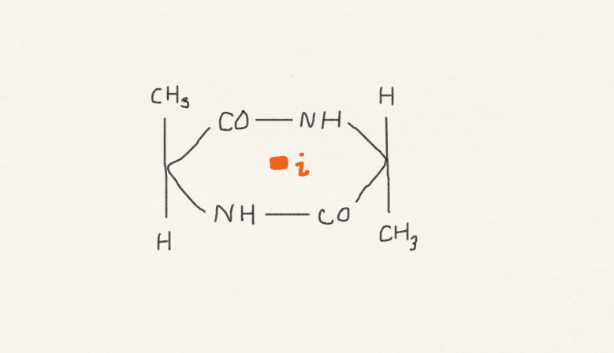
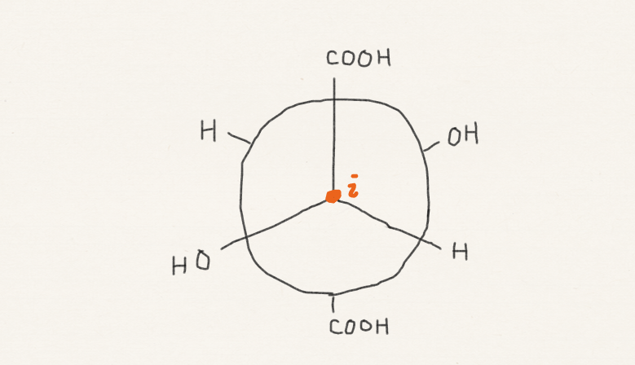
Inversion
Inversion maps (x, y, z) to (–x, –y, –z).

Slide 13
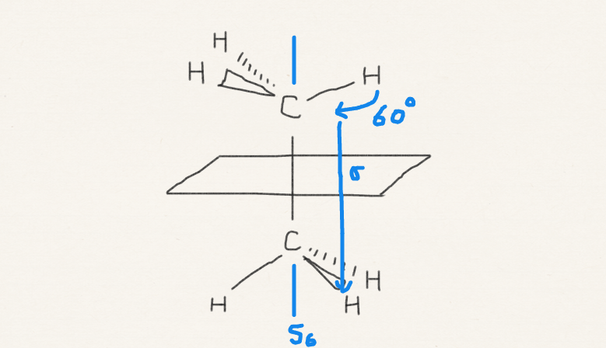
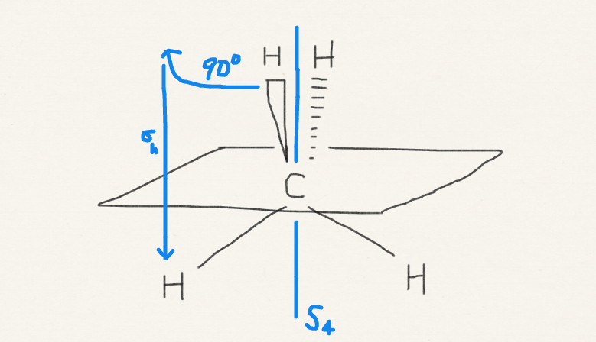
n-fold improper rotation
Rotation through 360º/n around the axis followed by a reflection through σ_{h}.

Slide 14
Symmetry classification of molecules
Molecules are classified into symmetry groups. The classification immediately informs us of the polarity and chirality of the molecule
We have two naming conventions – Schoenflies and Hermann–Mauguin system (International system) – we use the former.

Slide 15
C₁ group
has only identity symmetry element.

Slide 16
C_{i} group
has identity and inversion only.

Slide 17
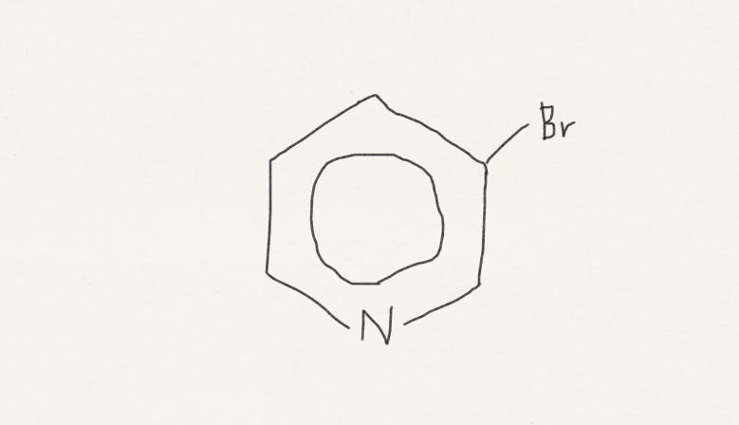
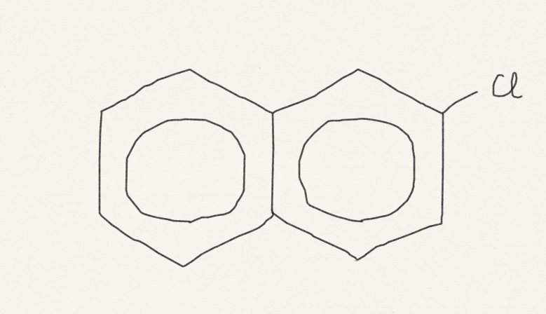
C_{s} group
has identity and mirror plane only.

Slide 18
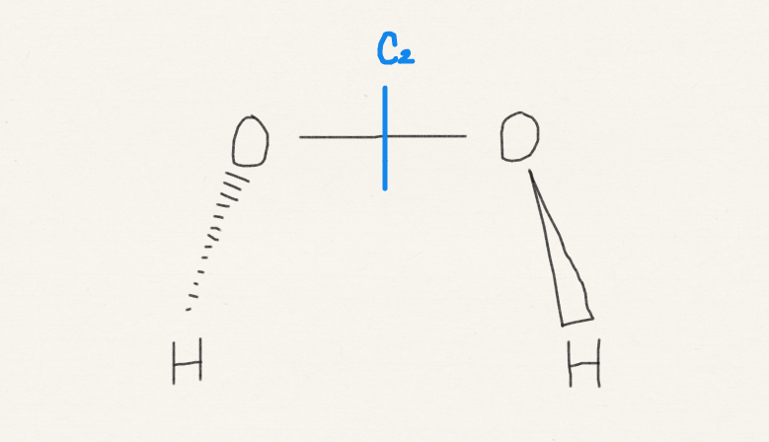
C_{n} group
has identity and n-fold rotation only.

Slide 19
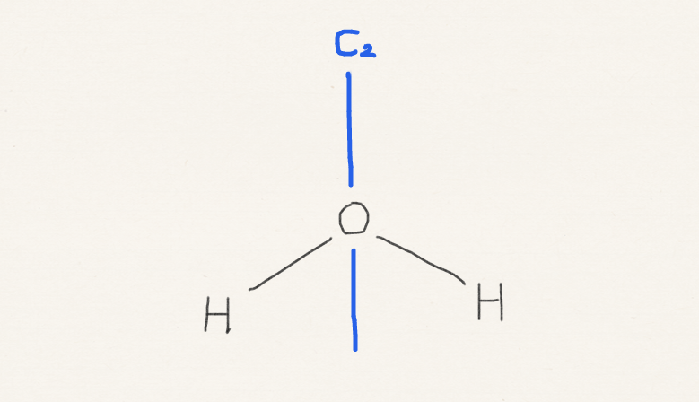
C_{nv} group
has identity, n-fold rotation, and σ_{v} only.

Slide 20
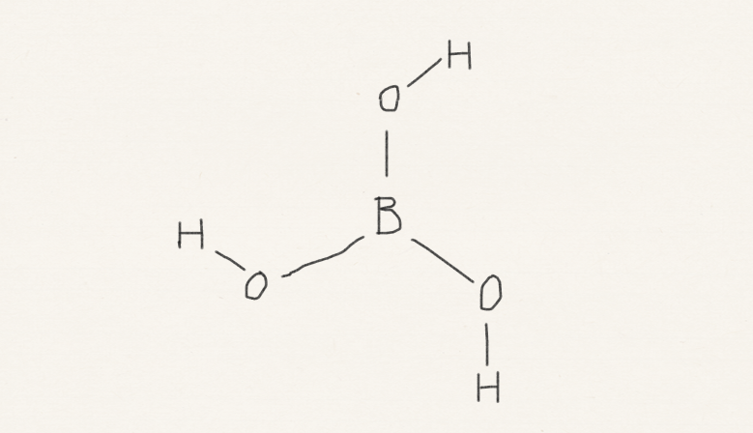
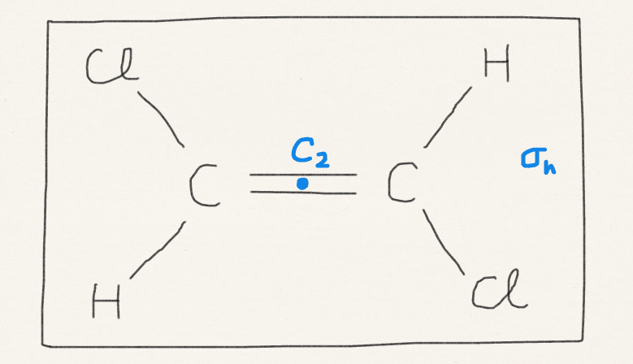
C_{nh} group
has identity, n-fold rotation, and σ_{h} (which sometimes imply inversion).

Slide 21
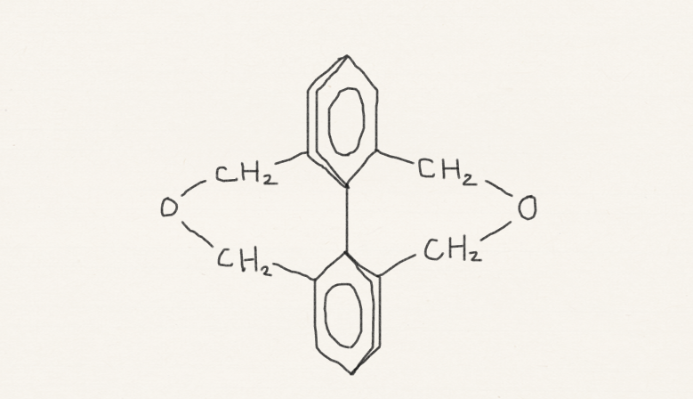
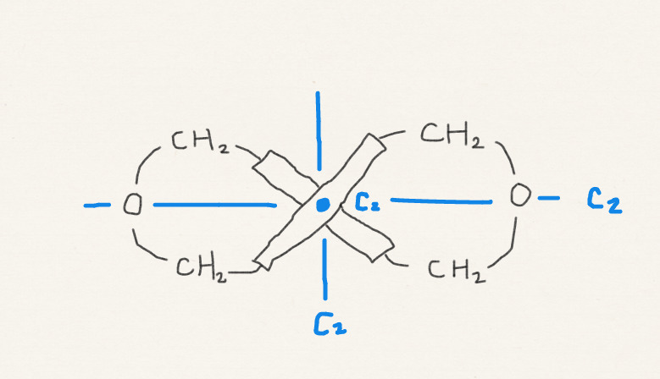
D_{n} group
has identity, n-fold principal axis, and n twofold axes perpendicular to C_{n}.

Slide 22
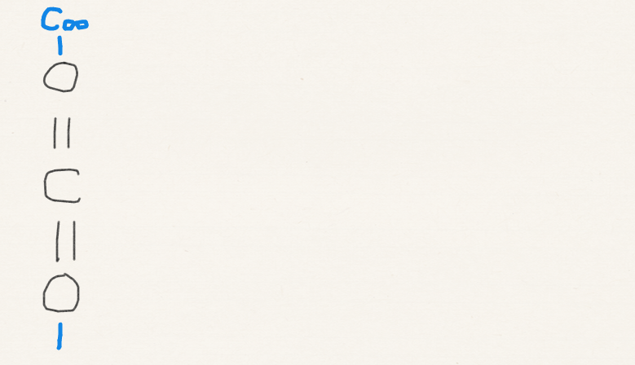
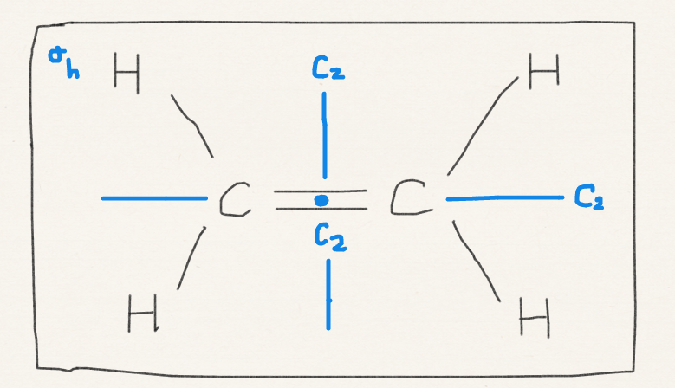
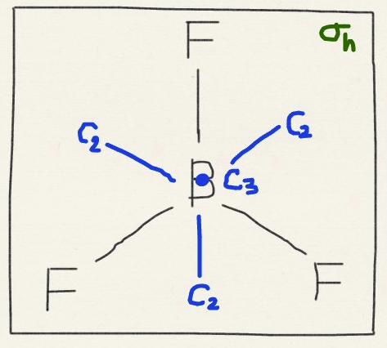
D_{nh} group
has identity, n-fold principal rotation, and n twofold axes perpendicular to C_{n}, and σ_{h}.

Slide 23
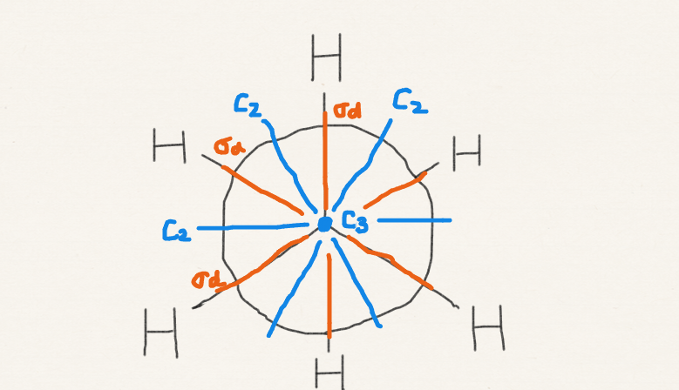
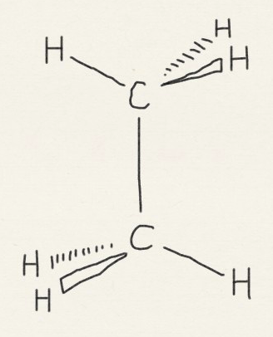
D_{nd} group
has identity, n-fold principal rotation, and n twofold axes perpendicular to C_{n}, and σ_{d}.

Slide 24
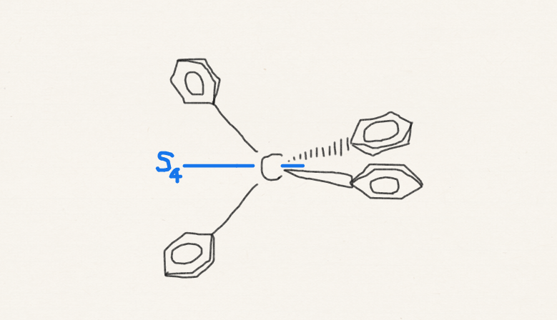
S_{n} group
molecules that have not been classified so far and have an S_{n} axis

Slide 25
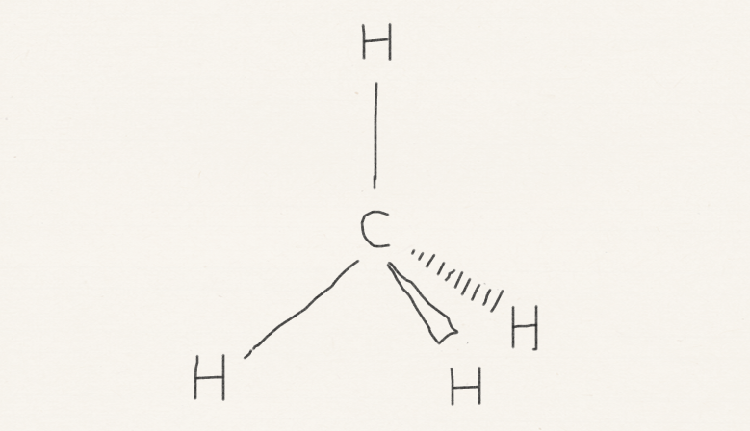
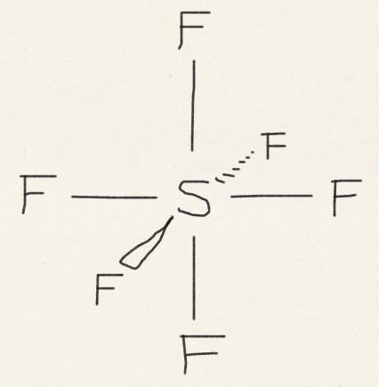
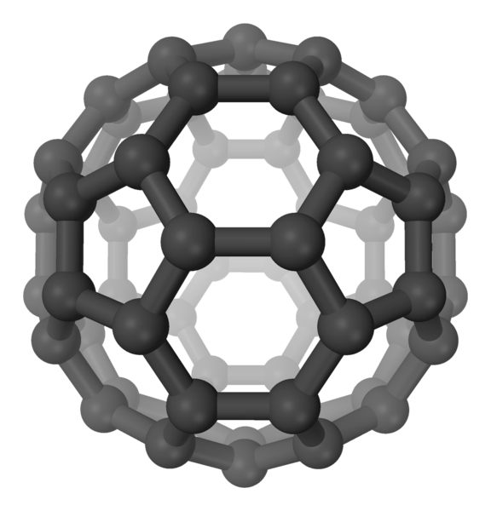
Cubic group
Tetrahedral group: CH₄ (T_{d}), etc.
Octahedral group: SF₆ (O_{h}), etc.
Icosahedral group: C₆₀ (I_{h}), etc.

Slide 26
Flow chart
Linear?
Inversion?
D_{∞h}
C_{∞h}
Very high symmetry?
Inversion?
T_{d}
C₅?
I_{h}
O_{h}
C_{n}?
nC₂ normal to principal C_{n}?
σ?
C_{s}
inversion?
C_{i}
C₁
σ_{h}?
D_{nh}
nσ_{d}?
D_{nd}
D_{n}
σ_{h}?
C_{nh}
nσ_{v}?
C_{nv}
S_{2n}?
S_{2n}
C_{n}
YES
NO
YES
NO
YES
NO
YES
NO
YES
NO
YES
NO
YES
NO
YES
NO
YES
NO
YES
NO
YES
NO
YES
NO
YES
NO
YES
NO

Slide 27
Flow chart
Linear?
Inversion?
D_{∞h}
C_{∞h}
Very high symmetry?
Inversion?
T_{d}
C₅?
I_{h}
O_{h}
C_{n}?
nC₂ normal to principal C_{n}?
σ?
C_{s}
inversion?
C_{i}
C₁
σ_{h}?
D_{nh}
nσ_{d}?
D_{nd}
D_{n}
σ_{h}?
C_{nh}
nσ_{v}?
C_{nv}
S_{2n}?
S_{2n}
C_{n}
YES
NO
YES
NO
YES
NO
YES
NO
YES
NO
YES
NO
YES
NO
YES
NO
YES
NO
YES
NO
YES
NO
YES
NO
YES
NO
YES
NO

Slide 28
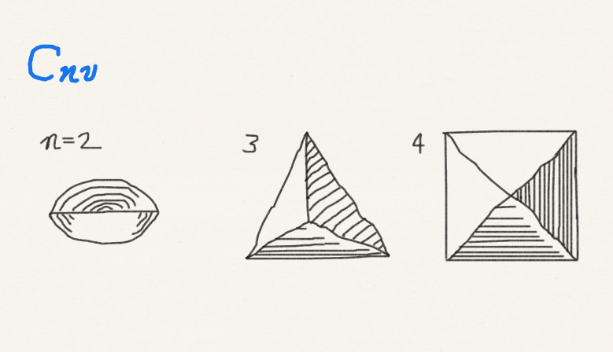
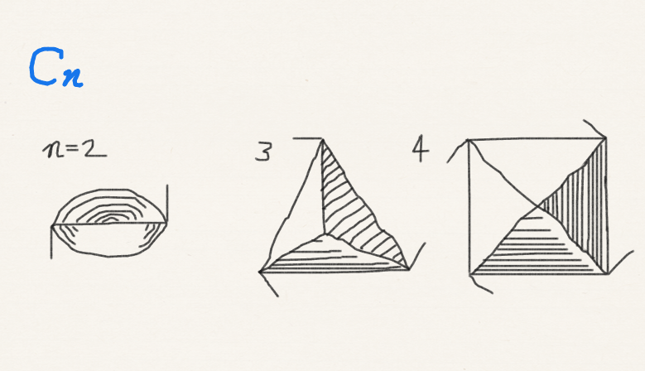
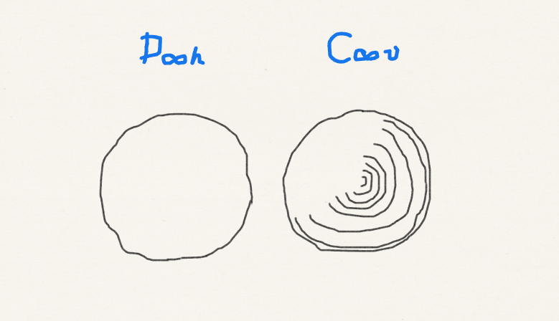
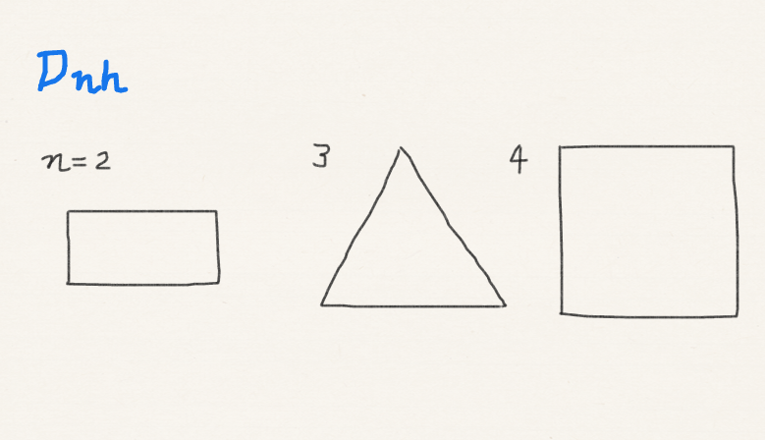
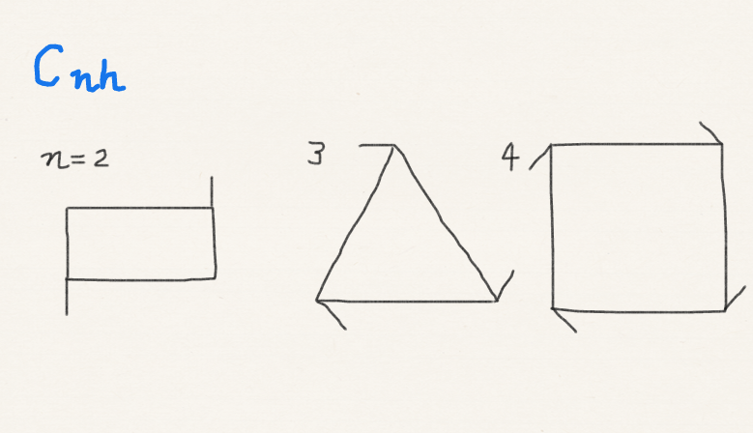
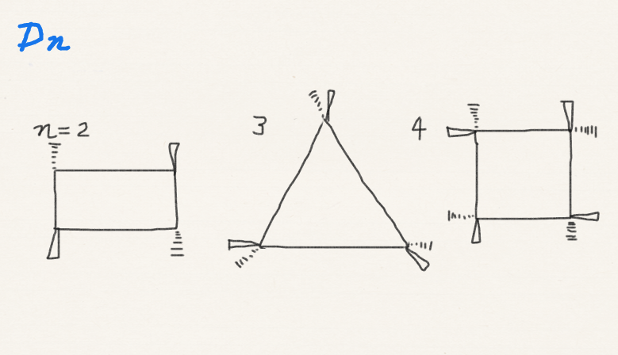
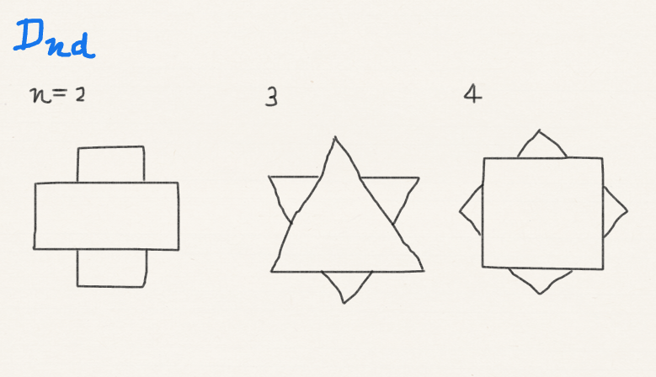
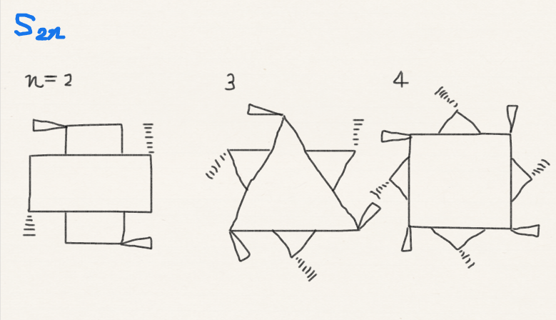
Pattern matching

Slide 29
Pattern matching

Slide 30
Polarity
Dipole moment should be along C_{n} axis. There should be no operation that turn this dipole upside down for it not to vanish.
Only C₁, C_{n}, C_{nv}, and C_{s} can have a permanent dipole moment.

Slide 31
Chirality
A chiral molecule is the one that cannot be superimposed by its mirror image (optical activity)
A molecule that can be superimposed by rotation after reflection (S_{n}) cannot be chiral.
Note that σ = S₁ and i = S₂.
Only C_{n} and D_{n} are chiral.

Slide 32

Homework challenge #9
Why does the reversal of left and right occur in a mirror image, whereas the reversal of the top and bottom does not?
Public domain image from Wikipedia

Slide 33
Summary
We have learned five symmetry operations and symmetry elements.
We have learned how to classify a molecule to the symmetry group by listing all its symmetry elements as the first step of symmetry usage.
From this step alone, we can tell whether the molecule is polar and/or chiral.

