Slide 1
Lecture 27
Molecular orbital theory III

Slide 2
Applications of MO theory
Previously, we learned the bonding in H₂⁺.
We also learned how to obtain the energies and expansion coefficients of LCAO MO’s, which amounts to solving a matrix eigenvalue equation.
We will apply these to homonuclear diatomic molecules, heteronuclear diatomic molecules, and conjugated π-electron molecules.

Slide 3
MO theory for H₂⁺ (review)
φ– = N–(A–B)
anti-bonding
φ₊ = N₊(A+B)
bonding
E_{1s}
φ– is more anti-bonding
than φ₊ is bonding
R

Slide 4
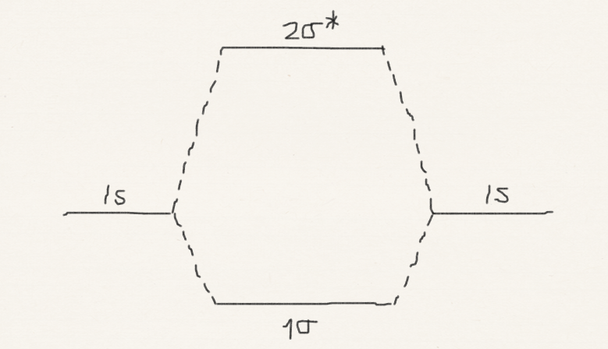
MO theory for H₂⁺ and H₂
MO diagram for H₂⁺ and H₂ (analogous to aufbau principle for atomic configurations)
H₂⁺
H₂
Reflecting: anti-bonding orbital is more anti-bonding than bonding orbital is bonding

Slide 5
Matrix eigenvalue eqn. (review)

Slide 6
MO theory for H₂
α is the 1s orbital energy.
β is negative.
anti-bonding orbital is more anti-bonding than bonding orbital is bonding.

Slide 7
MO theory for H₂

Slide 8
MO theory for He₂ and He₂⁺
He₂ has no covalent bond (but has an extremely weak dispersion or van der Waals attractive interaction). He₂⁺ is expected to be bound.
He₂
He₂⁺

Slide 9
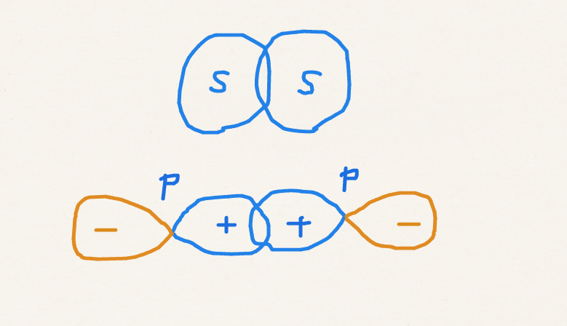
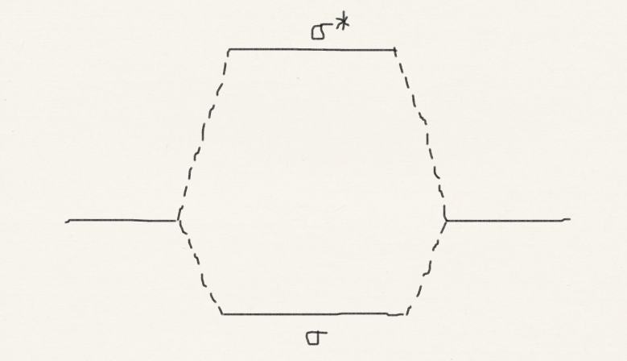
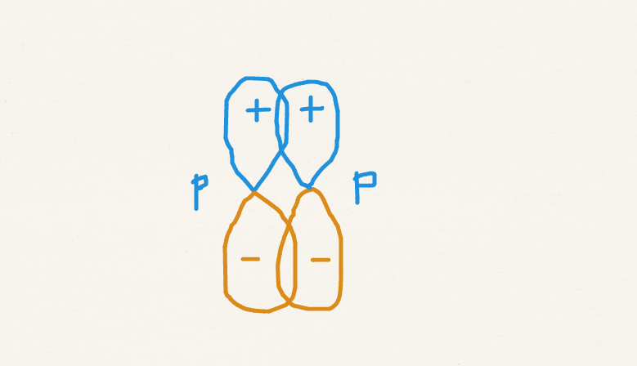
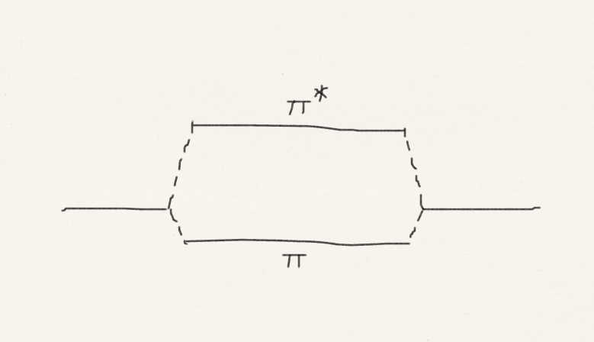
σ and π bonds
A π bond is weaker than σ bond because of a less orbital overlap in π.
σ bond
π bond

Slide 10
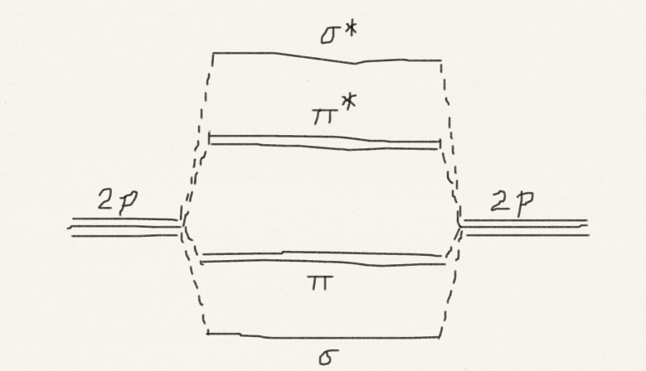
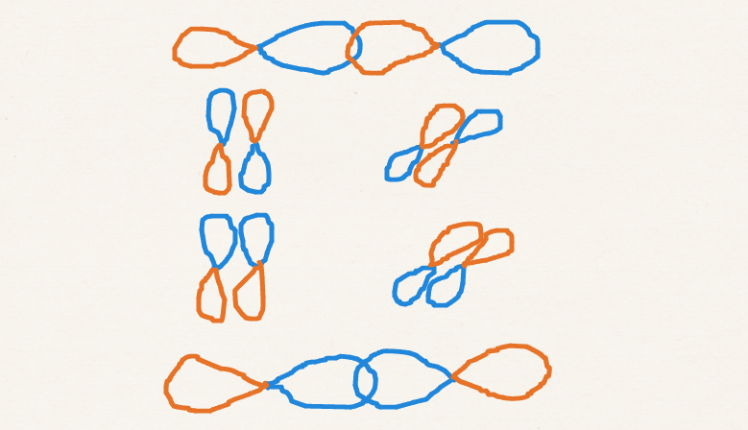
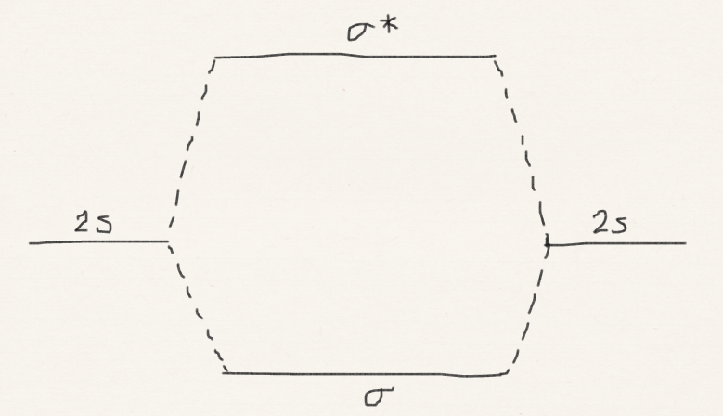
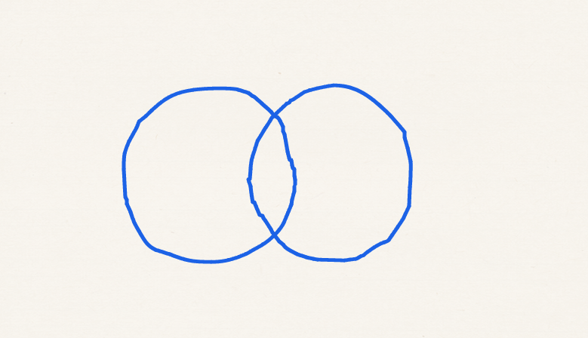
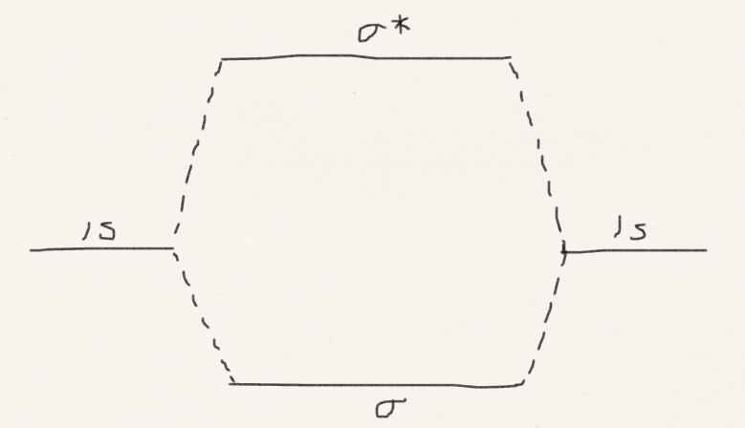
MO theory for Ne₂, F₂ and O₂
Hund’s rule
O₂ is magnetic
Ne₂
F₂
O₂

Slide 11
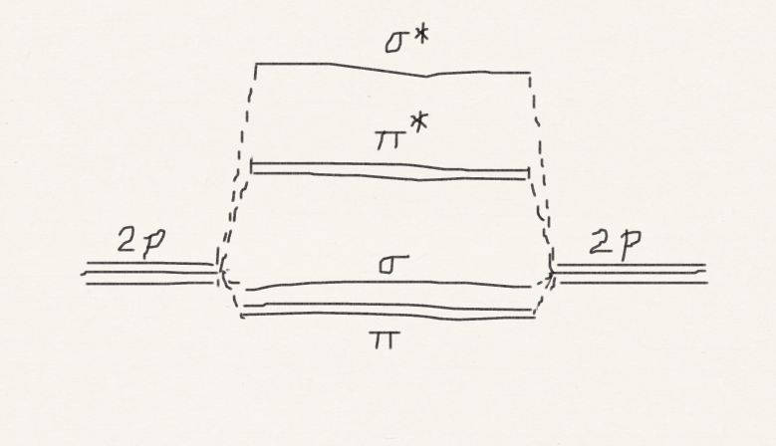
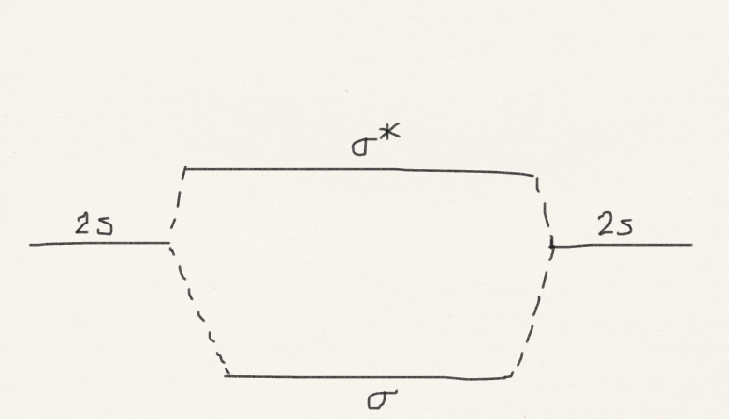
MO theory for N₂, C₂, and B₂
Hund’s rule
B₂ is magnetic
N₂
C₂
B₂

Slide 12
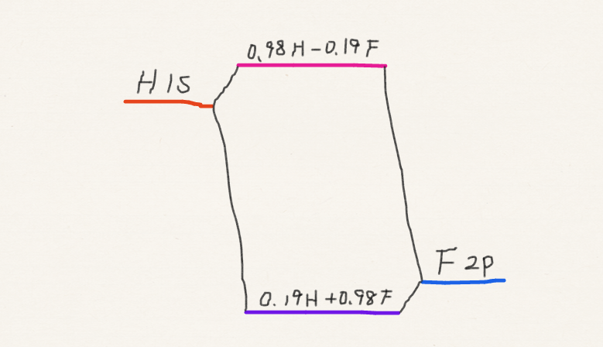
Polar bond in HF
The bond in hydrogen fluoride is covalent but also ionic (H^{δ+}F^{δ–}).
H 1s and F 2p form the bond, but they have uneven weights in LCAO MO’s .
H^{δ+}F^{δ–}

Slide 13
Polar bond in HF
Calculate the LCAO MO’s and energies of the σ orbitals in the HF molecule, taking β = –1.0 eV and the following ionization energies (α’s): H1s 13.6 eV, F2p 18.6 eV. Assume S = 0.

Slide 14
Matrix eigenvalue eqn. (review)
With S = 0,

Slide 15
Polar bond in HF
Ionization energies give us the depth of AO’s, which correspond to −α_{H1s} and −α_{F2p}.

Slide 16
Hückel approximation
We consider LCAO MO’s constructed from just the π orbitals of planar sp² hybridized hydrocarbons (σ orbitals not considered)
We analyze the effect of π electron conjugation.
Each p_{z} orbital has the same .
Only the nearest neighbor p_{z} orbitals have nonzero .
Centered on the nearest neighbor carbon atoms

Slide 17
Ethylene (isolated π bond)
Coulomb integral of 2p_{z}
Resonance integral
(negative)
α
α
β

Slide 18
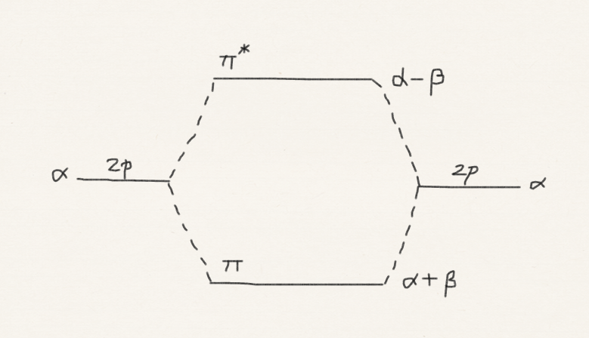
Ethylene (isolated π bond)

Slide 19
Butadiene
1 2 3 4
1
2
β
3
4
4 3 2 1
β
β

Slide 20
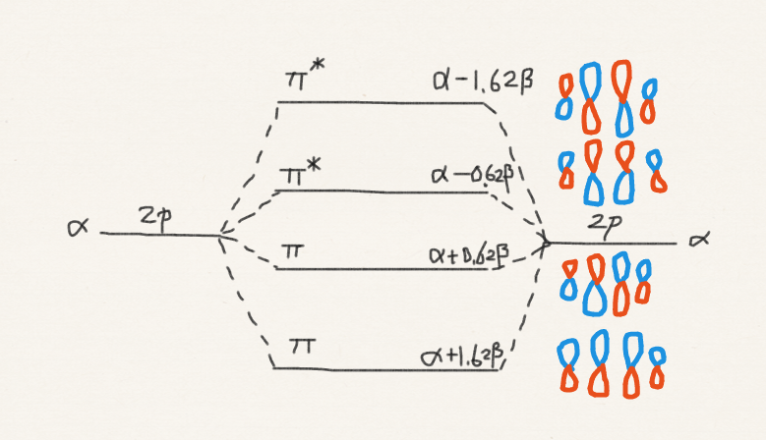

Butadiene
Two conjugated π bonds
Two isolated π bonds
extra 0.48β stabilization =
π delocalization

Slide 21
Cyclobutadiene
β
1 2 3 4
1
2
β
β
4 3 2 1
4
3
β

Slide 22
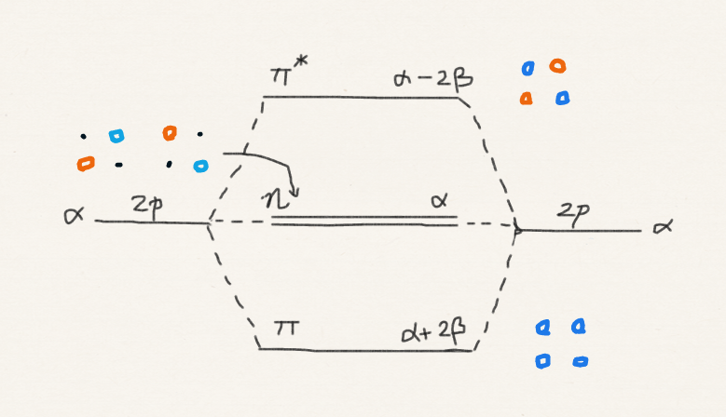
Cyclobutadiene
No delocalization energy; no aromaticity

Slide 23
Cyclobutadiene
β₁
1 2 3 4
1
2
4 3 2 1
β₂
β₂
4
3
β₁

Slide 24
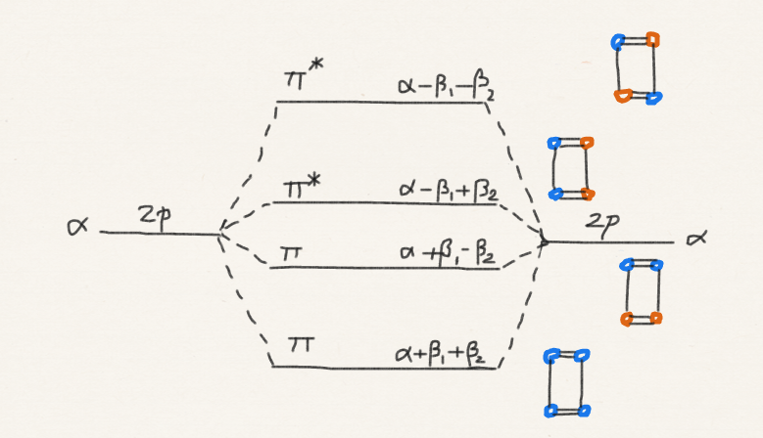
Cyclobutadiene
Spontaneous distortion from square to rectangle?

Slide 25
Homework challenge #8
Is cyclobutadiene square or rectangular? Is it planar or buckled? Is its ground state singlet or triplet?
Find experimental and computational research literature on these questions and report.
Perform MO calculations yourself (use the NWCHEM software freely distributed by Pacific Northwest National Laboratory).

Slide 26
Summary
We have applied numerical techniques of MO theory to homonuclear diatomic molecules, heteronuclear diatomic molecules, and conjugated π electron systems.
These applications have explained molecular electronic configurations, polar bonds, added stability due to π electron delocalization in butadiene, and the lack thereof in cyclobutadiene.
Acknowledgment: Mathematica (Wolfram Research) & NWCHEM (Pacific Northwest National Laboratory)

