Slide 1
Lecture 25
Molecular orbital theory I

Slide 2
Molecular orbital theory
Molecular orbital (MO) theory provides a description of molecular wave functions and chemical bonds complementary to VB.
It is more widely used computationally.
It is based on linear-combination-of-atomic-orbitals (LCAO) MO’s.
It mathematically explains the bonding in H₂⁺ in terms of the bonding and antibonding orbitals.

Slide 3
MO versus VB
Unlike VB theory, MO theory first combine atomic orbitals and form molecular orbitals in which to fill electrons.
MO theory
VB theory

Slide 4
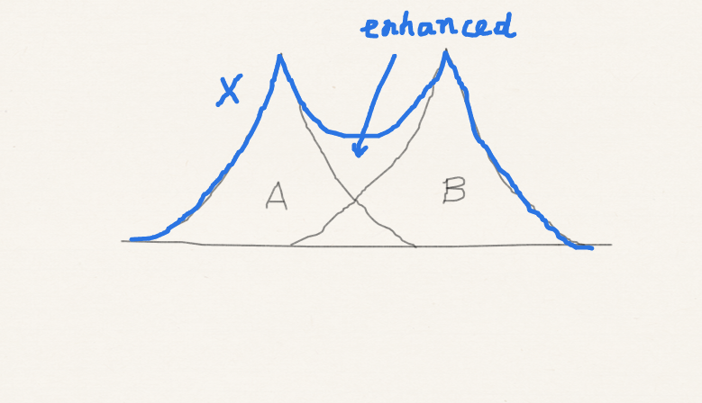
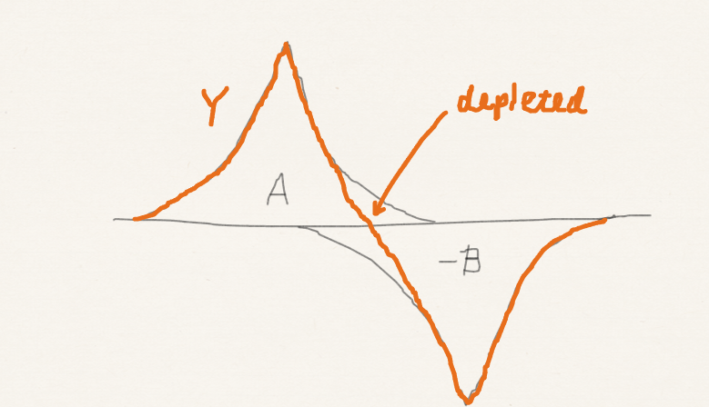
MO theory for H₂
First form molecular orbitals (MO’s) by taking linear combinations of atomic orbitals (LCAO):

Slide 5
MO theory for H₂
Construct an antisymmetric wave function by filling electrons into MO’s

Slide 6
Singlet and triplet H₂
(X)² singlet
far more stable
(X)¹(Y)¹ triplet
(X)¹(Y)¹ singlet
least stable

Slide 7
Singlet and triplet He (review)
In the increasing order of energy, the five states of He are
(1s)² singlet
by far most stable
(1s)¹(2s)¹ triplet
(1s)¹(2s)¹ singlet
least stable

Slide 8
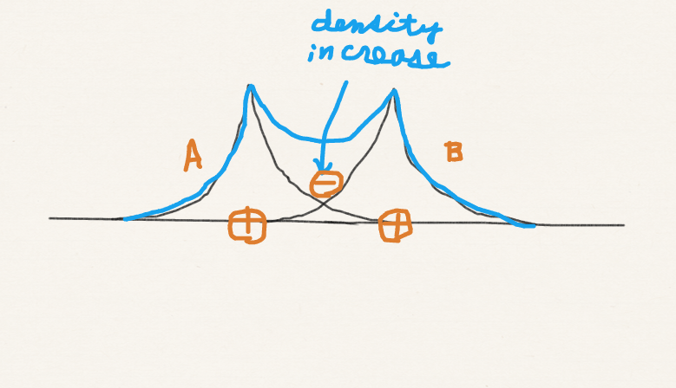
MO versus VB in H₂
VB
MO

Slide 9
MO versus VB in H₂
VB
covalent
covalent
MO
ionic
H⁻H⁺
covalent
=
covalent
ionic
H⁺H⁻

Slide 10
MO theory for H₂⁺
The simplest, one-electron molecule.
LCAO MO is by itself an approximate wave function (because there is only one electron).
Energy expectation value as an approximate energy as a function of R.
e
r_{A}
r_{B}
A
R
B
Parameter

Slide 11
LCAO MO
MO’s are completely determined by symmetry:
A
B
Normalization coefficient
LCAO-MO

Slide 12
Normalization
Normalize the MO’s:
2S

Slide 13
Bonding and anti-bonding MO’s
φ₊ = N₊(A+B)
φ– = N–(A–B)
bonding orbital – σ
anti-bonding orbital – σ*

Slide 14
Energy
Neither φ₊ nor φ– is an eigenfunction of the Hamiltonian.
Let us approximate the energy by its respective expectation value.

Slide 15
Energy

Slide 16
S, j, and k
r_{A}
r_{B}
A
R
B
r_{A}
r_{B}
A
R
B
R

Slide 17
Energy
R
R

Slide 18
Energy
φ– = N–(A–B)
anti-bonding
R
R
φ₊ = N₊(A+B)
bonding

Slide 19
Energy
φ– = N–(A–B)
anti-bonding
φ– is more anti-bonding
than φ₊ is bonding
R
E_{1s}
φ₊ = N₊(A+B)
bonding

Slide 20
Summary
MO theory is another orbital approximation but it uses LCAO MO’s rather than AO’s.
MO theory explains bonding in terms of bonding and anti-bonding MO’s. Each MO can be filled by two singlet-coupled electrons – α and β spins.
This explains the bonding in H₂⁺, the simplest paradigm of chemical bond: bound and repulsive PES’s, respectively, of bonding and anti-bonding orbitals.

