Slide 1
Lecture 23 Born-Oppenheimer approximation

Slide 2
The Born-Oppenheimer approximation
For polyatomic molecules, we use approximate separation of variables between the nuclear and electronic variables.
We first solve the electronic Schrödinger equation, in which nuclei are held fixed.
Next, we solve the nuclear Schrödinger equation.
The BO approximation introduces important chemical concepts such as potential energy surfaces, equilibrium geometries, binding energies, etc.

Slide 3
The molecular Hamiltonian
The molecular Hamiltonian is …
There is no hope that we can solve the Schrödinger equation with this Hamiltonian exactly. Can we separate variables approximately?
Kinetic (electron)
Kinetic (nuclei)
Coulomb
(e – e)
Coulomb
(n – n)
Coulomb
(e – n)

Slide 4
Separation of the Hamiltonian
H_{e}(r)
Kinetic (electron)
Kinetic (nuclei)
Coulomb
(e – e)
Coulomb
(n – n)
Coulomb
(e – n)
H_{n}(R)

Slide 5
Separation of the wave function
The first step of (approximate) separation of variables: assumption of product form of wave function
Electronic coordinates
Electronic wave function
Nuclear coordinates
Nuclear wave function

Slide 6
Separation of the wave function
The second step: substitution into the Schrödinger equation.
resists separation
involves also nuclear coordinates

Slide 7
Separation of the wave function
… we must demote some variables to parameters.
parameters R are held fixed
nuclear coords. are considered parameters

Slide 8
Parameters versus variables
Parameters are arguments of a function with which no differentiation or integration is performed. For example, the electron mass is a parameter. Parameters are held fixed.
Variables are arguments of a function with which differentiation or integration is performed. For example, electron coordinates in the hydrogenic Schrödinger equation are variables. Variables do vary.

Slide 9
Separation of the wave function
The third step: divide the whole equation by wave function.
Separation achieved
Electronic structure
Nuclear dynamics

Slide 10
The Born-Oppenheimer approximation
The BO approximation breaks the original problem into two smaller problems that must be solved in sequence:
Electronic structure (nuclei held fixed)
Nuclear dynamics
Potential energy surface (PES)

Slide 11
The Born-Oppenheimer approximation
In the electronic Schrödinger equation, nuclear coordinates are parameters and their kinetic energy operator does not act on them; the nuclei are held fixed. This is justified by that a nucleus is 1800+ times heavier than an electron and sluggish.
The electronic Schrödinger equation must be solved for various nuclear positions, forming a part of the potential energy surface.
The PES is the effective potential the nuclei feel and a part of the Hamiltonian for the nuclear Schrödinger equation.

Slide 12
Chemical concepts from BO
Electronic structure and nuclear dynamics (molecular vibration and rotation). Translational motion is separable exactly.
Potential energy (hyper)surfaces and curves – effective potentials that nuclei feel. One PES for each electronic state.
Equilibrium structure, binding energy, vibrational energy levels, rotational energy levels, Franck-Condon factors (see later lectures), nonadiabatic transition.

Slide 13
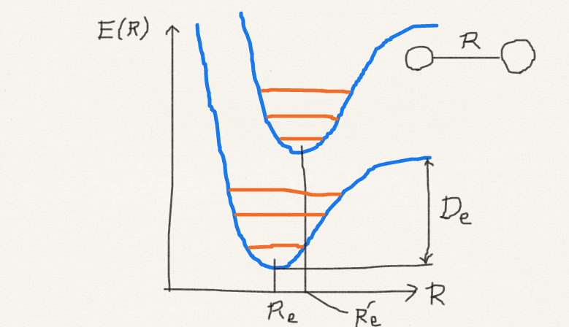
Chemical concepts from BO

Slide 14
Dynamical degrees of freedom
n electrons + N nuclei: 3(n+N) dynamical degrees of freedom.
Electronic structure: 3n dynamical DOF.
Nuclear dynamics: 3N dynamical DOF.
Translational DOF: 3.
Rotational DOF: 3 (nonlinear) or 2 (linear).
Vibrational DOF: 3N−6 (nonlinear) or 3N−5 (linear).

Slide 15
Dynamical degrees of freedom
all
3n+3N
electronic
3n
nuclear
3N
translational
3
relative
3N−3
rotational
3 or 2
vibrational
3N−6 or 3N−5
Born-Oppenheimer approximation
Exact separation
Rigid rotor approximation

Slide 16
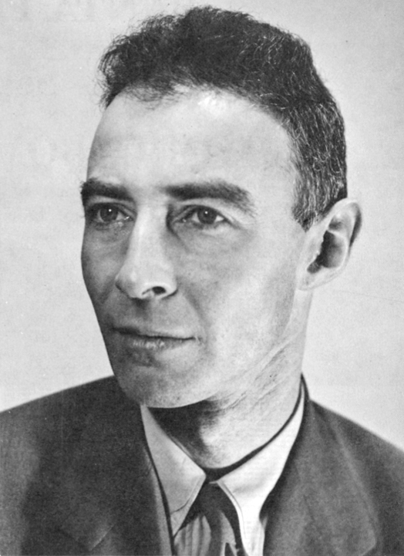
Summary
The BO is the approximate separation of variables.
It is one of the most accurate approximations in chemistry.
This leads to solving (1) electronic structure with clamped nuclei and then (2) nuclear dynamics with the PES from (1).
This is justified by nuclear mass >> electron mass.
J. Robert Oppenheimer
Public-domain image
It is the basis of many chemistry concepts.

