Slide 1
Lecture 22
Spin-orbit coupling

Slide 2
Spin-orbit coupling
Spin makes an electron act like a small magnet. An electron orbiting around the nucleus also makes a magnet. These two magnetic moments interact with each other and orbital energy will be slightly altered.
We use the so-called Na D line as a paradigm.
We use the first-order perturbation theory to describe the shifts in orbital energies.
The spin-orbit interaction is a relativistic effect and its derivation is beyond the scope of this course. We treat it as a phenomenological effect explained in analogy to two interacting magnets.

Slide 3
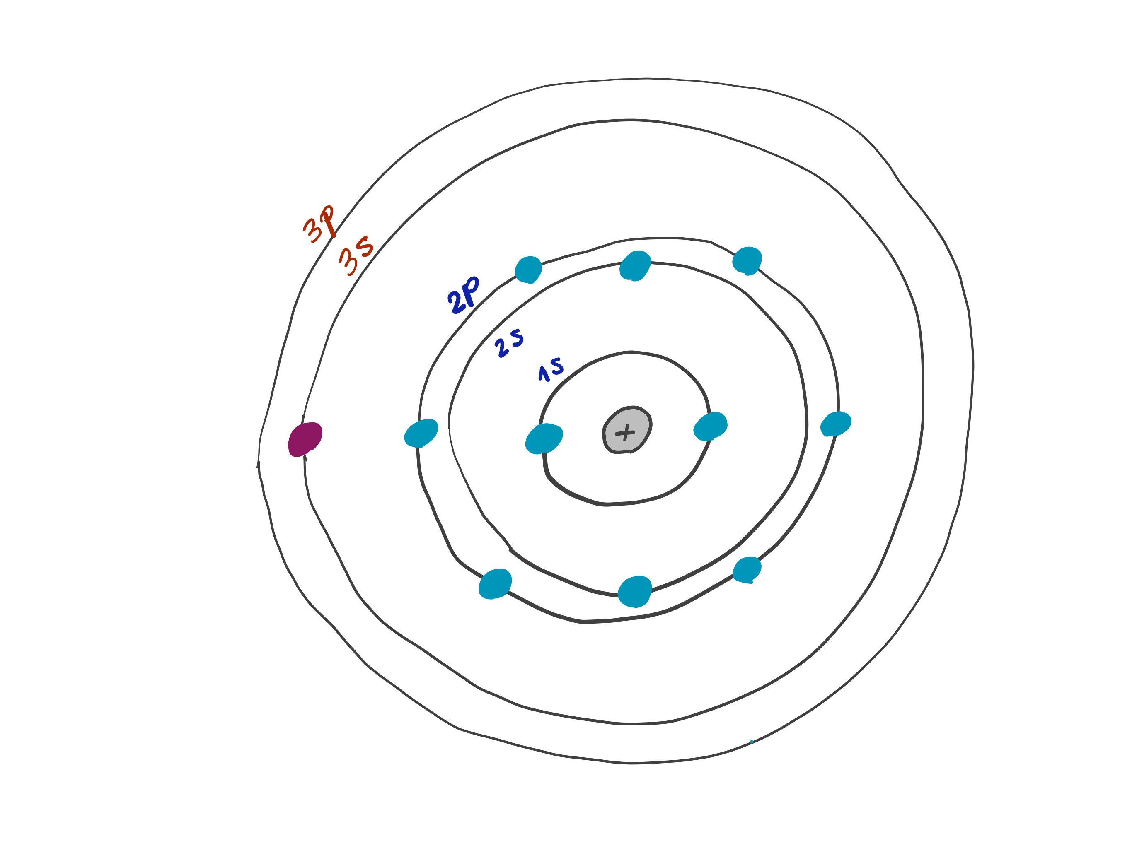
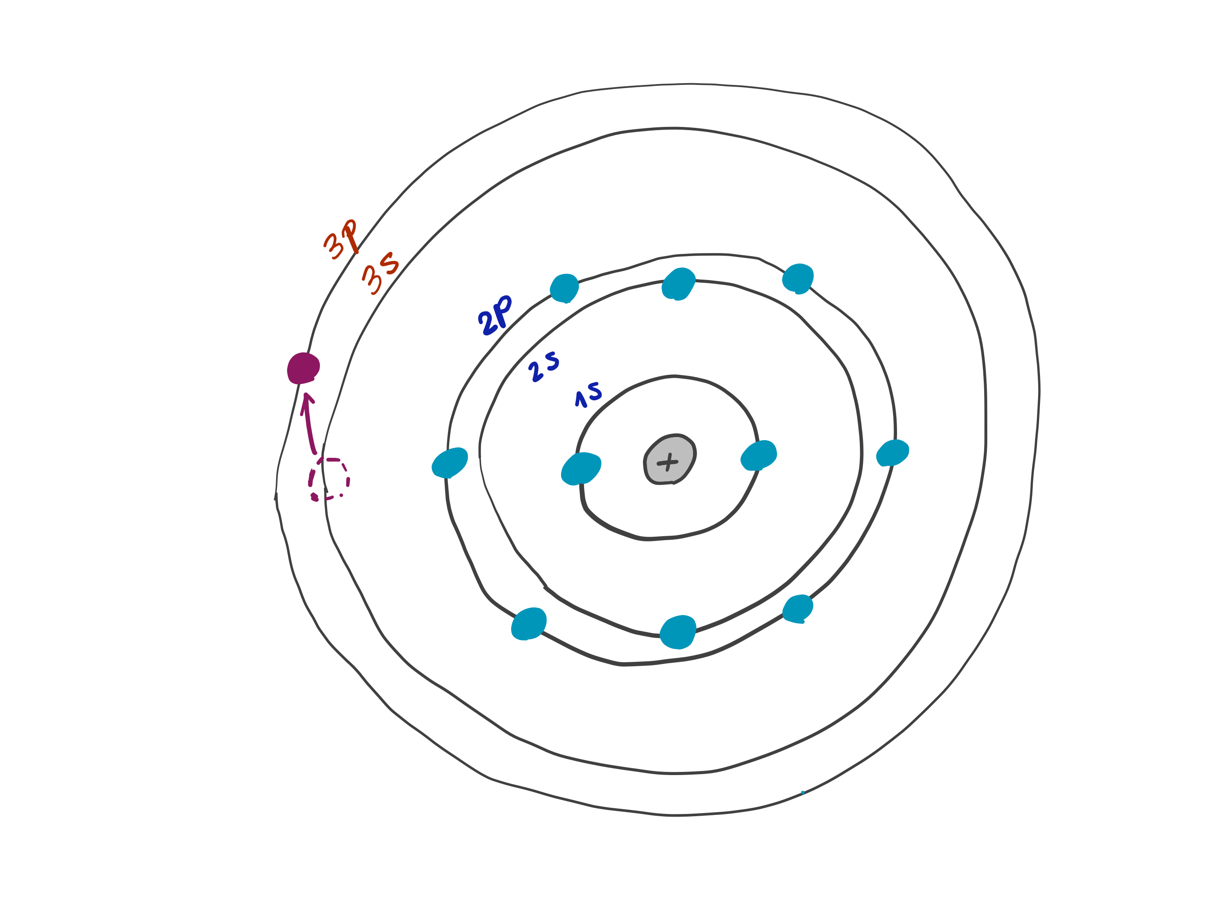
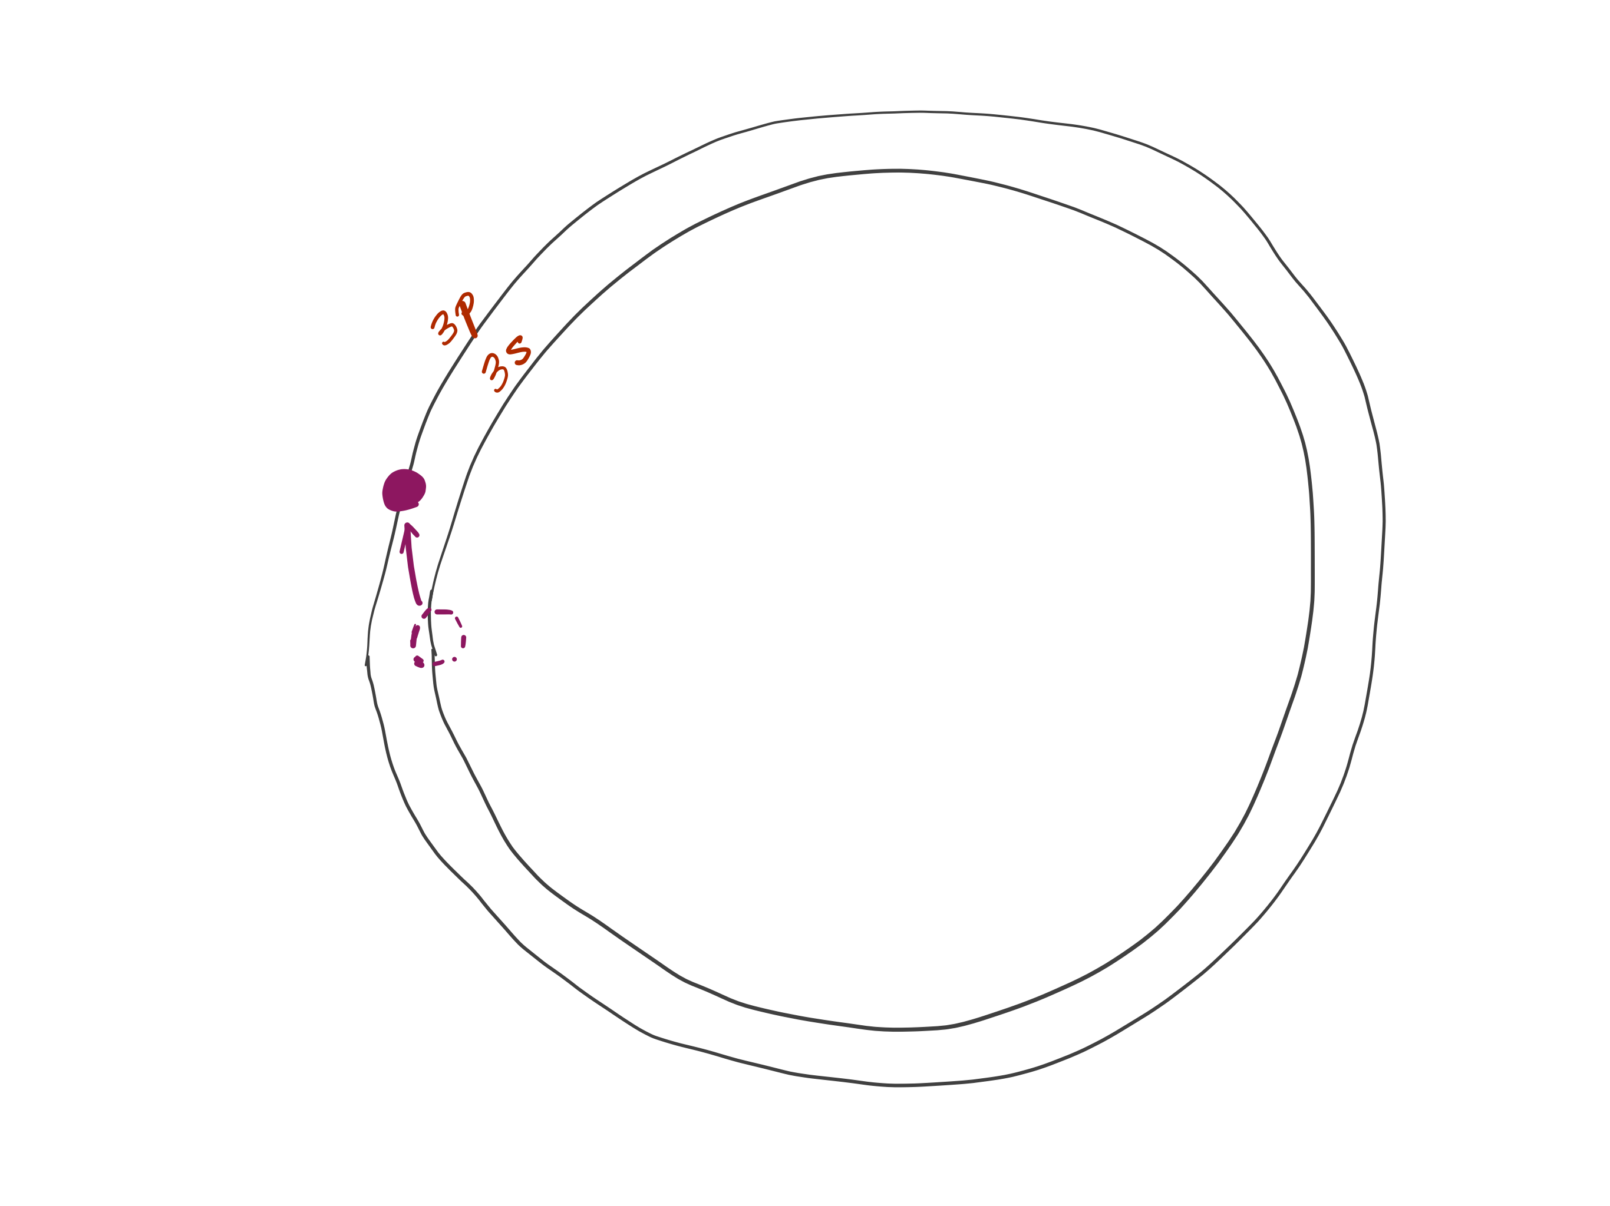
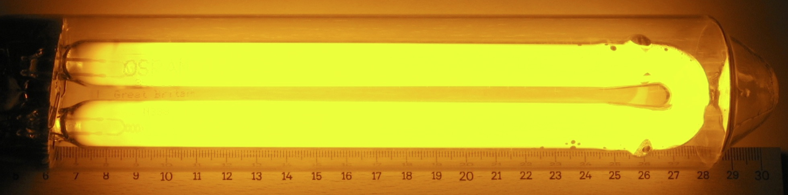
Na D line
The orange color of the sodium lamp is due to the Na 3p→3s emission at ca. 17000 cm⁻¹.
Public-domain image from Wikipedia

Slide 4
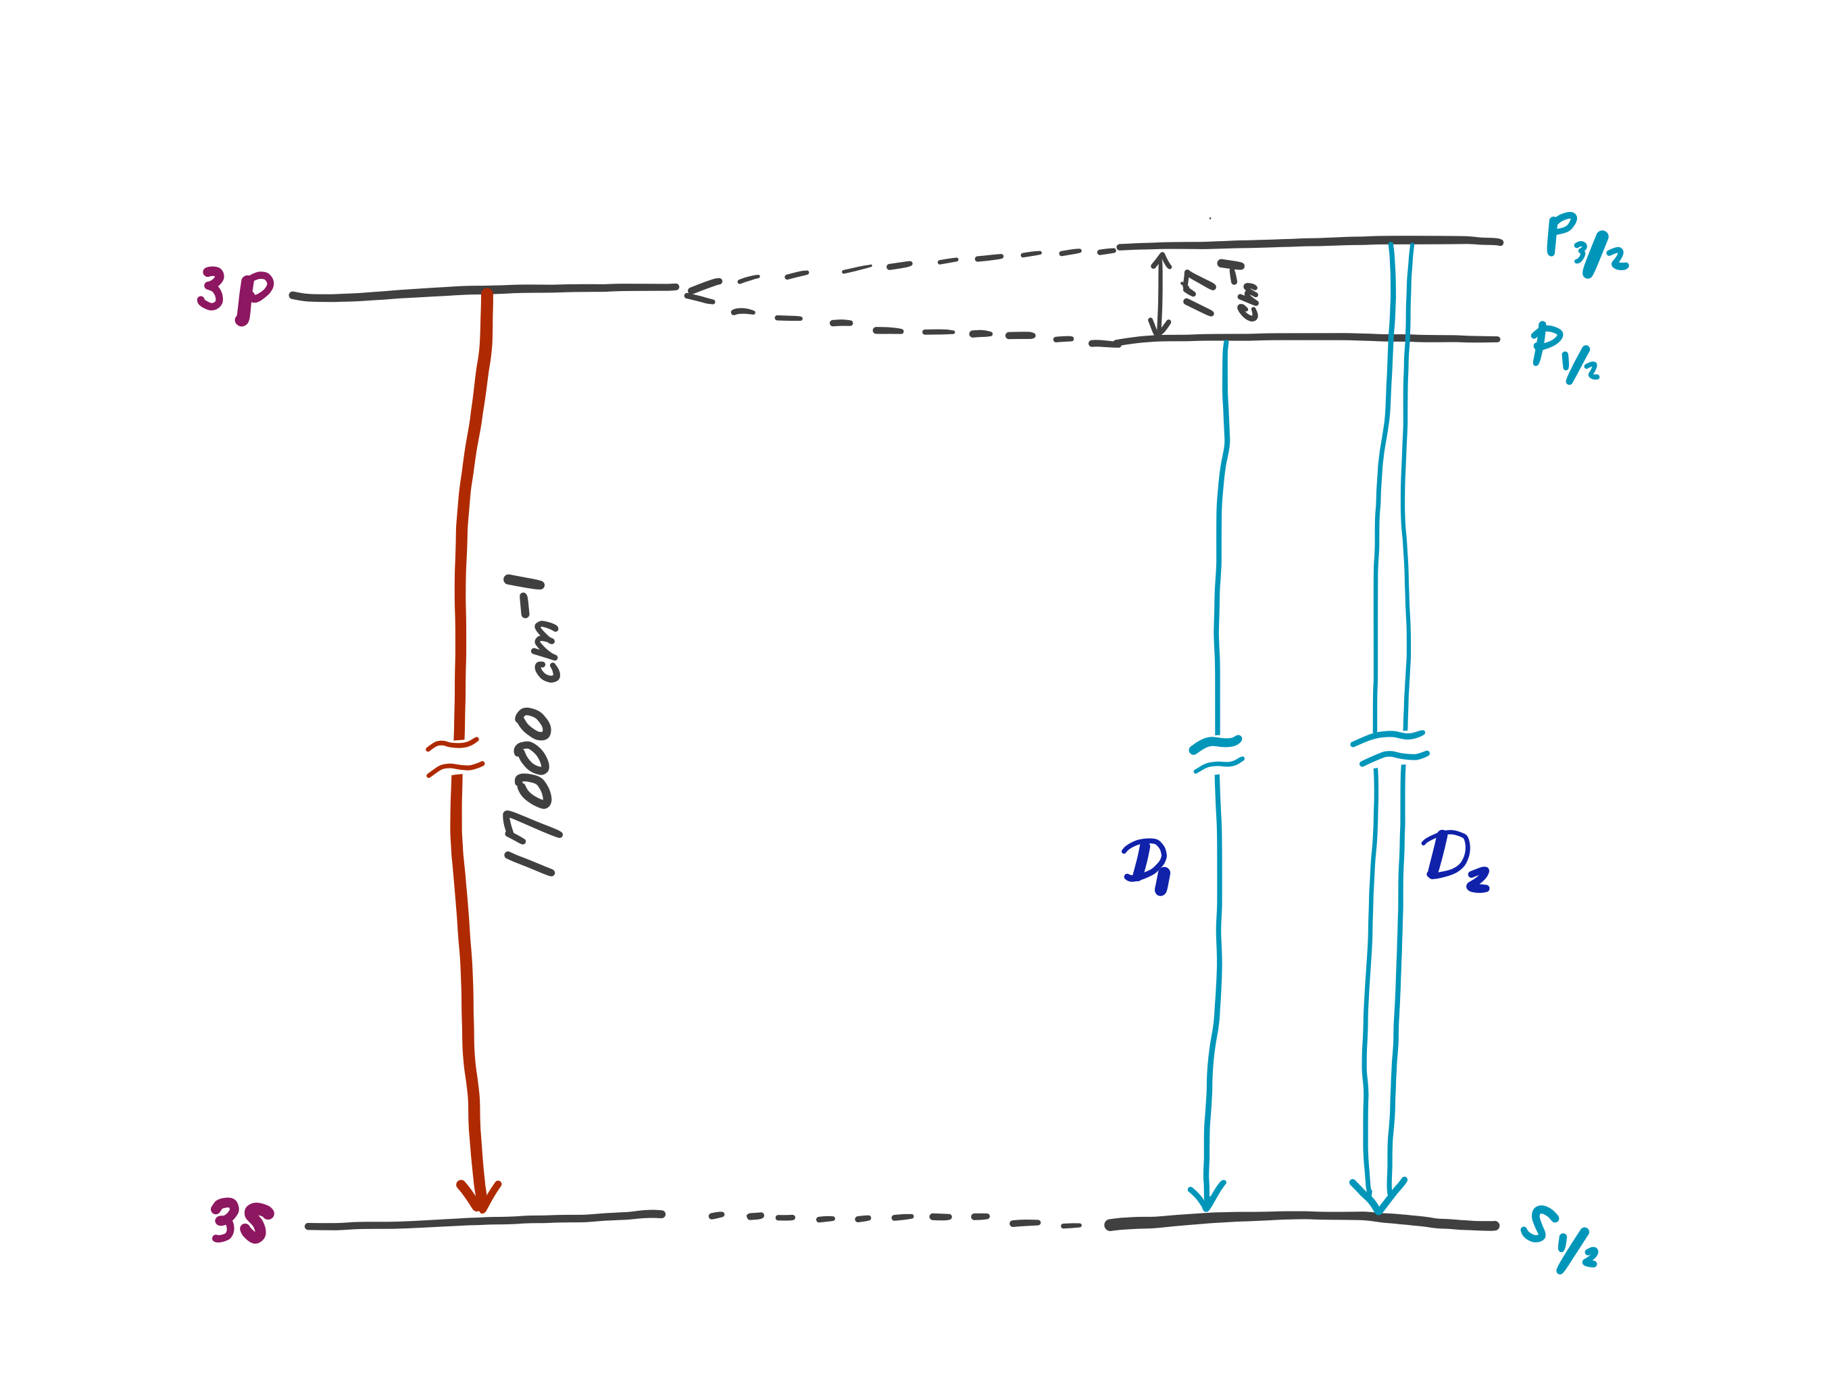
Na D line
A close examination of this transition reveals that the emission band consists of two bands separated by 17 cm⁻¹.

Slide 5
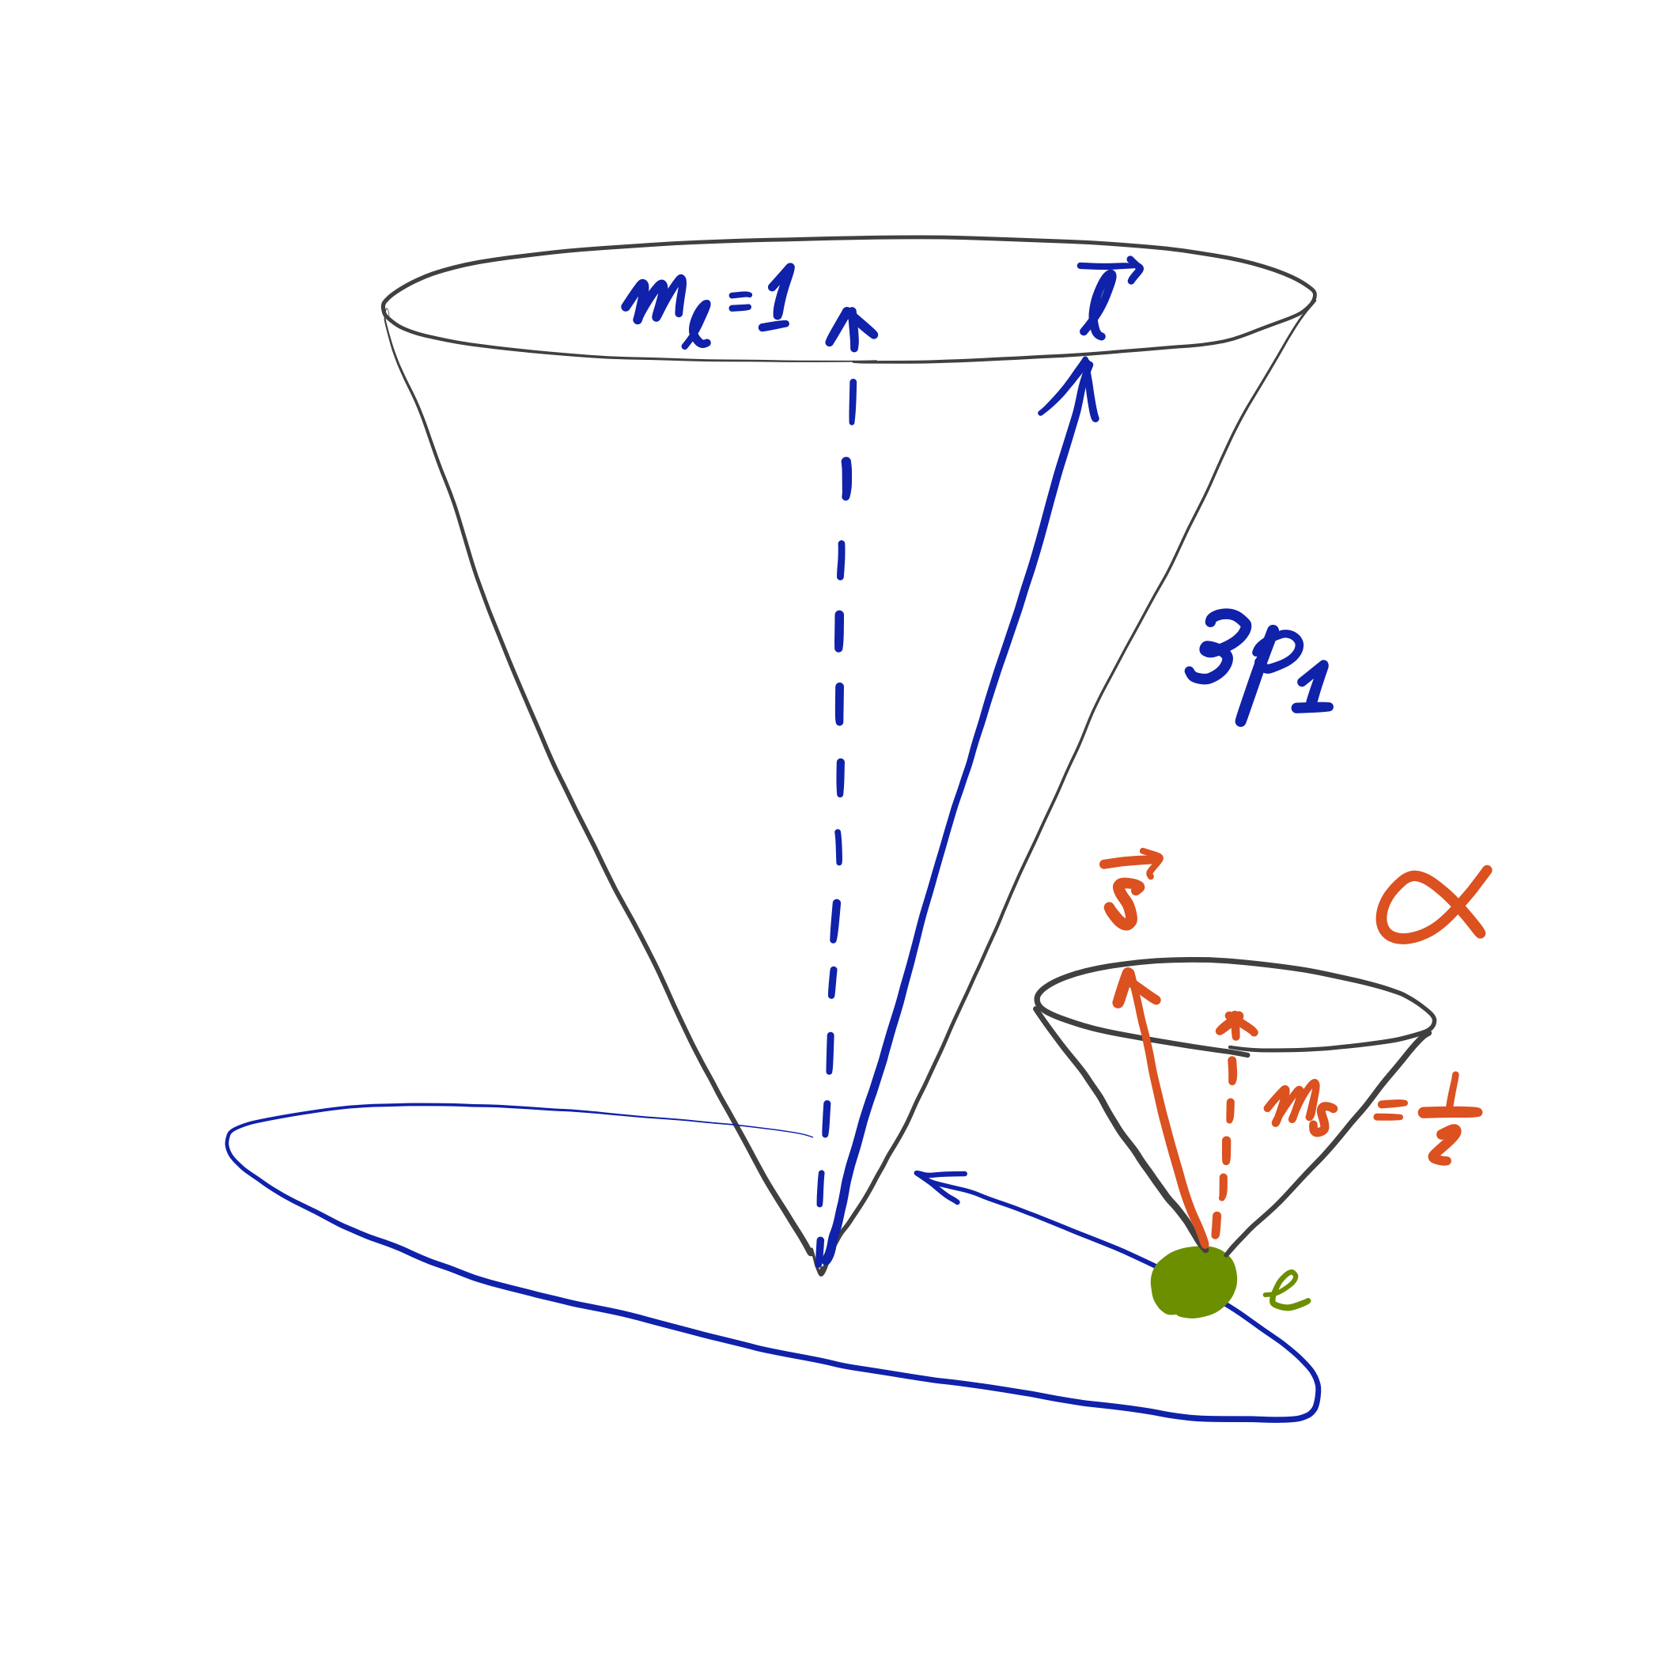
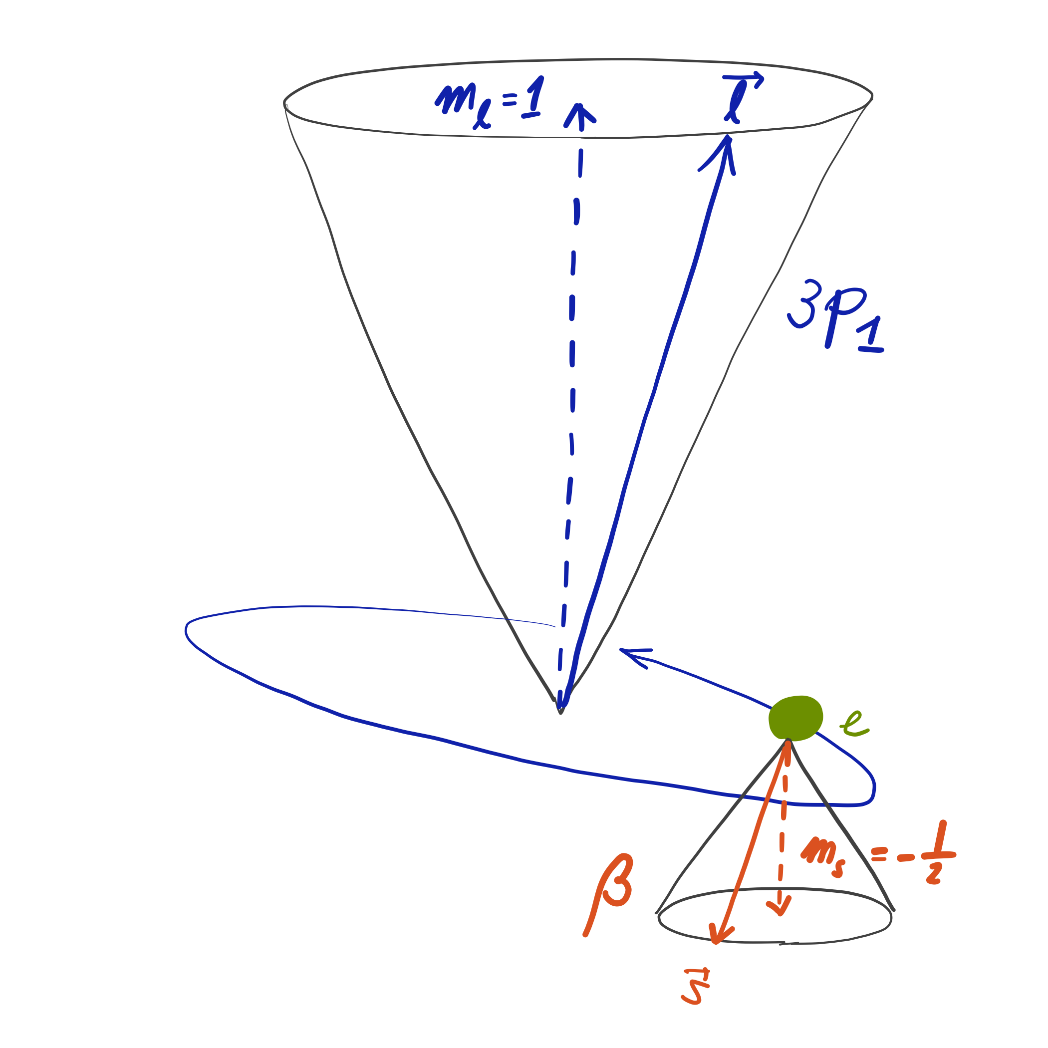
Spin-orbit coupling
Spin of an electron makes it a magnet. Orbital motion of the electron also makes it a magnet. These two magnetic moments can interact or “couple” (spin-orbit coupling) and cause energy level splitting.
S
S
N
N
S
N
N
S

Slide 6
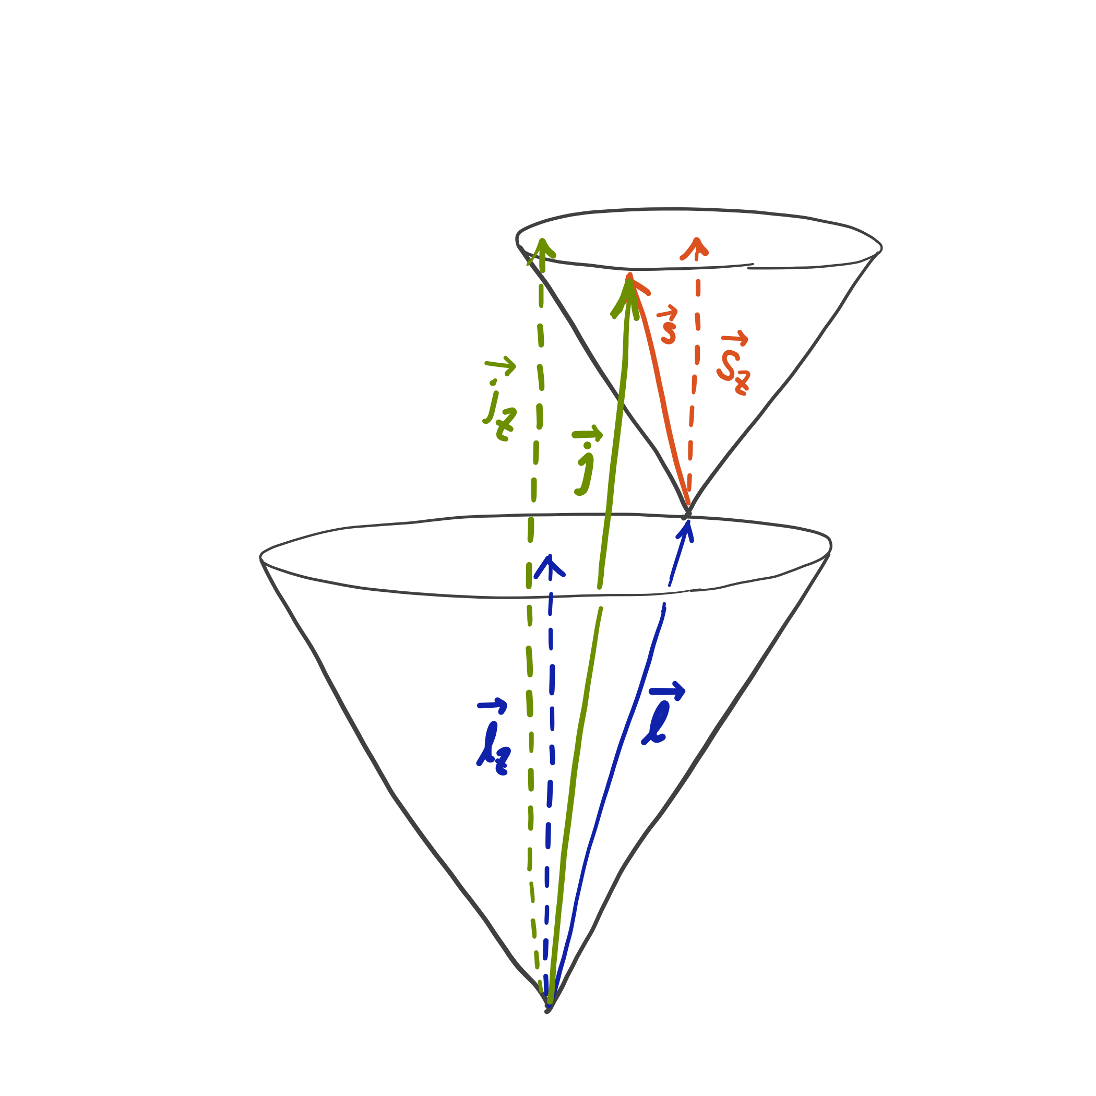
Sum of angular momenta
An electron has orbital angular momentum and spin angular momentum.
The total momentum
is their vector addition.
Total
Orbital
Spin

Slide 7
Sum of angular momenta
must be (space) quantized.
Its corresponding quantum numbers j and m_{j} are either a full or half integer.
The total and z-comp.
angular momenta are
and .
Total
Orbital
Spin

Slide 8
Sum of spins (review)
(parallel)
(anti-parallel)

Slide 9
Sum of angular momenta
(parallel)
(anti-parallel)

Slide 10
Examples
Identify the levels that may arise from the configurations (a) (3p)¹, (b) (3s)¹.

Slide 11
Examples
(a) (3p)¹ → l = 1; s = 1/2
j = 1+1/2, …, |1 – 1/2| = 3/2 or 1/2
(b) (3s)¹ → l = 0; s = 1/2
j = 0+1/2, …, |0 – 1/2| = 1/2

Slide 12
Spin-orbit coupling
Two magnets are the most stable when they are anti-parallel and the least stable when they are parallel.
In general, the energy due to the interaction of spin and orbital momenta is
S
N
S
S
N
S
N
N
S
N
N
S

Slide 13
Spin-orbit coupling operator
The atomic Hamiltonian does not have SO:
This is because the classical energy expression lacks SO, and the Hamiltonian is derived from the classical energy expression. We add spin-orbit interaction operator:

Slide 14
Spin-orbit coupling operator
The spin-orbit interaction operator
has the spin-orbit coupling constant A. It is in units of cm⁻¹, which is why hc is multiplied.
The value of A is extracted from experiment (11.5 cm⁻¹ for Na 3p from the splitting of 17 cm⁻¹) or relativistic quantum mechanics.

Slide 15
Spin-orbit coupling operator
The spin-orbit interaction operator
makes the solution of the Schrödinger equation even more difficult.
Since A is very small (0.001 of 3p-3s energy difference), we use perturbation theory.

Slide 16
First-order perturbation theory
(We used the fact that and commute.)

Slide 17
First-order perturbation theory

Slide 18
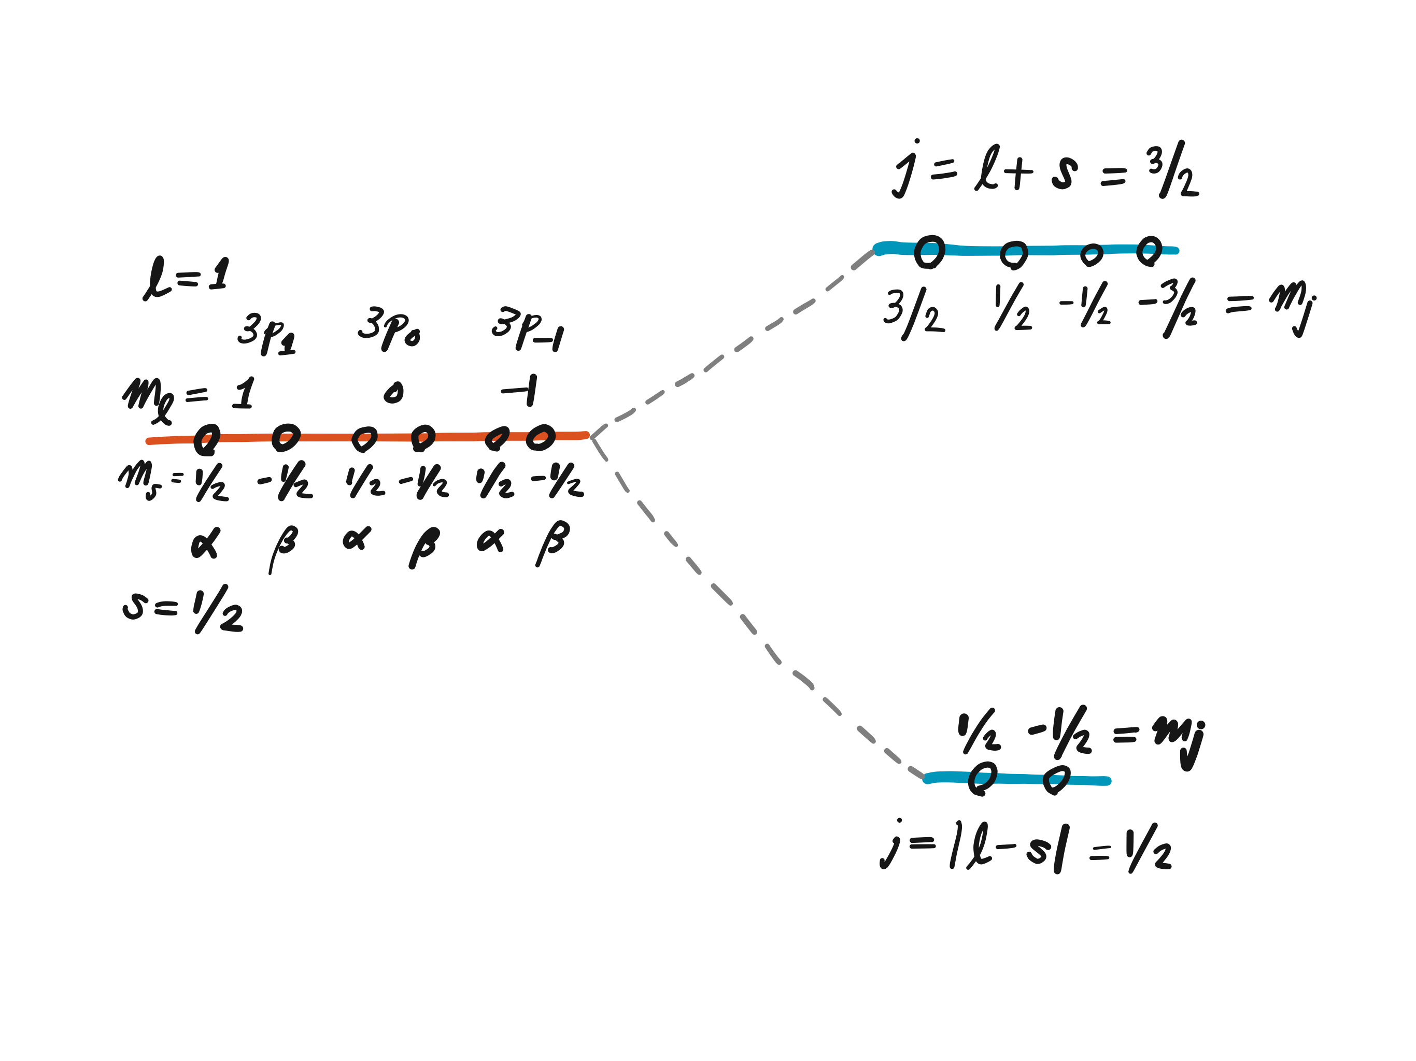
Na D line

Slide 19
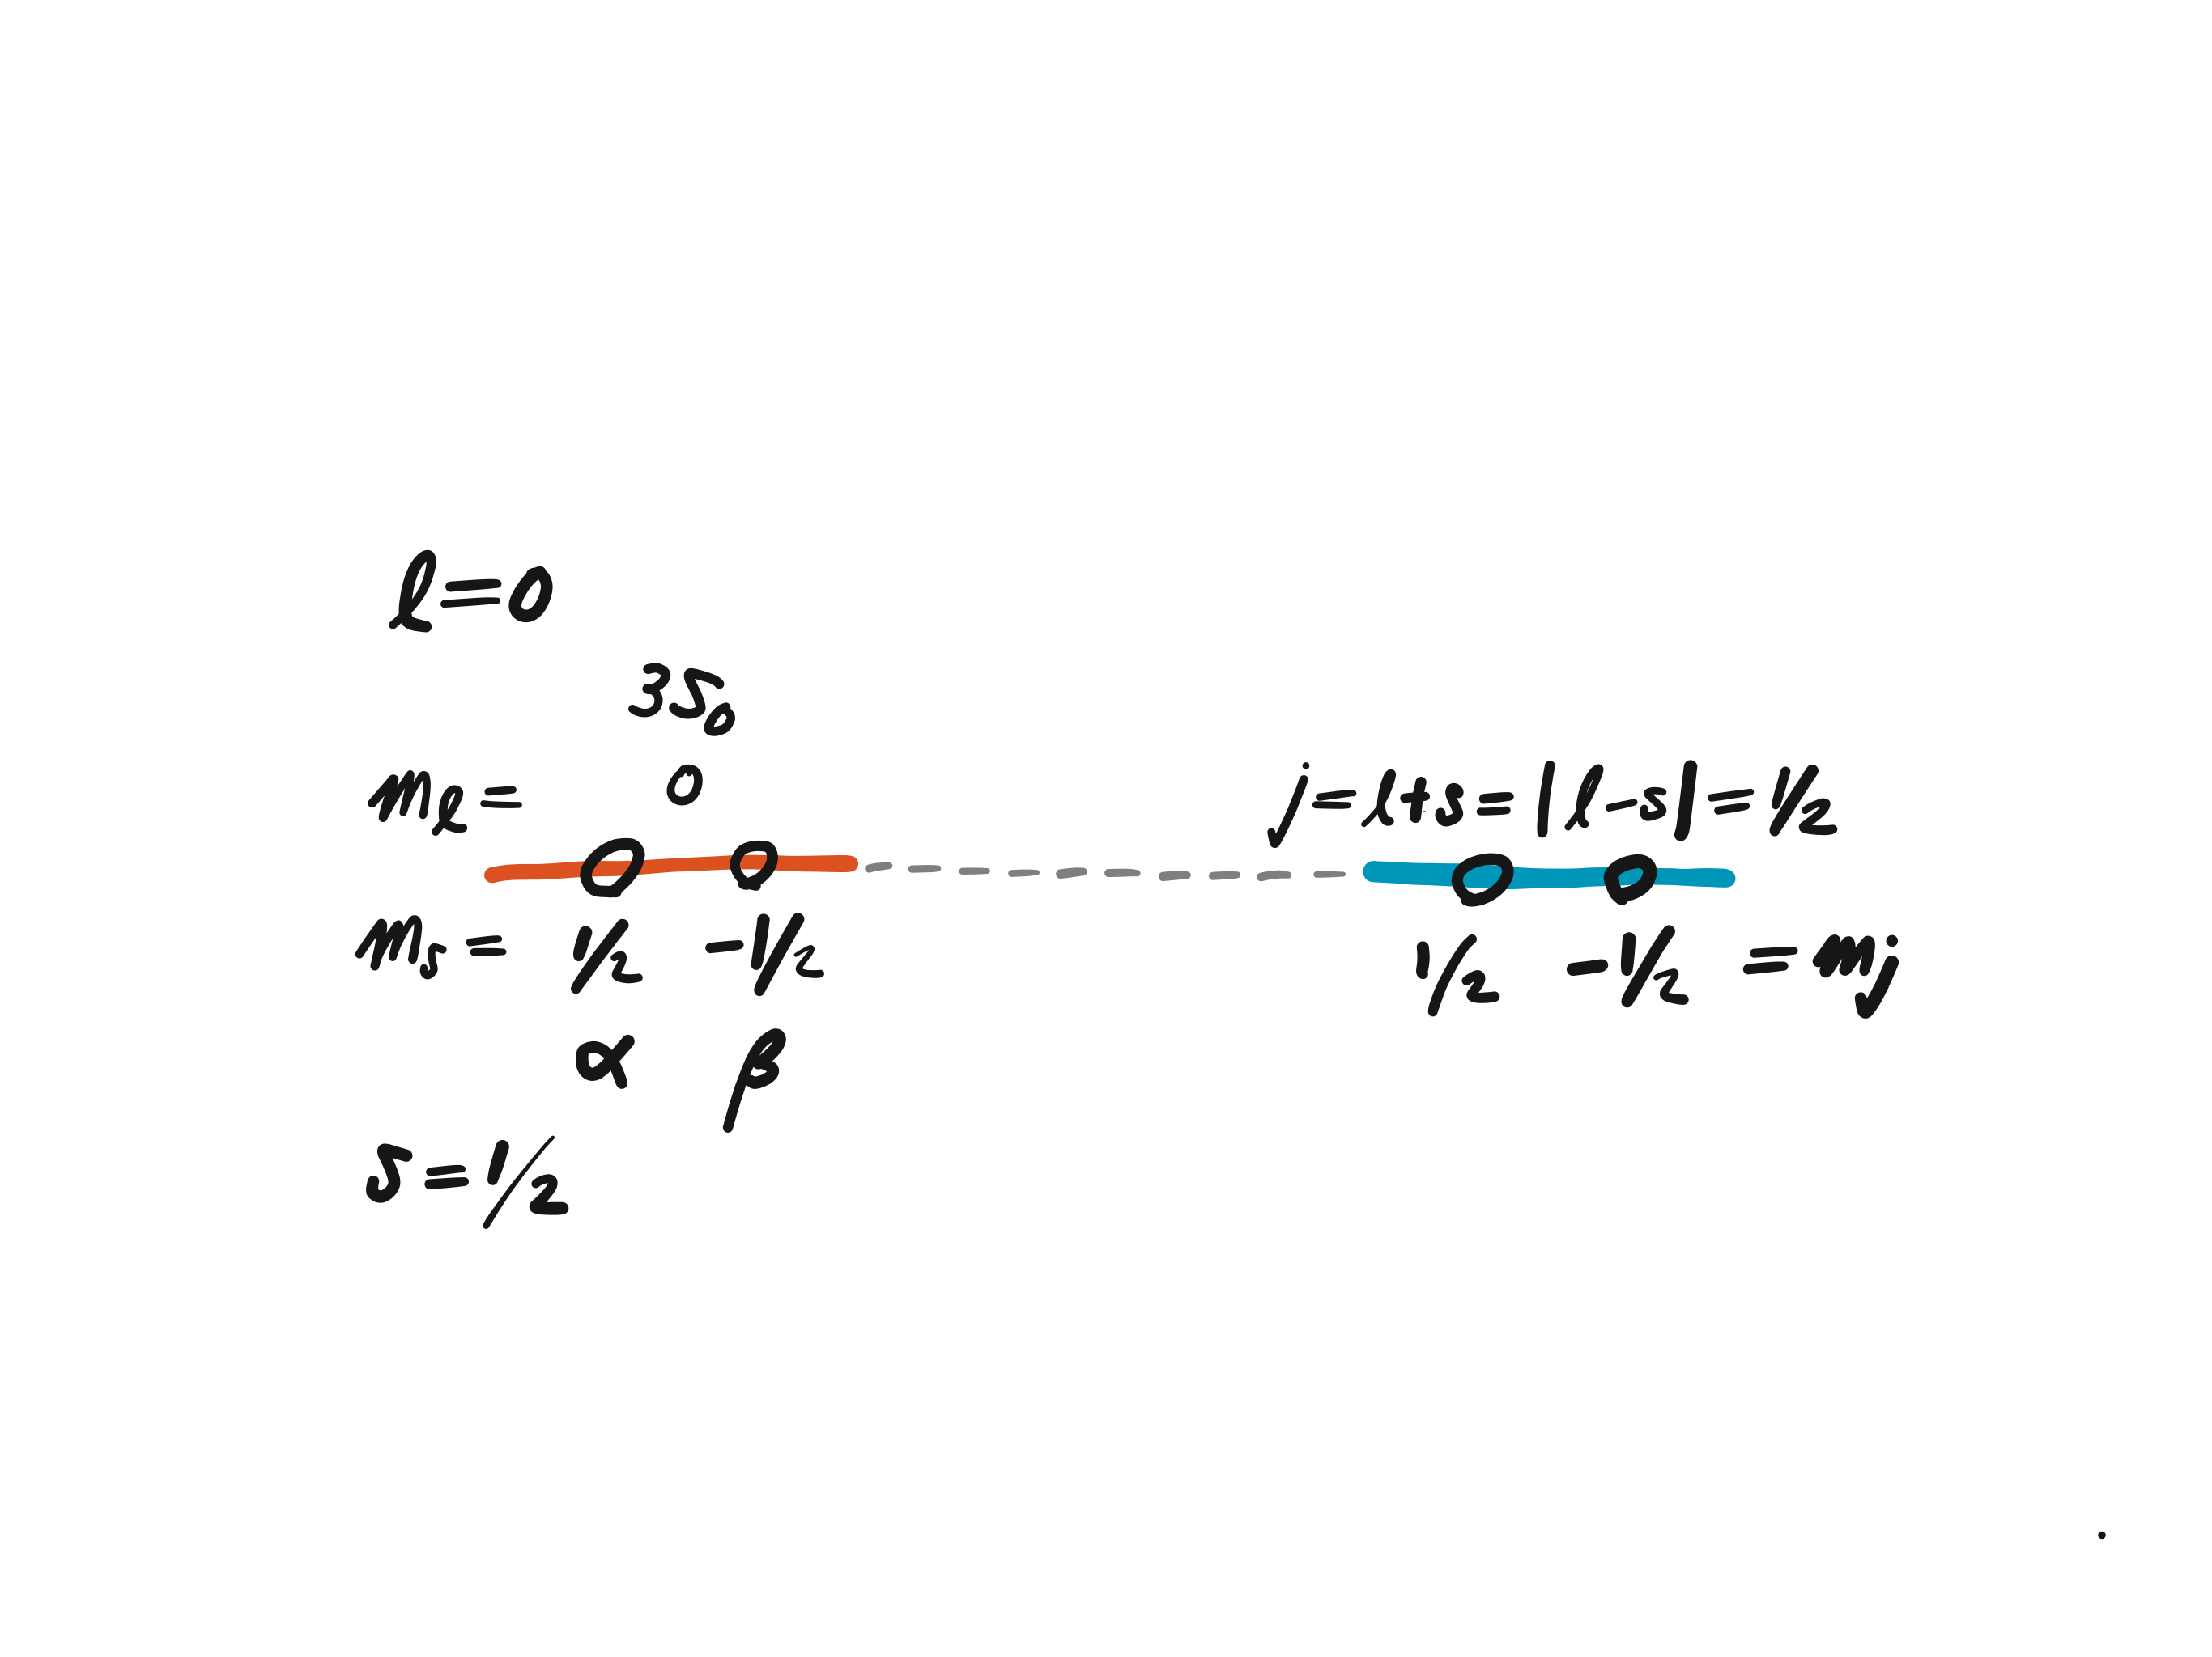
Na D line

Slide 20
Na D line
4-fold degenerate
2-fold degenerate

Slide 21
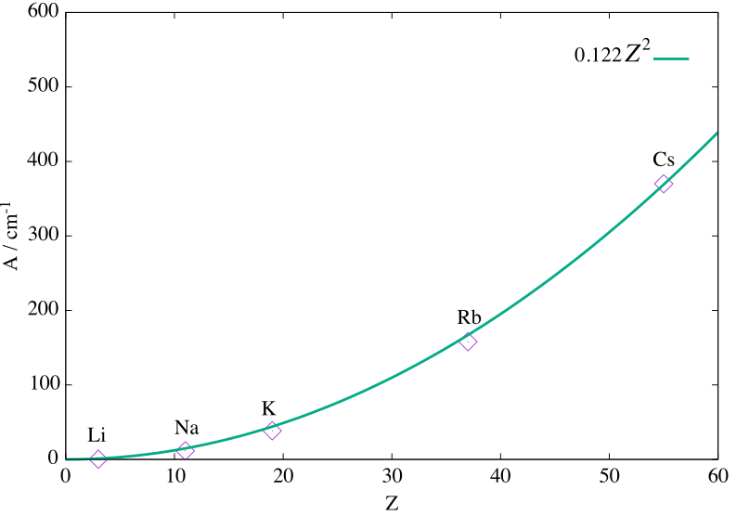
Spin-orbit coupling constants
The measured A values:
  Li (Z = 3): 0.23 cm^{–1}
  Na (Z = 11): 11.5 cm^{–1}
  K (Z = 19): 38.5 cm^{–1}
  Rb (Z = 37): 158 cm^{–1}
  Cs (Z = 55): 370 cm^{–1}
Spin-orbit coupling arises from the special theory of relativity and is greater for heavier elements because the 1s electrons in high-Z elements travel at a speed that reaches a fraction of the speed of light.

Slide 22
Challenge homework #6
Study the special theory of relativity (Special Theory for Relativity for Beginners by Freund).
Study Dirac’s theory of relativistic quantum mechanics (Modern Quantum Mechanics, 2nd Ed by Sakurai & Napolitano) and explain how spins and positrons emerge naturally in this theory.
Learn about relativistic effects in chemistry from Pekka Pyykkö, Acc. Chem. Res. 12, 276 (1979); Chem. Rev. 88, 563 (1988); Annu. Rev. Phys. Chem. 63, 45 (2012).

Slide 23
Consequences of SO coupling
An electron in each orbital no longer has a well-defined spin (z-component angular momentum).
States are no longer pure spin-singlet, doublet, triplet, etc.
Radiative transitions between singlet and triplet, between doublet and quartet, etc. become weakly allowed (phosphorescence).
Nonradiative transitions between singlet and triplet, etc. become weakly allowed (intersystem crossing).
These are more prevalent in heavier elements.

Slide 24
Singlet and triplet states
The singlet and triplet states are eigenfunctions of and operators with different eigenvalues. They are orthogonal if there is no spin-orbit coupling.
Separable because z operator does not act on spin part.
This is zero when final and initial states have different spin multiplicities, e.g., singlet and triplet.

Slide 25
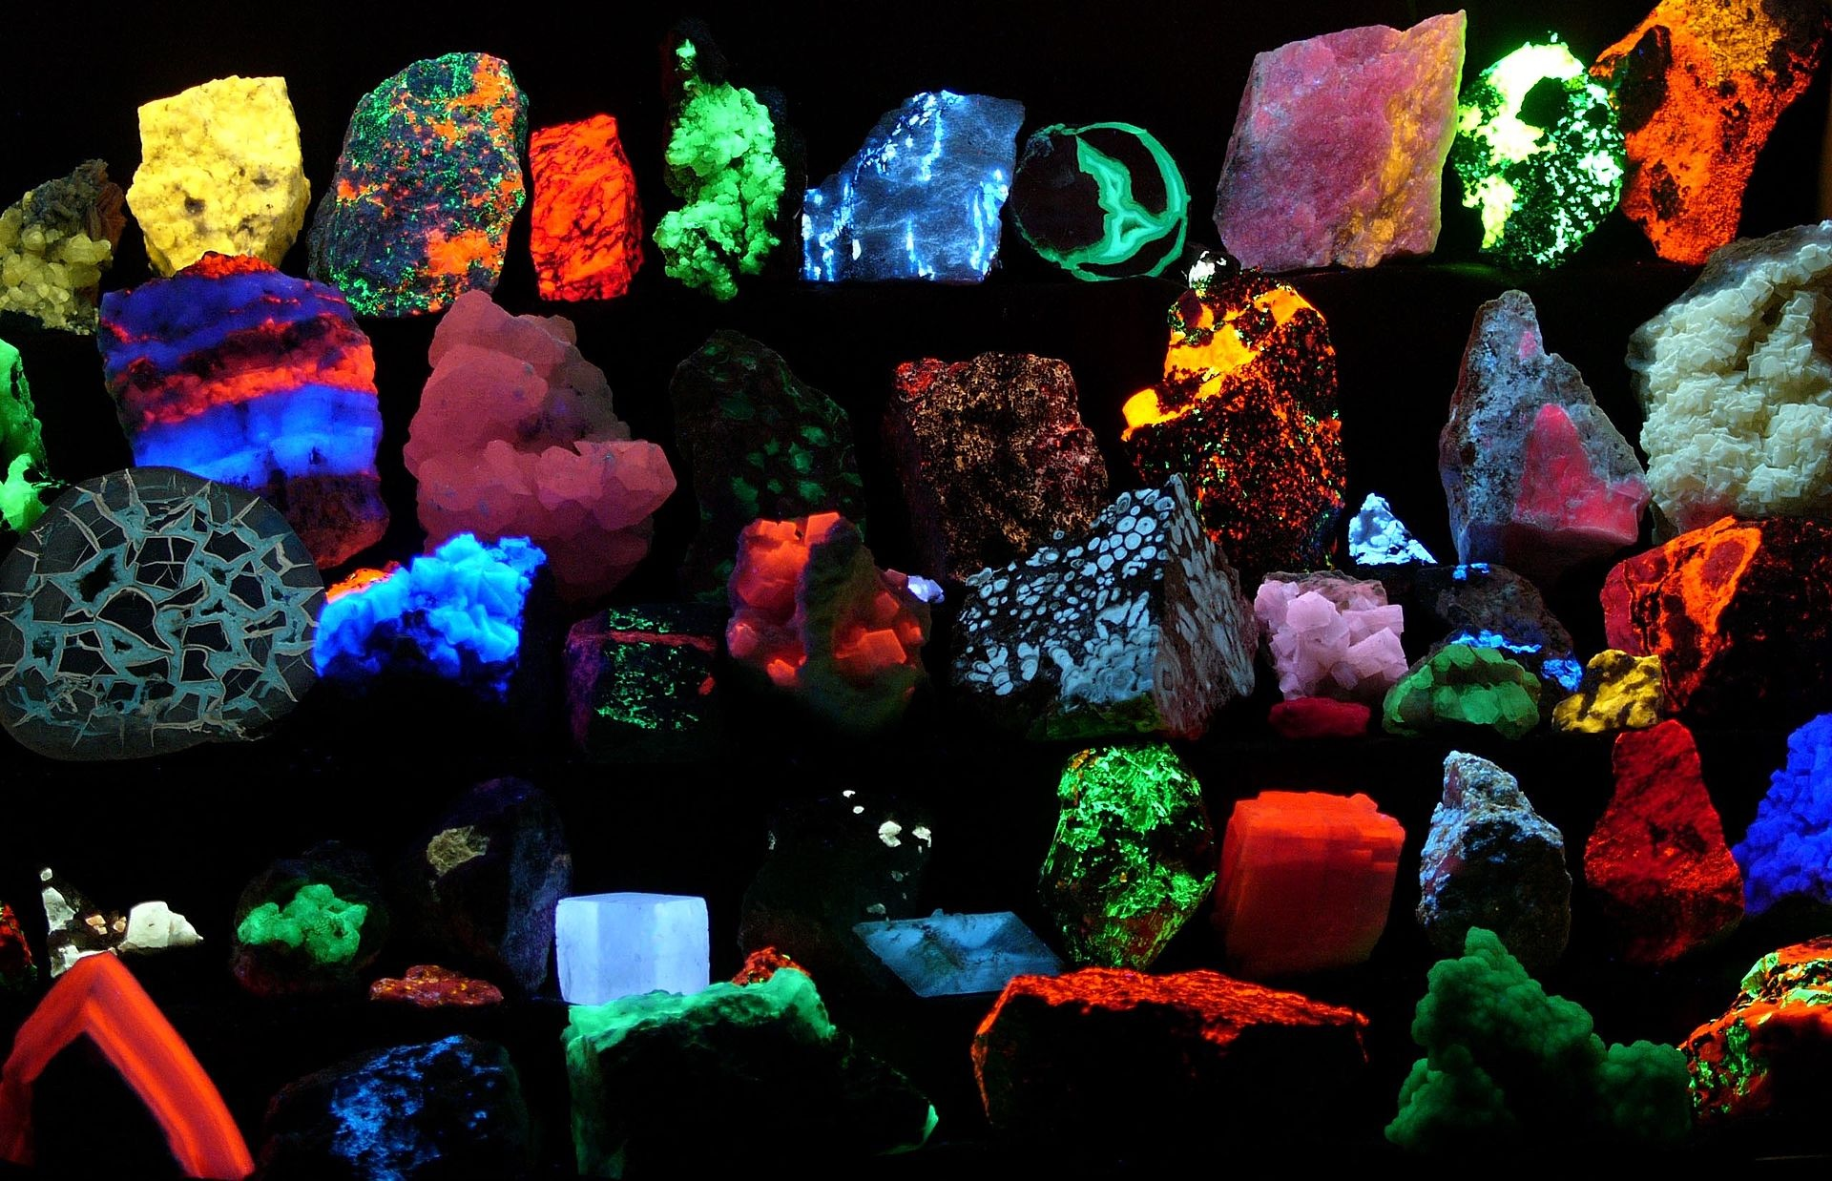
Fluorescence & IC
singlet
Fluorescence is an emission of light due to an optical transition between states of the same spin multiplicities (e.g., singlet to singlet).
Since this is an allowed transition, it is intense and fast.
Internal conversion (IC) is
a nonradiative transition
between states of the same
spin multiplicities.
singlet
IC
Fluorescence
singlet
“Fluorescent minerals emit visible light when exposed to ultraviolet light.”
Image taken from Wikipedia ((Hgrobe 06:16, 26 April 2006 (UTC)) - credit: Hannes Grobe/AWI - Own work)

Slide 26
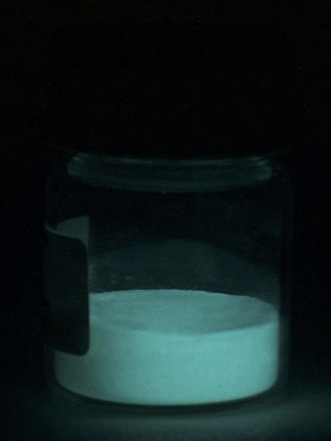
Phosphorescence & ISC
singlet
Phosphorescence is an emission of light due to an optical transition between states with different spin multiplicities (e.g., triplet to singlet).
Since this is a forbidden transition without spin-orbit coupling, it is weak and slow.
Intersystem crossing (ISC) is a nonradiative transition between states with different spin multiplicities.
triplet
ISC
Phosphorescence
singlet
Phosphorescence in total darkness
Public-domain image from Wikipedia

Slide 27
Summary
Spin angular momentum as a magnet and orbital angular momentum as another magnet interact with each other via spin-orbit coupling.
Spin-orbit coupling is a relativistic effect and is greater in heavy-element compounds.
It causes splitting of subshell states, phosphorescence, and intersystem crossing.
The first-order perturbation theory can accurately calculate the energy shifts due to spin-orbit coupling in light-element compounds.

