Slide 1
Lecture 2
Wave-particle duality

Slide 2
Wave-particle duality
Light has particle-like characteristics and electrons have wave-like characteristics. The de Broglie relation between wavelength and momentum λ = h / p quantifies these competing characteristics.
It is difficult to have a good mental image of a physical entity being a wave and a particle at the same time. We might just accept this as physical reality.

Slide 3
The particle character of light
In explaining black body radiation and heat capacity, Planck and Einstein had to assume that the energy of light is limited to 0, hv, 2hv, 3hv, ….
This suggests that light is a countable, particle-like entity. We call the particle a photon.

Slide 4
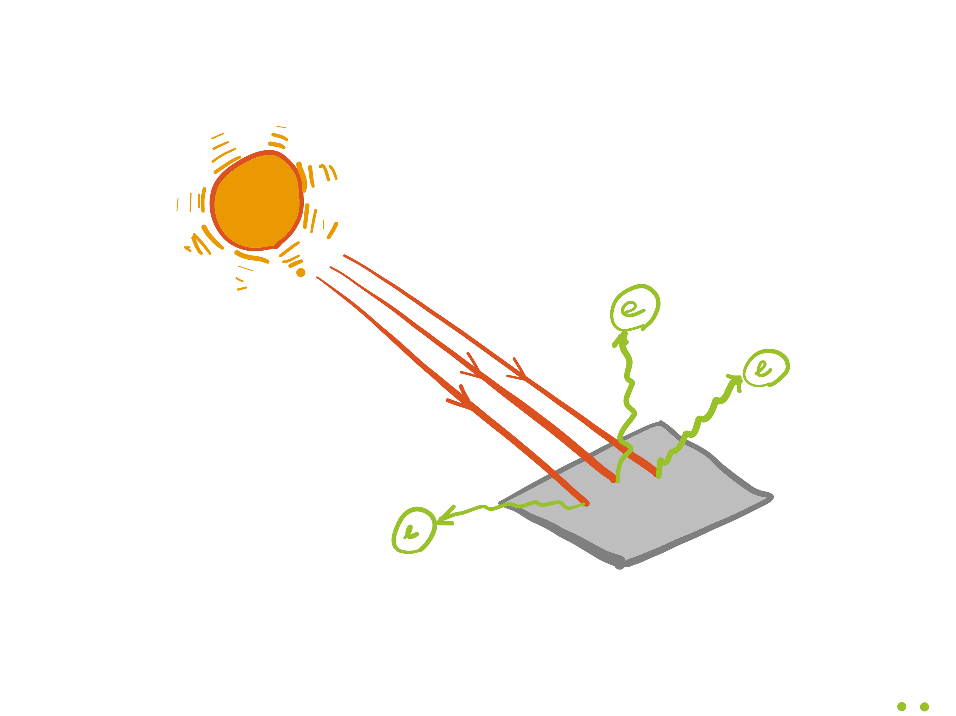
Photoelectric effect
The ejection of electrons from metal surfaces when exposed to ultraviolet radiation.
This phenomenon is related to solar cells, night vision devices, and photoelectron spectroscopy.

Slide 5
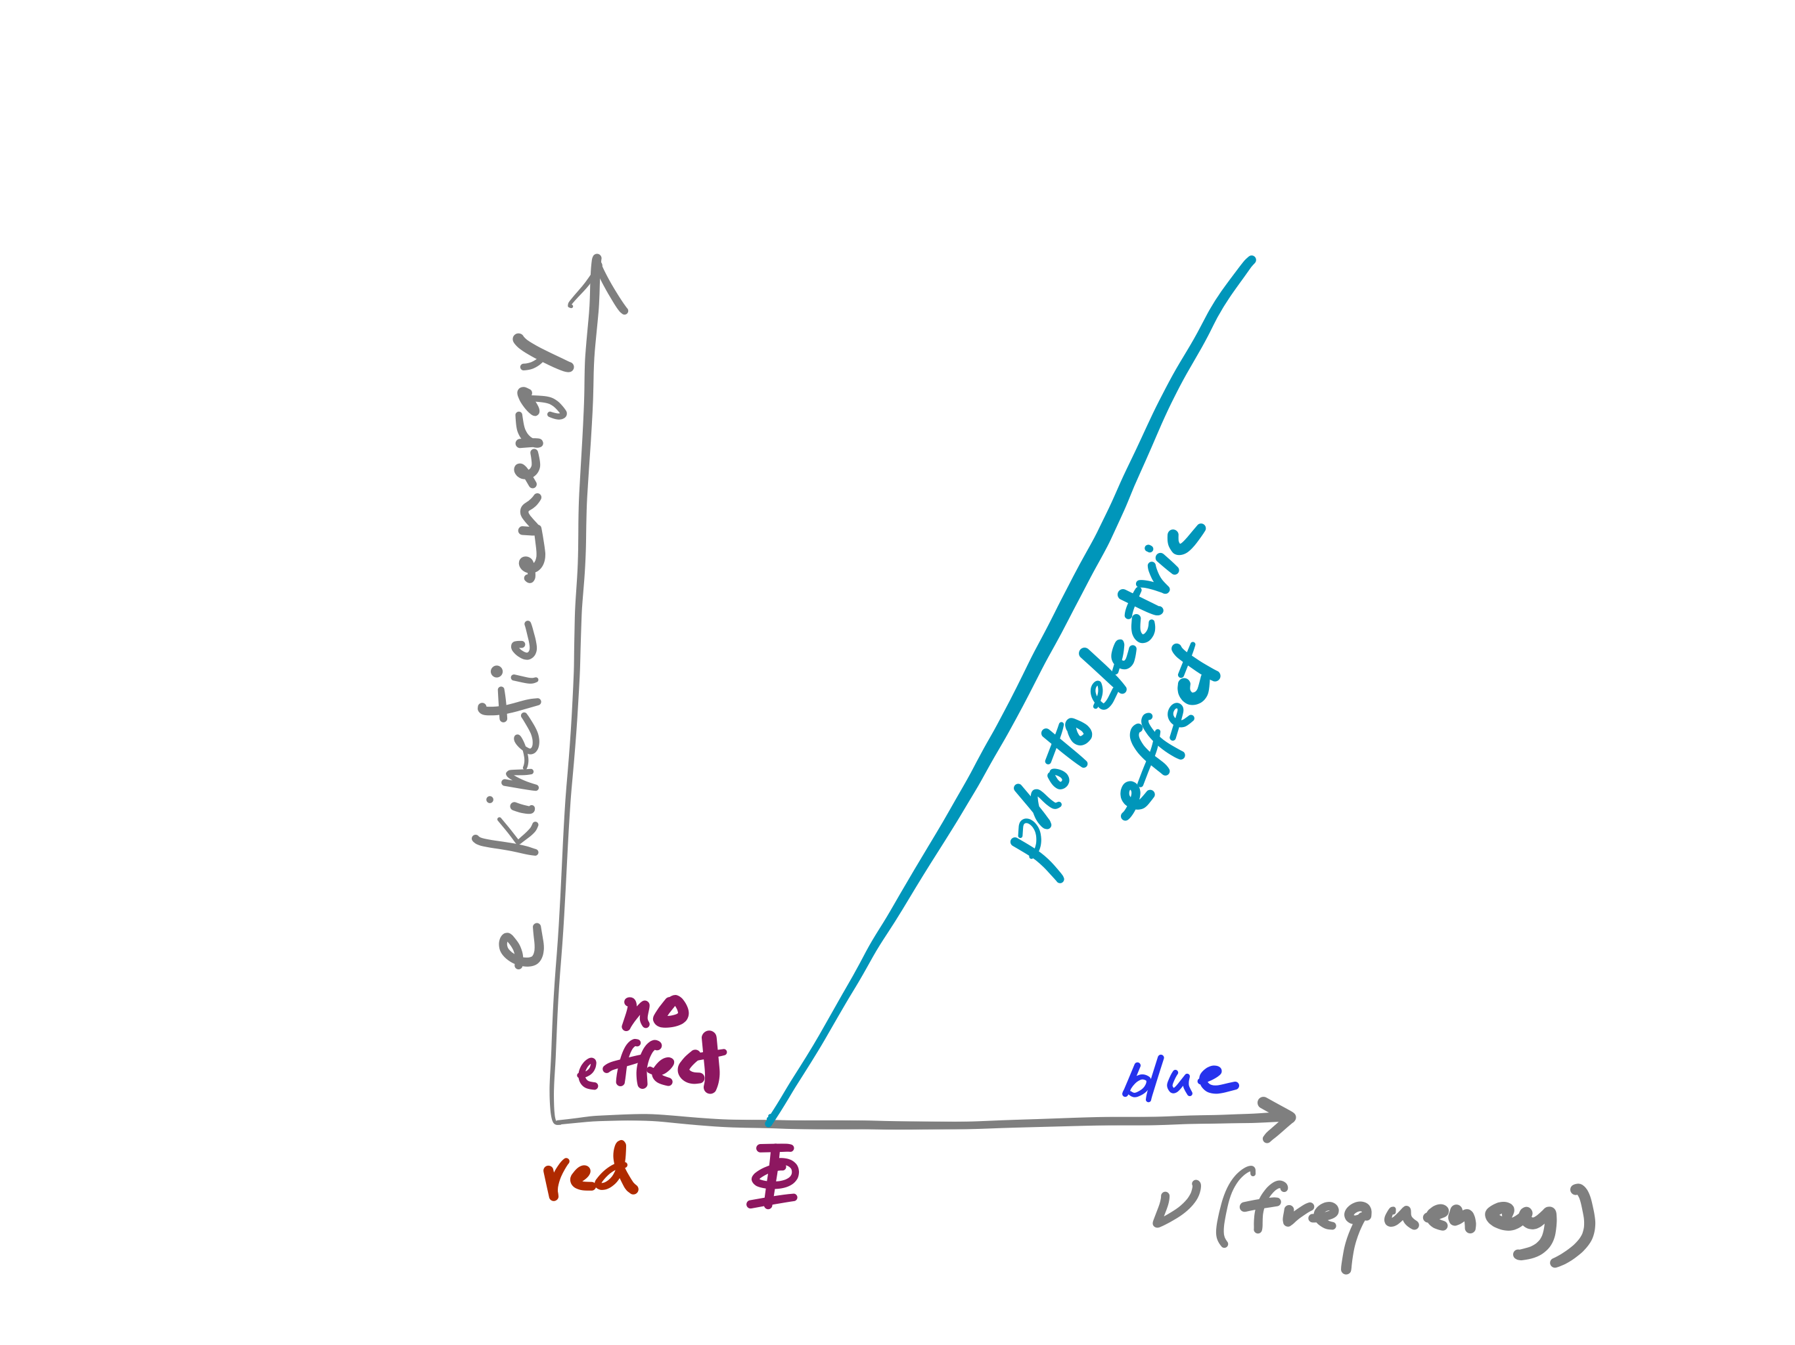
Photoelectric effect
No electrons are ejected unless the frequency of radiation is greater than a certain threshold, regardless of intensity.
Electrons are ejected immediately for the lowest intensity, if the frequency is greater than the threshold.
The kinetic energy of an ejected electron bears a linear relationship with the frequency of light (but not with the intensity).

Slide 6


Photoelectric effect
How is this incongruous to the conventional, wave-like picture of light?
We would expect that the greater the intensity, the more energy is given to the metal and an electron is ejected, but the intensity plays no role in deciding whether the ejection occurs or not.
We would expect that the longer we shine light, the more energy is transferred to the electrons over time and an electron is ultimately ejected, but the ejection happens right away with the lowest intensity if the frequency is high enough.

Slide 7
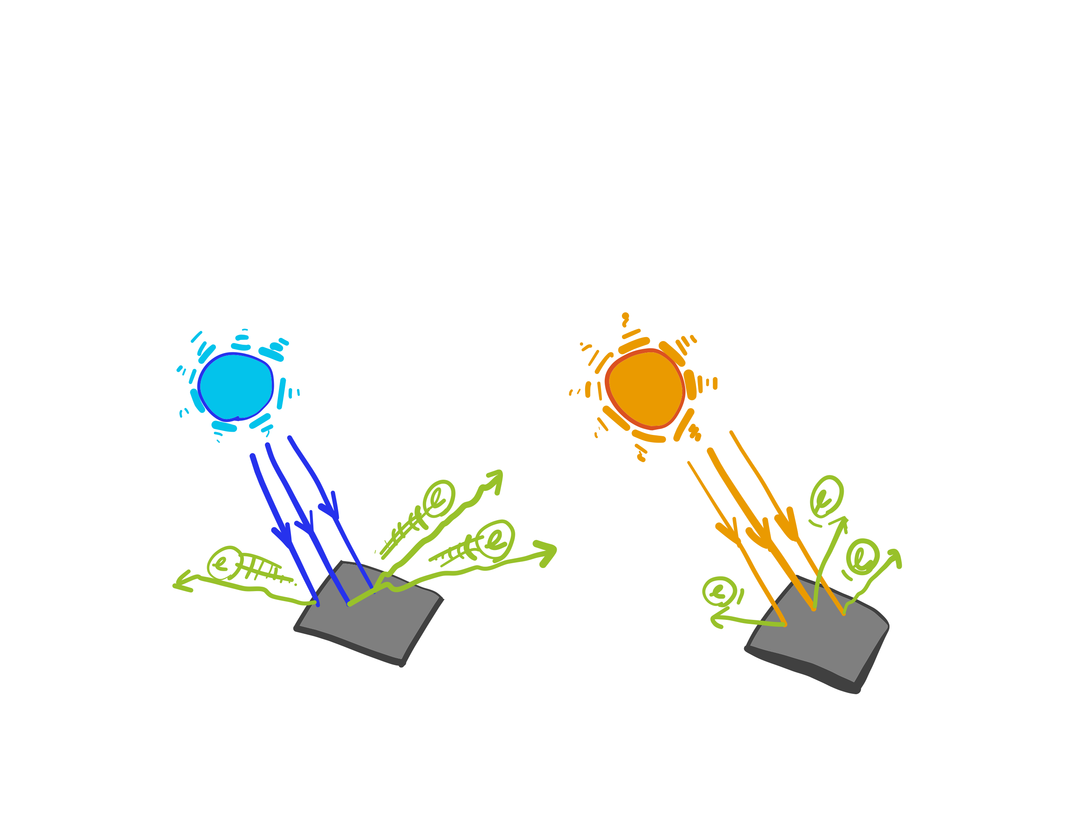
Photoelectric effect
The kinetic energy of an ejected electron increases linearly with the frequency but is independent of the intensity.

Slide 8
Photoelectric effect
All of these can be nicely explained once we accept the particle-like characteristics of light.
One particle of light (a photon) knocks one electron out of the metal.
Electrons are tied to the metal and escaping from the grip of the metal needs some energy (work function Φ).
A photon has an energy of hv (proportional to frequency but independent of intensity).

Slide 9
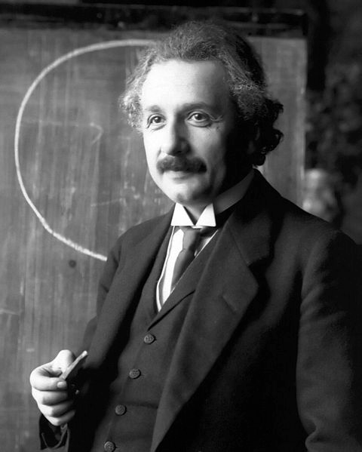
Photoelectric effect
If the energy of a photon hv is smaller than the work function, an electron cannot escape the metal surface.
If it is greater, a single photon is consumed by a single electron, which is then ejected (immediately and at minimum intensity).
The extra energy hv – Φ becomes electron’s kinetic energy.
Albert Einstein
Public domain photo
from Wikipedia

Slide 10
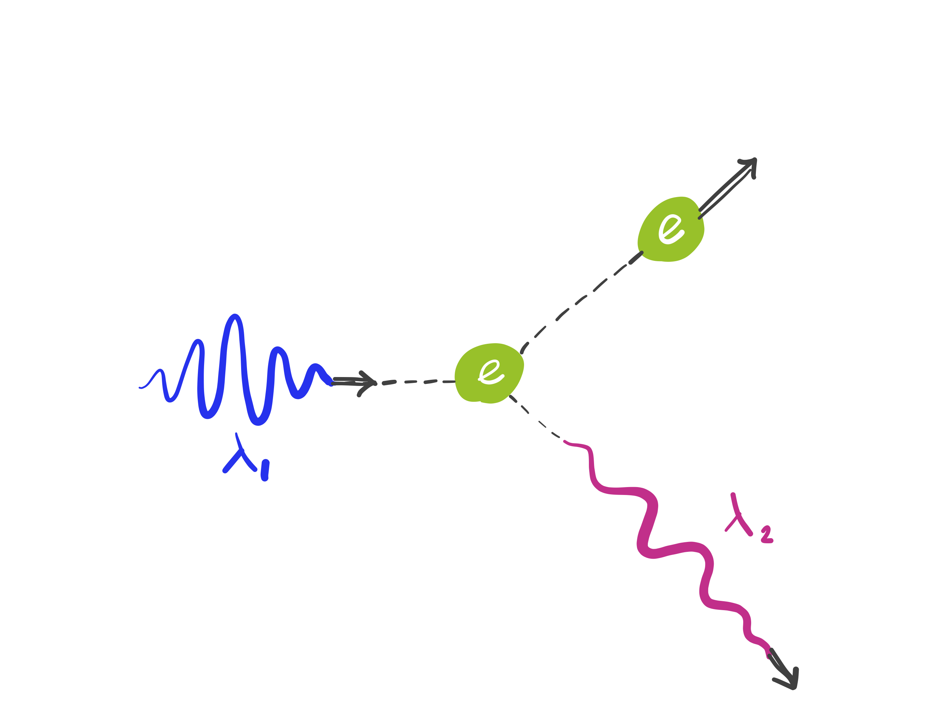
Compton scattering
Arthur Compton discovered that an electron is scattered by light (because a photon is a particle with a linear momentum).
Arthur Compton
Public domain photo
from Wikipedia

Slide 11
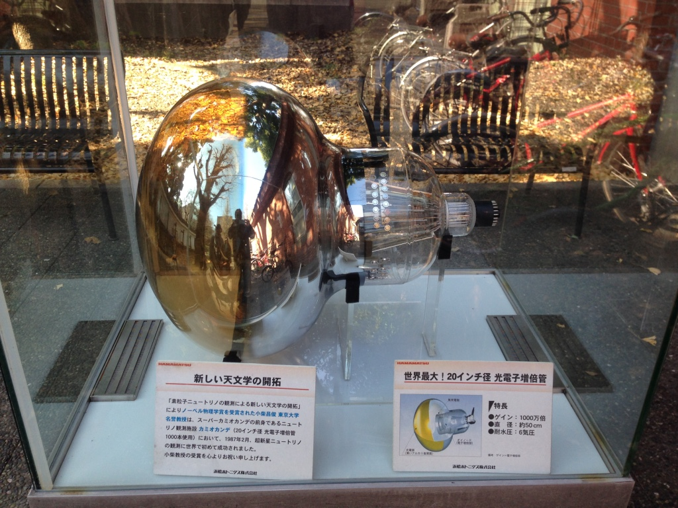
Macroscopic manifestations of the particle character of light
Our skin does not get tanned by infrared or visible light no matter how long it is exposed.
We can see a star many light-years away instantly with our eyes (or not at all).
A modern photomultiplier
can count photons all the
way down to one photon.
A photomultiplier (Hamamatsu Photonics) used in the Kamiokande Neutrino Observatory (shown at University of Tokyo). Public domain photo taken by So Hirata.

Slide 12
The wave character of particles
Light has both wave-like and particle-like characteristics.
Do particles such as electrons also have wave-like character?
The answer is YES.

Slide 13
Davisson-Germer experiment
Davisson and Germer at Bell Labs showed that electrons exhibit diffraction, a phenomenon characteristic of a wave.
Electron diffraction and neutron diffraction are widely used experimental techniques today, complementing X-ray diffraction.
Clinton Davisson (left) and
Lester Germer (right)
Public domain photo
from Wikipedia

Slide 14
Diffraction
Thin films of oil, soap bubbles, butterfly wings, sea shells, CD and DVD, etc. show a rainbow pattern. This is caused by the constructive and destructive interference of light traveling slightly different paths.
An electron can be scattered by different layers of a crystal lattice and interfere constructively or destructively, giving rise to alternating intensity patterns.
Public domain image from Wikipedia

Slide 15
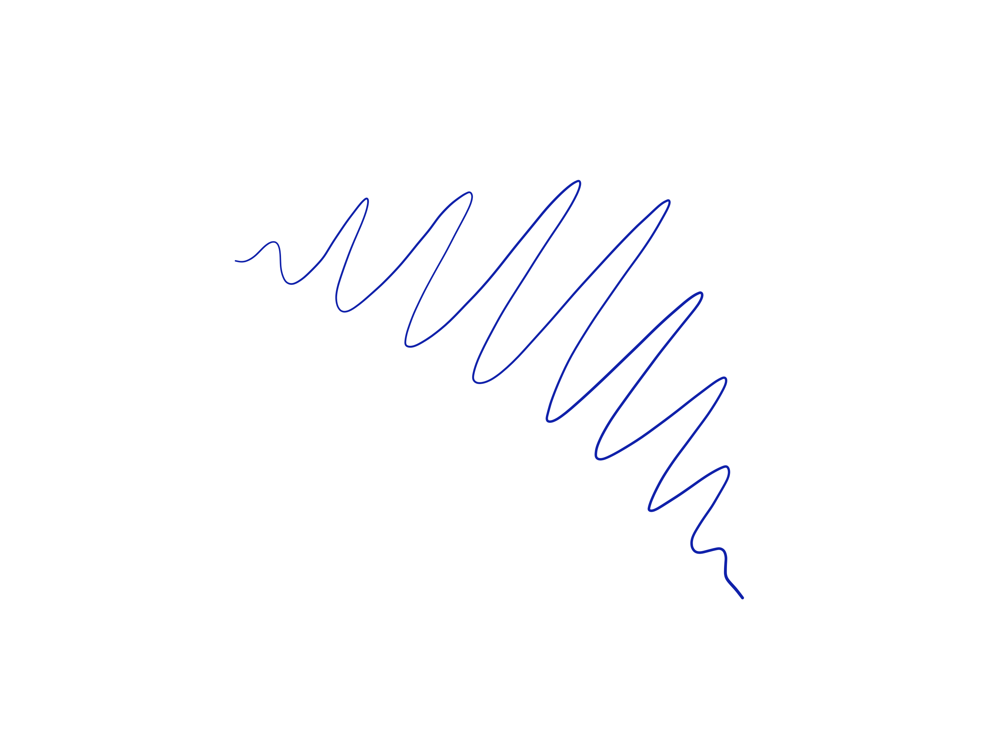
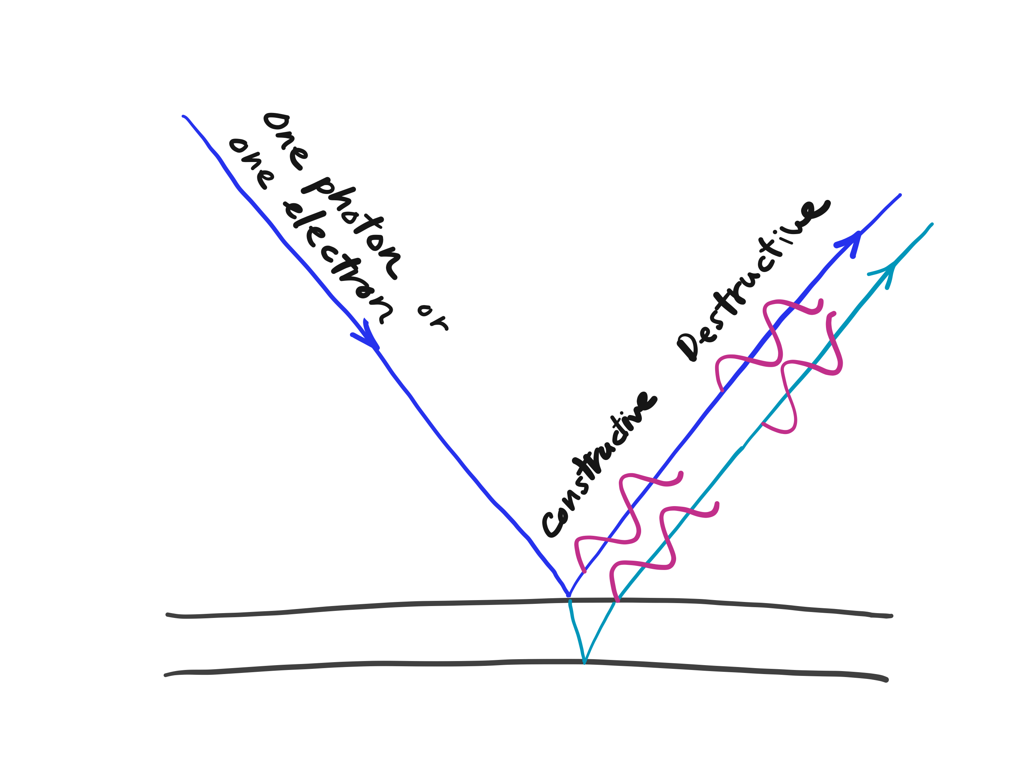
Diffraction

Slide 16
Wave-particle duality
Light is a wave and a particle; an electron is a particle and a wave. Is everything a wave and a particle?
The answer is YES
The wave-like and particle-like characteristics of a physical entity are inversely proportional to each other as described by the de Broglie relationship.

Slide 17
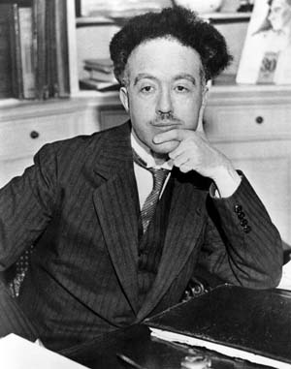
The de Broglie relation
Planck’s constant
Wavelength
(wave-like)
Linear
Momentum
(particle-like)
The larger the wavelength, the more wave-like characteristics; the larger the momentum, the more particle-like characteristics.
Louis-Victor-Pierre-Raymond 7e duc de Broglie
Public image from Wikipedia

Slide 18
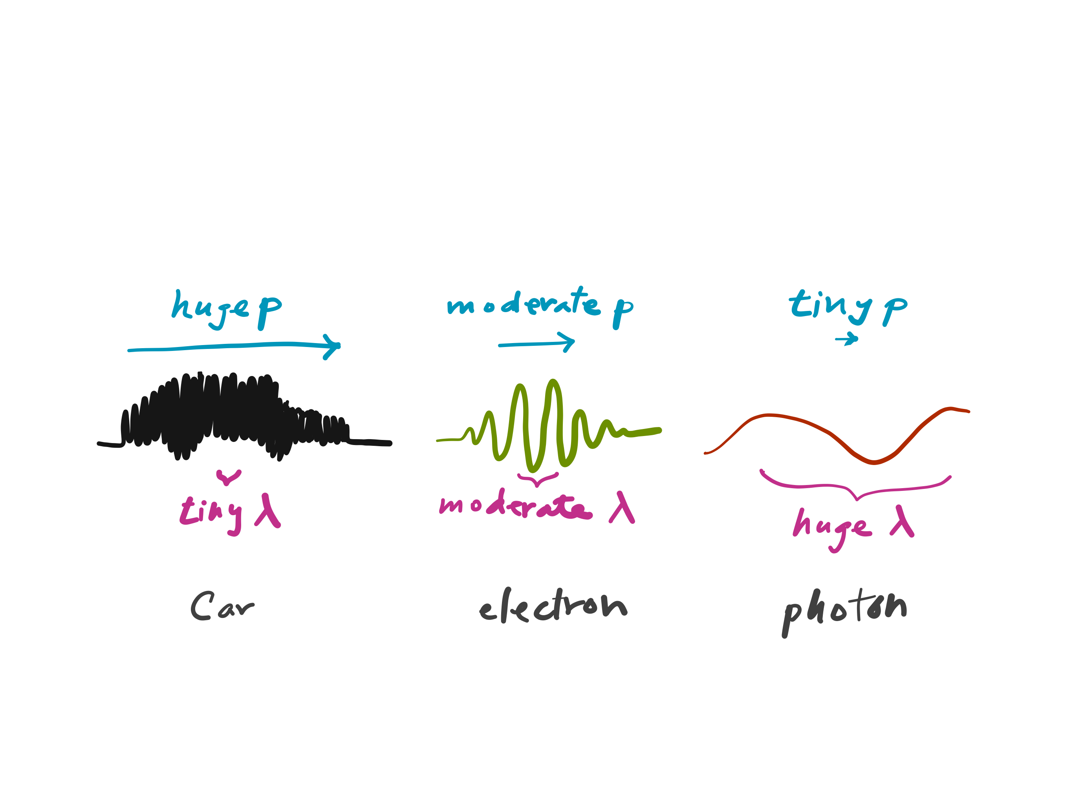
The de Broglie relation

Slide 19
The de Broglie relation
The de Broglie relation also defines the momentum of a photon (whose rest mass is zero and the classical mv formula does not apply).

Slide 20
Challenge homework #1
Planck’s constant
Wavelength
(wave-like)
Momentum
(particle-like)
Einstein’s mass-energy formula
from special theory of relativity

Slide 21
Summary
A physical entity has both wave-like (wavelengths, interference, diffraction, etc.) and particle-like (momentum, collision, countable, etc.) characteristics.
Wave-like and particle-like characteristics are inversely proportional to each other and are quantified by de Broglie relation λ = h / p.
An electron has a wavelength; a photon has a momentum.

