Slide 1
Lecture 19
Atomic spectra
(c) So Hirata, Department of Chemistry, University of Illinois at Urbana-Champaign. This material has been developed and made available online by work supported jointly by University of Illinois, the National Science Foundation under Grant CHE-1118616 (CAREER), and the Camille & Henry Dreyfus Foundation, Inc. through the Camille Dreyfus Teacher-Scholar program. Any opinions, findings, and conclusions or recommendations expressed in this material are those of the author(s) and do not necessarily reflect the views of the sponsoring agencies.

Slide 2
Spectroscopic transitions
A transition from one state of an atom (wave function) to another state (wave function) can occur by absorption or emission of a photon. Such a transition is allowed when certain conditions are met otherwise forbidden.
Fermi’s golden rule gives not only the selection rules but also intensities of the absorption or emission bands associated with one-photon transitions.

Slide 3
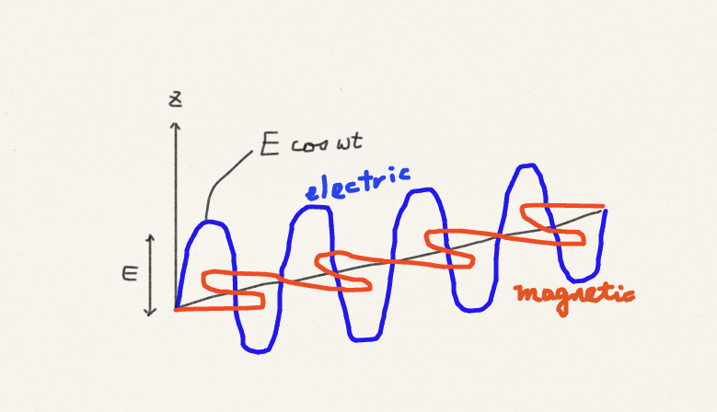
Perturbation = light
Light (photon) is oscillating electric and magnetic field. The oscillating electric field rocks the electrons and nuclei, which are charged.
The oscillating electric field can be polarized (in x, y, or z direction) or circularly polarized.

Slide 4
Spectroscopic transitions
We have learned (derived) from time-dependent perturbation theory that the rate of transition, and hence the intensity of the absorption or emission associated with the transition, is
Electric field amplitude
Transition dipole moment
for z-polarized light
Provided the energy conservation is met

Slide 5
Spectroscopic transitions
When light is an oscillating electric field in one direction (say, z), it is linearly polarized, we must use the corresponding axis operator in the TDM (transition dipole moment).
If it is not polarized or it is circularly polarized, we may consider all three (x, y, and z) TDM’s. If at least one of them is nonzero, the transition is allowed.

Slide 6
Hydrogenic atomic transitions
For a hydrogenic atom with z-polarized light,
Generally nonzero
Only α to α or β to β allowed
Kronecker’s delta

Slide 7
Hydrogenic atomic transitions
For a hydrogenic atom with z-polarized light,
Orthonormality

Slide 8
Hydrogenic atomic transitions
With x- or y-polarized light,
Only α to α or β to β allowed

Slide 9
Hydrogenic atomic transitions
With x- or y-polarized light,
Orthonormality

Slide 10
Selection rules
From the mathematical properties of spherical harmonics, this integral is zero unless

Slide 11
Selection rules
2p_{x}α ← 1sα allowed
3d_{z}2α ← 2p_{z}α allowed
2p_{x}α ← 1sβ forbidden
2sβ ← 1sβ forbidden

Slide 12
2p_{z} ← 1s

Slide 13
cm⁻¹
“cm^{–1}” is a unit of wave number and is only proportional to energy; In practice, it is used as a unit of energy.

Slide 14
Summary
We have applied Fermi’s golden rule to atomic spectroscopic transitions.
It is even more important to know the definition of transition dipole moment and how it can be derived than to memorize the selection rules.
In this atomic case, the mathematical properties of spherical harmonics determine the selection rules. x, y, and z operators can also be written as spherical harmonics.

