Slide 1
Lecture 18
Hydrogenic atoms. II

Slide 2
The energy expression
The nuclear charge
This explains the experiment. Note that the angular momentum quantum numbers do not enter the energy expression.
Discrete energies are negative

Slide 3
Challenge homework #4
The special theory of relativity states that a mass cannot travel faster than the speed of light. By assuming that the energy of the ground-state hydrogenic atom is equal to the negative of the classical kinetic energy of the electron (cf. the virial theorem) and using the above speed limit, estimate an upper limit of the atomic number Z. Explain the fact that there are only 120 or so atom types in nature and not so many more.

Slide 4
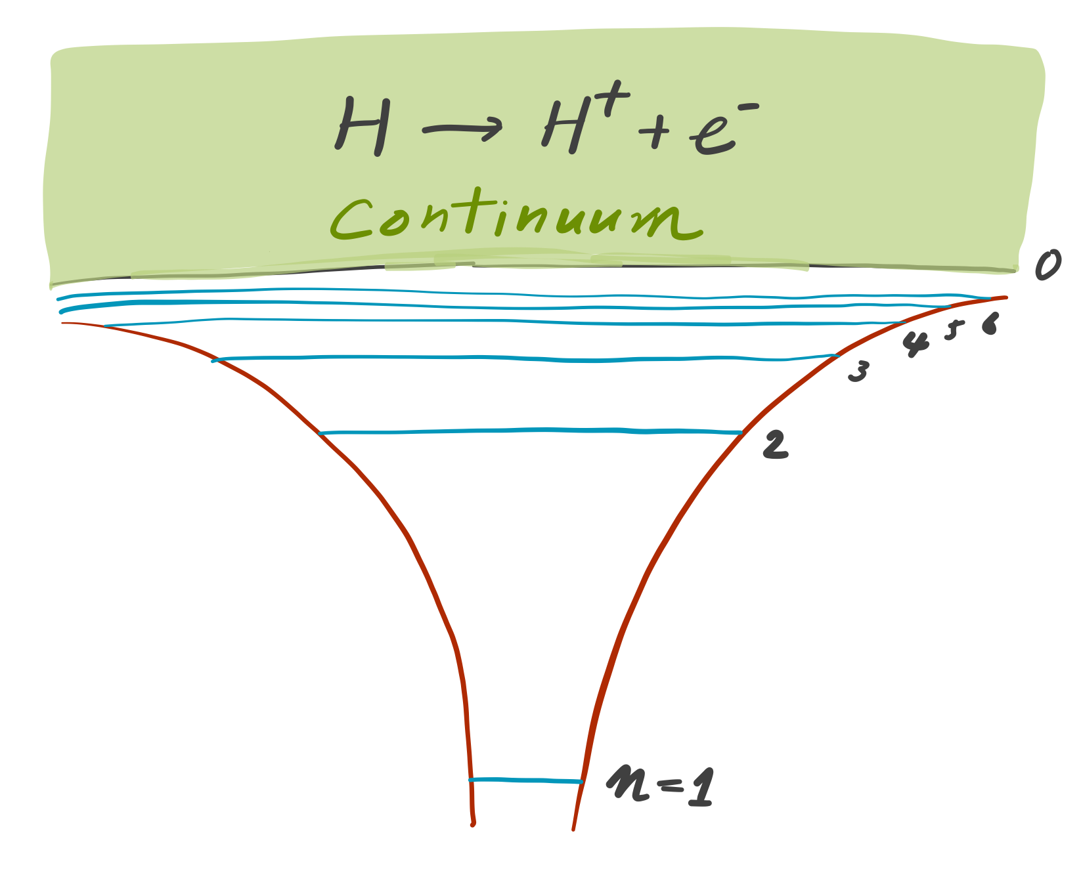
The energy levels
When an electron is given an energy greater than that required to be excited into the highest bound state, it escapes from the Coulomb force of the nucleus and ionized into an unbound, continuum state (cf. photoelectric effect)
There are an infinite number of bound states with a negative energy

Slide 5
Atomic orbitals
AO has the form:
With three orbital quantum numbers: n, l, m_{l}.
n = 1, 2, 3,…
l = 0, 1, 2,…, n–1
m_{l} = –l, –(l–1),…, (l–1), l
Also spin quantum numbers: s = ½, m_{s} = ±½.
Principal quantum number
They are orthonormal functions

Slide 6
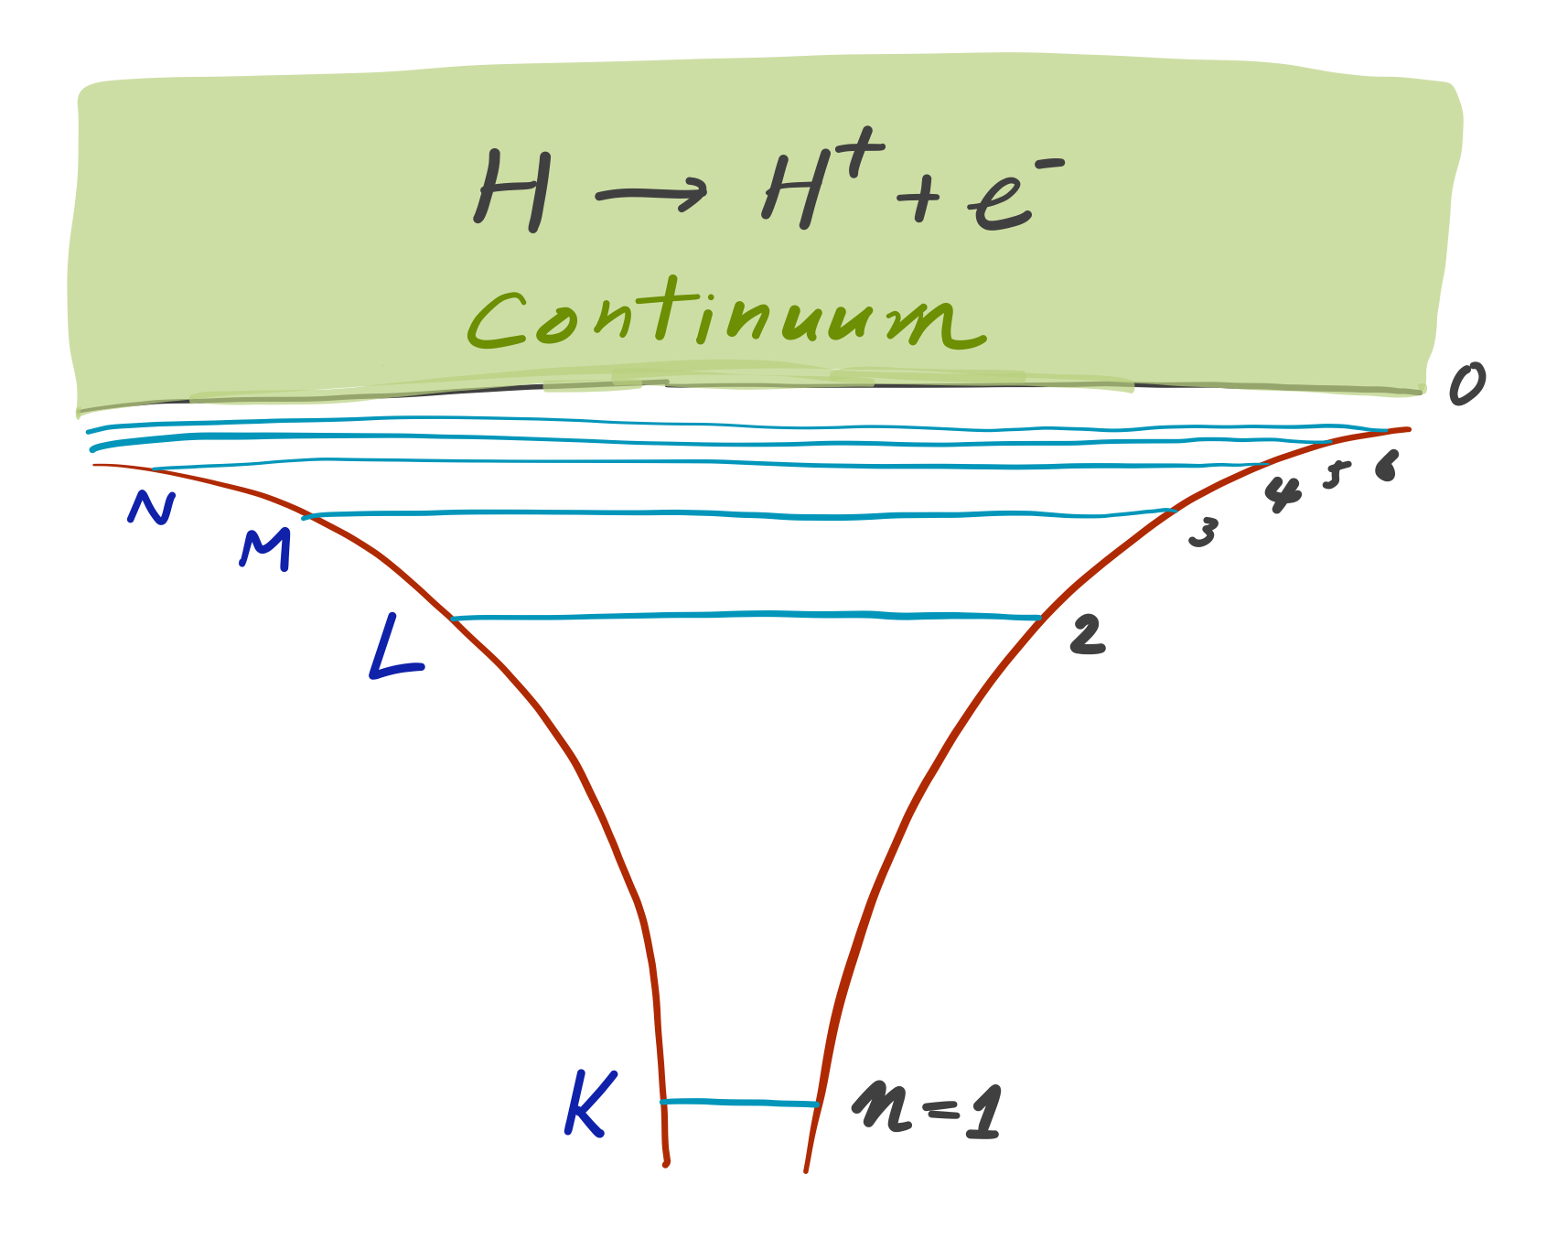
Shells
The orbitals are classified by their principal quantum number n.
n = 1, K shell.
n = 2, L shell.
n = 3, M shell, etc.
Because energies are determined by n, the orbitals in the same shell have the same energy.

Slide 7
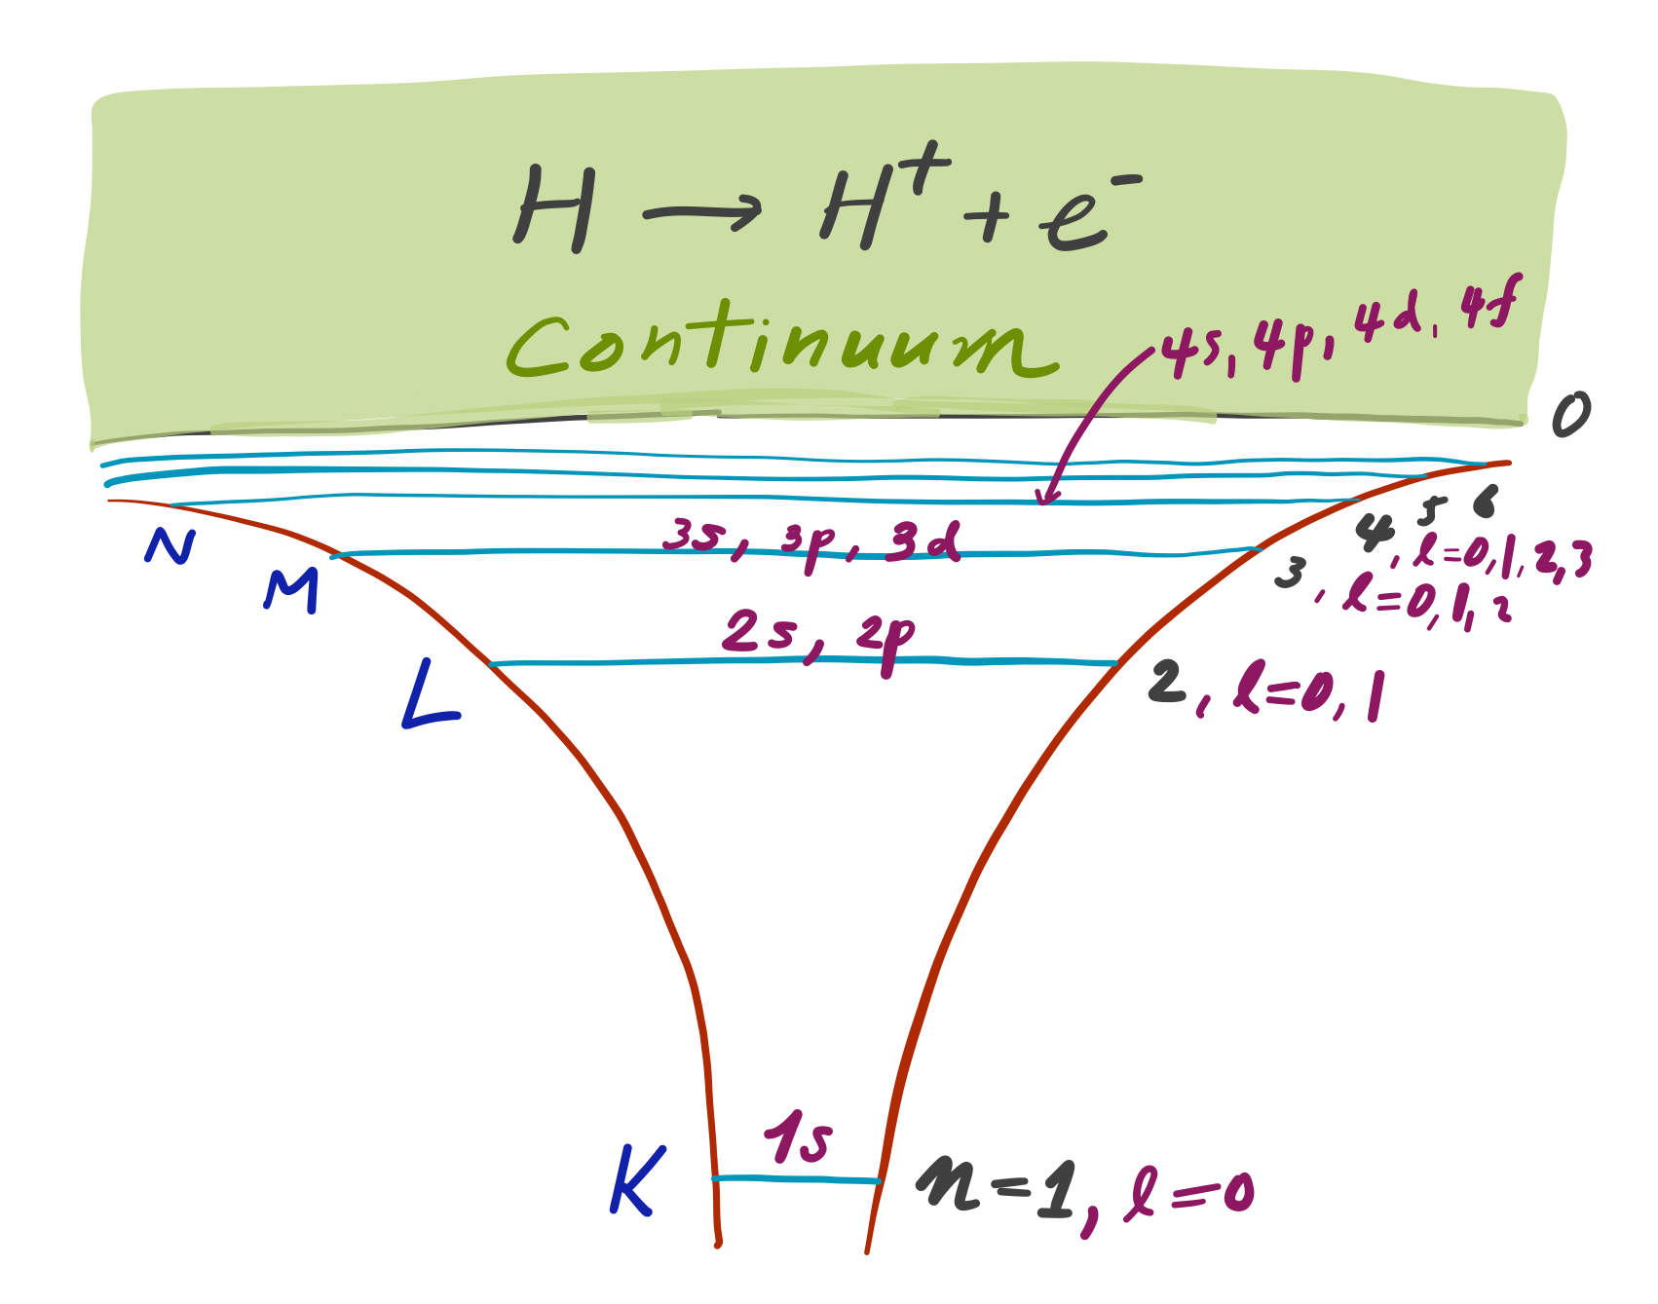
Subshells
For each value of n, we classify the orbitals by l.
l = 0, s subshell
(1 orbital).
l = 1, p subshell
(3 orbitals because
2l +1-fold degeneracy: m_{l} = – 1,0,1).
l = 2, d subshell
(5 orbitals).

Slide 8
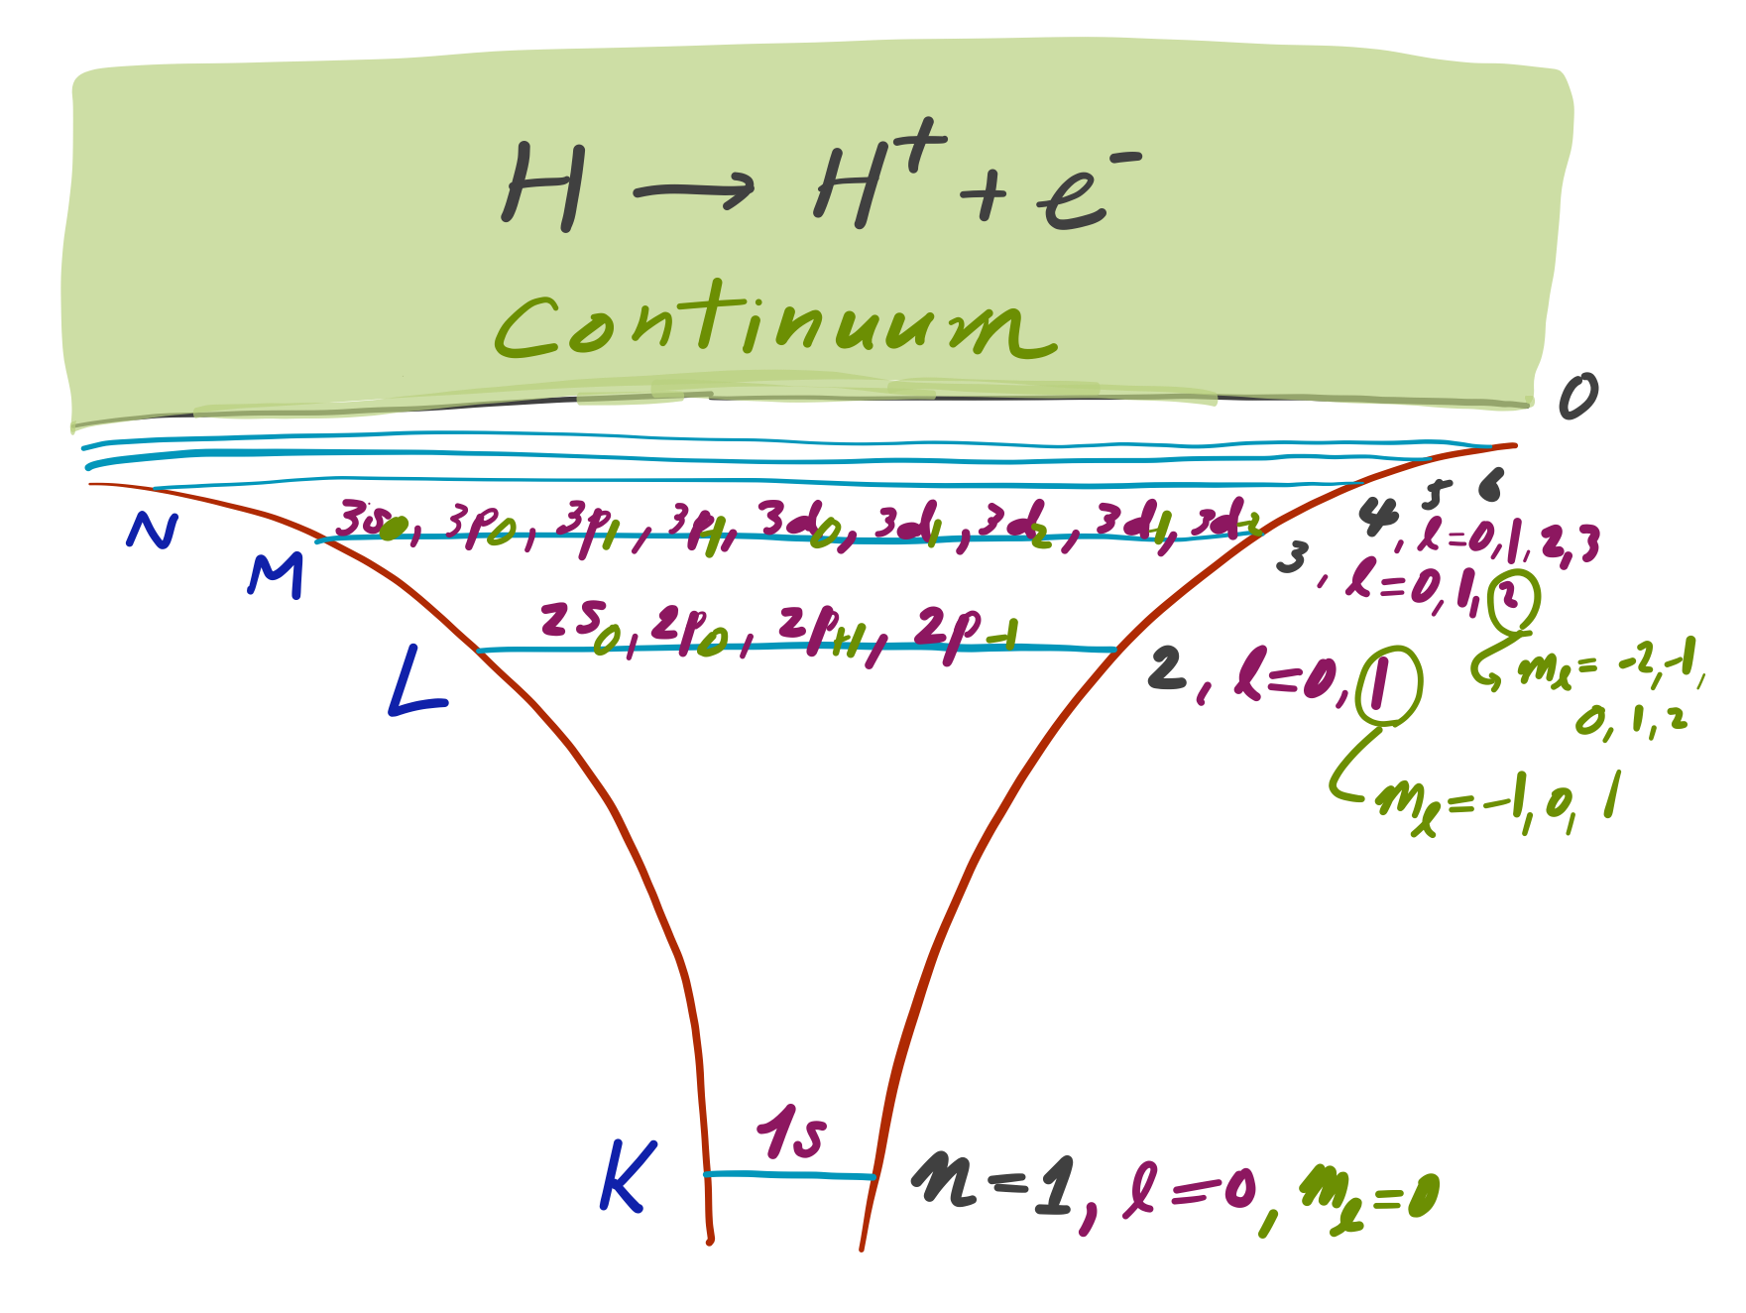
Atomic orbitals
Angular momentum quantum number l
Principal quantum number n
3d₊₂
Angular momentum quantum number m_{l}

Slide 9
The s orbitals
The higher the quantum number n, the more diffuse the orbitals are
1s
2s
3s
The higher the quantum number n, the higher the energy and the more (n–1) nodes
The s orbitals have a kink at the nucleus

Slide 10
Challenge homework #5
Given the fact that the electron in the hydrogen atom can exist exactly on top of the nucleus, why is it that the energy of the atom is not −∞ (stability of matter of the first kind)?
Given the fact that the particles in a chemical system interact through two-body Coulomb forces, why is it that the energy of the system grows only asymptotically linearly with the number of particles (not quadratically) (stability of matter of the second kind)?

Slide 11
The p orbitals: radial part
The higher the quantum number n, the more diffuse the orbitals are
2p
3p
The p orbitals are zero and kinked at the nucleus.
The number of nodes is n–2.

Slide 12
The p_{z} orbital
Angular part
Radial part
The product of n = 2 radial function and l = 1 and m_{l} = 0 angular function gives rise to r cosθ = z.

Slide 13
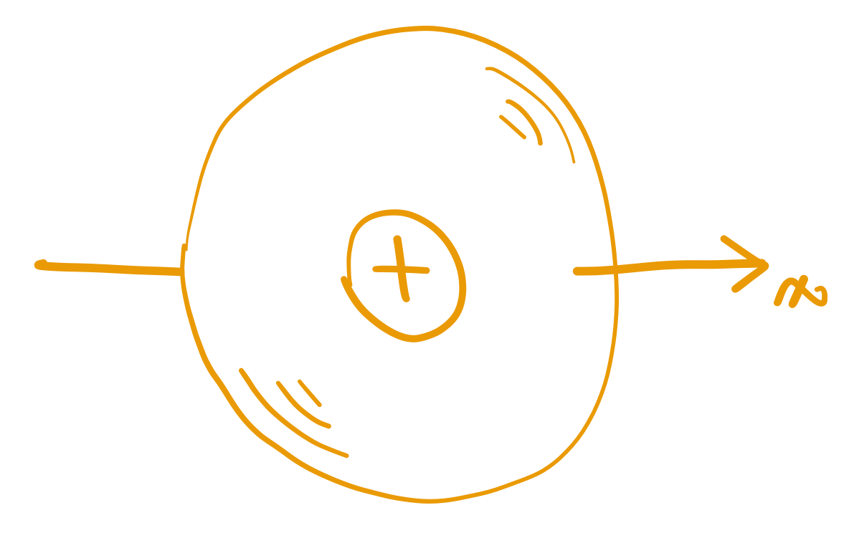
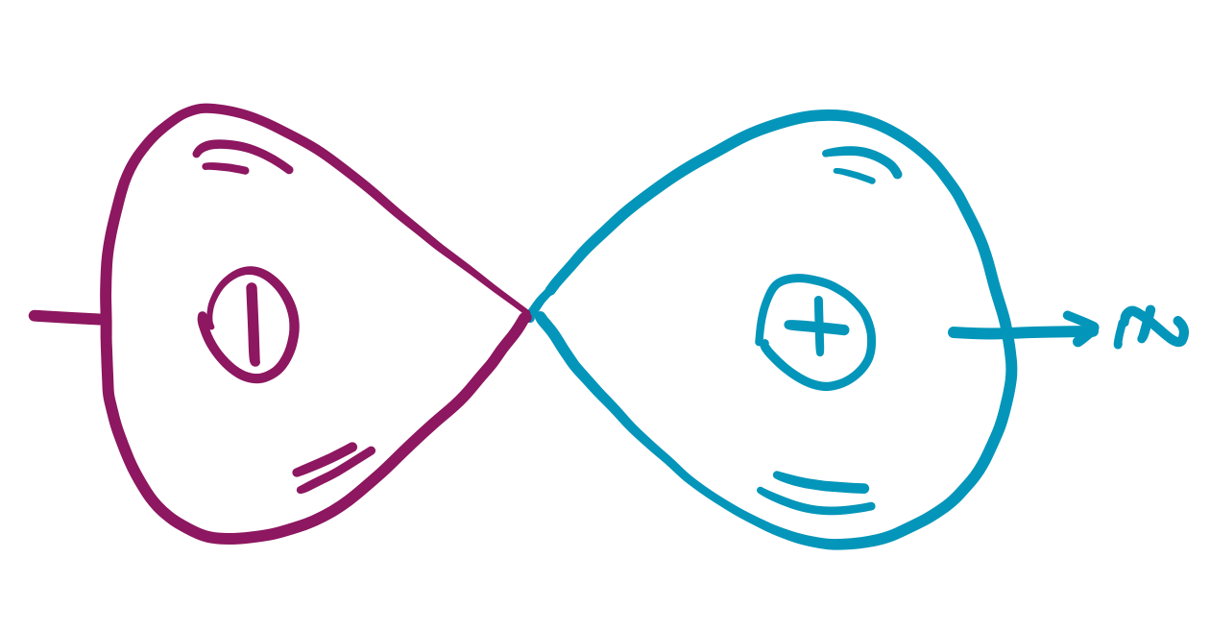
The p_{z} orbital

Slide 14
The p_{x} and p_{y} orbitals
Angular part
Radial part
The l = 1 and m_{l} = ±1 angular functions do not lend themselves to such simple interpretation or visualization; they are complex.

Slide 15
The p_{x} and p_{y} orbitals
Radial part
Angular part
However, we can take linear combinations of these to make them orient along x or y axis.
We are entitled to take any linear combination of degenerate eigenfunctions (with the same n and l) to form another eigenfunction (with the same energy and total angular momentum but no well-defined m_{l}).

Slide 16
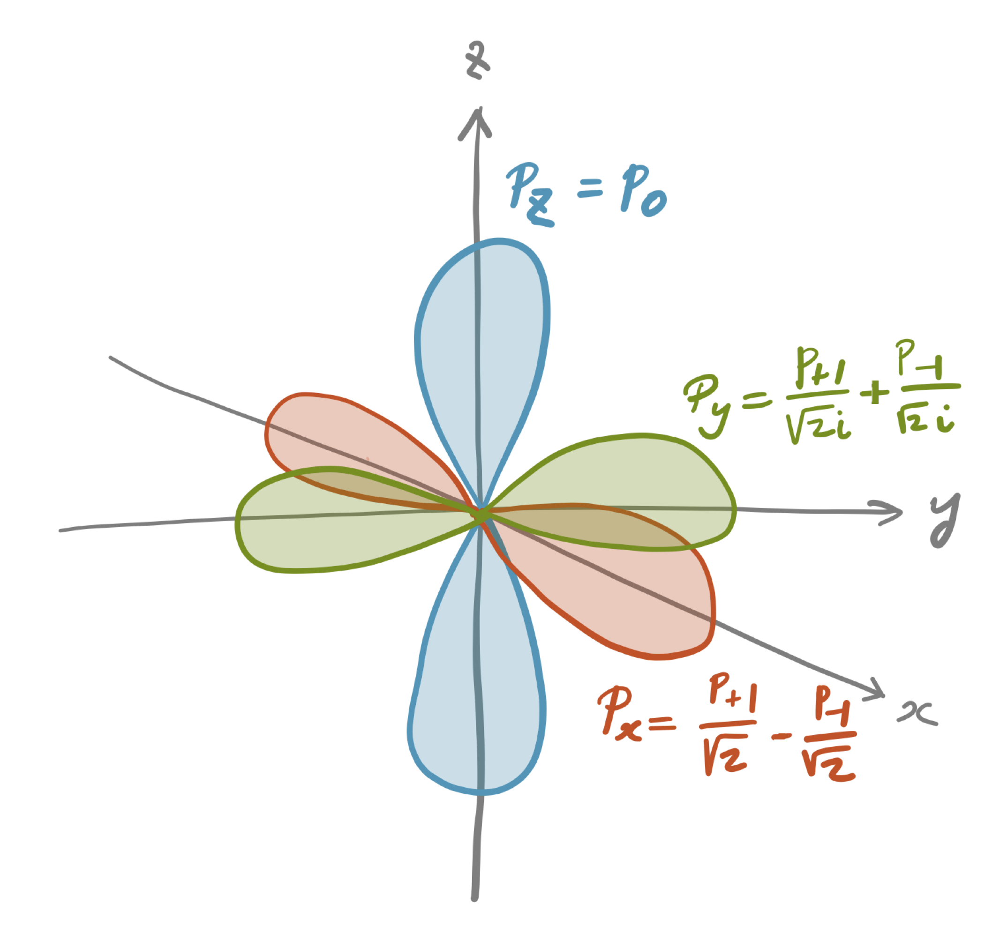
The p_{x} and p_{y} orbitals

Slide 17
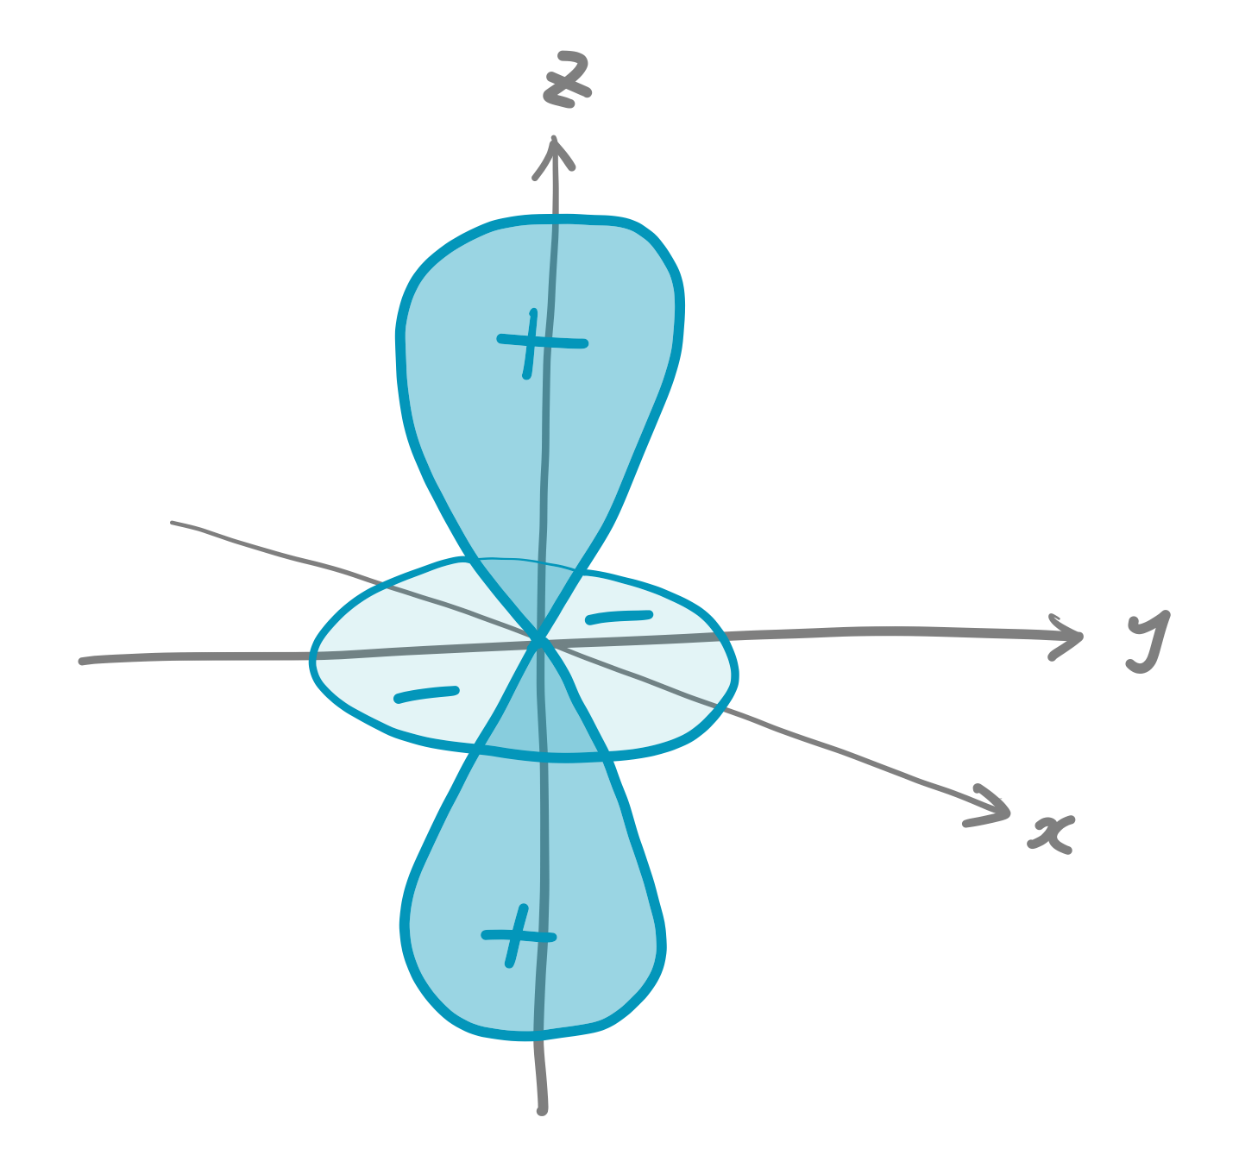
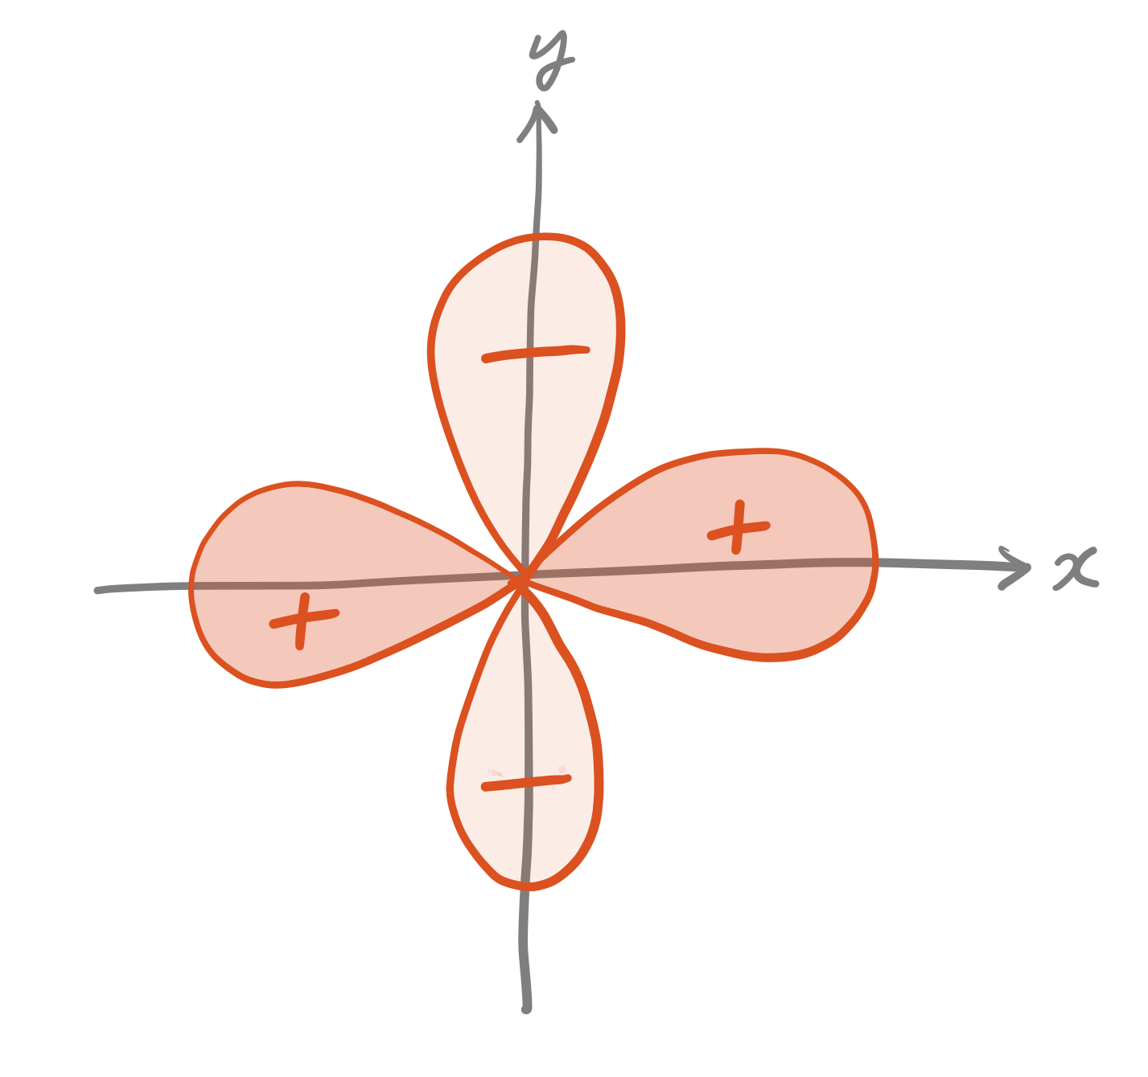
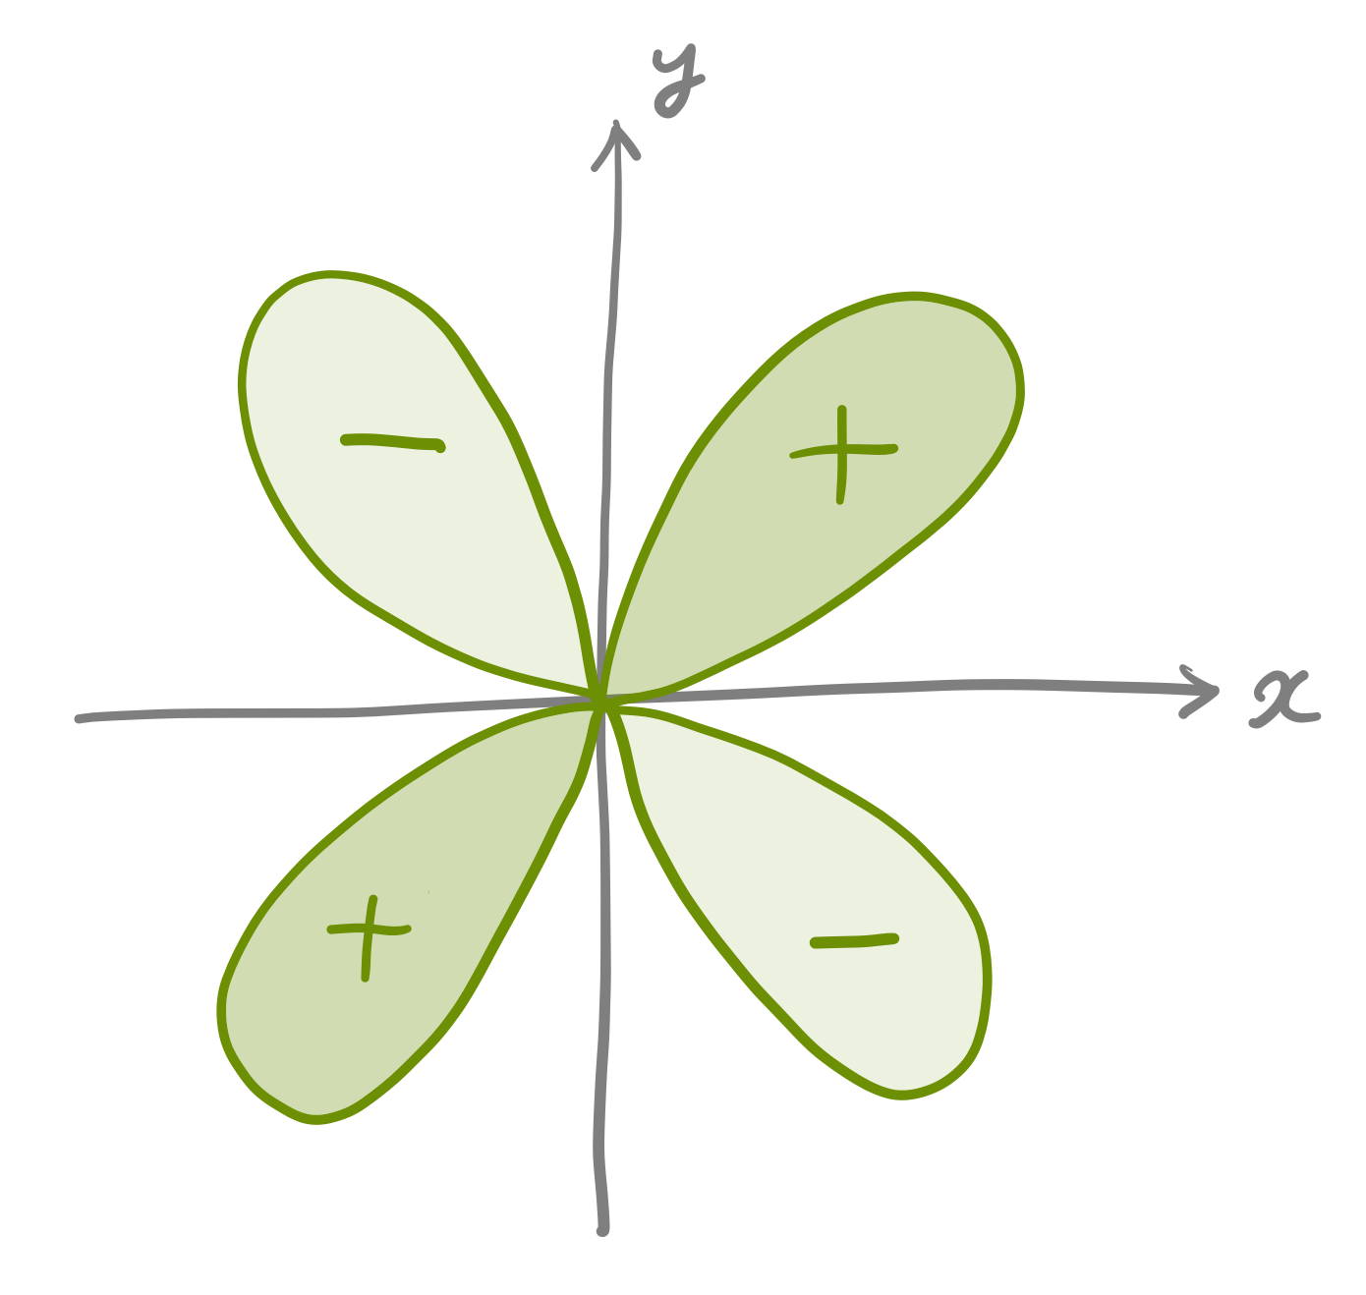
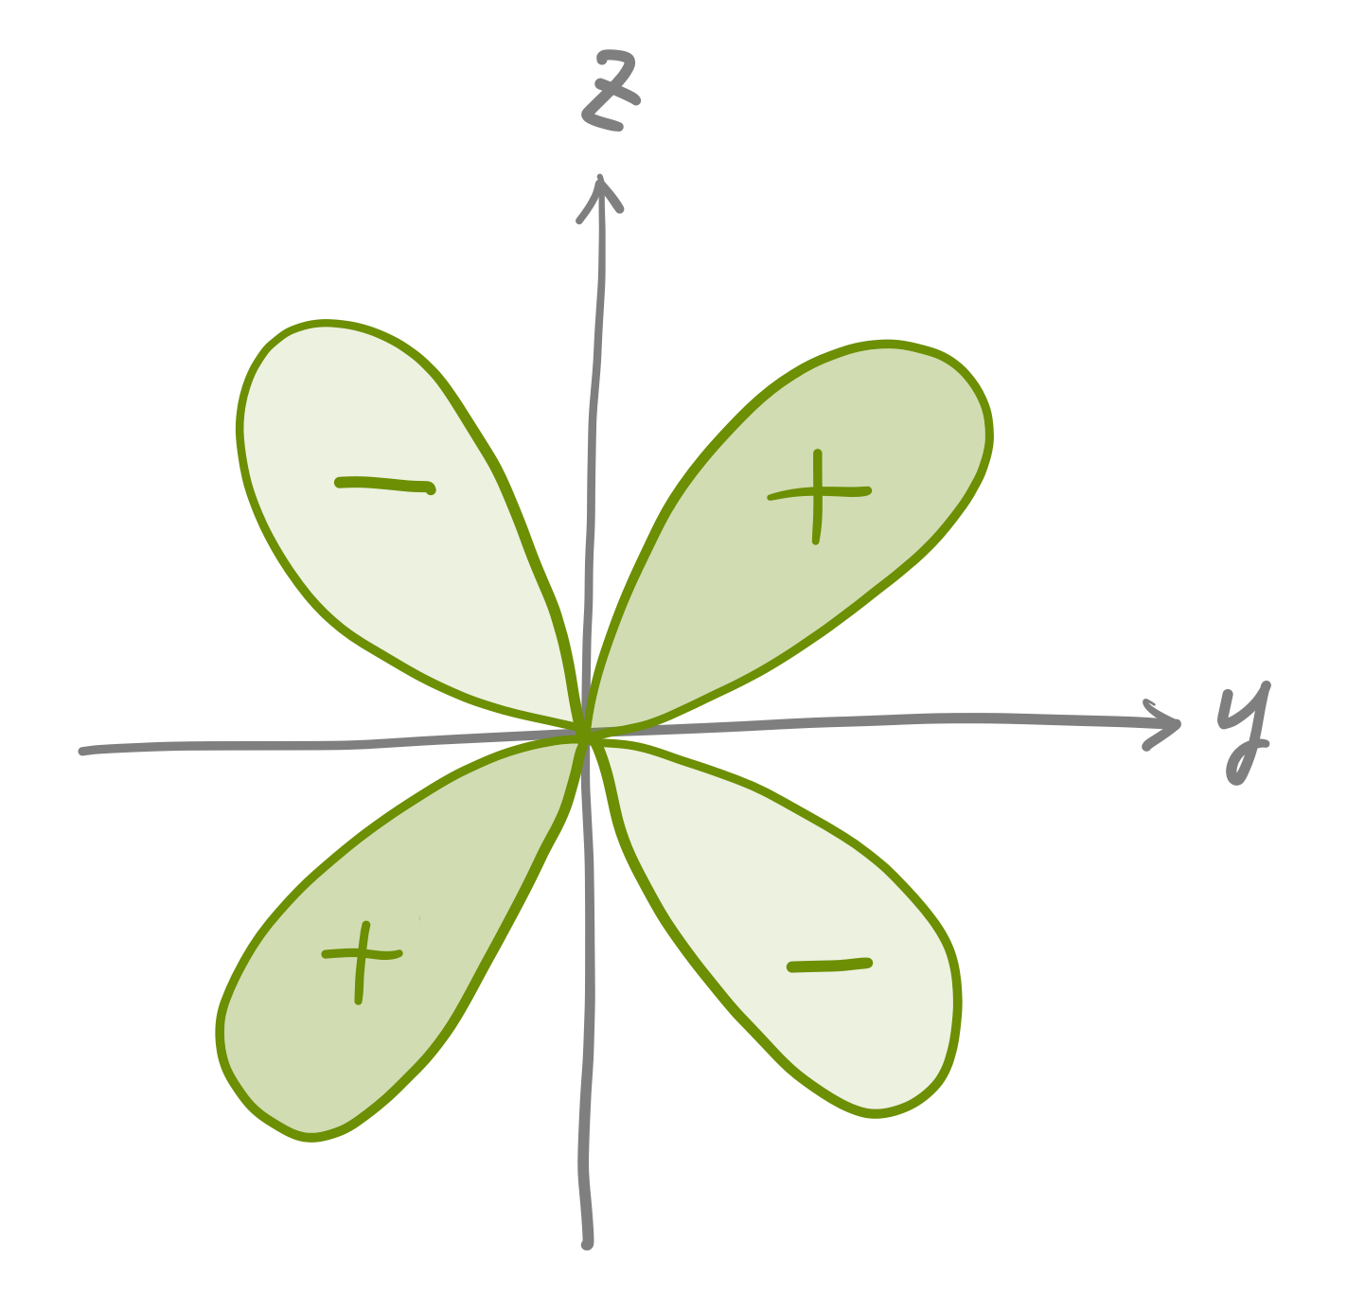
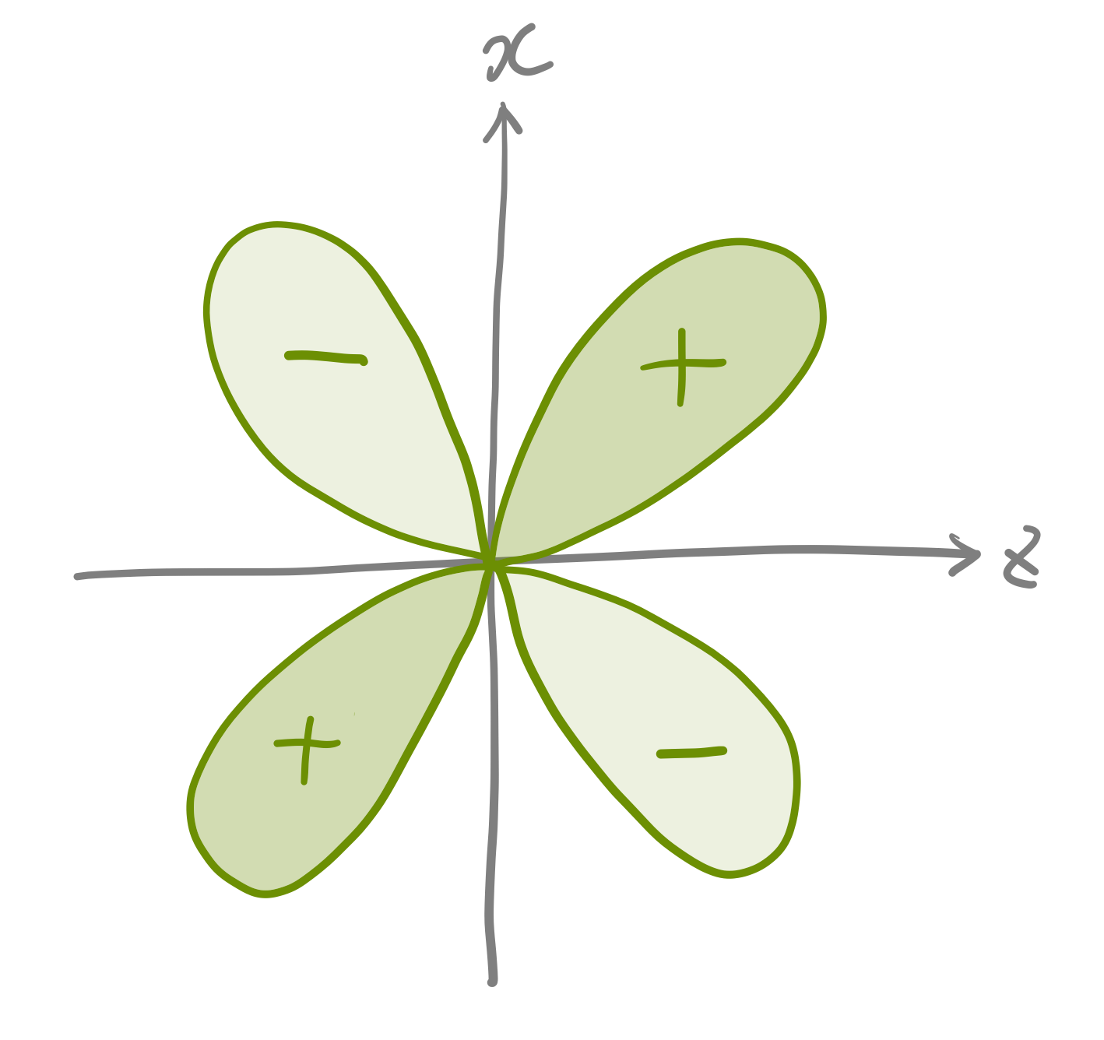
The d orbitals
The linear combination of d₊₂, d₊₁, d₀, d_{–1}, d_{–2} gives rise to d_{xy}, d_{yz}, d_{zx}, d_{x2–y2}, d_{3z2–r2}.
They are degenerate (the same n and l = 2) and have the same energy and same total angular momentum.
They no longer have a well-defined m_{l} except for m_{l} = 0 (d_{3z2–r2}).
d_{x2–y2}
d_{3z2–r2} = d₀
d_{xy}
d_{yz}
d_{zx}

Slide 18
Size of the hydrogen atom
Calculate the average radius of the hydrogen atom in the ground state (the electron is in the 1s orbital).

Slide 19
The solution

Slide 20
Radial distribution functions
Because the wave function is the product of radial (R) and angular (Y) parts, the probability density is also the product …
Radial distribution function (probability of finding an electron in the shell of radius r and thickness dr)

Slide 21
Size of the hydrogen atom
Calculate the most probable radius of the hydrogen atom in the ground state (the electron is in the 1s orbital).

Slide 22
The solution
Most probable point
Average radius
Most probable radius

Slide 23
Summary
Examining the solutions of the hydrogenic Schrödinger equation, we have obtained the quantum-mechanical explanations of chemistry concepts such as
  discrete energies of the hydrogenic atom
  ionization and continuum states
  atomic shell structures
  s, p, and d-type atomic orbitals
  atomic size and radial distribution function

