Slide 1
Lecture 17
Hydrogenic atoms. I

Slide 2
Hydrogenic atoms
We study the Schrödinger equation of the hydrogenic atom, for which the exact, analytical solution exists.
We add to our repertories another special function – associated Laguerre polynomials – as the solution of the radial part of the hydrogenic atom’s Schrödinger equation.
The separation-of-variable technique divides the 6D partial differential equation into six 1D differential equations.

Slide 3
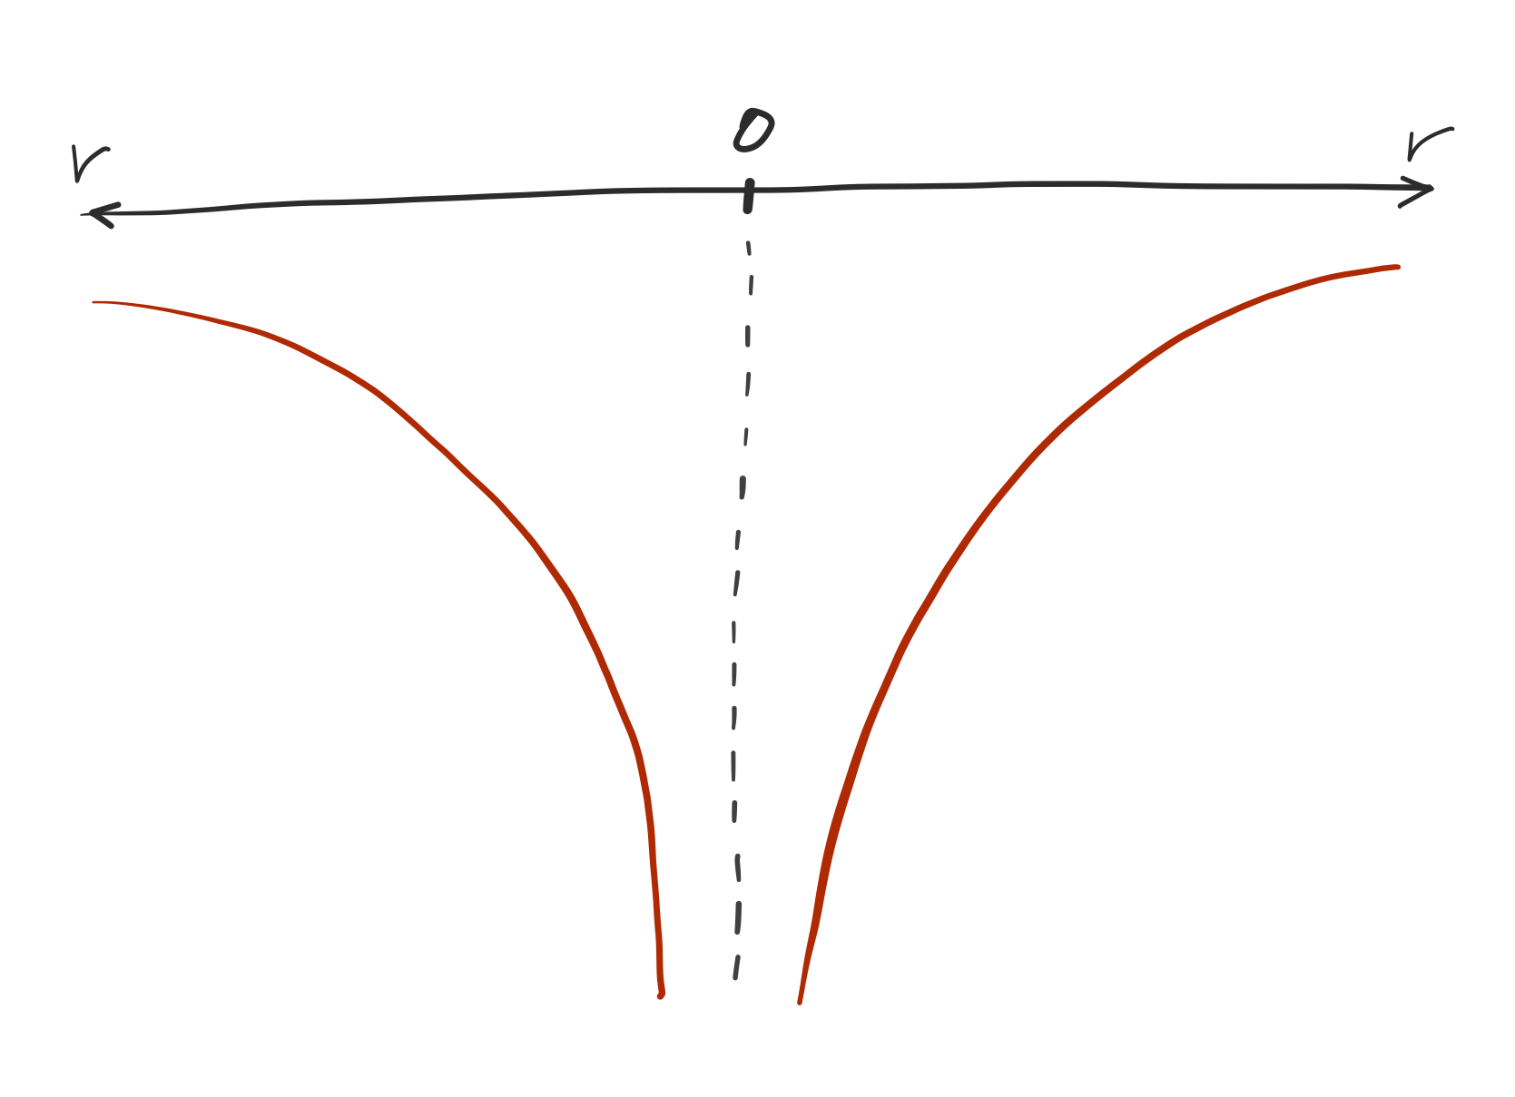
Coulomb potential
The potential energy between a nucleus with atomic number Z and an electron is
Proportional to nuclear charge
Attractive
Inversely proportional to distance

Slide 4
Classical Hamiltonian
The Classical total energy in Cartesian coordinates is
Center of mass motion
Relative motion

Slide 5
The Schrödinger equation
Center of mass motion
Relative motion
6-dimensional equation!

Slide 6
Separation of variables
Separable into 3 + 3 dimensions
Center of mass motion
Relative motion

Slide 7
The Schrödinger equation
Two Schrödinger equations
Hydrogen’s gas-phase dynamics (3D particle in a box)
Hydrogen’s atomic electronic structure
In spherical coordinates centered at the nucleus

Slide 8
Further separation of variables
The Schrödinger eq. for electronic structure:
Can we further separate variables? YES
Still 3 dimensional!

Slide 9
Further separation of variables
Function of just r
Function of just φ and θ

Slide 10
Particle on a sphere redux
We have already solved the angular part – it is the particle on a sphere

Slide 11
Radial and angular components
For the radial degree of freedom, we have a new equation:
This is kinetic energy in the radial motion
Original Coulomb potential + new one

Slide 12
Centrifugal force
This new term partly canceling the attractive Coulomb potential is viewed as the repulsive potential due to the centrifugal force.
The higher the angular momentum, the greater the force in the positive r direction
Classical centrifugal potential and force

Slide 13
The radial part
Simplify the equation by scaling the variables

Slide 14
The radial solutions
The radial differential equation:
The solution:
Slater-type orbital
Associated Laguerre polynomial
Normalization

Slide 15
The Slater-type orbital

Slide 16
The radial solutions

Slide 17
Verification
Verify that the (n = 1, l = 0) and (n = 2, l = 1) radial solutions indeed satisfy the radial equation:

Slide 18
Wave functions

Slide 19
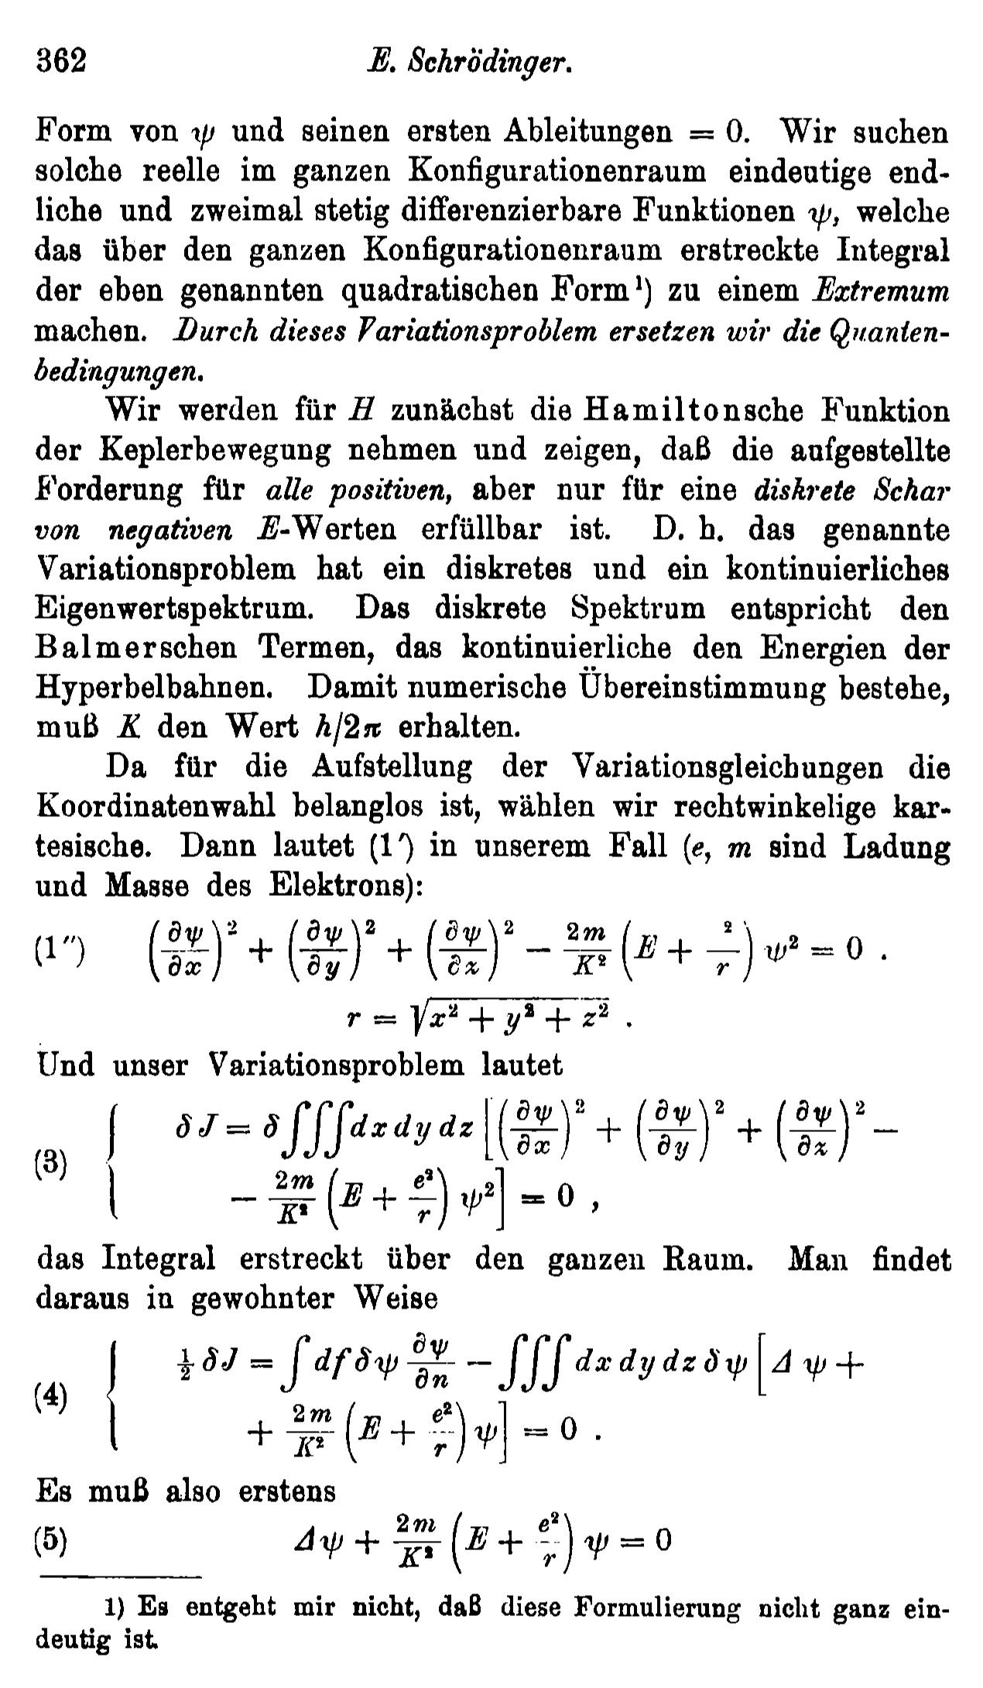
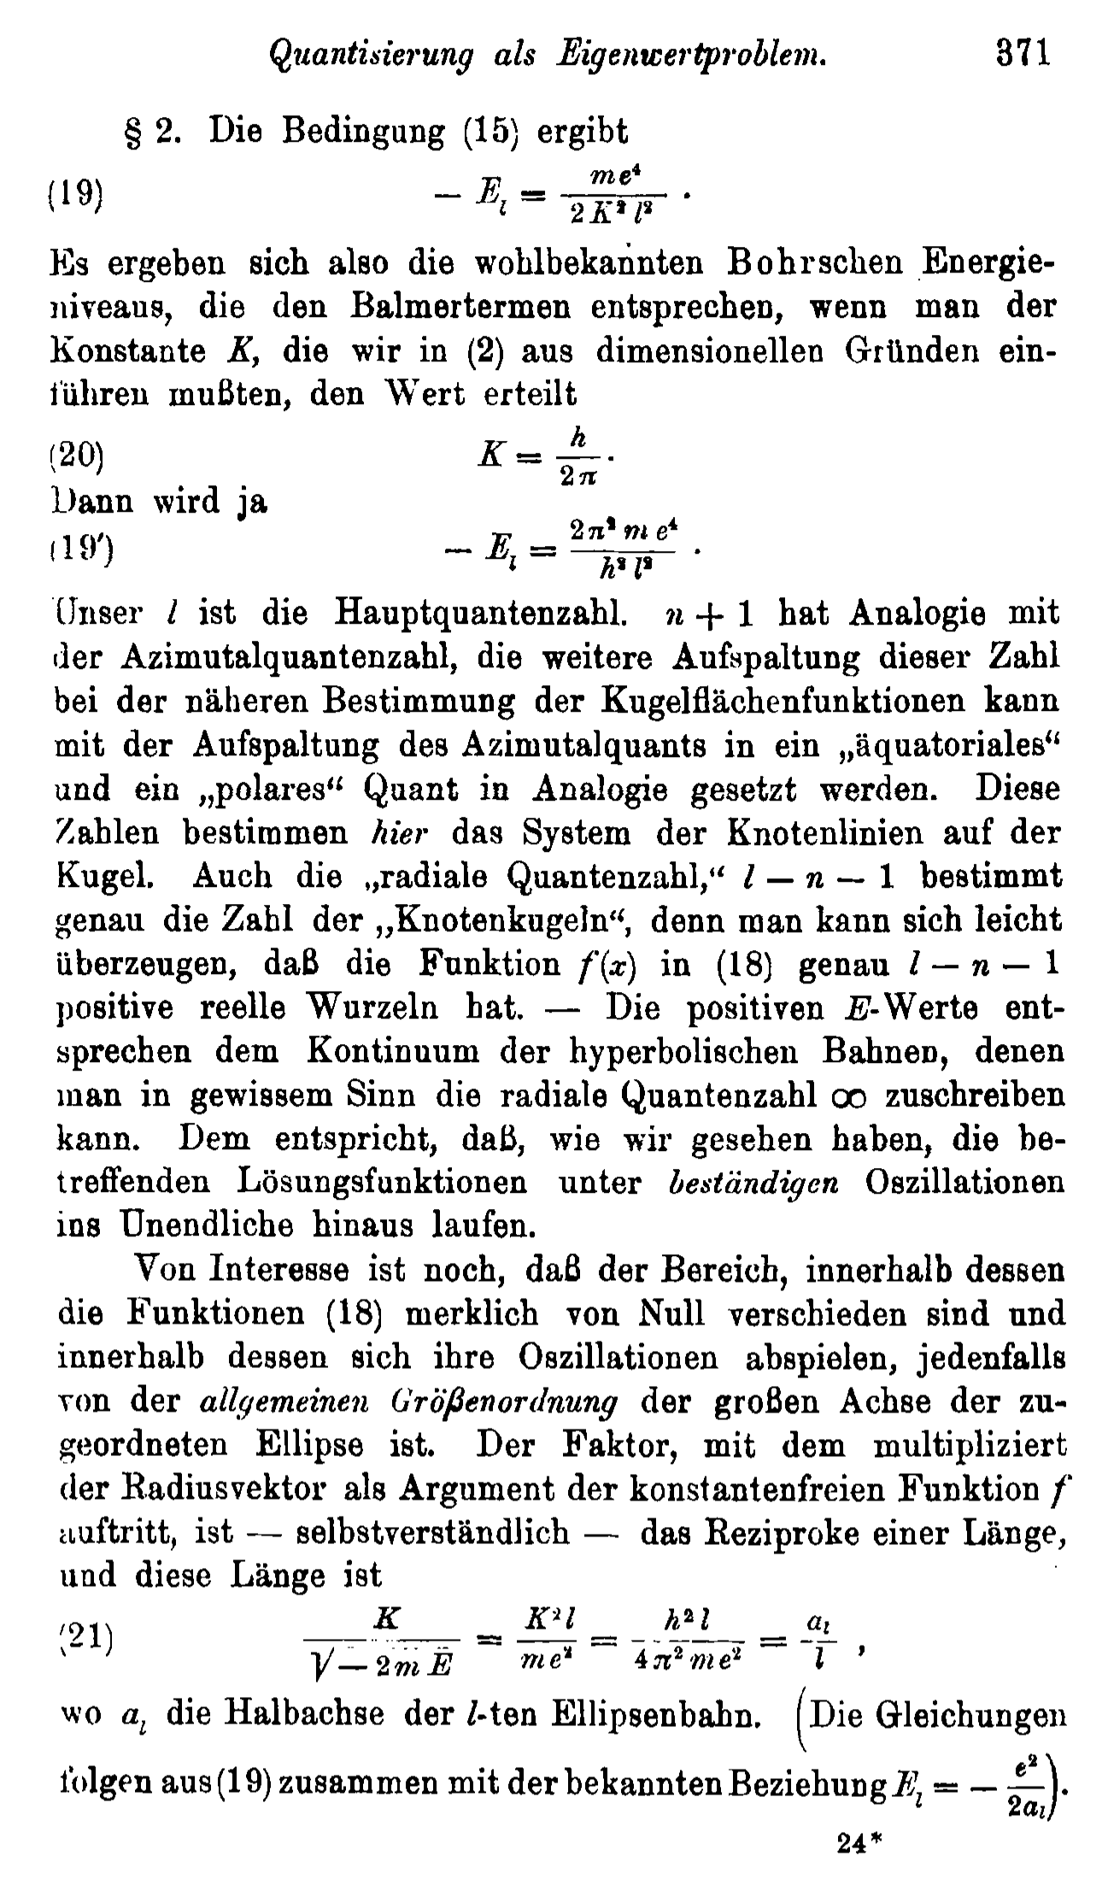
Erwin Schrödinger in 1926
Erwin Schrödinger
Public image from Wikipedia
Annalen der Physik 384(4) 361-376

Slide 20
Summary
The 6-dimensional Schrödinger equation for a hydrogenic atom can be solved exactly analytically after a complete separation of variables.
The electronic wave function is a product of the radial part (an associated Laguerre polynomial and the Slater-type orbital) and the angular part (a spherical harmonics).
There are 3 quantum numbers n, l, and m.
The discrete energy eigenvalues are negative and inversely proportional to n².

