Slide 1
Lecture 16 Tunneling

Slide 2
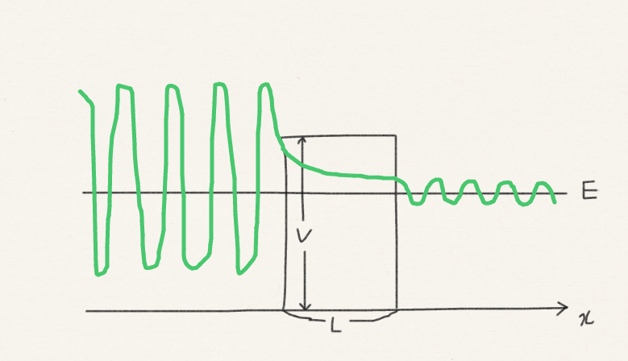
Tunneling
We will consider a problem in which a particle of mass m and energy E hits a potential barrier of height V and width L. V is greater than E. Classically, the particle cannot overcome the barrier, but quantum mechanically it can “tunnel” through it.

Slide 3
Tunneling
The Schrödinger equation to solve:
Energy E is given (continuous) and assumed smaller than V.

Slide 4
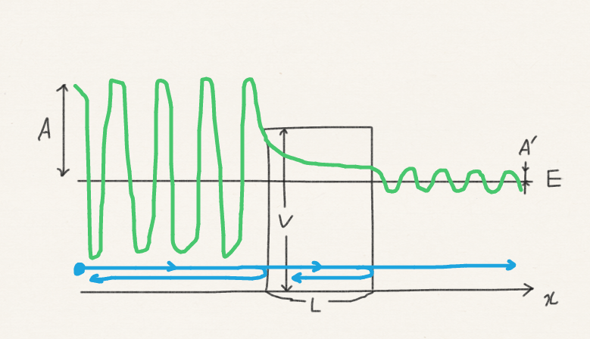
Tunneling
The situation we describe:
A particle flies in from the left.
Sometimes it is bounced back by the left edge; sometimes it passes through the left edge.
When it passes through the left edge, sometimes it is bounced back by the right edge; sometimes it passes through the right edge.
What is the ratio of transmission versus reflection |A|²/|A’|²?

Slide 5
Tunneling
The shape of the potential naturally divides the space into three regions. In each region, the potential is flat.
For a flat potential, e^{ikx} (or equivalently sin and cos) and e^{kx} are the most promising functional forms.

Slide 6
Tunneling
Our intuitive picture of the solution:
e^{ikx} represents an incoming particle, with momentum +ħk
e^{ikx} is a transmitted particle, with momentum +ħk
e^{–ikx} is a reflected particle, with momentum –ħk
e^{–κx}, e^{+κx} is a decaying function which connects the left and right wave functions.

Slide 7
Tunneling
The wave function within the barrier: Here, V > E and e^{–κx} and e^{+κx} are more suitable.
Negative
Positive

Slide 8
Tunneling
E
E
= E < V

Slide 9
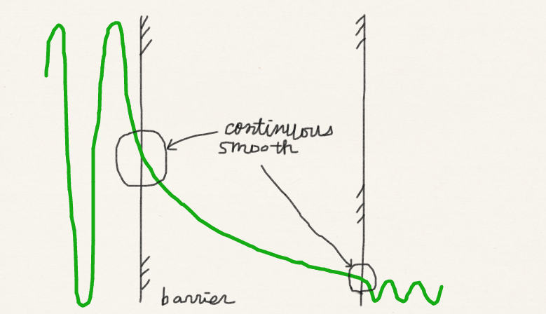
Boundary conditions
The wave functions must be continuous and smooth (because there is no singularity in the potential).
Continuous
Continuous
Smooth
Smooth
We know k and κ.

Slide 10
Tunneling
Energy E, thus, k and κ are known.
We have five unknowns: A, B, C, D, A΄.
We have four boundary conditions.
The fifth condition comes from the normalization, determining all five unknowns.
We want to determine the transmission probability |A΄|² / |A|². In fact, with the four boundary conditions alone (without normalization), we can find four ratios: B/A, C/A, D/A, A΄/A.

Slide 11
Tunneling
For a high, wide barrier, the transmission probability decreases exponentially with
Thickness of barrier,
Square root of particle mass,
Square root of energy deficit V–E.

Slide 12
Tunneling
Tunneling occurs when the particle does not have enough energy to overcome the barrier.
Classically, this is impossible. Within the barrier, the kinetic energy would be negative.
Quantum mechanically, this is possible according to the Schrödinger equation.
(Some argue that the particle can acquire a higher energy necessary to cross the barrier momentarily thanks to the time-energy uncertainty principle).

Slide 13
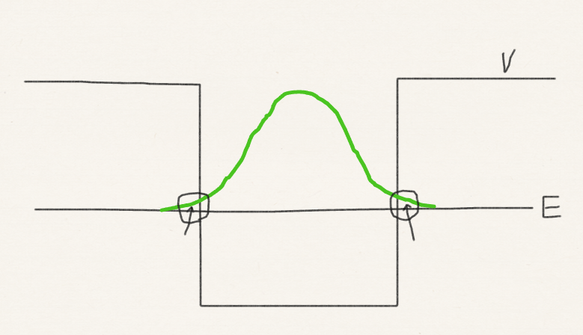
Permeation
We have already seen (in harmonic oscillator problem) that a wave function can permeate in the classically forbidden region. This is by the same mechanism that tunneling occurs.

Slide 14
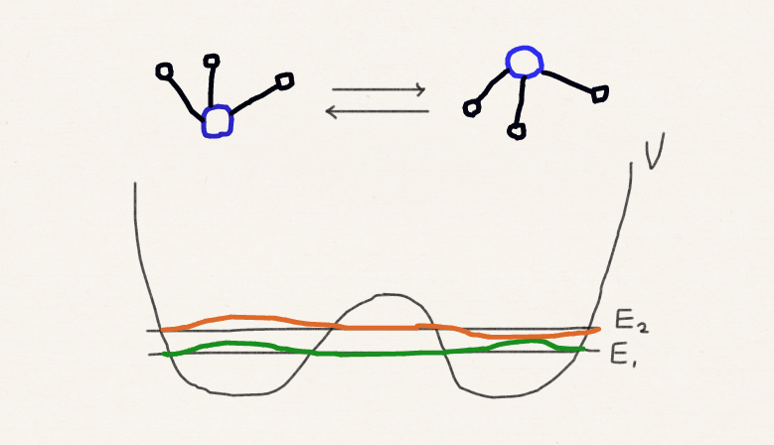
Ammonia inversion

Slide 15
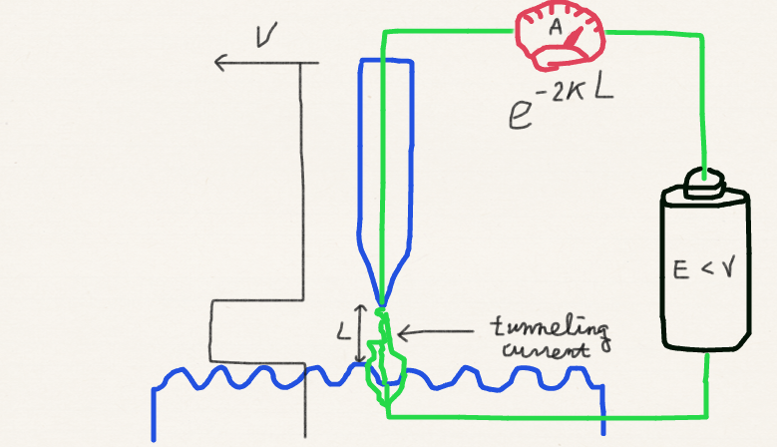
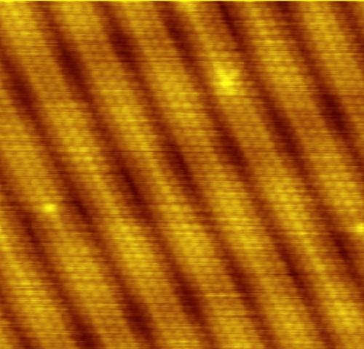
Scanning tunneling microscope
Gold (100) surface
Public image
from Wikipedia

Slide 16
Summary
A particle of energy E can tunnel through a barrier of potential height V > E.
A particle of energy E can also permeate into the potential wall of V > E.
The thinner the barrier or the lower the barrier height or the lighter the particle, the more likely the particle can tunnel.

