Slide 1
Lecture 15 Time-dependent perturbation theory
(c) So Hirata, Department of Chemistry, University of Illinois at Urbana-Champaign. This material has been developed and made available online by work supported jointly by University of Illinois, the National Science Foundation under Grant CHE-1118616 (CAREER), and the Camille & Henry Dreyfus Foundation, Inc. through the Camille Dreyfus Teacher-Scholar program. Any opinions, findings, and conclusions or recommendations expressed in this material are those of the author(s) and do not necessarily reflect the views of the sponsoring agencies.

Slide 2
Time-dependent perturbation theory
The theory described here is essential for understanding the optical transitions from one state to another and thus spectroscopies. It gives the formula for intensities of spectral bands.
The probability of transition (intensity of a spectral band for the transition n ← 0) is

Slide 3
Zeroth order
Before the perturbation is turned on, the system is in time-independent ground state.
Let us remember that a “time-independent” wave function does have hidden time dependence of the form:

Slide 4
Perturbation = light
Next, we shine light on the system. Light (or a photon) is a time-oscillating electromagnetic field. It is very weak as compared to electrostatic interactions between electrons and nuclei in atoms and molecules. It can be treated as a time-dependent perturbation:
Oscillating real electrostatic field in z direction with intensity E and angular frequency ω = 2πν.

Slide 5
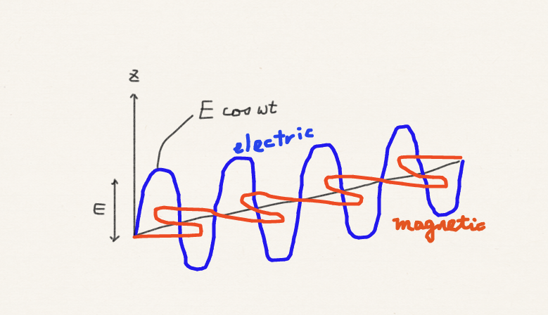
Perturbation = light
Oscillating real electrostatic field in z direction with intensity E and angular frequency ω = 2πν.

Slide 6
First order
Once we turn on the time-dependent perturbation, the wave function will have time-dependent response. We consider the first-order response. We expand the first-order correction to the zeroth-order wave function by eigenfunctions of the known (initial, time-independent) system.

Slide 7
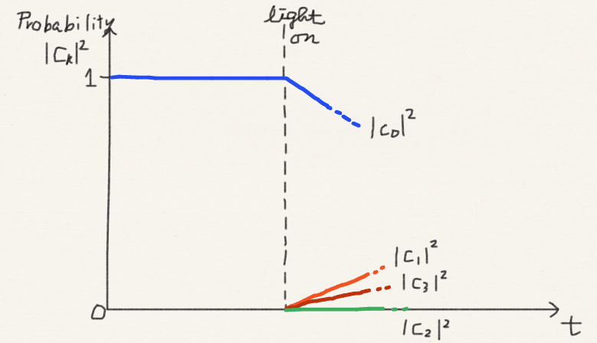
Light absorption

Slide 8
First order
Substituting into the time-dependent Schrödinger equation:

Slide 9
First order
Collecting the terms in first order in λ

Slide 10
First order
Using that are eigenfunctions of H⁽⁰⁾
Cancel

Slide 11
First order
Multiplying from the left and integrating
Cancel
1 only if n = k

Slide 12
First order
Simplifying
1 only if n = k
Equal
Energy conservation!

Slide 13
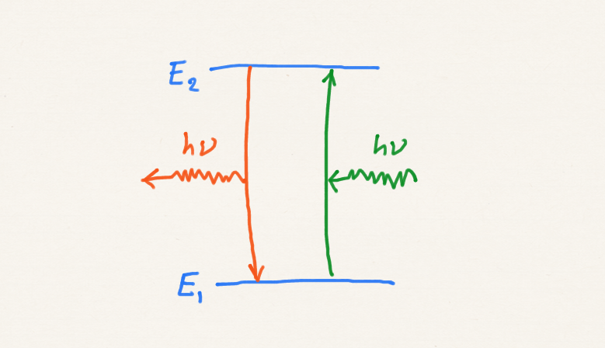
First order
Excitation or deexcitation

Slide 14
First order
Removing the time-oscillating factors

Slide 15
Fermi’s golden rule
The probability of transition (intensity of a spectral band for the transition n ← 0) is
When the dipole moment interacts with the oscillating electric field (light), the transition probability is proportional to the square of the transition dipole moment (in the direction of polarization) and the intensity of light (square of electric field amplitude).

Slide 16
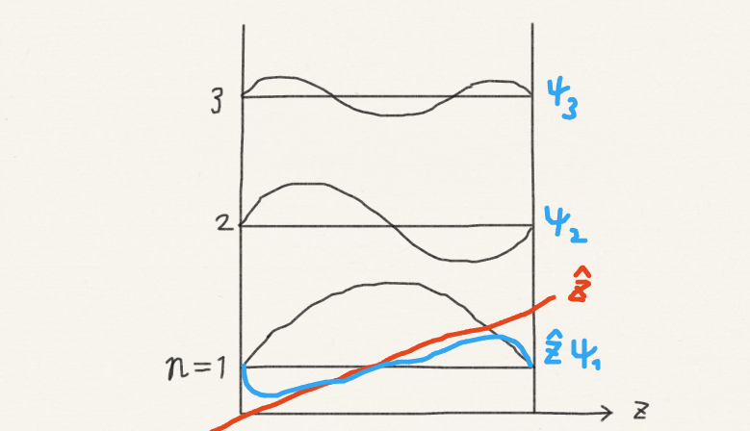
Fermi’s golden rule

Slide 17
Summary
Spectroscopic transitions can be explained by the time-dependent Schrödinger equation. One-photon transition can be understood by first-order time-dependent perturbation theory.
Energy conservation
Transition dipole moment
Intensity of light

