Slide 1
Lecture 13 Space quantization and spin

Slide 2
z-component angular momentum
The z-component of the angular momentum operator depends only on φ
The particle-on-a-sphere wave function is the eigenfunction of the l_{z} operator.
Angular
momentum

Slide 3
Total angular momentum
The total angular momentum operator is

Slide 4
Total angular momentum
The particle-on-a-sphere wave function is also the eigenfunction of the l ²_{total} operator.
Angular momentum squared

Slide 5
z-component and total angular momenta
The particle-on-a-sphere wave function, therefore, has a well-defined total energy and total angular momentum:
… and a well-defined z-component energy and z-component angular momentum:

Slide 6
x- and y-component angular momenta
This is because l_{z} and l_{total} commute.
l_{x} and l_{y} operators depend on both θ and φ. They do not commute with l_{z} or l_{total} or H.

Slide 7
Uncertainty principle
Observable | Determined Simultaneously?
Energy | Yes
x angular momentum | Yes, only for one (say, z) No, for the other two (x and y)
y angular momentum
z angular momentum
total angular momentum | Yes

Slide 8
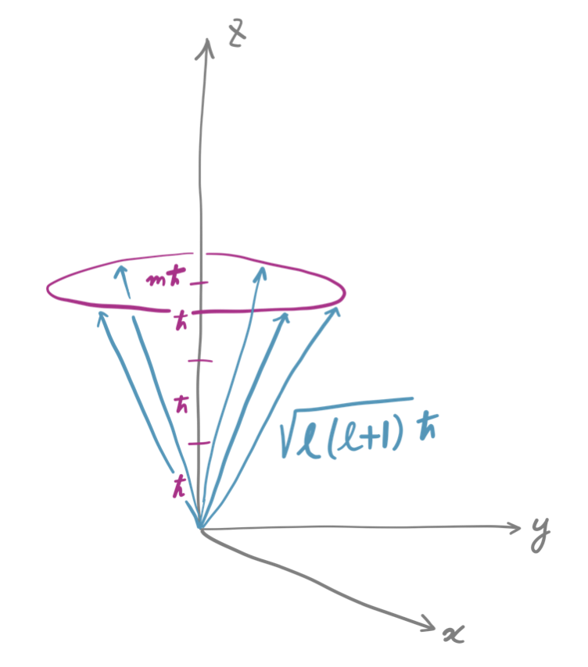
Space quantization
The angular momentum is discretized in its total length ( ) and z-component length ( ).
The x- and y-components are completely unknown.
The momentum vector is on the cone with slant height of and height of .

Slide 9
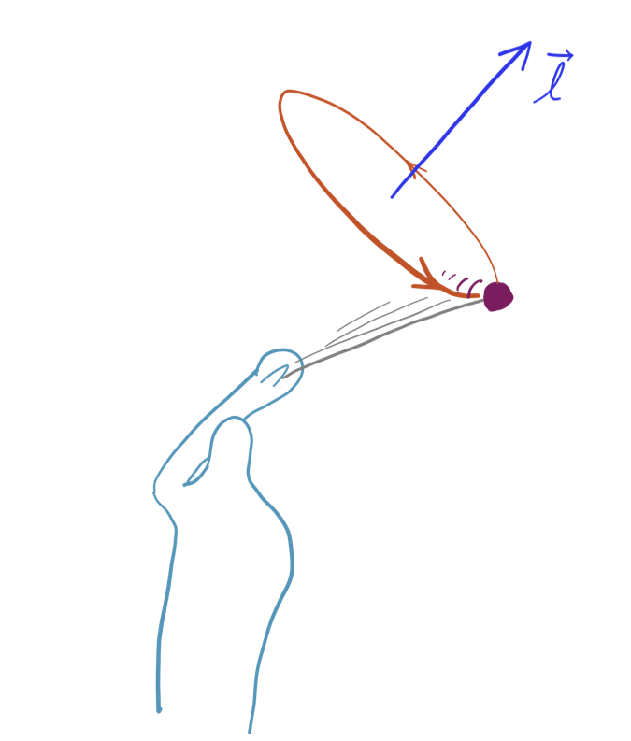
Space quantization
Not only the length of the angular momentum vector, but also its orientation is quantized (in a rather complex manner).

Slide 10
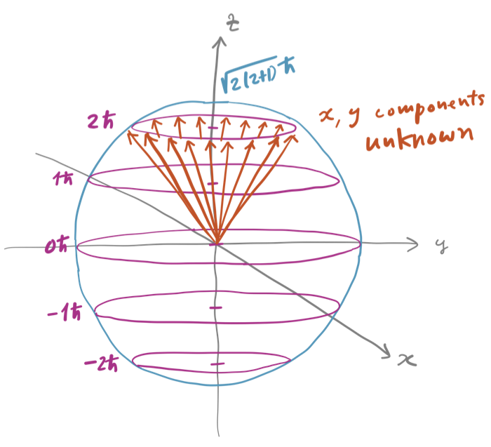
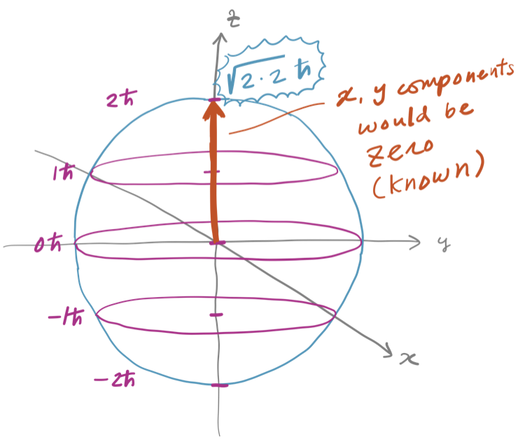
Space quantization
If it were not for “+1” in , m_{l} = l would have the z-component exhaust the total angular momentum, leaving nothing for x- and y-components, which are zero. This amounts to determining all x-, y-, and z-components exactly and simultaneously, violating uncertainty principle!

Slide 11
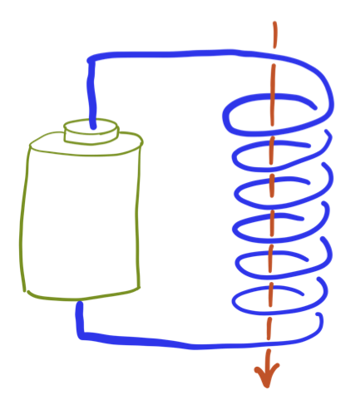
Angular momentum as a magnet
Circular motion of a charged particle (e.g., an electron) creates a magnetic field.
Magnetic moment is proportional to angular momentum.
Applying an external magnetic field (along z axis) and measuring the interaction, one can determine the (z-component) angular momentum of circular motion of an electron.

Slide 12
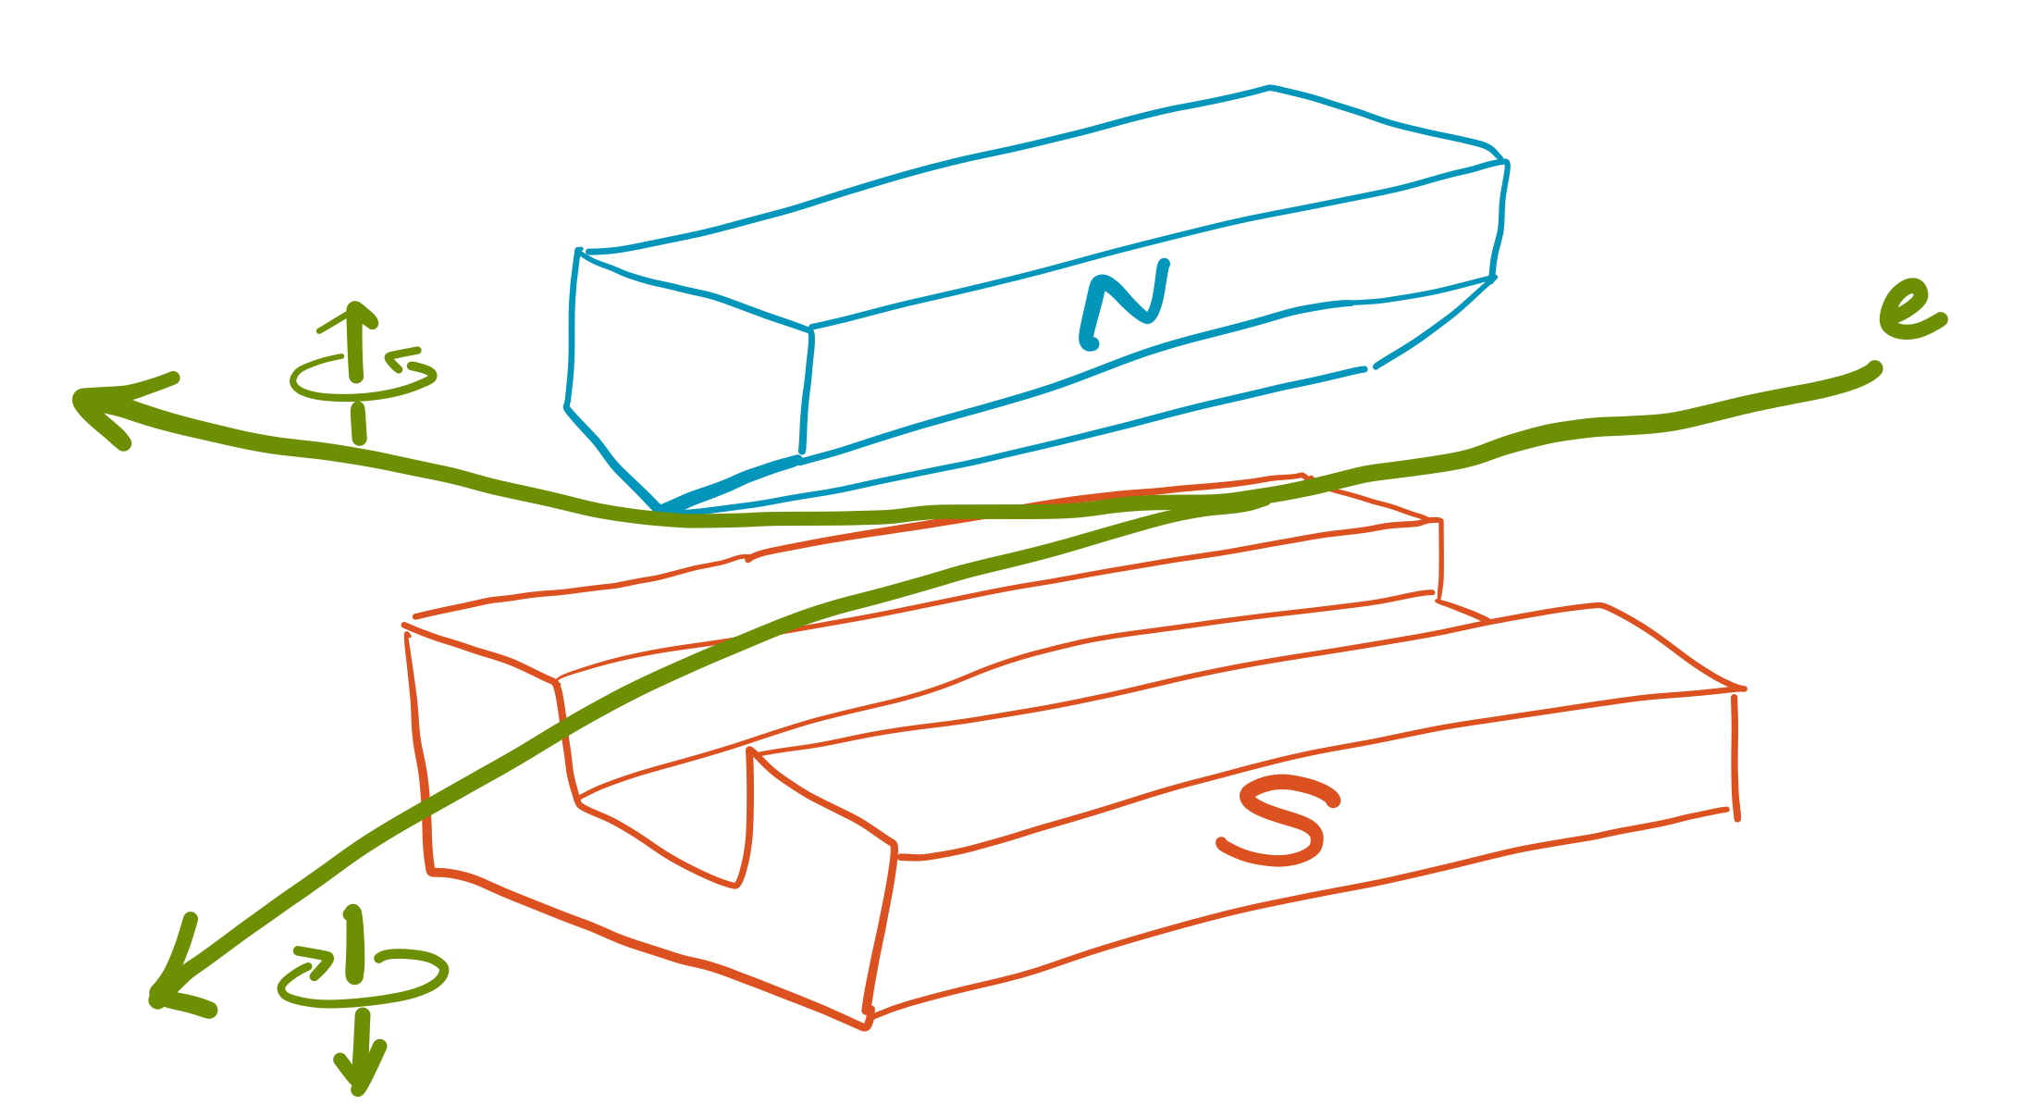
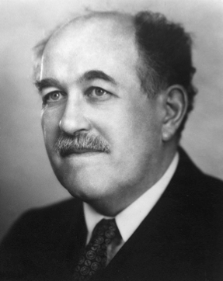
Stern–Gerlach experiment
The trajectories of electrons in an inhomogeneous magnetic field are bent.
The trajectories are “quantized” – the proof of the quantization of angular momenta, namely, space quantization.
Otto Stern
Public domain image from Wikipedia

Slide 13
Summary so far (not the end!)
The total angular momentum and only one of the three Cartesian components (z-component) can be determined exactly simultaneously. One component cannot exhaust the total momentum (because of “+1” in ).
The angular momentum is quantized in both its length and orientation – it cannot point at any arbitrary direction (space quantization).

Slide 14
Stern–Gerlach experiment revisited
Just two trajectories observed for electrons.
This suggests l = ½ and m_{l} = ½ and –½.
This cannot exactly be the particle on a sphere (where l and m_{l} are full integers)?

Slide 15
Spin
It is the “spin” angular momentum of an electron.
It has been discovered that the particle has intrinsic magnetic momentum. Its precise derivation is beyond quantum chemistry.
We can imagine the particle spinning and its associated angular momentum acts like a magnetic moment.

Slide 16
Spin
An electron has the spin quantum number s = ½ (corresponding to l of particle on a sphere). The total spin angular momentum is .
The spin magnetic quantum number m_{s} (corresponding to m_{l}) can take s,…,–s (unit interval). For an electron m_{s} = ½ (spin up or α spin) and –½ (spin down or β spin).
A proton or neutron also has s = ½.
A photon has s = 1.

Slide 17
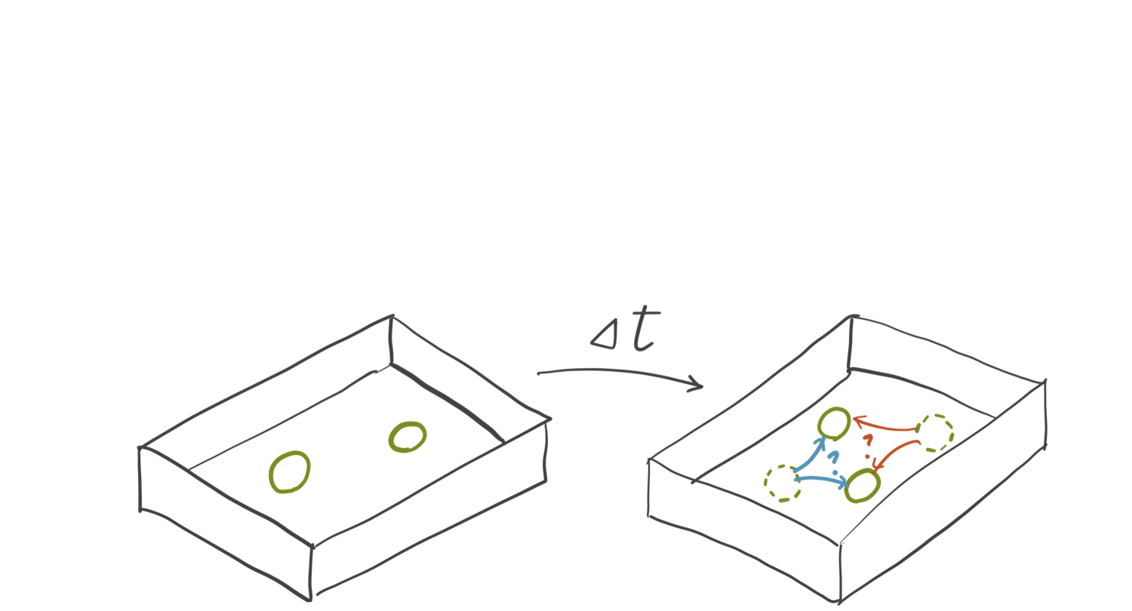
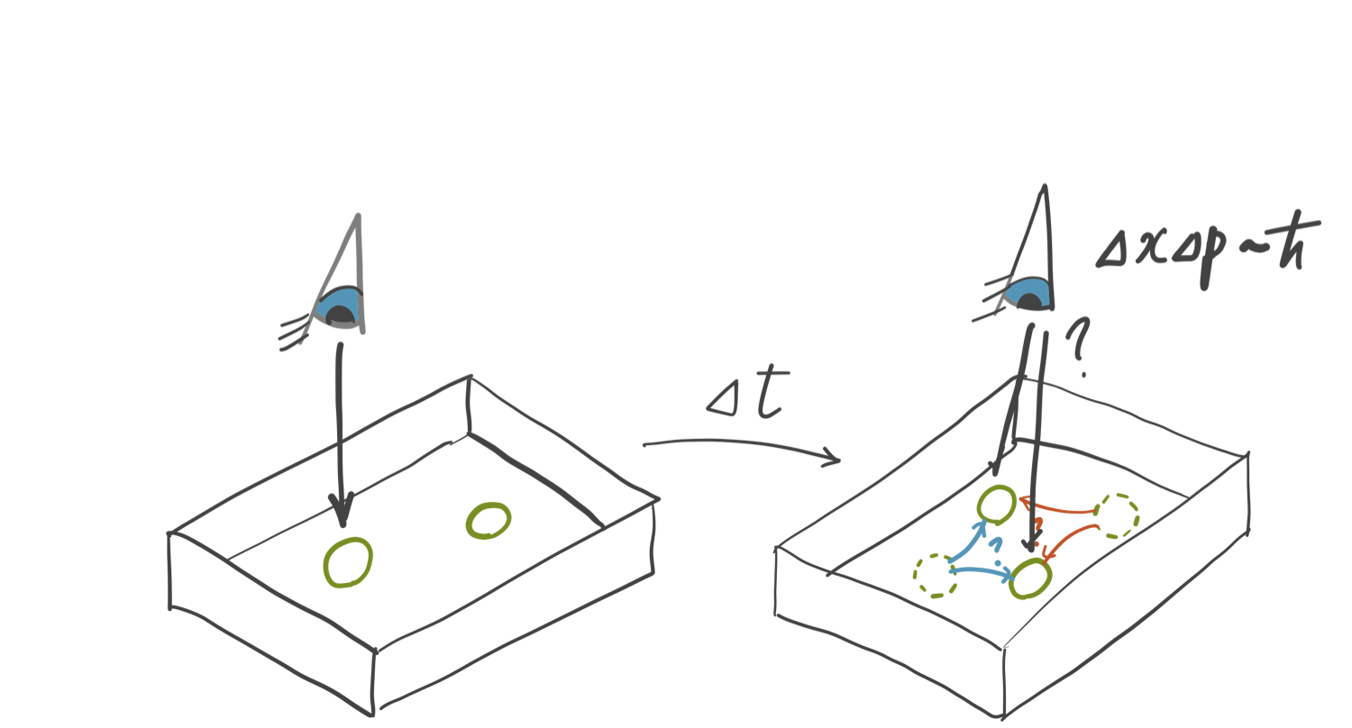
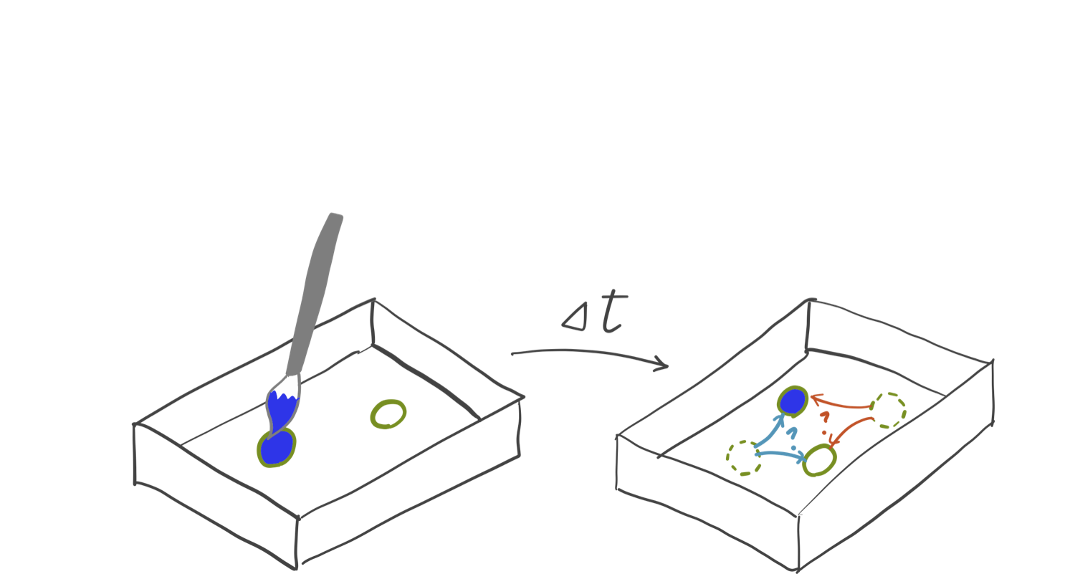
Indistinguishability
Because of the uncertainty in the position and momentum of a particle, in a microscopic scale, two particles of the same kind (such as two electrons) nearby are indistinguishable.

Slide 18
Indistinguishability
The probability of finding particle 1 at position r₁ and particle 2 at r₂ is the same as that of finding particle 2 at r₁ and particle 1 at r₂ (otherwise we can distinguish the two).
There are two immediate possibilities

Slide 19
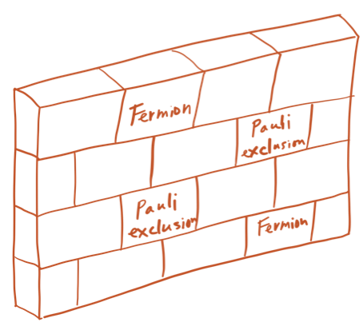
Fermions
Possibility 1: Fermions: particles having half integer spin quantum numbers (such as electrons).
Two fermions of the same spin cannot occupy the same position in space (Pauli exclusion principle). They form matter.

Slide 20
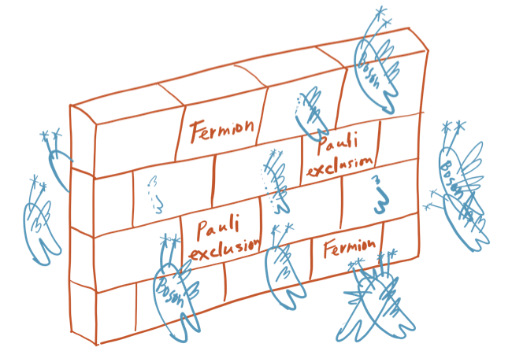
Bosons
Possibility 2: Bosons: particles having full integer spin quantum numbers (such as photons).
Two bosons can occupy the same position in space (e.g., photons can overlap). They tend to mediate fundamental interactions.

Slide 21
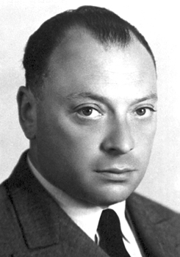
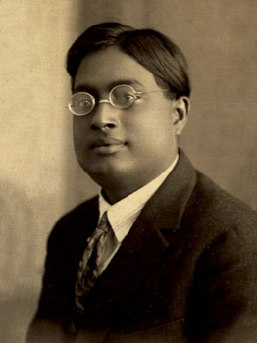
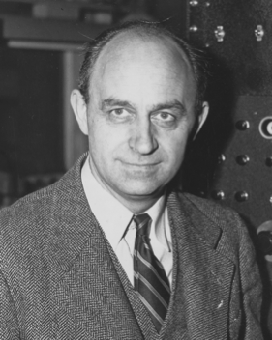
Caveat
The origins of spin, fermions, and bosons are beyond the scope of quantum chemistry.
However, spin and the Pauli exclusion principle for electrons (as fermions) are a crucial element of the whole chemistry.
We treat these as external postulates.
Wolfgang Pauli
Public domain image from Wikipedia
Satyendra Nath Bose
Public domain image from Wikipedia
Enrico Fermi
Public domain image from Wikipedia

Slide 22
Challenge homework #3
Find the origin of spins. Explain why the spin quantum number of an electron, proton, and neutron is ½, whereas that of a photon is 1.
Explain why particles with half integer spin quantum numbers are fermions and have wave functions that are anti-symmetric with respect to particle interchange. Explain why particles with full integer spin quantum numbers are bosons and their wave functions are symmetric with respect to interchange.

