Slide 1
Lecture 12 Particle on a sphere
(c) So Hirata, Department of Chemistry, University of Illinois at Urbana-Champaign. This material has been developed and made available online by work supported jointly by University of Illinois, the National Science Foundation under Grant CHE-1118616 (CAREER), and the Camille & Henry Dreyfus Foundation, Inc. through the Camille Dreyfus Teacher-Scholar program. Any opinions, findings, and conclusions or recommendations expressed in this material are those of the author(s) and do not necessarily reflect the views of the sponsoring agencies.
Notes:
This lecture will describe the quantum mechanical particle on a sphere.

Slide 2
The particle on a sphere
Main points: the particle on a sphere leads to a two-dimensional Schrödinger equation and we must use the separation of variables. One of the resulting one-dimensional equations is the particle on a ring. For the other, we seek mathematicians’ help: we introduce associated Legendre polynomials. The product of these and the particle on a ring eigenfunctions are spherical harmonics.
Notes:
The particle on a sphere describes the motion of a free particle on a sphere. This is a two dimensional motion so it is described by two dimensional Schrodinger equation. For any differential equation beyond one dimension, we must use the separation of variables, which is an almighty dimension reduction method. It works in this case and breaks the original two-dimensional equation into two one-dimensional equations. One of them turns out to be our familiar particle-on-a ring problem. The other is a rather hairy equation, for which we seek mathematicians’ help. The solution for the second equation is known as the associated Legendre polynomials. The products of these two solutions are very important set of functions known as spherical harmonics.

Slide 3
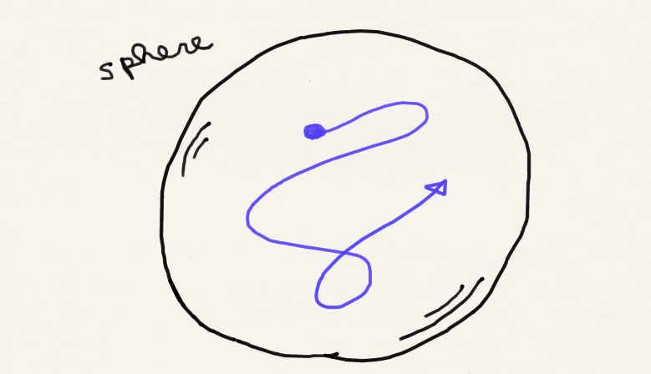
The particle on a sphere
Notes:
Let me define the problem. We let one particle of mass m roam freely on a sphere of radius r. The particle cannot leave the surface of the sphere but otherwise does not feel any potential. The surface of a sphere is a two dimensional object so this is essentially a two dimensional problem.

Slide 4
The particle on a sphere
The potential is zero – only kinetic energy:
In the Cartesian (xyz) coordinates, the ‘del squared’ is
What is it in spherical coordinates?
Notes:
The Schrodinger equation for this has no potential. In other words, the Hamiltonian is purely kinetic energy operator. Symbolically, we can always write the kinetic energy operator as negative hbar squared over 2 m times del squared. In Cartesian coordinates, the del squared has this simple, intuitive form, ddx sq + ddy sq + ddz sq. This matches our understanding of kinetic energy as being the sum of its x component, y component, and z component. If we insist on working in Cartesian coordinates, our Schrodinger equation is 3 dimensional because the particle on a sphere moves in all of x, y, and z dimension. The simplicity of del squared does not justify the increased dimensionality of the differential equation – we use spherical coordinates to aggressively try to reduce dimension. So, what is the form of del squared in spherical coordinates?

Slide 5
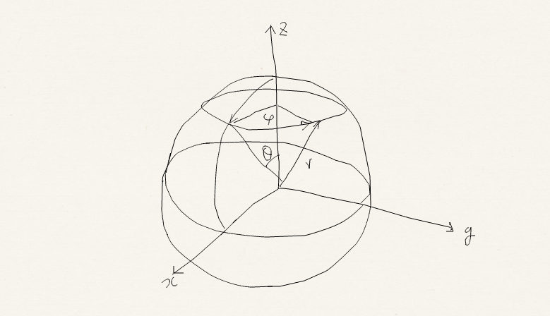
The particle on a sphere
The answer is:
The derivation is analogous to that for cylindrical coordinates. You are invited to derive!
Notes:
The answer is this. Deriving this was one of the optional, challenge homework problems. If you have managed to obtain this, please submit your derivation to me or TA’s. If you have not tried, the derivation is analogous to the derivation of del squared in cylindrical coordinates. In fact, the strategy is identical so you may now have a clear idea how to do this. You are still invited to derive this.

Slide 6
The particle on a sphere
The value of r is held fixed. The derivatives with respect to r vanish.
The Schrödinger equation is
Two variables θ and φ.
Notes:
At first sight, this del square seems to worsen the situation, but that’s not the case. Since the motion of the particle does not change the radius r, the first two terms in the del squared can be erased because the wave function is not a function of r and these derivatives have nothing to act on. Remaining 1/r squared right here is just a constant. So at this point, we see the clear benefit of using spherical coordinates over Cartesian coordinates; our Schrodinger equation is two-dimensional, as it should be, with just two variables theta and phi. So this is how the Schrodinger equation looks. It looks scary, but reducing dimension is always more important than the look of the equation and we have already achieved knocking off one dimension so we should feel good about this.

Slide 7
The particle on a sphere
Two variables – let us try the separation of variables technique.
Substituting For the separation to take place, we must be able to cleanly separate the equation into two parts, each depending on just one variable.
Notes:
We still have two dimensional differential equation, so we must try separation of variables, which is probably our best friend in this and many other disciplines. The first step, as usual, is a wishful thinking. We assume that the separation occurs and the solution is a product of a function of theta and a function of phi which we express by big Theta and big Phi. We did the same for two dimensional particle in a well. Substituting this product form of wave function in the schrodinger equation we obtain this. For the separation to take place, we must be able to cleanly separate the equation into two parts, each depending on just one variable.

Slide 8
The particle on a sphere
The differentiation with respect to θ for example acts on Θ alone. Therefore
Dividing the both sides by ΘΦ
Notes:
So let us recognize that the differentiation wrt phi will only act on big Phi and big theta is a spectator or just a multiplicative factor in the first term. Differentiation wrt theta acts only on big theta and big Phi is just a spectator. Before I forget, I want to clarify what this operator exactly does to an input function. It differentiate an input function wrt theta first, then multiply sin theta to the result of this differentiation, then differentiate the resulting product by theta, then divide the result by sin theta. The order is very important and strictly right to left; in other words, operators closer to the input function acts first.
The next step is, again as usual, divide the whole expression by the solution big theta times big phi. We did the same for two dimensional particle in a well so this is a routine and so you might want to just remember the whole sequence. At this point, the second term is a function of theta alone. The first term is almost a function of phi alone, but sin square theta prevents the clean separation.

Slide 9
The particle on a sphere
Multiplying both by sin²θ
Subtracting the RHS from both sides
Function of φ
Function of θ
Function of θ
Function of φ
Function of θ
Constant
Notes:
So next we multiply both sides by sin square theta. Then the first term becomes the function of phi alone. The second term remains to be a function of theta alone. The problem is that the RHS, which used to be a constant, which we want to remain a constant, becomes a function of theta. But this is not a problem because we can simply subtract the RHS from both sides and the right hand side becomes a constant zero. At this point, we can say we have achieved the separation of variables. We have rewritten the equation into a sum of a function of phi alone and a function of theta alone, which is a constant. This logically means that each function is individually a constant.

Slide 10
The particle on a sphere
Two independent one-dimensional equations!
We have already solved the first equation.
These two parts of the equation must be constant.
Notes:
We have divided the one two-dimensional SE into two one-dimensional differential equations. Let us call the constant for the function of phi E sub phi. Then the other constant for the function of theta should be negative E sub phi because the sum of these two constants must be zero.
We also notice that we have already solved the first equation. If you multiply big Phi on both sides of this equation, you’d see that this is exactly the SE of particle on a ring. So the constant E sub phi is in fact the energy of particle on a ring, that is, m sub l squared hbar squared over 2 m r squared. The wave function big Phi is exponential i msubl phi.

Slide 11
The particle on a sphere
Separation of variables
2D rotation, m_{l} is introduced
Custom-made solutions
Associated Legendre polynomials
l and m_{l} are quantum numbers
Custom-made
Spherical harmonics
Notes:
The other differential equation shown here is rather complicated. We cannot expect to come across solutions by just substituting familiar functions for big Theta. So we use the second plan, which is to seek mathematicians’ help. Sure enough, 18th century mathematican named Legendre has already studies a differential equation which is essentially of the same form as this and thoroughly characterized the solutions. They are now called associated Legendre polynomials. They are an inifinite set of orthogonal functions designed specifically for this equation long before QM and each polynomial is characterized by quantum number l, which is 0 or positive integer, and has the same rank as the value of l. Furthermore, the product of associated legendre polynomials and the particle on a ring wave functions are such an important set of functions that they have their own names, they are called spherical harmonics. Spherical harmonics are two dimensional functions of theta and phi and they are the eigenfunctions of the particle on a sphere. They are characterized by two quantum numbers l and m sub l.
You have learned Hermite polynomials in the context of vibrational schrodinger equation. Now please add two more special functions, associated Legendre polynomials and spherical harmonics, into your repertories. The more you know these functions and the corresponding differential equations, the more useful you are as a scientist or engineer.

Slide 12
The particle on a sphere
To summarize: the Schrödinger equation is
The eigenfunctions are spherical harmonics specified by two quantum numbers l (= 0, 1, 2, …) and m_{l} (= –l, … l), having the form
Normalization
Associated
Legendre
e^{imlφ}
Spherical harmonics
Notes:
Let me summarize what we have found so far. The SE for the particle on a sphere is written like so in spherical coordinates.
The eigenfunction solutions of this equation are normalization coefficient times spherical harmonics specified by two quantum numbers l and m sub l. l is 0 or positive integer and m sub l is an integer less than or equal to l and greater than or equal to minus l. I will come back to explaining this domain of m sub l later. A spherical harmonics is in turn a product of associated Legendre polynomial of rank l times the particle on a ring wave function exponential i m sub l phi. I will talk about the energy eigenvalue in a minute.

Slide 13
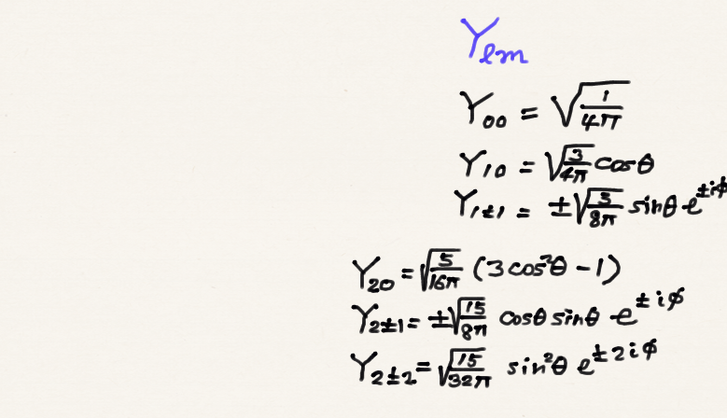
The particle on a sphere
Some low-rank spherical hamonics are given on the right.
Spherical harmonics are orthogonal functions. They as fundamental to spherical coordinates as sin and cos to Cartesian coordinates.
Notes:
We have seen from particle in a box of various dimensions that sin, cos, and exp ikx functions have fundamental significance in a rectangular space. They are eigenfunctions of these rectangular box shapes in the absence of potentials. Spherical harmonics have the same fundamental importance in the spherical space. They are counterparts of sin and cos functions in spherical coordinates. Symbol Y l m is reserved in math, physics and chemistry for spherical harmoncis.
Some of the low-rank spherical harmonics are given here. There is of course no need to memorize them because there are infinite number of them. Except perhaps you might want to know that Y00 or spherical harmonics with l = 0 and m sub l = 0 is just a constant. These exponential functions of phi are the particle on a ring portion of spherical harmonics and the rest are associated Legendre polynomials and normalization coefficients.

Slide 14
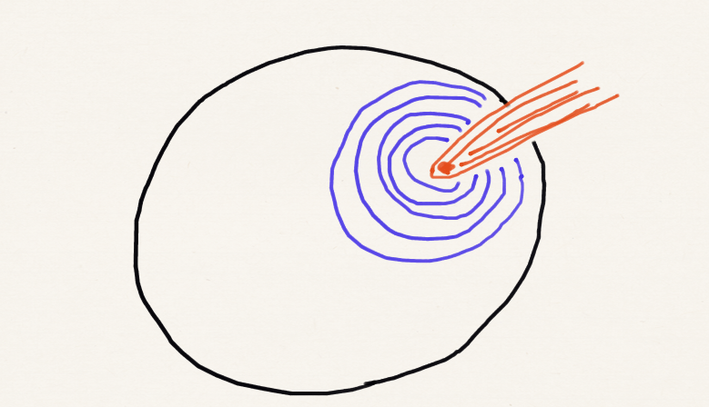
Spherical harmonics
Spherical harmonics are the standing waves of a sphere surface (e.g., soap bubble, earthquake).
Imagine a floating bubble. It vibrates – the amplitudes of the vibration is a linear combination of spherical harmonics.
GNU Image from Wikipedia
Notes:
Again, the importance of spherical harmonics transcends QM. It describes standing waves of a surface of a sphere such as vibrations of floating soap bubbles, vibrations of earth crust such as earthquake. Many objects in nature are spherical and scientists use spherical harmonics to study their structures and dynamics. In fact, Schrodinger was also studying such problems before QM and this is partly why he was surprisingly fast in solving SE for hydrogen atom and showing that the results agree with the experiment.

Slide 15
The particle on a sphere
The total energy is determined by the quantum number l only:
Out of this, the energy arising from the φ rotation is
The latter cannot exceed the former.
Notes:
According to Legendre, the energy eigenvalue of the SE is determined by quantum number l only. It is l l + 1 hbar squared over 2 m r squared. L is 0 or positive integer. So the energy level of the particle on a sphere is increasingly widely separated with l similar to particle in a box or particle on a ring.
We have already seen that the energy of the particle on a ring is ml squared hbar squared over 2 m r squared. We have also seen that the quantum m sub l is proportional to the angular momentum of the rotational motion around the z axis.
If we compare these two expressions, you’d agree with me on the following interpretation without rigorous mathematical proof. This expression is the total energy of the rotating particle on the two dimensional surface of a sphere and l is related to the total angular momentum of this overall rotational motion. This expression is a component or partial energy of the rotating particle or the energy that is coming only from the rotation around the z axis. m sub l is proportional to this z-component angular momentum. Since E sub m is a part of E sub l, E sub m cannot exceed E sub l. This restricts the domain of integers quantum number m sub l can take. It is an integer between l and minus l so that E sub m is always smaller than E sub l. The reason why we have subscript l on m is that the domain of values of m is dependent on the value of l.
By now, you must be disturbed by “+1” in the E sub l expression right here. This +1 makes this expression differ in form from this expression. This “+1” is very important and I need to you to memorize its presence. I will discuss how this +1 matters in space quantization and uncertainty principles in the next lecture.

Slide 16
The particle on a sphere
Parameter l is called the orbital angular momentum quantum number.
Parameter m_{l} is the magnetic quantum number.
Energy is independent of m_{l}. Therefore, a rotational state with l is (2l +1)-fold degenerate because there are (2l +1) permitted integers m_{l} can take.
Notes:
l is called the orbital angular momentum quantum number. As I said in the previous page, this is related to the total angular momentum.
m sub l is called the magnetic quantum number. It is proportional to the z component angular momentum.
Energy is independent of m sub l. So a eigenfunction or state specified by one value of l is (2l+1) fold degenerate because there are (2l+1) different values of integers, minus l to plus l, m sub l can take and they all give the same energy. So the particle on a sphere solutions can be highly degenerate. I mentioned that the degeneracy occurs often because of high symmetry and sphere is very highly symmetric.

Slide 17
The particle on a sphere
Let us verify that the associated Legendre polynomial is indeed the solution for l = 1 and m_{l} = 1.
Notes:
We have not really solved the theta-part of the differential equation. We instead obtained the solutions from mathematicians. So what we do in this course is for us to verify that some of the associated Legendre polynomials are indeed the solutions and admire their structures and functions. This slide shows this verification for l = 1 and m sub l = 1 and we also use the energy expression which is a part of the solution. I will include some additional verifications in the problem set.

Slide 18
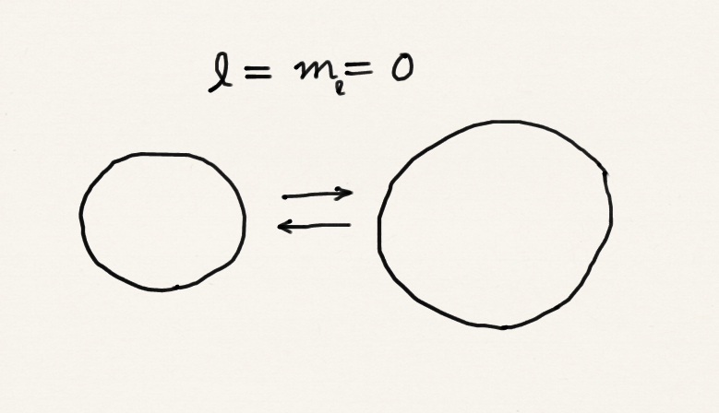
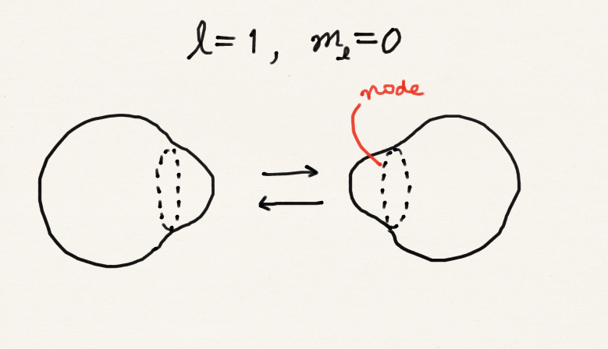
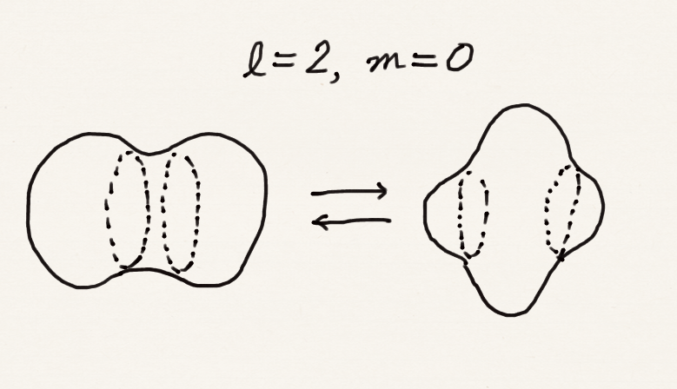
Spherical harmonics
This is a breathing mode of a bubble
This is a a-candy-in-mouth mode of a bubble
This is an accordion mode of a bubble
Notes:
Spherical harmonics describes the amplitudes of standing waves of particle on a sphere or vibrations of a soap bubble or earthquake. Y 0 0 or l = 0 m sub l = 0 is a constant. This corresponds to a breathing of the whole sphere. Y 1 0 or l = 1 m sub l = 1 describes a candy-in-mouth motion, in which one half side of the sphere expand and the other side shrink and vice versa. Y 2 0 corresponds to an accordion-like motion, at one point, two edges expand and the center shrink and at another point, the center expands and the edges shrinks. You do not have to try to memorize these; I just wanted to remind you that spherical harmonics do represent waves of the particle here.

Slide 19
Summary
The spherical harmonics are the most fundamental functions in a spherical coordinates.
We have encountered a differential equation whose solution involves associated Legendre polynomials.
The eigenfunctions of the particle on a sphere are spherical harmonics and characterized by two quantum numbers l and m_{l}.
The energy is determined by l only and is proportional to l(l + 1).

