Slide 1
Lecture 10 Harmonic oscillator
(c) So Hirata, Department of Chemistry, University of Illinois at Urbana-Champaign. This material has been developed and made available online by work supported jointly by University of Illinois, the National Science Foundation under Grant CHE-1118616 (CAREER), and the Camille & Henry Dreyfus Foundation, Inc. through the Camille Dreyfus Teacher-Scholar program. Any opinions, findings, and conclusions or recommendations expressed in this material are those of the author(s) and do not necessarily reflect the views of the sponsoring agencies.

Slide 2
Vibrational motion
Quantum-mechanical harmonic oscillator serves as the basic model for molecular vibrations. Its solutions are characterized by (a) uniform energy separation, (b) zero-point energy, (c) larger probability at turning points.
We introduce the concept of orthogonal polynomials. Here, we encounter the first set: Hermite polynomials.

Slide 3
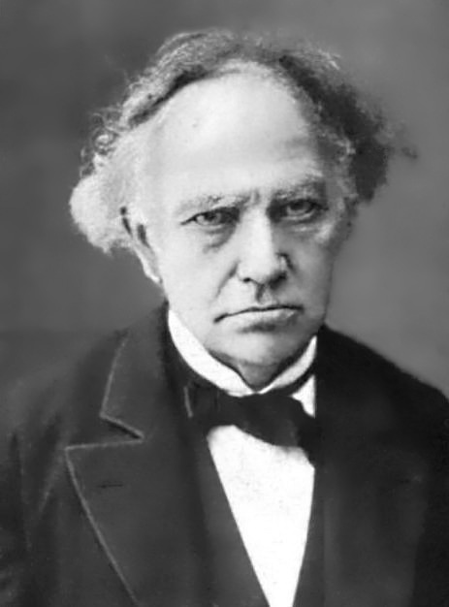
Differential equations
Differential equations
Custom-made solutions:
Orthogonal polynomials
18th-19th century
mathematical
geniuses
Know, verify, and use
the solutions (thankfully)
We

Slide 4
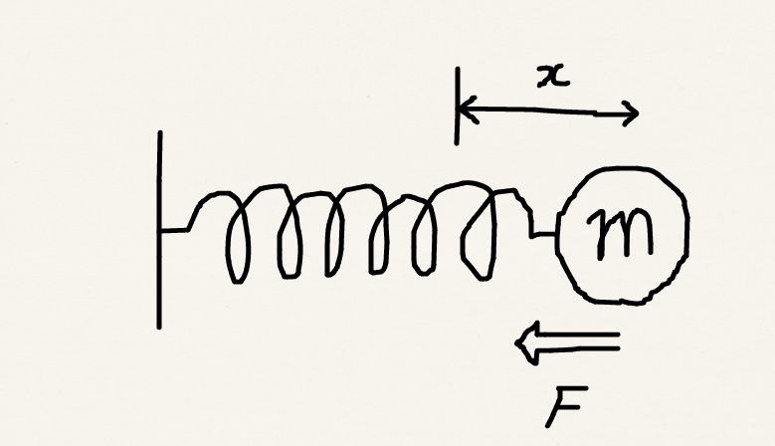
Vibrational motion
Quantum mechanical version of a “spring and mass” problem.
The mass feels the force proportional to the displacement: F = – kx.
The potential energy is a harmonic potential: V = ½kx² (F = –∂V/∂x).

Slide 5
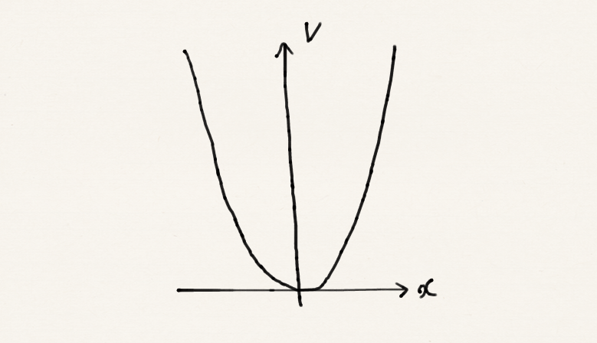
Eigenvalues
The Schrödinger equation is:
If we solve this, we obtain the eigenvalues:

Slide 6
Comparison to classical case
Quantum mechanical
Classical
Quantum number
Same frequency
Amplitude can take any arbitrary value, so energy is not quantized
When the object stretches the spring the most, the total energy is purely potential energy

Slide 7
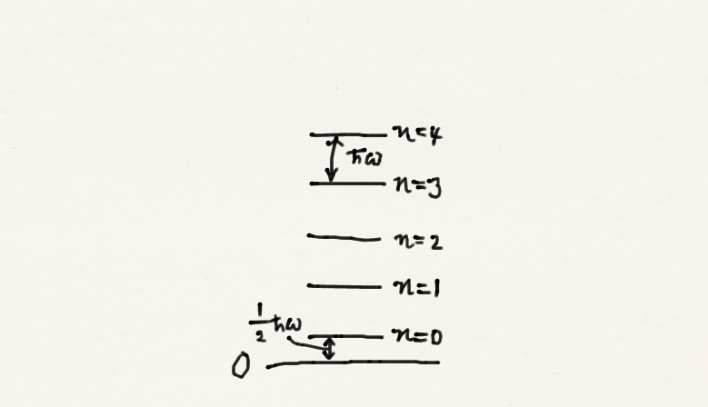
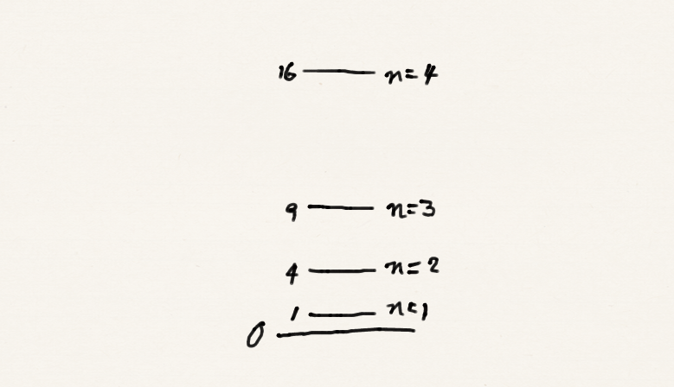
Comparison to the particle in a box
The particle in a box Harmonic potential

Slide 8
The energy levels
Zero-point energy
Energy separation
Molecules never cease to vibrate even at 0 K – otherwise the uncertainty principle would be violated.
For molecular vibration, this amounts the energy of photon in the infrared range. This is why many molecules absorb in the infrared and get heated.

Slide 9
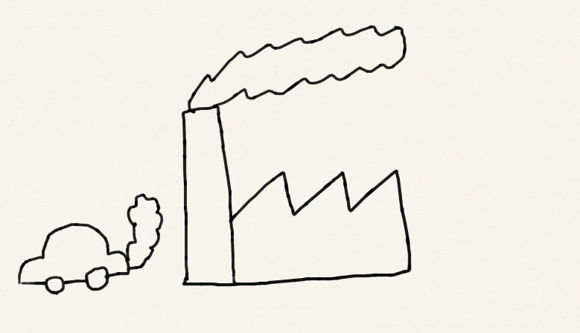
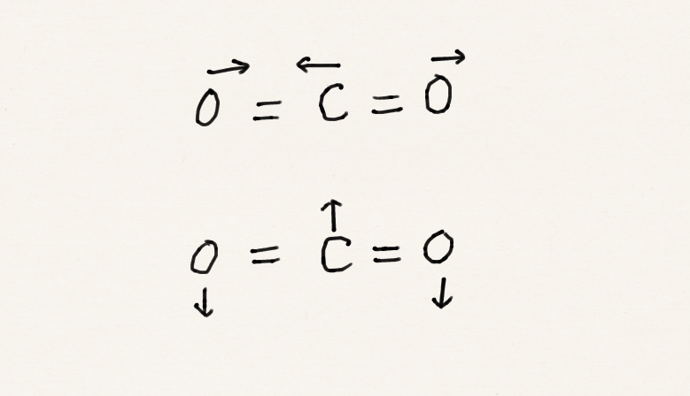
Quantum in nature
Vibrations of CO₂
Why is global warming?

Slide 10
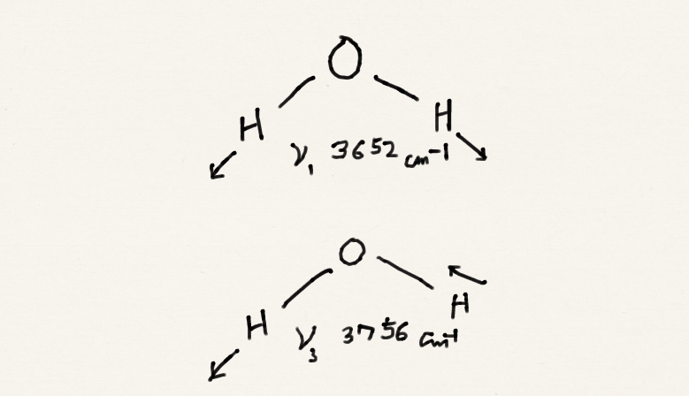
Quantum in nature
Vibrations of H₂O
Why is water blue?

Slide 11
Eigenfunctions
The eigenfunctions (wave functions) are
We do not have to memorize this precise form but we must remember its overall structure: normalization coefficient x Hermite polynomial x Gaussian function.
Normalization
Gaussian function
Hermite polynomial

Slide 12
Orthogonal polynomials
The Hermite polynomials are one example of orthogonal polynomials.
They are discovered or invented as the solutions of important differential equations. They ensure orthogonality and completeness of eigenfunctions.
Hermite | Vibrational wave function
Laguerre | Radial part of atomic wave function
Legendre | Angular part of atomic wave function

Slide 13
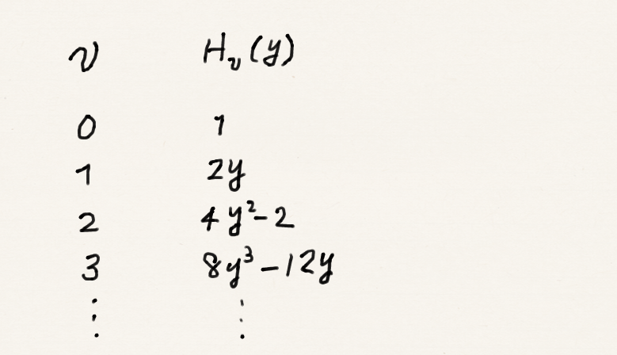
The Hermite polynomials

Slide 14
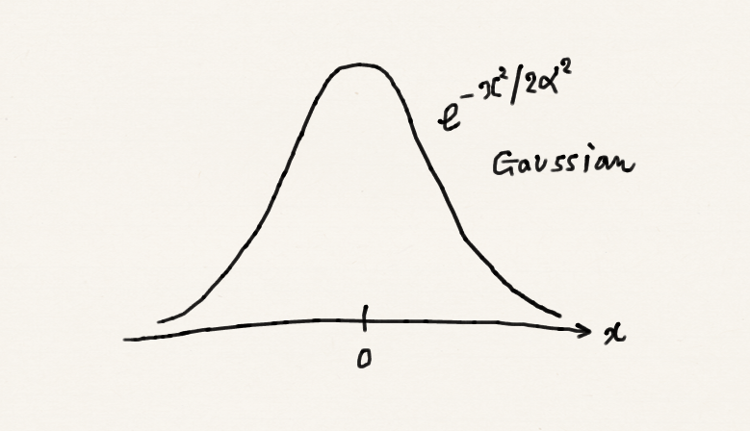
Ground-state wave function
Since H₀ = 1, the ground state wave function is simply a Gaussian function.

Slide 15
The Hermite polynomials
The Hermite polynomials have the following important mathematical properties:
They are the solution of the differential equation:
They satisfy the recursion relation:
Orthogonality

Slide 16
Verification
Second derivatives of a product of two functions

Slide 17
Verification
Let us verify that this is indeed the eigenfunction. Substituting into the Schrödinger equation, we find

Slide 18
Verification
Let us verify that this is indeed the eigenfunction. Substituting into the Schrödinger equation, we find
Zero point energy

Slide 19
Exercise
Calculate the mean displacement of the oscillator when it is in a quantum state v.
Hint: Use the recursion relation to expose vanishing integrals

Slide 20
Exercise
Orthogonality

Slide 21
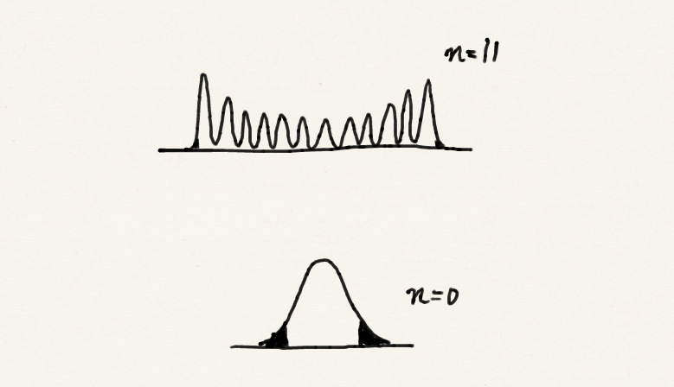
Permeation of wave functions
v
Probability in the classically forbidden region gets smaller with increasing v (quantum number). Another correspondence principle result.
Greater probability near the turning points. Again correspondence to classical case.
v
8 % of probability permeates into the classically forbidden region.

Slide 22
Summary
The solution of the Schrödinger equation for a harmonic potential or the quantum-mechanical harmonic oscillator has the properties:
The eigenfunctions are a Hermite polynomial times a Gaussian function.
The eigenvalues are evenly spaced with the energy separation of ħω and the zero-point energy of ½ħω.
The greater probability near the turning points for higher values of v.

