Slide 1
Lecture 1
Quantization of energy

Slide 2
Quantization of energy
Energies are discrete (“quantized”) and not continuous.
This quantization principle cannot be derived; it should be accepted as physical reality.
Historical developments in physics are surveyed that led to this important discovery. The details of each experiment or its analysis are not so important, but the conclusion is important.

Slide 3
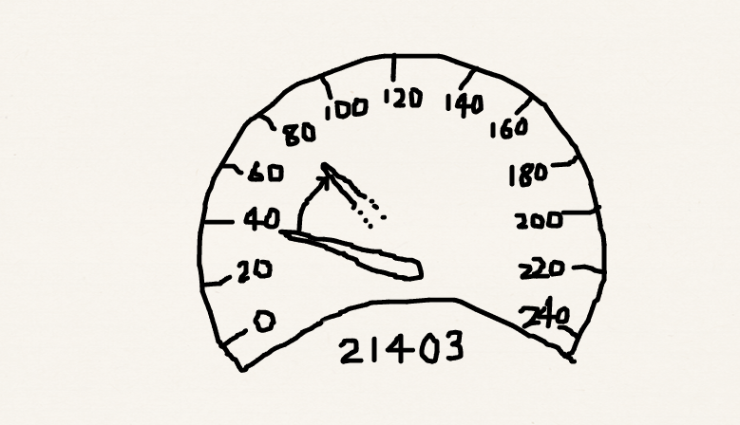
Quantization of energy
Classical mechanics: Any real value of energy is allowed. Energy can be continuously varied.
Quantum mechanics: Not all values of energy are allowed. Energy is discrete (quantized).

Slide 4
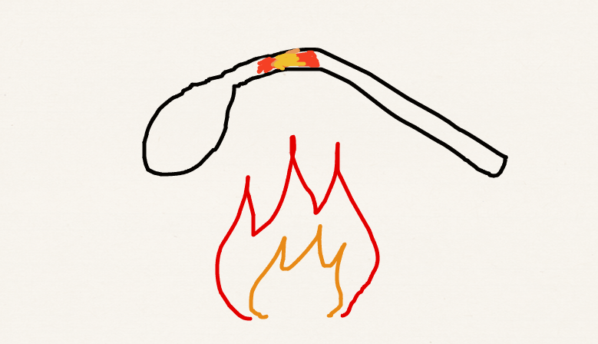
Black-body radiation
A heated piece of metal emits light.
As the temperature becomes higher, the color of the emitted light shifts from red to white to blue.
How can physics explain this effect?

Slide 5
Light: electromagnetic oscillation
Wavelength (λ) and frequency (ν) of light are inversely proportional: c = νλ (c is the speed of light).
Longer wave length
Radio-wave | Micro-wave | IR | Visible | UV | X-ray | γ-ray
>30 cm | 30 cm – 3 mm | 33–13000 cm^{–1} | 700–400 nm | 3.1–124 eV | 100 eV –100 keV | >100 keV
Nuclear spin | Rotation | Vibration | Electronic | Electronic | Core electronic | Nuclear
Higher frequency

Slide 6
Black-body radiation
What is “temperature”? – the kinetic energy (translation, rotation, vibrations, etc.) per particle in a matter.
Light of frequency v can be viewed as an oscillating spring and has a temperature.
Equipartition principle: Heat flows from high to low temperature area; in equilibrium, each oscillator has the same thermal energy k_{B}T (k_{B} is the Boltzmann constant).

Slide 7
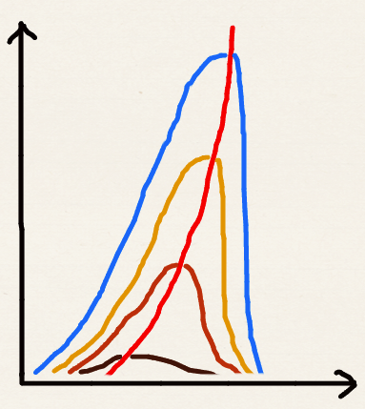
Black-body radiation: experiment
With increasing temperature, the intensity of light increases and the frequency of light at peak intensity also increases.
Intensity curves are distorted bell-shaped and always bound.
High T
Intensity I
Low T
Red
Frequency v
Violet

Slide 8
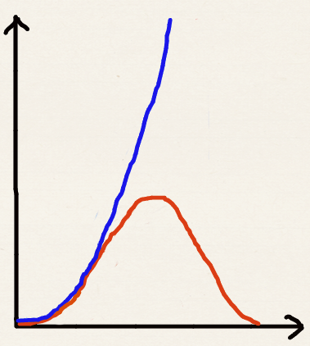
Black-body radiation: classical
Classical mechanics leads to the Rayleigh-Jeans law.
As per this law, the number of oscillators with frequency v is v ² and each oscillator has k_{B}T energy. Hence I ~ k_{B}Tv ² (unbounded at high v).
Ultraviolet catastrophe!
Intensity I
Rayleigh-Jeans ~ k_{B}Tv ²
Experimental
Red
Frequency v
Violet

Slide 9
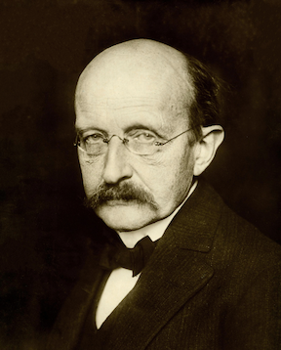
Black-body radiation: quantum
Planck could explain the bound experimental curve by postulating that the energy of each electromagnetic oscillator is limited to discrete values (quantized).
E = nhν (n = 0,1,2,…).
h is Planck’s constant.
Max Planck
A public image from Wikipedia

Slide 10
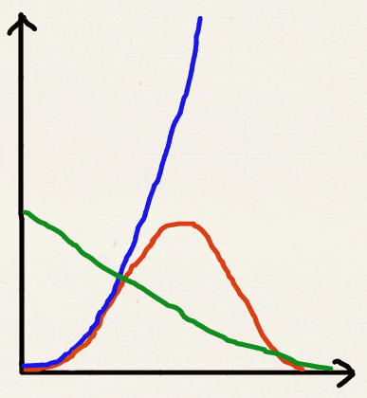
Black-body radiation: quantum
hν
hν
hν
hν
hν
hν
hν
hν
hν
hν
hν
k_{B}T
hν
hν
hν
hν
0 ν ∞
Thermal energy k_{B}T ceases to be able to afford even a single quantum of electromagnetic oscillator with high frequency v; the effective number of oscillators decreases with v.
# oscillators ~ v ²
Intensity I
Correct curve
I ~ v ² × hv / (e^{hv/kBT}−1)
Effective # of oscillators
1 / (e^{hv/kBT}−1)
Energy of an oscillator
hv / (e^{hv/kBT}−1)
Frequency v

Slide 11
Planck’s constant h
E = nhν (n = 0,1,2,…)
h = 6.63 x 10^{–34} J s. (J is the units of energy and is equal to Nm). The frequency has the units s^{–1}.
Note how small h is in the macroscopic units (such as J s). This is why quantization of energy is hardly noticeable and classical mechanics works so well at macro scale.
In the limit h → 0, E becomes continuous and an arbitrary real value of E is allowed. This is the classical limit.

Slide 12
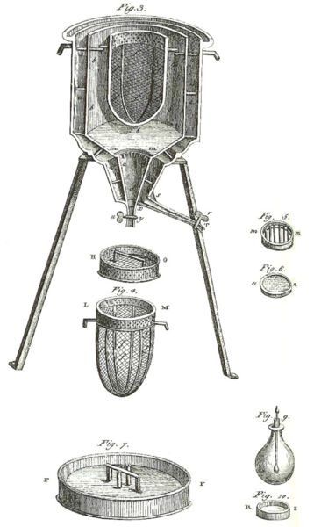
Heat capacities
Heat capacity is the amount of energy needed to heat a substance by 1 K.
It is the derivative of energy with respect to temperature:
Lavoisier’s calorimeter
A public image from Wikipedia

Slide 13
Heat capacities: classical
The classical Dulong-Petit law: the heat capacity of a monatomic solid is 3R irrespective of temperature or atomic identity (R is the gas constant, R = N_{A} k_{B}).
There are N_{A} (Avogadro’s number of) atoms in a mole of a monatomic solid. Each acts as a three-way oscillator (oscillates in x, y, and z directions independently) and a reservoir of heat.
According to the equipartition principle, each oscillator is entitled to k_{B}T of thermal energy.

Slide 14
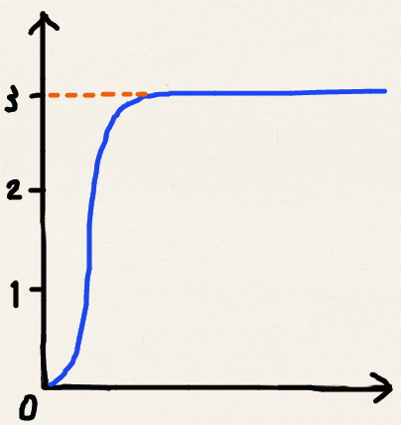
Heat capacities: experiment
R
The Dulong-Petit law holds at high temperatures.
At low temperatures, it does not; Experimental heat capacity tends to zero at T = 0.
Dulong-Petit law
Heat capacity C
Experiment
Temperature T

Slide 15
Heat capacities: quantum
This deviation was explained and corrected by Einstein using Planck’s (then) hypothesis.
At low T, the thermal energy k_{B}T ceases to be able to afford one quantum of oscillator’s energy hν.
k_{B}T
hv
hv
hv
k_{B}T
hv
k_{B}T
hv
hv
…
hv
hv
hv
hv
hv
hv
Low T High T

Slide 16
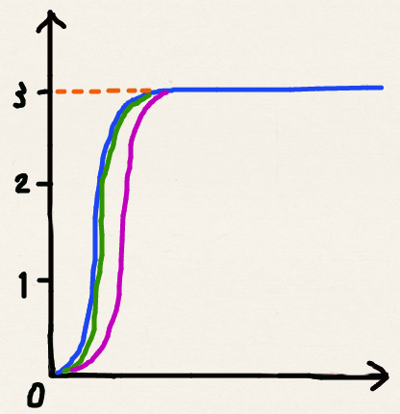
Heat capacities: quantum
R
Einstein assumed only one frequency of oscillation.
Debye used a more realistic distribution of frequencies (proportional to v ²), better agreement was obtained with experiment.
Debye
Heat capacity C
Experiment
Einstein
Temperature T

Slide 17

Continuous vs. quantized
In both cases (black body radiation and heat capacity), the effect of quantization of energy manifests itself macroscopically when a single quantum of energy is comparable with the thermal energy:
k_{B}T
k_{B}T
k_{B}T
k_{B}T
Higher frequencies
or lower temperatures

Slide 18

Atomic & molecular spectra
Emission spectrum of the iron atom
A public image from Wikipedia
Colors of matter originate from the light emitted or absorbed by constituent atoms and molecules.
The frequencies of light emitted or absorbed are found to be discrete.

Slide 19
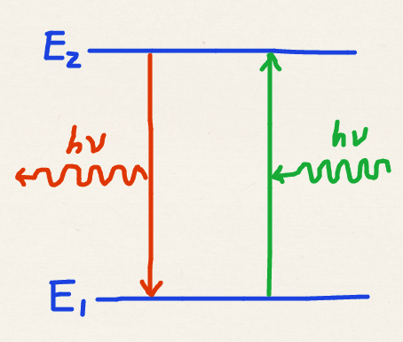
Atomic & molecular spectra
This immediately indicates that atoms and molecules exist in states with discrete energies (E₁, E₂, …).
When light is emitted or absorbed, the atom or molecule jumps from one state to another and the energy difference (hv = E_{n} – E_{m}) is supplied by light or used to generate light.

Slide 20
Summary
Energies of stable atoms, molecules, electromagnetic radiation, and vibrations of atoms in a solid, etc. are discrete (quantized) and are not continuous.
Some macroscopic phenomena, such as red color of hot metals, heat capacity of solids at a low temperature, and colors of matter are all due to quantum effects.
Quantized nature of energy cannot be derived. We must simply accept it.

